Slide 1
MFC – 2 Project Presentation Graphs and Networks (LSTM, Logistic regression, GRU & GCN)
Team-17
BARANIDHARAN SELVARAJ[CB.SC.U4AIE23015]
KEERTHIVASAN S V[CB.SC.U4AIE23037]
MOPURU SAI BAVESH REDDY[CB.SC.U4AIE23044]
SUTHEKSHAN KARUPPUSAMI[CB.SC.U4AIE23067]

Slide 2
Introduction to Graphs
Graph is a collection of nodes (vertices) and edges (connections) between them.
Components:
Vertices (Nodes): Represent entities.
Edges (Links): Represent relationships between entities.

Slide 3
Binary Classification Of ECG Using LSTM

Slide 4
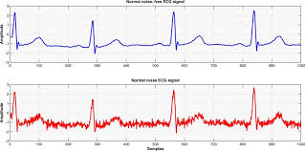
INTRODUCTION
Heart disease is a leading cause of mortality worldwide, encompassing various cardiovascular conditions such as coronary artery disease, heart failure, and arrhythmias.
Timely and accurate diagnosis is crucial for effective management and treatment.
One of the primary diagnostic tools for assessing cardiac health is the Electrocardiogram (ECG), which records the electrical activity of the heart over time.
However, interpreting ECG signals manually can be challenging and time-consuming, requiring specialized training and expertise.

Slide 5
PROBLEM STATEMENT AND OBJECTIVE
Early detection of cardiac abnormalities plays a crucial role in preventing adverse health outcomes and improving patient prognosis.
Traditional methods of interpreting electrocardiogram (ECG) signals often require manual analysis, which can be time-consuming and prone to errors.
Therefore, there is a pressing need for automated systems capable of accurately classifying ECG signals as normal or abnormal to facilitate timely intervention and treatment.

Slide 6
Model Architecture
The model architecture plays a pivotal role in the performance and effectiveness of the binary classification of ECG signals using Long Short-Term Memory (LSTM) networks. The architecture encompasses the design and configuration of the neural network layers, defining how data flows through the network and how features are extracted and processed.
LSTM LAYER:
The core component of the architecture is the LSTM layer, which is specifically designed to capture temporal dependencies and patterns in sequential data such as time-series signals.
2. Dense Layer:
Following the LSTM layer, a dense layer is added to the architecture to perform the final classification based on the features extracted by the LSTM units.
3. Model Compilation:
Once the architecture is defined, the model is compiled with appropriate loss functions, optimizers, and evaluation metrics to facilitate training and evaluation.

Slide 7
METHODOLGY
Dataset Description:
The dataset used in this project is the MIT-BIH Arrhythmia Database, a well-known dataset in the field of cardiac research. It consists of a collection of ECG recordings from various subjects, annotated with labels indicating different heartbeat types, including Normal (N), Supraventricular (S), Ventricular (V), Fusion (F), and Unknown (Q). Each ECG recording typically contains a sequence of voltage values representing the electrical activity of the heart over time.
Preprocessing:
Before training the model, the dataset undergoes preprocessing steps to ensure its suitability for analysis. This includes:
Loading the ECG signals and corresponding labels from the dataset.
Converting the multiclass labels into binary labels for simplicity, often by considering any non-normal heartbeat as abnormal.
Standardizing the features (voltage values) to have a mean of 0 and a standard deviation of 1 to ensure uniformity across features and aid in model convergence during training.
Training and Evaluation
Processing:
During training, the model iteratively updates its parameters to minimize a loss function, typically using optimization algorithms such as stochastic gradient descent (SGD) or Adam. The training process involves feeding batches of preprocessed ECG signals and corresponding labels into the model and computing the loss between the predicted probabilities and the true labels. The model then adjusts its parameters using backpropagation and gradient descent to reduce this loss, thus improving its predictive performance.

Slide 8
METHODOLGY
Applying Optimizing Properties (Loss Function):
Let's denote:
X as the input ECG signals (with shape [batch_size, sequence_length, num_features]).
Y as the binary labels indicating normal (0) or abnormal (1) heartbeats.
Y’ as the predicted probabilities for each class.
Θ as the parameters of the LSTM model.
L as the loss function, typically binary cross-entropy.
The training process involves minimizing the loss function L with respect to the parameters θ:
θ_{t+1} = θ_{t} – α(∇θ​L(X, Y; θt​))
where α is the learning rate and ∇θ​L is the gradient of the loss function with respect to the parameters.
is the gradient of the loss function with respect to the parameters.

Slide 9
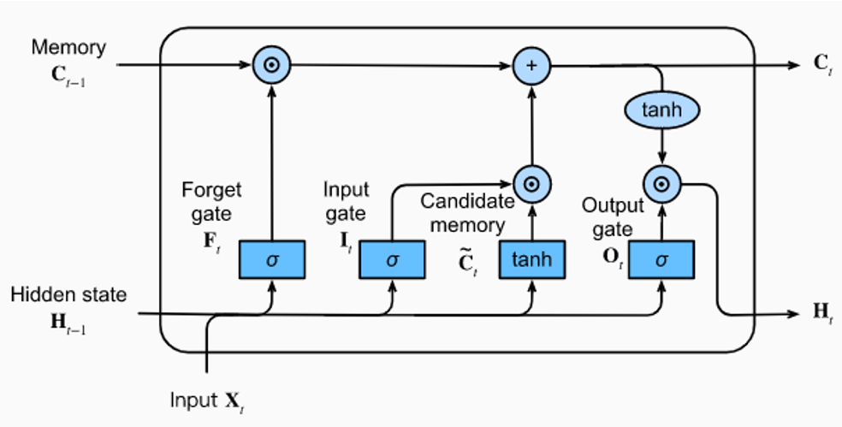
METHODOLGY
Evaluation:
After training, the model's performance is evaluated on a separate validation dataset. The evaluation involves:
Feeding preprocessed ECG signals into the trained model to obtain predicted probabilities for each class.
Computing evaluation metrics such as accuracy, precision, recall, and F1-score by comparing the predicted probabilities with the true labels.
Analyzing the model's performance across different heartbeat types to assess its robustness and effectiveness in classifying ECG signals.
FIGURE: LSTM ARCHITECTURE

Slide 10
CONCLUSION
In conclusion, our project aimed at classifying ECG signals into normal and abnormal using LSTM networks has shown promising results. We used datasets from MIT-BH and processed them to achieve high accuracy rates in identifying heart conditions while minimizing errors. This demonstrates the potential of LSTM networks in accurately diagnosing heart rhythm problems. Going forward, we need to refine the model further to make it even more effective in improving patient care and medical practices.

Slide 11
MOLECULAR SOLUBILITY PREDICTION USING GRAPH NEUTRAL NETWORKS

Slide 12
ABSTRACT:
Molecular Solubility Importance: Molecular solubility prediction plays a pivotal role in diverse domains such as drug discovery and material science. The ability to accurately predict solubility impacts crucial aspects like drug efficacy, formulation, and bioavailability.
Traditional vs. Machine Learning Methods: Traditional methods for solubility prediction often rely on empirical data and heuristic rules, which can be time-consuming and limited in scope. Machine learning, especially Graph Neural Networks (GNNs), offers a more data-driven and accurate approach.
GNNs for Enhanced Predictions: This paper explores the use of GNNs, which leverage the structural information inherent in molecular graphs, to predict solubility with greater accuracy and efficiency.

Slide 13
INTRODUCTION:
Significance of Solubility: Solubility directly influences the behavior of molecules in different solvents, impacting their absorption, distribution, metabolism, and excretion (ADME). In the pharmaceutical industry, high solubility is vital for effective drug delivery, while in the chemical industry, it affects product formulation and reaction rates.
Challenges with Traditional Methods: Traditional solubility prediction methods often rely on empirical formulas or quantitative structure-activity relationships (QSAR), which may not capture the complex relationships in molecular structures accurately.
Role of Machine Learning: Machine learning, particularly GNNs, offers a data-driven approach to solubility prediction by effectively capturing the structural and relational information in molecular graphs.

Slide 14
Dataset description:
DATA = MoleculeNet(root=".", name="ESOL"): This line loads the ESOL dataset from MoleculeNet and stores it in the variable DATA. The MoleculeNet dataset is a large-scale benchmark for molecular machine learning. It curates multiple public datasets, establishes metrics for evaluation, and offers high-quality open-source implementations of multiple previously proposed molecular featurization and learning algorithms. The ESOL dataset is a valuable resource for researchers in cheminformatics and drug discovery. It provides a standardized benchmark for evaluating the performance of machine learning models on the task of predicting solubility, which is a key property in drug design. Solubility affects a compound’s bioavailability, or how easily a drug can be absorbed into the body. Therefore, accurately predicting solubility can help in the early stages of drug discovery by identifying promising compounds for further development.
The ESOL dataset, specifically, is a small dataset consisting of water solubility data for 1128 compounds. The dataset has been used to train models that estimate solubility directly from chemical structures (as encoded in SMILES strings). It is made up of water solubility data (log solubility in mols per litre) for common organic small molecules.

Slide 15
OBJECTIVES:
Develop GNN-Based Model: The primary objective is to design and implement a GNN model specifically tailored for predicting molecular solubility.
Analyze Interpretability and Generalizability: Understand how the GNN model makes predictions and assess its ability to generalize to new data, ensuring its applicability beyond training datasets.
METHODOLOGY-DATA COLLECTION:
Datasets Description: Data sourced from PubChem and ChEMBL databases, curated to include diverse molecular structures. We imported them using !pip install torch
!pip install torch-geometric
!pip install rdkit import rdkit
from torch_geometric.datasets import MoleculeNet
Data Preprocessing: Normalization of solubility values, handling missing data, and extracting molecular descriptors for model training.

Slide 16
METHODOLOGY-MOLECULAR REPRESENTATION:
Graph Representation: Molecules are represented as graphs, with atoms as nodes and bonds as edges.
Features: Node features include atomic number, hybridization state, aromaticity, and formal charge. Edge features include bond type, length, and order.
METHODOLOGY- GNN ARCHITECTURE:
GNN Overview: Description of Graph Neural Networks is used in our study.
Network Layers: Input layer, hidden layers with graph convolution/attention layers, and output layer for solubility prediction.

Slide 17
METHODOLOGY-TRAINING PROCEDURE:
Loss Function: Mean Squared Error (MSE) used for measuring prediction accuracy.
Optimization Algorithm: Adam optimizer employed for efficient gradient-based optimization.
Hyperparameter Tuning: Parameters such as learning rate, batch size, and network architecture tuned for optimal performance.
METHODOLOGY-EVALUATION MATRICES:
Performance Metrics: RMSE and R^2 score used to evaluate model performance.
Cross-Validation: k-fold cross-validation ensures robust evaluation by training and testing on multiple data splits.

Slide 18
EXPERIMENTAL RESULTS:
Qualitative Analysis: Visualizations like scatter plots, histograms, and residual plots showcasing prediction accuracy and error distribution.
Case Studies: Detailed analyses of specific molecules to illustrate the GNN model's strengths. Model showed good accuracy when prediction vs real is plotted as a scatter plot.

Slide 19
CONCLUSION:
Key Findings: Summary of research findings, emphasizing the GNN model's effectiveness in solubility prediction.
High Prediction Accuracy: The Graph Neural Network (GNN) model demonstrates exceptional accuracy in predicting molecular solubility as visualized in graph.
Implications: Discussion on implications for the field, including applications and potential impact on drug development and material science.
Future Research: Suggestions for future research directions, including improvements in GNN architecture, integration with other computational methods, and exploration of other molecular properties.

Slide 20
Traffic Prediction Using GRU Models
Leveraging Deep Learning for Urban

Slide 21
OVERVIEW:
Objective: Develop an accurate traffic prediction model using GRU neural networks for urban mobility planning and traffic management.
Methodology: Collect and preprocess historical traffic data, extract relevant features, design GRU model architecture, and evaluate performance using RMSE metrics.
Findings: GRU models demonstrate superior accuracy in predicting traffic volumes across junctions and time intervals compared to baseline models.
Implications: Enable data-driven decisions, reduce congestion, optimize traffic flow, and improve urban livability through accurate traffic prediction.
Significance: Highlights the potential of deep learning techniques in addressing complex urban challenges and enhancing transportation efficiency.

Slide 22
INTRODUCTION:
Optimizing Traffic Flow: Accurate predictions reduce congestion and improve commute times.
Infrastructure Planning: Guides effective design and expansion of road networks and public transport.
Resource Allocation: Enhances efficient use of traffic management resources like signal timing and patrols.
Complexity of Traffic Patterns: Vary by time, influenced by weather, events, accidents, and show spatial variability.
Need for Accurate Forecasting: Requires high-quality data, real-time updates, and scalability to manage large urban areas.
Role of Deep Learning: Captures complex, nonlinear relationships in traffic data, improving prediction accuracy and handling temporal dependencies with GRU models.

Slide 23
DATA DESCRIPTION:
Source of Data:
Historical traffic data collected from multiple junctions.
Sourced from a CSV file capturing traffic volume over time.
Columns in Dataset:
DateTime: Timestamp for each data point, essential for time-series analysis.
Junction: Specific junction identifier where traffic data is recorded.
Vehicles: Number of vehicles observed at each junction during the timestamp.
DATA PREPROCESSING:
DateTime Conversion:
Convert the DateTime column to a datetime format for chronological ordering and time-based analysis.
Enables time-based operations such as aggregating data over intervals and extracting temporal features.

Slide 24
Missing Values Handling:
Address missing values using imputation (mean, median, mode) or removal.
Ensures data completeness and reliability for accurate modeling.
Exploratory Data Analysis (EDA):
Conduct EDA to understand data characteristics, patterns, and distributions.
Helps in identifying trends, seasonality, and correlations between variables.
EDA Techniques:
Histograms: Visualize data distribution and identify outliers or anomalies.
Line Plots: Track traffic volume trends over time to spot seasonal patterns.
Correlation Matrices: Analyze relationships between variables to guide feature selection for modeling.
Data Transformation:
Transform dataset to achieve stationarity, a key requirement for time-series forecasting models.
Include techniques such as differencing and seasonal decomposition to stabilize mean and variance.
Feature Extraction:
Derive new features from the DateTime column (e.g., hour, day, month) to capture temporal patterns.
Create lagged features to capture sequential dependencies and rolling statistics for short-term trends.

Slide 25
MODEL TRAINING:
GRU Model Architecture Overview:
GRU (Gated Recurrent Unit) captures temporal dependencies in sequential data, such as traffic volume.
Multiple GRU Layers:
Stacked GRU layers increase complexity and capacity to learn intricate patterns in traffic data.
Dropout Regularization:
Dropout layers prevent overfitting by randomly dropping neurons during training, improving model generalization.
Model Compilation:
Includes selecting an optimizer (e.g., SGD with decay) and compiling the model for training.
Loss Function Selection:
Mean Squared Error (MSE) is used to measure prediction accuracy by calculating average squared differences.
Training Process:
Iterative weight adjustment to minimize prediction errors, with early stopping to prevent overfitting.
Tuning hyperparameters (epochs, batch size, learning rate) for optimal performance.

Slide 26
MODEL EVALUATION:
Prediction Generation:
Generate traffic volume predictions using the trained GRU model on the test dataset.
Ensure comprehensive evaluation by predicting traffic volumes for all timesteps in the test data.
Evaluation Metrics:
Root Mean Squared Error (RMSE): Measures the average magnitude of prediction errors.
Mean Absolute Error (MAE): Calculates the average absolute difference between predicted and actual values.
Visualization Techniques:
Line Plots: Compare predicted traffic volume against actual values over time.
Scatter Plots: Assess prediction accuracy and identify discrepancies between predicted and actual values.

Slide 27
RESULT AND ANALYSIS:
Model Performance:
Compare GRU model's performance against baseline models.
Highlight key metrics (RMSE, MAE).
Visualizations for Analysis:
Use line plots and scatter plots for predictions vs. actual traffic volumes.
Identify patterns and discrepancies.
Insights into Model Accuracy:
Discuss GRU model's capture of traffic volume fluctuations.
Highlight well-performing junctions or periods.
Generalization Capability:
Evaluate model's performance on new, unseen data.
Discuss factors contributing to robustness and reliability.
Strengths of the Model:
Emphasize GRU model's handling of sequential data and temporal patterns.
Discuss improvements over traditional models.

Slide 28
CONCLUSION:
Accurate Prediction Model: Successfully developed a robust traffic prediction model using GRU neural networks.
Areas for Improvement: Identified opportunities for enhancing model performance, particularly in data-scarce junctions.
Recommendations: Suggested integrating additional features and refining the model architecture for improved accuracy.
Data-Driven Decision-Making: Demonstrated the potential of data-driven insights in optimizing traffic management strategies.
Future Directions: Explored advanced deep learning architectures and real-time data integration for further model enhancement and real-world applicability.

Slide 29
Sentiment Analysis Using Logistic Regression

Slide 30
Overview
Introduction
Objective: To develop and evaluate machine learning models capable of classifying textual data as either positive or negative sentiment.
Relevance: Sentiment analysis is crucial in domains such as social media monitoring, customer feedback analysis, and market research.

Slide 31
Dataset Description
Source: Graph-based dataset derived from Twitter.
Structure:
Nodes represent words of tweet and contains label.
Edges indicate co-occurrence relationships between terms within tweets.
Each graph corresponds to a tweet, labeled with binary sentiment values (1 for positive, -1 for negative).
CSV Conversion: The graph data is extracted and converted into a CSV file with two columns: sentences and corresponding sentiment labels.

Slide 32
Data Preprocessing
Preprocessing
Text Extraction:
Sentences are formed from the text present in the graph nodes.
Labels (1 or -1) are extracted from the graph and associated with each sentence.
Text Cleaning:
Lowercasing text.
Removing stop words and punctuation.
Ensuring uniformity and removing noise from the text data.

Slide 33
Feature Extraction
Feature Extraction
Vectorizers:
Count Vectorizer: Converts text data into feature vectors based on word counts.
TF-IDF Vectorizer: A more sophisticated approach that accounts for term frequency and inverse document frequency, emphasizing significant words over common ones.

Slide 34
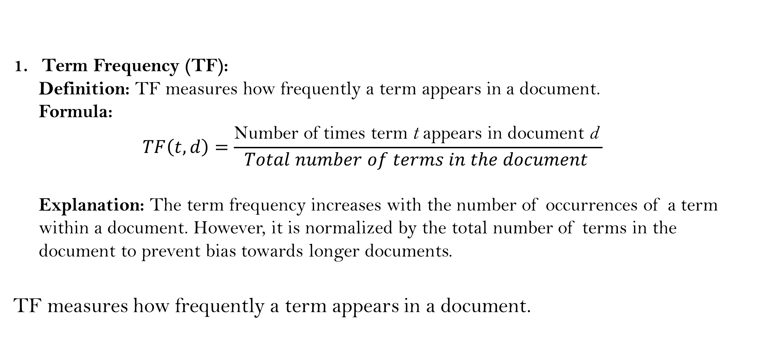
TF-IDF Vectorizer
Term Frequency (TF):
Definition: TF measures how frequently a term appears in a document.
Formula:
$$TF\left(t,d\right)=\frac{\text{Number} \text{of} \text{times} \text{term} \text{t} \text{appears} \text{in} \text{document} \text{d} }{Total number of terms in the document }$$
Explanation: The term frequency increases with the number of occurrences of a term within a document. However, it is normalized by the total number of terms in the document to prevent bias towards longer documents.
TF measures how frequently a term appears in a document.

Slide 35
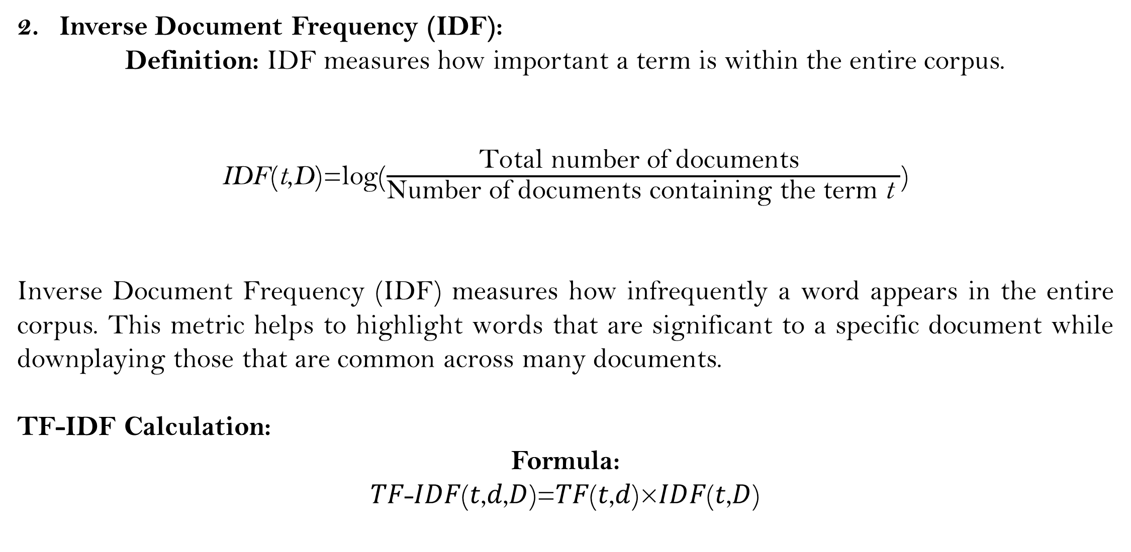
TF-IDF Vectorizer
Inverse Document Frequency (IDF):
Definition: IDF measures how important a term is within the entire corpus. $\text{IDF}\text{(}\text{t}\text{,}\text{D}\text{)}$=log($\frac{\text{Total} \text{number} \text{of} \text{documents} }{\text{Number} \text{of} \text{documents} \text{containing} \text{the} \text{term} \text{t} }$)
Inverse Document Frequency (IDF) measures how infrequently a word appears in the entire corpus. This metric helps to highlight words that are significant to a specific document while downplaying those that are common across many documents.
TF-IDF Calculation:
Formula: 𝑇𝐹-𝐼𝐷𝐹(𝑡,𝑑,𝐷)=𝑇𝐹(𝑡,𝑑)×𝐼𝐷𝐹(𝑡,𝐷)

Slide 36
Count Vectorizers
The main idea behind count vectorizers is to create a matrix where each row represents a document and each column represents a term (word) from the vocabulary, with the cell values indicating the count of the term in the document.
Given a corpus with 𝑁N documents and a vocabulary of 𝑀M unique terms, the count vectorizer can be formally defined as follows:
Let 𝑑_{𝑖} ​ represent the 𝑖-th document in the corpus.
Let 𝑡_{𝑗}​ represent the 𝑗-th term in the vocabulary.
The count vector 𝑥_{𝑖} for document 𝑑_{𝑖​} is a vector of size 𝑀 where each element 𝑥_{𝑖𝑗}​ represents the count of term 𝑡_{𝑗}​ in document 𝑑_{𝑖}​:
𝑥_{𝑖}=[𝑥_{𝑖1},𝑥_{𝑖2},…,𝑥_{𝑖𝑀}]xi​
where , 𝑥_{𝑖𝑗}=count(𝑡_{𝑗},𝑑_{𝑖})

Slide 37
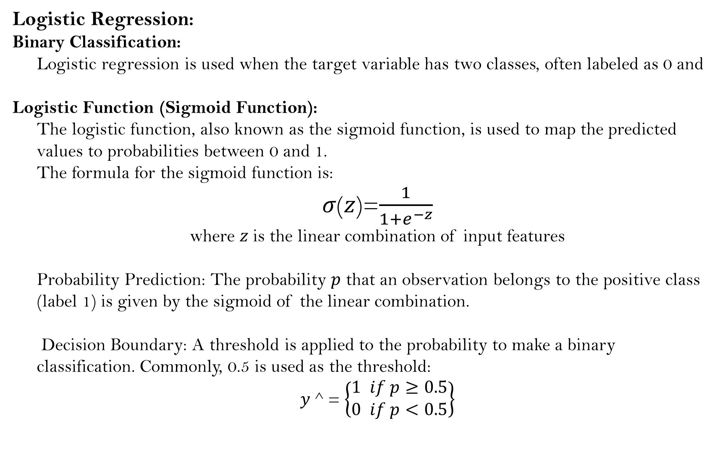
Model Selection and Training
Logistic Regression:
Binary Classification:
Logistic regression is used when the target variable has two classes, often labeled as 0 and
Logistic Function (Sigmoid Function):
The logistic function, also known as the sigmoid function, is used to map the predicted values to probabilities between 0 and 1.
The formula for the sigmoid function is:
𝜎(𝑧)=$\frac{1}{1+e^{−z}}$
where 𝑧 is the linear combination of input features
Probability Prediction: The probability 𝑝 that an observation belongs to the positive class (label 1) is given by the sigmoid of the linear combination.
Decision Boundary: A threshold is applied to the probability to make a binary classification. Commonly, 0.5 is used as the threshold:
𝑦 ^ = $\left\{\begin{matrix}1 if p≥0.5 \\ 0 if p<0.5\end{matrix}\right\}$

Slide 38
Evaluations: A confusion matrix is a table that visualizes the performance of a classification model by comparing predicted labels with actual labels.
True Positive (TP): Predicted positive and actually positive.True Negative (TN): Predicted negative and actually negative.False Positive (FP): Predicted positive but actually negative (Type I error).False Negative (FN): Predicted negative but actually positive (Type II error).Evaluation Metrics Derivation:Accuracy: (TP + TN) / (TP + TN + FP + FN)Precision: TP / (TP + FP)Recall (Sensitivity): TP / (TP + FN)Specificity: TN / (TN + FP)F1 Score: 2 * (Precision * Recall) / (Precision + Recall)
Future scope:
Model Improvements:
Experiment with additional classification models (e.g., SVM, Random Forest).
Incorporate more advanced feature extraction methods, such as word embedding.
Broader Applications:
Apply the sentiment analysis model to other domains, such as product reviews and news articles.

