Slide 1
Employee Data Analysis using Excel
STUDENT NAME: KEERTHIVASAN.V
REGISTER NO: 312207155 , 468CB17D2332B288F5E47A581CCAC318
DEPARTMENT: B.COM ( MARKETING MANAGEMENT)
COLLEGE : A.M JAIN COLLEGE

Slide 2
PROJECT TITLE
Employee Performance Analysis using Excel

Slide 3

AGENDA
Problem Statement
Project Overview
End Users
Our Solution and Proposition
Dataset Description
Modelling Approach
Results and Discussion
Conclusion
3/21/2024 Annual Review

Slide 4

PROBLEM STATEMENT
Conduct regular performance reviews to provide employee
with feedback on their strengths and areas for improvements
Use these reviews to set clear, achievable goals and track progress over time
Offer continuous training programs to help employees acquire new skills and improve existing ones
Ensure the employees have a clear understanding of what is expected of them in their roles

Slide 5

PROJECT OVERVIEW
.
Gather and organize performance related data such as productivity metrics, sales figures, employee performance score, and attendance records. This data serves as the foundation for evaluating employee performance
Use analytical tools like Excel to process and analyse the data, identifying trends, strengths, and areas for improvement . this step involves comparing individual performance against benchmarks or peer performance

Slide 6

WHO ARE THE END USERS?
Managers: Assess team performance and make decisions on promotions and development.
HR Department: Plan training, manage talent and ensure fair evaluation.
Executives: align employee performance with strategic goals.
Employees: gain insights for self-improvement and career growth

Slide 7

OUR SOLUTION AND ITS VALUE PROPOSITION
Targeted training: Develop personalized training programs based on specific performance gaps
Filtering-missing valves
Conditional formatting-blank values
Pivot table
Pie chart

Slide 8
Dataset Description
Employee data set-Kaggle
It have 26features
Feature-9
Gender-male, female
Performance score-employee
Business unit
Name
Rating-numerical
Employee status-married, single
Department type-sales, production
Employee type-full time, part time, contract

Slide 9

THE "WOW" IN OUR SOLUTION
Develop personalized training programs based on specific performance gaps
Decreasing an employee workload
Streamline workflows and eliminate unnecessary steps to increase efficiency
3/21/2024 Annual Review
9

Slide 10
MODELLING
Data collection:
The data are collected from Kaggle
Function collection:
Performance score
Deportment type
Employee classification etc.
Data cleaning :
Identifying values
Filtering the missing values
4. Performance score
Exceeds
Fully meets
10

Slide 11
Needs improvement
Pip
Summery
Collecting the from Kaggle and convert the specific data into the pivot table and then we prepare the chart for better understand
Visualization:
Pie chart
Bar chart

Slide 12
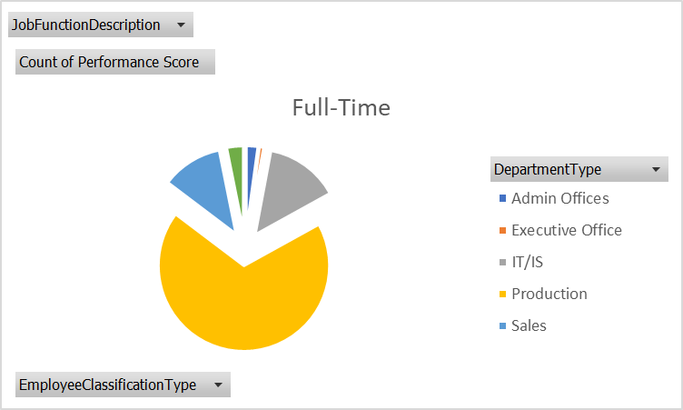
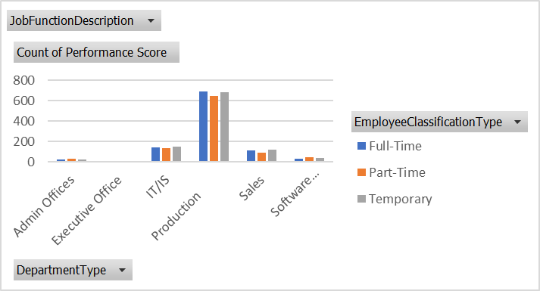
RESULTS
12

Slide 13
conclusion
The department-wise performance scores reveal varying levels of achievement across the development teams. While some departments excelled with high scores, reflecting effective strategies and strong outcomes, others showed opportunities for growth. Departments with lower scores may benefit from targeted improvements, such as additional training or refined processes. Overall, focusing on these areas of improvement and leveraging successful practices can enhance overall performance and drive better results across the board

