Slide 1


SMART IRRIGATION SYSTEM

Slide 2

Learning Objectives:
Understand threshold-based decision making using sensor data
Apply logic to control irrigation automatically
Integrate real-time status updates into a web dashboard
Display soil moisture trends visually
Simulate real-world IoT behavior with CSV sensor data
GOAL
Source :
www.freepik.com/

Slide 3
Tools and Technology used:
Python 3 – Core logic and data processing
Flask – Lightweight web framework for real-time dashboard
HTML/CSS + Bootstrap – UI layout and styling
Chart.js – To visualize moisture trends dynamically
Pandas – Handle CSV data input
CSV File – Simulated soil moisture sensor data

Slide 4
Methodology:
Read latest moisture values from a CSV file
Compare value with a preset threshold (e.g., 40%)
Determine irrigation status ("ON" or "OFF")
Display the sensor data and irrigation status on the dashboard
Visualize trend using a real-time updating chart
Auto-refresh every 10 seconds for live feel

Slide 5
Problem Statement:
Traditional irrigation often leads to water wastage due to the absence of real-time soil monitoring. Manual watering is not only inefficient but may also result in over- or under-irrigation, affecting plant health. To address this, there's a need for an intelligent system that automates irrigation based on actual soil moisture conditions, ensuring optimal water usage and crop care.

Slide 6
Solution:
A smart irrigation dashboard that:
Automatically switches irrigation status based on real-time moisture levels
Uses CSV data to simulate real sensors
Displays both numeric data and visual graphs
Updates automatically every few seconds
Highlights irrigation status clearly to the user

Slide 7
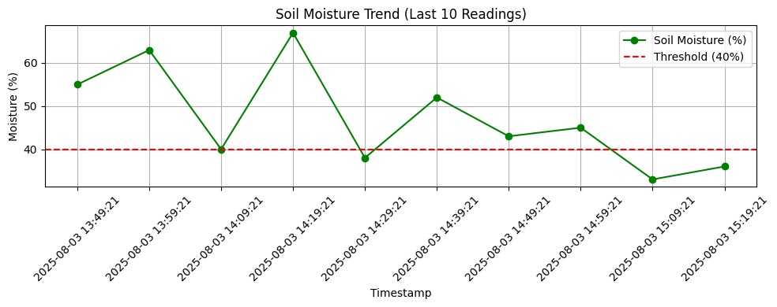
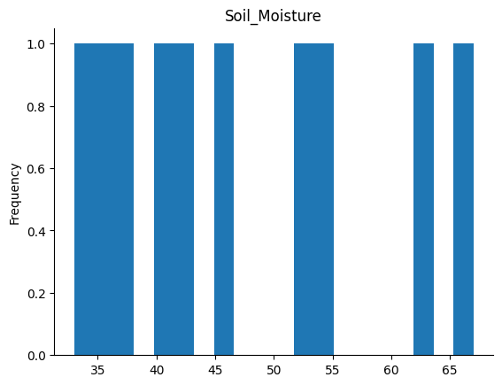
Screenshot of Output:

Slide 8
Conclusion:
Real-time irrigation logic was successfully implemented
System is scalable to use with actual sensors in the future
Efficiently simulates smart agriculture behavior
Forms a solid foundation for (remote control or prediction using AI/ML)

