Slide 1
JavaScript Tutorial
Amrita University

Slide 2
Why Study JavaScript?
JavaScript is one of the 3 languages all web developers must learn:
1. HTML to define the content of web pages
2. CSS to specify the layout of web pages
3. JavaScript to program the behavior of web pages

Slide 3
JavaScript Where To
In HTML, JavaScript code must be inserted between <script> and </script> tags.
<!DOCTYPE html>
<html>
<body>
<h2>JavaScript in Body</h2>
<p id="demo">A Paragraph.</p>
<button type="button" onclick="myFunction()">Try it</button>
<script>
function myFunction() {
document.getElementById("demo").innerHTML = "Paragraph changed.";
}
</script>
</body>
</html>
<!DOCTYPE html>
<html>
<head>
<script>
function myFunction() {
document.getElementById("demo").innerHTML = "Paragraph changed.";
}
</script>
</head>
<body>
<h2>JavaScript in Head</h2>
<p id="demo">A Paragraph.</p>
<button type="button" onclick="myFunction()">Try it</button>
</body>
</html>

Slide 4
External JavaScript
Scripts can also be placed in external files
External References
External file: myScript.js
function myFunction() {
document.getElementById("demo").innerHTML = "Paragraph changed.";
}
<!DOCTYPE html>
<html>
<body>
<h2>External JavaScript</h2>
<p id="demo">A Paragraph.</p>
<button type="button" onclick="myFunction()">Try it</button>
<p>(myFunction is stored in an external file called "myScript.js")</p>
<script src="myScript.js"></script>
</body>
</html>
<!DOCTYPE html>
<html>
<body>
<h2>External JavaScript</h2>
<p id="demo">A Paragraph.</p>
<button type="button" onclick="myFunction()">Try it</button>
<p>(myFunction is stored in an external file called "myScript.js")</p>
<script src="https://www.w3schools.com/js/myScript.js"></script>
</body>
</html>

Slide 5
JavaScript Output
JavaScript can "display" data in different ways:
Writing into an HTML element, using innerHTML.
Writing into the HTML output using document.write().
Writing into an alert box, using window.alert().
Writing into the browser console, using console.log().

Slide 6
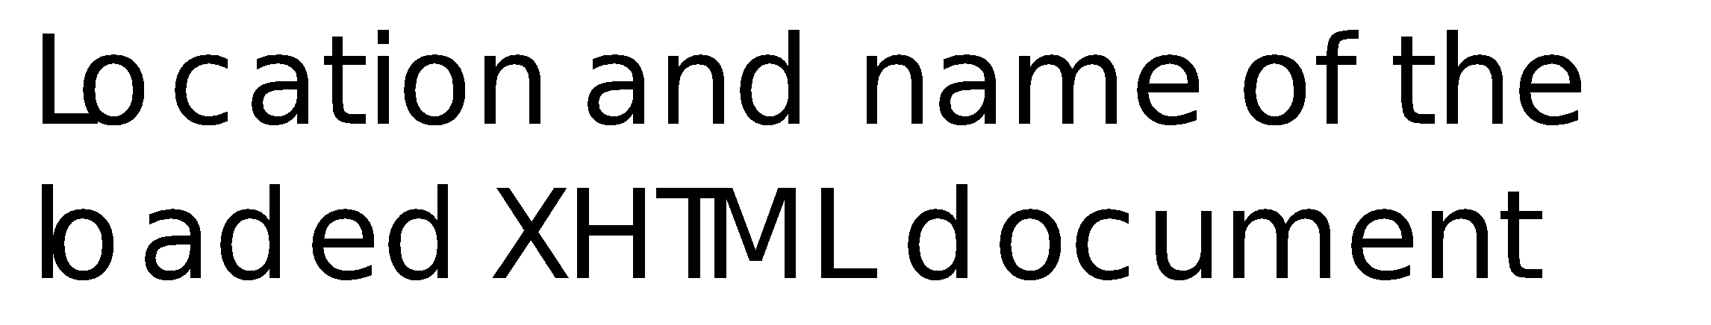
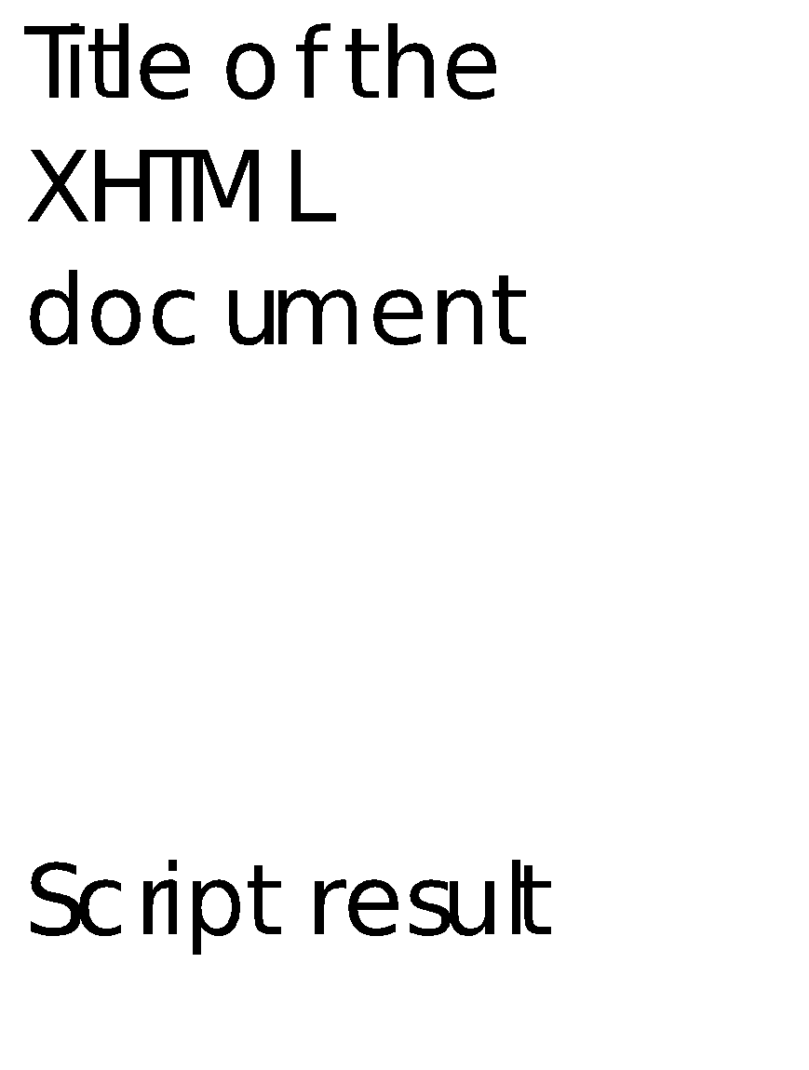
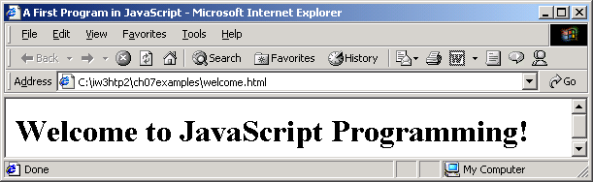
welcome.html Program Output
1 <?xml version = "1.0"?>
2 <!DOCTYPE html PUBLIC "-//W3C//DTD XHTML 1.0 Strict//EN"
3 "http://www.w3.org/TR/xhtml1/DTD/xhtml1-strict.dtd">
4
5 <!-- Fig. 7.1: welcome.html -->
6 <!-- Displaying a line of text -->
7
8 <html xmlns = "http://www.w3.org/1999/xhtml">
9 <head>
10 <title>A First Program in JavaScript</title>
11
12 <script type = "text/javascript">
13 <!--
14 document.writeln(
15 "<h1>Welcome to JavaScript Programming!</h1>" );
16 // -->
17 </script>
18
19 </head><body></body>
20 </html>
The script tag indicates to the browser that the text which follows is part of a script.
The document object’s writeln method writes a line of XHTML markup in the XHTML document.

Slide 7
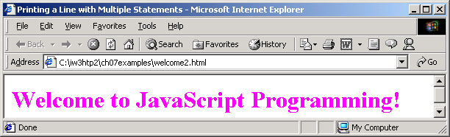
Welcome2.html Program Output
1 <?xml version = "1.0"?>
2 <!DOCTYPE html PUBLIC "-//W3C//DTD XHTML 1.0 Strict//EN"
3 "http://www.w3.org/TR/xhtml1/DTD/xhtml1-strict.dtd">
4
5 <!-- Fig. 7.2: welcome2.html -->
6 <!-- Printing a Line with Multiple Statements -->
7
8 <html xmlns = "http://www.w3.org/1999/xhtml">
9 <head>
10 <title>Printing a Line with Multiple Statements</title>
11
12 <script type = "text/javascript">
13 <!--
14 document.write( "<h1 style = \"color: magenta\">" );
15 document.write( "Welcome to JavaScript " +
16 "Programming!</h1>" );
17 // -->
18 </script>
19
20 </head><body></body>
21 </html>
Using the style attribute, the color of the text is changed from black to magenta.
The escape sequence \” places a quote in the string and is not displayed in the browser.

Slide 8
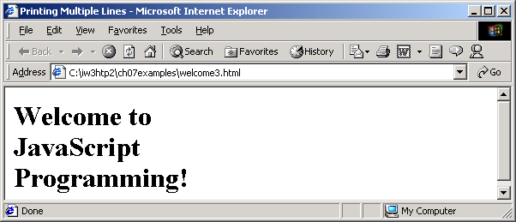
Welcome3.html Program Output
1 <?xml version = "1.0"?>
2 <!DOCTYPE html PUBLIC "-//W3C//DTD XHTML 1.0 Strict//EN"
3 "http://www.w3.org/TR/xhtml1/DTD/xhtml1-strict.dtd">
4
5 <!-- Fig. 7.3: welcome3.html -->
6 <!-- Printing Multiple Lines -->
7
8 <html xmlns = "http://www.w3.org/1999/xhtml">
9 <head><title>Printing Multiple Lines</title>
10
11 <script type = "text/javascript">
12 <!--
13 document.writeln( "<h1>Welcome to<br />JavaScript" +
14 "<br />Programming!</h1>" );
15 // -->
16 </script>
17
18 </head><body></body>
19 </html>
Using break tags, the text is displayed as three lines.

Slide 9
Welcome4.html
1 <?xml version = "1.0"?>
2 <!DOCTYPE html PUBLIC "-//W3C//DTD XHTML 1.0 Strict//EN"
3 "http://www.w3.org/TR/xhtml1/DTD/xhtml1-strict.dtd">
4
5 <!-- Fig. 7.4: welcome4.html -->
6 <!-- Printing multiple lines in a dialog box -->
7
8 <html xmlns = "http://www.w3.org/1999/xhtml">
9 <head><title>Printing Multiple Lines in a Dialog Box</title>
10
11 <script type = "text/javascript">
12 <!--
13 window.alert( "Welcome to\nJavaScript\nProgramming!" );
14 // -->
15 </script>
16
17 </head>
18
19 <body>
20 <p>Click Refresh (or Reload) to run this script again.</p>
21 </body>
22 </html>
The window method alert displays an alert dialog to the user.
When the alert dialog displays, the string passed as its one argument is displayed.
The escape sequence \n is the newline character that places all remaining text on the next line.

Slide 10
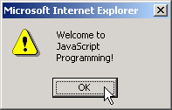
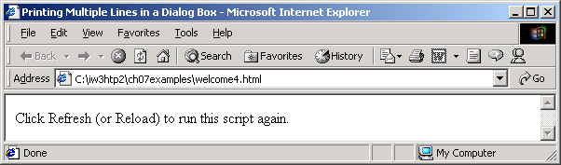
Program Output
Title bar
The dialog is
The
OK
button
automatically sized
allows the user to
to accommodate
dismiss (or hide)
the string.
the dialog.
Mouse cursor

Slide 11
Example 2
1 <?xml version = "1.0"?>
2 <!DOCTYPE html PUBLIC "-//W3C//DTD XHTML 1.0 Strict//EN"
3 "http://www.w3.org/TR/xhtml1/DTD/xhtml1-strict.dtd">
4
5 <!-- Fig. 7.6: Addition.html -->
6 <!-- Addition Program -->
7
8 <html xmlns = "http://www.w3.org/1999/xhtml">
9 <head>
10 <title>An Addition Program</title>
11
12 <script type = "text/javascript">
13 <!--
14 var firstNumber, // first string entered by user
15 secondNumber, // second string entered by user
16 number1, // first number to add
17 number2, // second number to add
18 sum; // sum of number1 and number2
19
20 // read in first number from user as a string
21 firstNumber =
22 window.prompt( "Enter first integer", "0" );
23
24 // read in second number from user as a string
25 secondNumber =
26 window.prompt( "Enter second integer", "0" );
27
28 // convert numbers from strings to integers
29 number1 = parseInt( firstNumber );
30 number2 = parseInt( secondNumber );
31
32 // add the numbers
33 sum = number1 + number2;
34
The window method prompt displays a prompt dialog in the browser with a message and a text field for input.
The first argument passed to method prompt is the message to be displayed.
The second argument is the default value for the text field.
Function parseInt converts its string argument to an integer.
The + operator adds the two numbers input by the user.

Slide 12
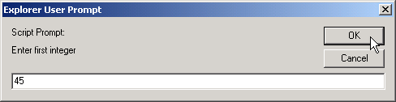
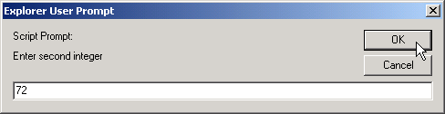
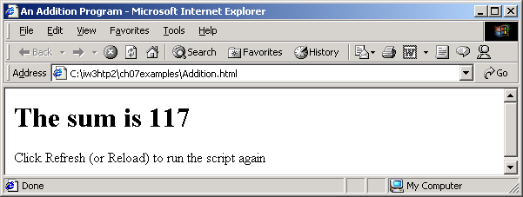
Addition.html Program Output
35 // display the results
36 document.writeln( "<h1>The sum is " + sum + "</h1>" );
37 // -->
38 </script>
39
40 </head>
41 <body>
42 <p>Click Refresh (or Reload) to run the script again</p>
43 </body>
44 </html>

Slide 13
Average.html
1 <?xml version = "1.0"?>
2 <!DOCTYPE html PUBLIC "-//W3C//DTD XHTML 1.0 Strict//EN"
3 "http://www.w3.org/TR/xhtml1/DTD/xhtml1-strict.dtd">
4
5 <!-- Fig. 8.7: average.html -->
6 <!-- Class Average Program -->
7
8 <html xmlns = "http://www.w3.org/1999/xhtml">
9 <head>
10 <title>Class Average Program</title>
11
12 <script type = "text/javascript">
13 <!--
14 var total, // sum of grades
15 gradeCounter, // number of grades entered
16 gradeValue, // grade value
17 average, // average of all grades
18 grade; // grade typed by user
19
20 // Initialization Phase
21 total = 0; // clear total
22 gradeCounter = 1; // prepare to loop
23
24 // Processing Phase
25 while ( gradeCounter <= 10 ) { // loop 10 times
26
27 // prompt for input and read grade from user
28 grade = window.prompt( "Enter integer grade:", "0" );
29
30 // convert grade from a string to an integer
31 gradeValue = parseInt( grade );
32
33 // add gradeValue to total
34 total = total + gradeValue;
35
The while loop will execute the statements in the body of the loop until the value of gradeCounter equals 10.
Prompt for the user input a grade.
Convert input to an integer.
Add new grade to total.

Slide 14
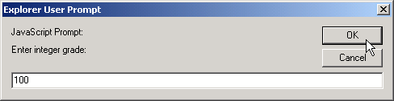
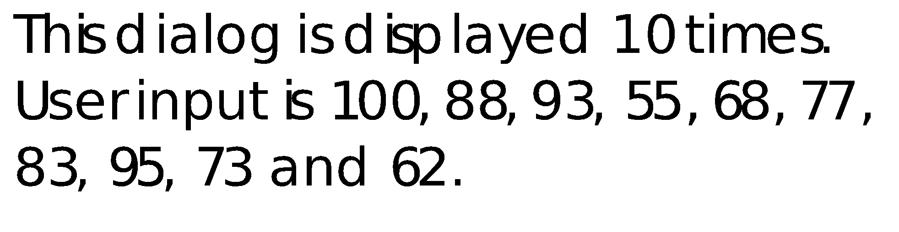
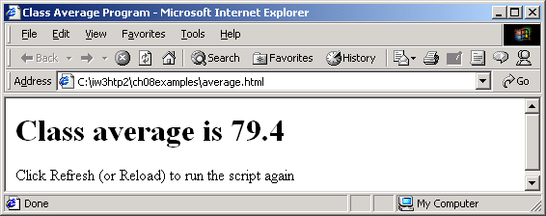
Average.html Program Output
36 // add 1 to gradeCounter
37 gradeCounter = gradeCounter + 1;
38 }
39
40 // Termination Phase
41 average = total / 10; // calculate the average
42
43 // display average of exam grades
44 document.writeln(
45 "<h1>Class average is " + average + "</h1>" );
46 // -->
47 </script>
48
49 </head>
50 <body>
51 <p>Click Refresh (or Reload) to run the script again<p>
52 </body>
53 </html>
Increment the counter.
Calculate the average of the grades input by the user.
Write the result to the XHTML document.

Slide 15
Average2.html
1 <?xml version = "1.0"?>
2 <!DOCTYPE html PUBLIC "-//W3C//DTD XHTML 1.0 Strict//EN"
3 "http://www.w3.org/TR/xhtml1/DTD/xhtml1-strict.dtd">
4
5 <!-- Fig. 8.9: Average2.html -->
6 <!-- Sentinel-controlled Repetition -->
7
8 <html xmlns = "http://www.w3.org/1999/xhtml">
9 <head>
10 <title>Class Average Program:
11 Sentinel-controlled Repetition</title>
12
13 <script type = "text/javascript">
14 <!--
15 var gradeCounter, // number of grades entered
16 gradeValue, // grade value
17 total, // sum of grades
18 average, // average of all grades
19 grade; // grade typed by user
20
21 // Initialization phase
22 total = 0; // clear total
23 gradeCounter = 0; // prepare to loop
24
25 // Processing phase
26 // prompt for input and read grade from user
27 grade = window.prompt(
28 "Enter Integer Grade, -1 to Quit:", "0" );
29
30 // convert grade from a string to an integer
31 gradeValue = parseInt( grade );
32
33 while ( gradeValue != -1 ) {
34 // add gradeValue to total
35 total = total + gradeValue;
Prompt for the user to enter a grade, -1 to end.
The while loop will continue until the user input equals –1.

Slide 16
Average2.html
36
37 // add 1 to gradeCounter
38 gradeCounter = gradeCounter + 1;
39
40 // prompt for input and read grade from user
41 grade = window.prompt(
42 "Enter Integer Grade, -1 to Quit:", "0" );
43
44 // convert grade from a string to an integer
45 gradeValue = parseInt( grade );
46 }
47
48 // Termination phase
49 if ( gradeCounter != 0 ) {
50 average = total / gradeCounter;
51
52 // display average of exam grades
53 document.writeln(
54 "<h1>Class average is " + average + "</h1>" );
55 }
56 else
57 document.writeln( "<p>No grades were entered</p>" );
58 // -->
59 </script>
60 </head>
61
62 <body>
63 <p>Click Refresh (or Reload) to run the script again</p>
64 </body>
65 </html>
Each iteration of the loop will open a prompt dialog allowing the user to input another grade.

Slide 17
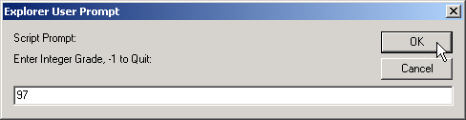
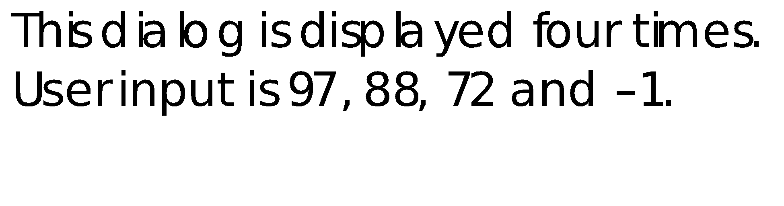
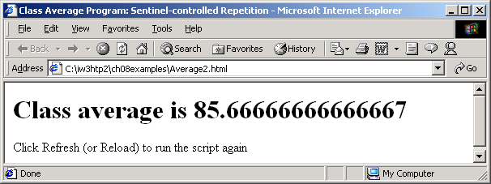
Program Output

Slide 18
Analysis.html
1 <?xml version = "1.0"?>
2 <!DOCTYPE html PUBLIC "-//W3C//DTD XHTML 1.0 Strict//EN"
3 "http://www.w3.org/TR/xhtml1/DTD/xhtml1-strict.dtd">
4
5 <!-- Fig. 8.11: analysis.html -->
6 <!-- Analyzing Exam Results -->
7
8 <html xmlns = "http://www.w3.org/1999/xhtml">
9 <head>
10 <title>Analysis of Examination Results</title>
11
12 <script type = "text/javascript">
13 <!--
14 // initializing variables in declarations
15 var passes = 0, // number of passes
16 failures = 0, // number of failures
17 student = 1, // student counter
18 result; // one exam result
19
20 // process 10 students; counter-controlled loop
21 while ( student <= 10 ) {
22 result = window.prompt(
23 "Enter result (1=pass,2=fail)", "0" );
24
25 if ( result == "1" )
26 passes = passes + 1;
27 else
28 failures = failures + 1;
29
30 student = student + 1;
31 }
32
The while loop will continue until the value of student is 10 meaning 10 results were entered.
Entering a 1 into the prompt dialog means the student passed the exam. A value of 2 means the student failed.
If a value of 1 was entered, the value of passes is incremented by one, otherwise, failures is incremented.

Slide 19
Analysis.html
33 // termination phase
34 document.writeln( "<h1>Examination Results</h1>" );
35 document.writeln(
36 "Passed: " + passes + "<br />Failed: " + failures );
37
38 if ( passes > 8 )
39 document.writeln( "<br />Raise Tuition" );
40 // -->
41 </script>
42
43 </head>
44 <body>
45 <p>Click Refresh (or Reload) to run the script again</p>
46 </body>
47 </html>
If more than 8 students passed the exam, the program says to “Raise Tuition”.

Slide 20
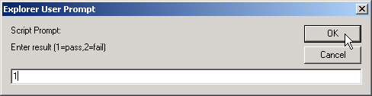
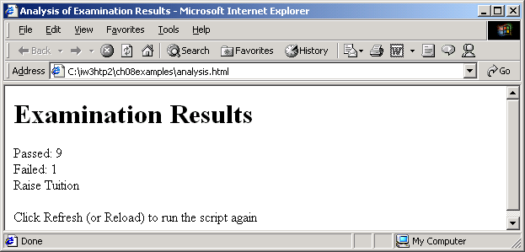
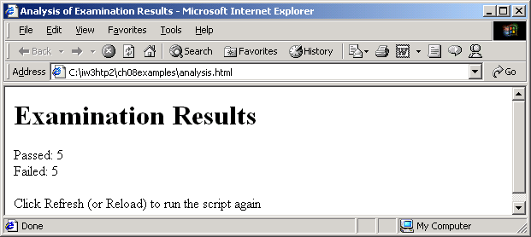
Program Output

Slide 21
SwitchTest.html
1 <?xml version = "1.0"?>
2 <!DOCTYPE html PUBLIC "-//W3C//DTD XHTML 1.0 Strict//EN"
3 "http://www.w3.org/TR/xhtml1/DTD/xhtml1-strict.dtd">
4
5 <!-- Fig. 9.7: SwitchTest.html -->
6 <!-- Using the switch structure -->
7
8 <html xmlns = "http://www.w3.org/1999/xhtml">
9 <head>
10 <title>Switching between XHTML List Formats</title>
11
12 <script type = "text/javascript">
13 <!--
14 var choice, // user’s choice
15 startTag, // starting list item tag
16 endTag, // ending list item tag
17 validInput = true, // indicates if input is valid
18 listType; // list type as a string
19
20 choice = window.prompt( "Select a list style:\n" +
21 "1 (bullet), 2 (numbered), 3 (lettered)", "1" );
22
23 switch ( choice ) {
24 case "1":
25 startTag = "<ul>";
26 endTag = "</ul>";
27 listType = "<h1>Bullet List</h1>";
28 break;
29 case "2":
30 startTag = "<ol>";
31 endTag = "</ol>";
32 listType = "<h1>Ordered List: Numbered</h1>";
33 break;
Variable choice is given the value input by the user in the prompt dialog.
The value of choice is evaluated against each of the values of the case labels.
The break statement causes program control to proceed with the first statement after the switch structure.

Slide 22
SwitchTest.html
34 case "3":
35 startTag = "<ol type = \"A\">";
36 endTag = "</ol>";
37 listType = "<h1>Ordered List: Lettered</h1>";
38 break;
39 default:
40 validInput = false;
41 }
42
43 if ( validInput == true ) {
44 document.writeln( listType + startTag );
45
46 for ( var i = 1; i <= 3; ++i )
47 document.writeln( "<li>List item " + i + "</li>" );
48
49 document.writeln( endTag );
50 }
51 else
52 document.writeln( "Invalid choice: " + choice );
53 // -->
54 </script>
55
56 </head>
57 <body>
58 <p>Click Refresh (or Reload) to run the script again</p>
59 </body>
60 </html>
If none of the cases match, variable validInput is set to false.
If the user input a valid value, the list is created.
Otherwise, the message “Invalid choice” is displayed in the browser.

Slide 23
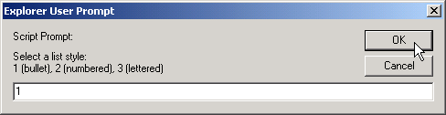
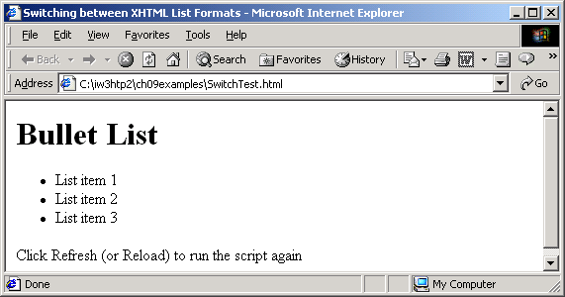
Program Output

Slide 24

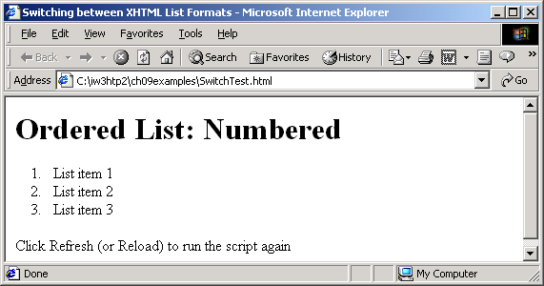

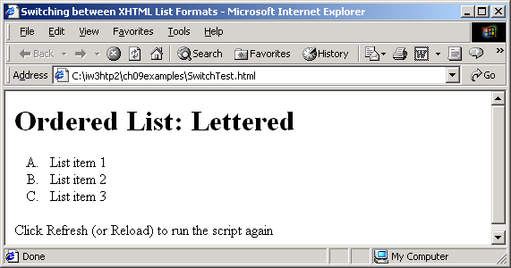
Program Output

Slide 25
InitArray.html
1 <?xml version = "1.0"?>
2 <!DOCTYPE html PUBLIC "-//W3C//DTD XHTML 1.0 Strict//EN"
3 "http://www.w3.org/TR/xhtml1/DTD/xhtml1-strict.dtd">
4
5 <!-- Fig. 11.3: InitArray.html -->
6 <!-- Initializing an Array -->
7
8 <html xmlns = "http://www.w3.org/1999/xhtml">
9 <head>
10 <title>Initializing an Array</title>
11
12 <script type = "text/javascript">
13 <!--
14 // this function is called when the <body> element's
15 // onload event occurs
16 function initializeArrays()
17 {
18 var n1 = new Array( 5 ); // allocate 5-element Array
19 var n2 = new Array(); // allocate empty Array
20
21 // assign values to each element of Array n1
22 for ( var i = 0; i < n1.length; ++i )
23 n1[ i ] = i;
24
25 // create and initialize five-elements in Array n2
26 for ( i = 0; i < 5; ++i )
27 n2[ i ] = i;
28
29 outputArray( "Array n1 contains", n1 );
30 outputArray( "Array n2 contains", n2 );
31 }
32
Array n1 has five elements.
Array n2 is an empty array.
The for loop initializes the elements in n1 to their subscript numbers (0 to 4).
The for loop adds five elements to Array n2 and initialize each element to its subscript number (0 to 4).
Each function displays the contents of its respective Array in an XHTML table.

Slide 26
InitArray.html
33 // output "header" followed by a two-column table
34 // containing subscripts and elements of "theArray"
35 function outputArray( header, theArray )
36 {
37 document.writeln( "<h2>" + header + "</h2>" );
38 document.writeln( "<table border = \"1\" width =" +
39 "\"100%\">" );
40
41 document.writeln( "<thead><th width = \"100\"" +
42 "align = \"left\">Subscript</th>" +
43 "<th align = \"left\">Value</th></thead><tbody>" );
44
45 for ( var i = 0; i < theArray.length; i++ )
46 document.writeln( "<tr><td>" + i + "</td><td>" +
47 theArray[ i ] + "</td></tr>" );
48
49 document.writeln( "</tbody></table>" );
50 }
51 // -->
52 </script>
53
54 </head><body onload = "initializeArrays()"></body>
55 </html>
The second time function ouputArray is called, variable header gets the value of “Array n2 contains” and variable theArray gets the value of n2.
The first time function ouputArray is called, variable header gets the value of “Array n1 contains” and variable theArray gets the value of n1.

Slide 27
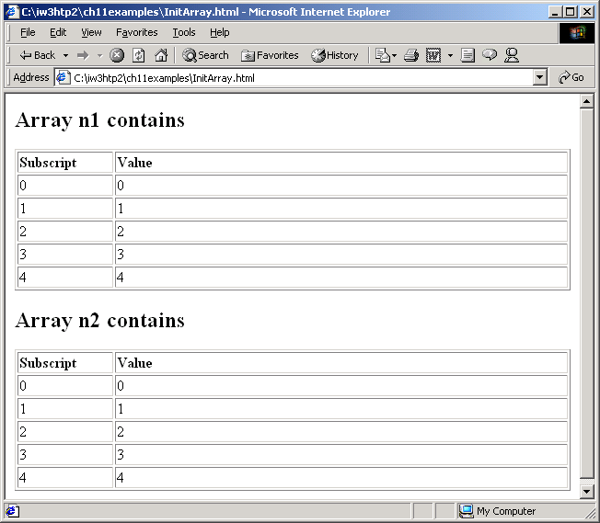
Program Output

Slide 28
InitArray2.html
1 <?xml version = "1.0"?>
2 <!DOCTYPE html PUBLIC "-//W3C//DTD XHTML 1.0 Strict//EN"
3 "http://www.w3.org/TR/xhtml1/DTD/xhtml1-strict.dtd">
4
5 <!-- Fig. 11.4: InitArray2.html -->
6 <!-- Initializing an Array with a Declaration -->
7
8 <html xmlns = "http://www.w3.org/1999/xhtml">
9 <head>
10 <title>Initializing an Array with a Declaration</title>
11
12 <script type = "text/javascript">
13 <!--
14 function start()
15 {
16 // Initializer list specifies number of elements and
17 // value for each element.
18 var colors = new Array( "cyan", "magenta",
19 "yellow", "black" );
20 var integers1 = [ 2, 4, 6, 8 ];
21 var integers2 = [ 2, , , 8 ];
22
23 outputArray( "Array colors contains", colors );
24 outputArray( "Array integers1 contains", integers1 );
25 outputArray( "Array integers2 contains", integers2 );
26 }
27
Array integers1 is initialized using an initializer list.
Two values are not supplied for integer2, which will be displayed as undefined.

Slide 29
InitArray2.html
28 // output "header" followed by a two-column table
29 // containing subscripts and elements of "theArray"
30 function outputArray( header, theArray )
31 {
32 document.writeln( "<h2>" + header + "</h2>" );
33 document.writeln( "<table border = \"1\"" +
34 "width = \"100%\">" );
35 document.writeln( "<thead><th width = \"100\" " +
36 "align = \"left\">Subscript</th>" +
37 "<th align = \"left\">Value</th></thead><tbody>" );
38
39 for ( var i = 0; i < theArray.length; i++ )
40 document.writeln( "<tr><td>" + i + "</td><td>" +
41 theArray[ i ] + "</td></tr>" );
42
43 document.writeln( "</tbody></table>" );
44 }
45 // -->
46 </script>
47
48 </head><body onload = "start()"></body>
49 </html>

Slide 30
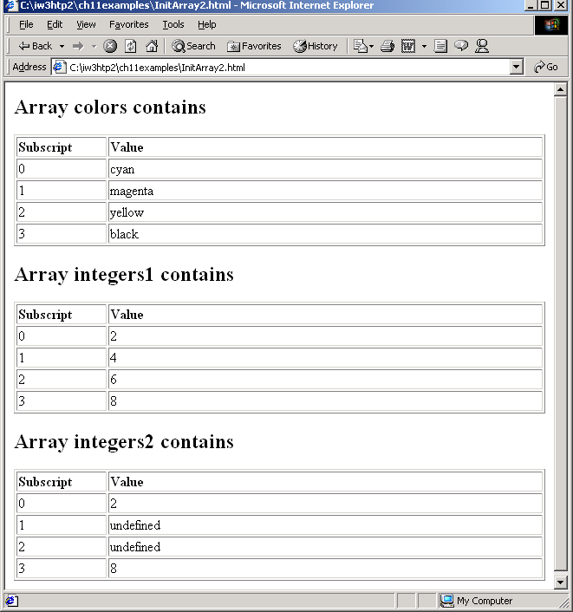
Program Output

Slide 31
CharacterProcessing.html
1 <?xml version = "1.0"?>
2 <!DOCTYPE html PUBLIC "-//W3C//DTD XHTML 1.0 Strict//EN"
3 "http://www.w3.org/TR/xhtml1/DTD/xhtml1-strict.dtd">
4
5 <!-- Fig. 12.4: CharacterProcessing.html -->
6 <!-- Character Processing Methods -->
7
8 <html xmlns = "http://www.w3.org/1999/xhtml">
9 <head>
10 <title>Character Processing Methods</title>
11
12 <script type = "text/javascript">
13 <!--
14 var s = "ZEBRA";
15 var s2 = "AbCdEfG";
16
17 document.writeln( "<p>Character at index 0 in '" +
18 s + "' is " + s.charAt( 0 ) );
19 document.writeln( "<br />Character code at index 0 in '"
20 + s + "' is " + s.charCodeAt( 0 ) + "</p>" );
21
22 document.writeln( "<p>'" +
23 String.fromCharCode( 87, 79, 82, 68 ) +
24 "' contains character codes 87, 79, 82 and 68</p>" )
25
26 document.writeln( "<p>'" + s2 + "' in lowercase is '" +
27 s2.toLowerCase() + "'" );
28 document.writeln( "<br />'" + s2 + "' in uppercase is '"
29 + s2.toUpperCase() + "'</p>" );
30 // -->
31 </script>
32
33 </head><body></body>
34 </html>
Method charAt returns a string containing the character at the specified index (0 in this example).
Method charCodeAt returns the Unicode value of the character at the specified index (0 in this example).
Method fromCharCode takes a comma-separated list of Unicode values and builds a string containing the character representation of those Unicode values.
Methods toLowerCase and toUpperCase display versions of String s2 in all lowercase and all upper case letters, respectively.

Slide 32
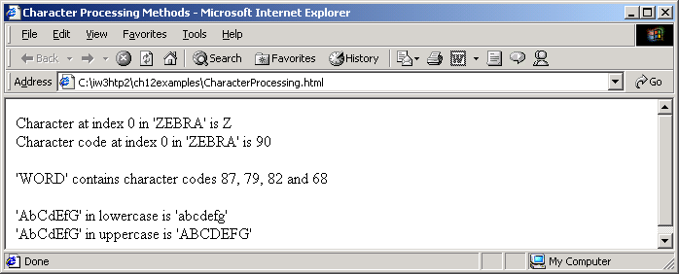
Program Output

Slide 33
SearchingStrings.html
1 <?xml version = "1.0"?>
2 <!DOCTYPE html PUBLIC "-//W3C//DTD XHTML 1.0 Strict//EN"
3 "http://www.w3.org/TR/xhtml1/DTD/xhtml1-strict.dtd">
4
5 <!-- Fig. 12.5: SearchingStrings.html -->
6 <!-- Searching Strings -->
7
8 <html xmlns = "http://www.w3.org/1999/xhtml">
9 <head>
10 <title>
11 Searching Strings with indexOf and lastIndexOf
12 </title>
13
14 <script type = "text/javascript">
15 <!--
16 var letters = "abcdefghijklmnopqrstuvwxyzabcdefghijklm";
17
18 function buttonPressed()
19 {
20 searchForm.first.value =
21 letters.indexOf( searchForm.inputVal.value );
22 searchForm.last.value =
23 letters.lastIndexOf( searchForm.inputVal.value );
24 searchForm.first12.value =
25 letters.indexOf( searchForm.inputVal.value, 12 );
26 searchForm.last12.value =
27 letters.lastIndexOf(
28 searchForm.inputVal.value, 12 );
29 }
30 // -->
31 </script>
32
33 </head>
Method indexOf determines the first occurrence in the string letters of the string searchForm.inputVal.value.
Method lastIndexOf determines the location of the last occurrence in letters of the string in text field inputVal.

Slide 34
SearchingStrings.html
34 <body>
35 <form name = "searchForm" action = "">
36 <h1>The string to search is:<br />
37 abcdefghijklmnopqrstuvwxyzabcdefghijklm</h1>
38 <p>Enter substring to search for
39 <input name = "inputVal" type = "text" />
40 <input name = "search" type = "button" value = "Search"
41 onclick = "buttonPressed()" /><br /></p>
42
43 <p>First occurrence located at index
44 <input name = "first" type = "text" size = "5" />
45 <br />Last occurrence located at index
46 <input name = "last" type = "text" size = "5" />
47 <br />First occurrence from index 12 located at index
48 <input name = "first12" type = "text" size = "5" />
49 <br />Last occurrence from index 12 located at index
50 <input name = "last12" type = "text" size = "5" /></p>
51 </form>
52 </body>
53 </html>

Slide 35
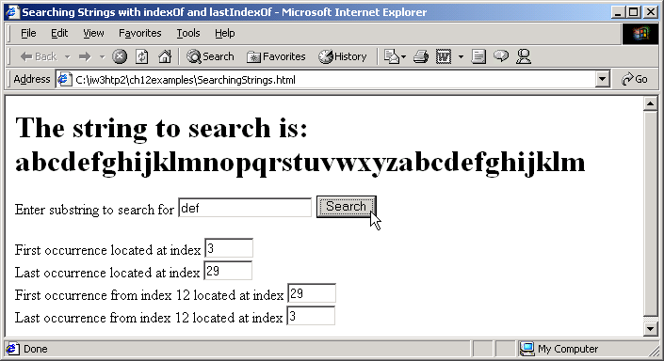

Program Output

Slide 36
SplitAndSubString.html
1 <?xml version = "1.0"?>
2 <!DOCTYPE html PUBLIC "-//W3C//DTD XHTML 1.0 Strict//EN"
3 "http://www.w3.org/TR/xhtml1/DTD/xhtml1-strict.dtd">
4
5 <!-- Fig. 12.6: SplitAndSubString.html -->
6 <!-- String Method split and substring -->
7
8 <html xmlns = "http://www.w3.org/1999/xhtml">
9 <head>
10 <title>String Method split and substring</title>
11
12 <script type = "text/javascript">
13 <!--
14 function splitButtonPressed()
15 {
16 var strings = myForm.inputVal.value.split( " " );
17 myForm.output.value = strings.join( "\n" );
18
19 myForm.outputSubstring.value =
20 myForm.inputVal.value.substring( 0, 10 );
21 }
22 // -->
23 </script>
24 </head>
25
26 <body>
27 <form name = "myForm" action = "">
28 <p>Enter a sentence to split into words<br />
29 <input name = "inputVal" type = "text" size = "40" />
30 <input name = "splitButton" type = "button" value =
31 "Split" onclick = "splitButtonPressed()" /></p>
32
33 <p>The sentence split into words is<br />
34 <textarea name = "output" rows = "8" cols = "34">
35 </textarea></p>
Method split tokenizes the contents of text field inputVal.
The argument to method split is the delimiter string.
Method subString obtains a string containing the first 10 characters of the string the user input in text field inputVal.

Slide 37
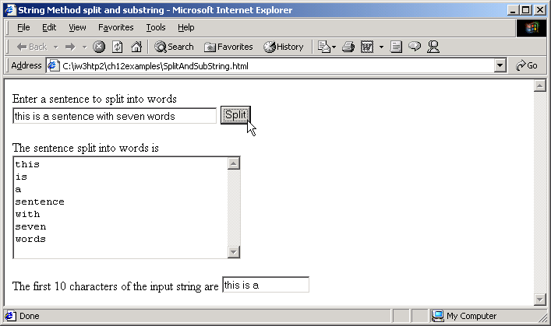
SplitAndSubString.html Program Output
36
37 <p>The first 10 characters of the input string are
38 <input name = "outputSubstring" type = "text"
39 size = "15" /></p>
40 </form>
41 </body>
42 </html>

Slide 38
MarkupMethods.html
1 <?xml version = "1.0"?>
2 <!DOCTYPE html PUBLIC "-//W3C//DTD XHTML 1.0 Strict//EN"
3 "http://www.w3.org/TR/xhtml1/DTD/xhtml1-strict.dtd">
4
5 <!-- Fig. 12.7: MarkupMethods.html -->
6 <!-- XHTML markup methods of the String object -->
7
8 <html xmlns = "http://www.w3.org/1999/xhtml">
9 <head>
10 <title>XHTML Markup Methods of the String Object</title>
11
12 <script type = "text/javascript">
13 <!--
14 var anchorText = "This is an anchor",
15 blinkText = "This is blinking text",
16 fixedText = "This is monospaced text",
17 linkText = "Click here to go to anchorText",
18 strikeText = "This is strike out text",
19 subText = "subscript",
20 supText = "superscript";
21
22 document.writeln( anchorText.anchor( "top" ) );
23 document.writeln( "<br />" + blinkText.blink() );
24 document.writeln( "<br />" + fixedText.fixed() );
25 document.writeln( "<br />" + strikeText.strike() );
26 document.writeln(
27 "<br />This is text with a " + subText.sub() );
28 document.writeln(
29 "<br />This is text with a " + supText.sup() );
30 document.writeln(
31 "<br />" + linkText.link( "#top" ) );
32 // -->
Method strike displays text with a line through it.
Method anchor marks up the text as an anchor.
Method sub creates subscript text.
Method sup creates superscript text.
Method blink makes the string blink in the Web page.
The link method creates a hyperlink.
Method fixed displays txt in a fixed-width font.

Slide 39
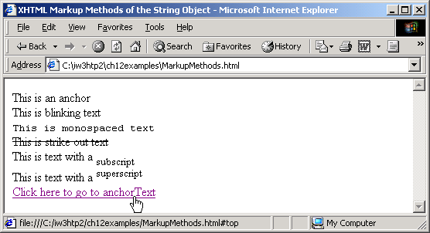
MarkupMethods.html Program Output
33 </script>
34
35 </head><body></body>
36 </html>

Slide 40
More topics to follow >> Events , Objects and so on..,
Thanks

