Slide 1
Getting Started with AWS
Amrita University

Slide 2
Amazon Web Services
Amazon Web Services (AWS) provides on-demand computing resources and services in the cloud, with pay-as-you-go pricing.
Capacity exactly matches your need, you pay only for what you use, economies of scale result in lower costs, and the service is provided by a vendor experienced in running large-scale networks.

Slide 3
What Can I Do with AWS?
Store public or private data.
Host a static website. These websites use client-side technologies (such as HTML, CSS, and JavaScript) to display content that doesn't change frequently. A static website doesn't require server-side technologies (such as PHP and ASP.NET).
Host a dynamic website, or web app. These websites include classic three-tier applications, with web, application, and database tiers.
Support students or online training programs.
Process business and scientific data.
Handle peak loads.

Slide 4
Regions and Availability Zones
Amazon has data centers in different areas of the world (for example, North America, Europe, and Asia).
AWS products are available to use in different regions.
By placing resources in separate regions, you can design your website or app to be closer to specific customers or to meet legal or other requirements.
Note that prices for AWS usage vary by region.
Each region contains multiple distinct locations called Availability Zones.
Each Availability Zone is engineered to be isolated from failures in other Availability Zones, and to provide inexpensive, low-latency network connectivity to other zones in the same region.

Slide 5
Security & AWS Product Categories
AWS provides a secure global infrastructure, plus a range of features that you can use to secure your data in the cloud.
Compute and Networking Services
Storage and Content Delivery Services
Security and Identity Services
Database Services
Analytics Services
Application Services
Management Tools

Slide 6
Compute and Networking Services for AWS
Users can provision virtual servers, set up a firewall, configure Internet access, allocate and route IP addresses, and scale your infrastructure to meet increasing demand.
Users can use the compute and networking services with the storage, database, and application services to provide a complete solution for computing, query processing, and storage across a wide range of applications.

Slide 7
Key Services – Compute and Networking Services
Amazon EC2
Provides virtual servers in the AWS cloud.
Amazon VPC
Provides an isolated virtual network for your virtual servers.
Elastic Load Balancing
Distributes network traffic across your set of virtual servers.
Auto Scaling
Automatically scales your set of virtual servers based on changes in demand.
Amazon Route 53
Routes traffic to your domain name to a resource, such as a virtual server or a load balancer.
AWS Lambda
Runs your code on virtual servers from Amazon EC2 in response to events.
Amazon ECS
Provides Docker containers on virtual servers from Amazon EC2.

Slide 8
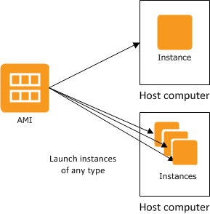
Amazon Elastic Compute Cloud (Amazon EC2)
It provides re-sizeable computing capacity.
Used to build and host your software systems.
An Amazon Machine Image (AMI) is a template that contains a software configuration (for example, an operating system, an application server, and applications).
From an AMI, you launch an instance, which is a copy of the AMI running as a virtual server on a host computer in Amazon's data center.
You can launch multiple instances from an AMI.

Slide 9
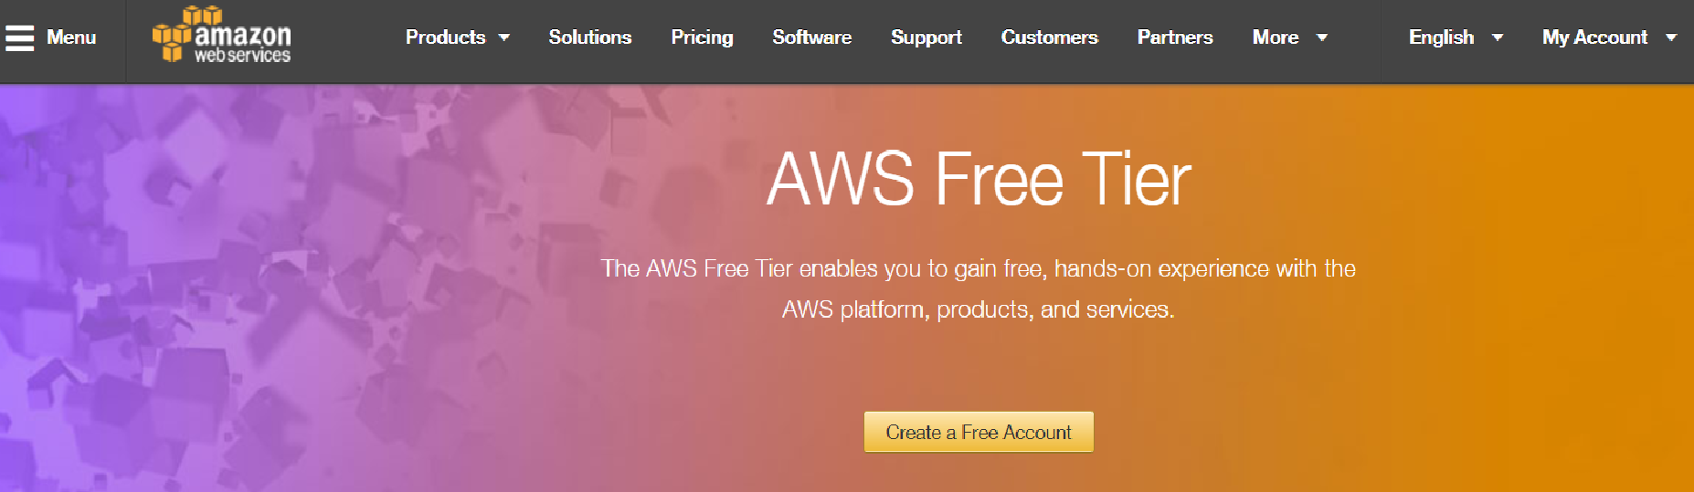
Step 1 : Create an AWS free Account
https://aws.amazon.com/free/

Slide 10
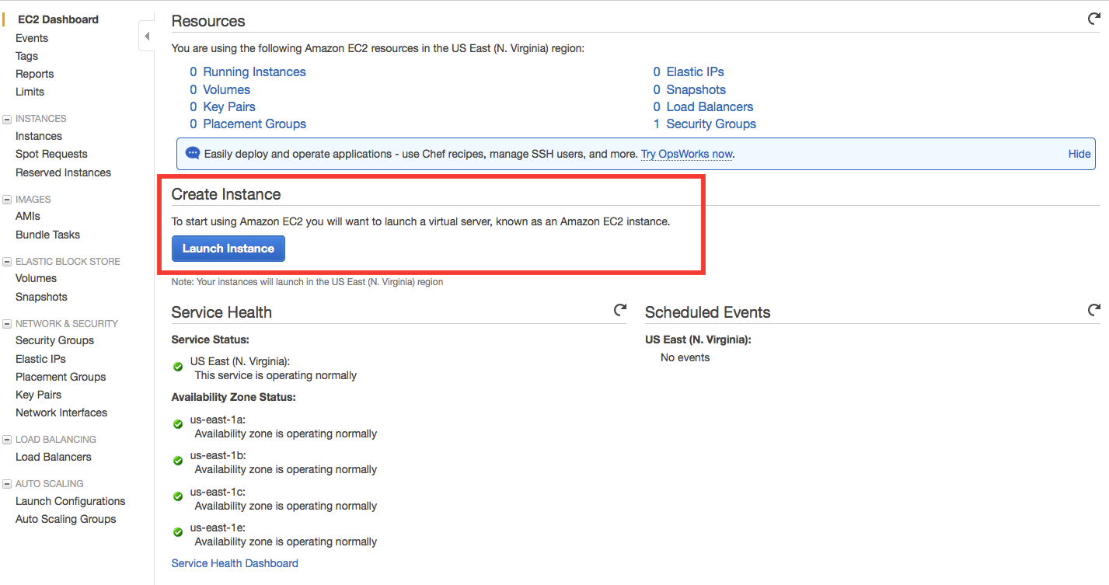
Example 1 Launch a Linux Virtual Machine Step 1: Create Instance

Slide 11
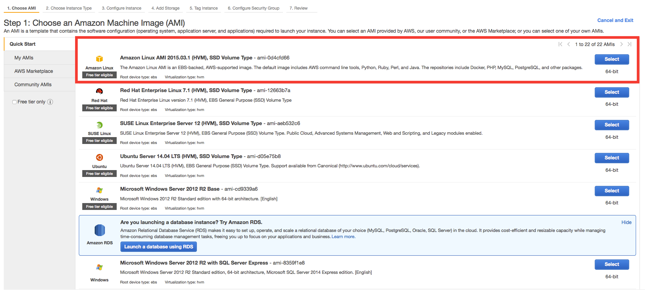
Step 2: Configure your Instance

Slide 12
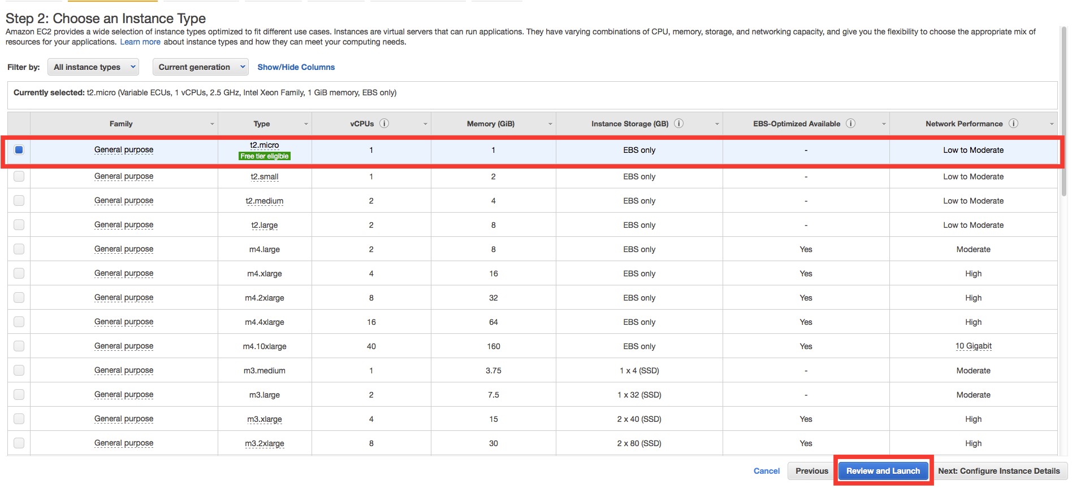
Step 3 : Choose Instance Type

Slide 13
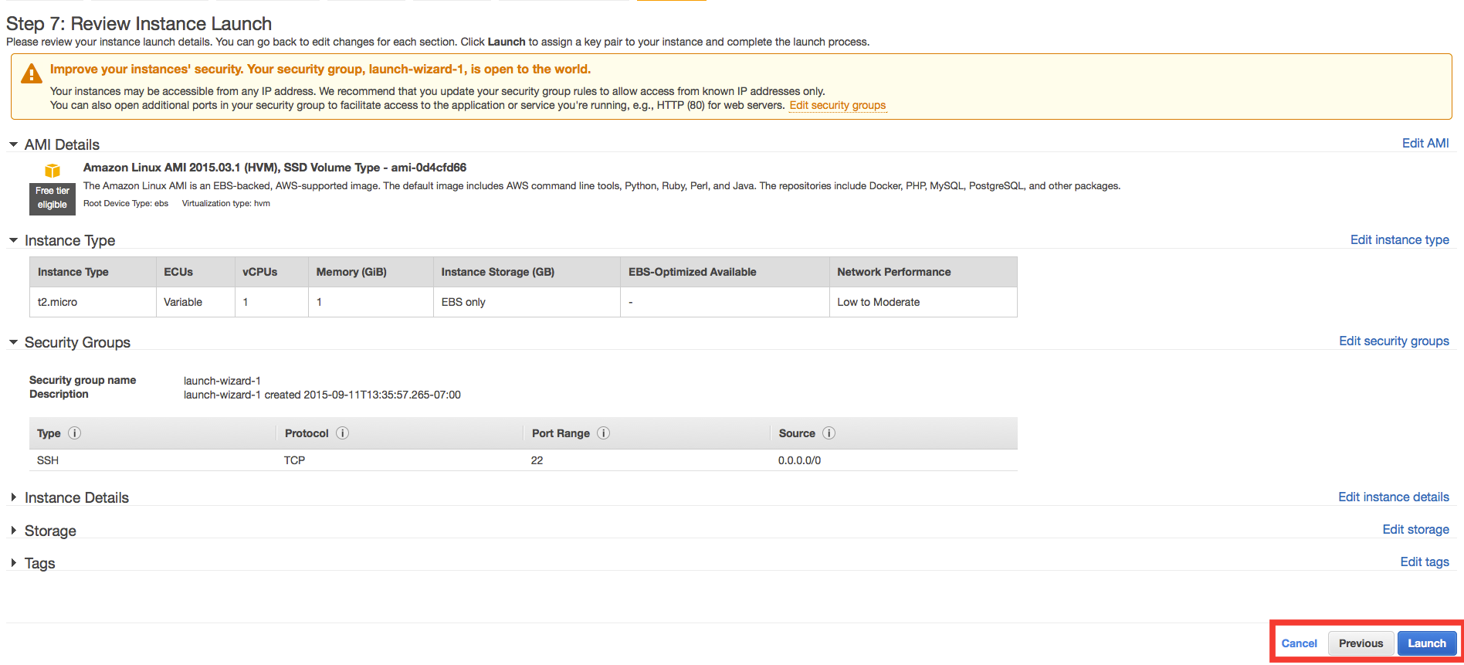
Step 4 : Instance Launch

Slide 14
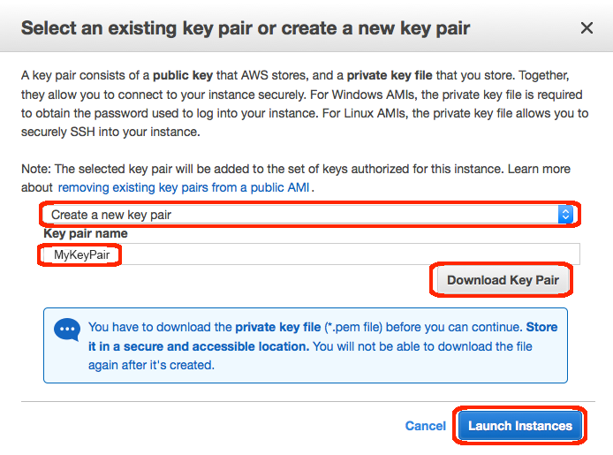
Step 5: Create a key pair
Download and Store it in your machine.
Your house key is used to enter your home

Slide 15
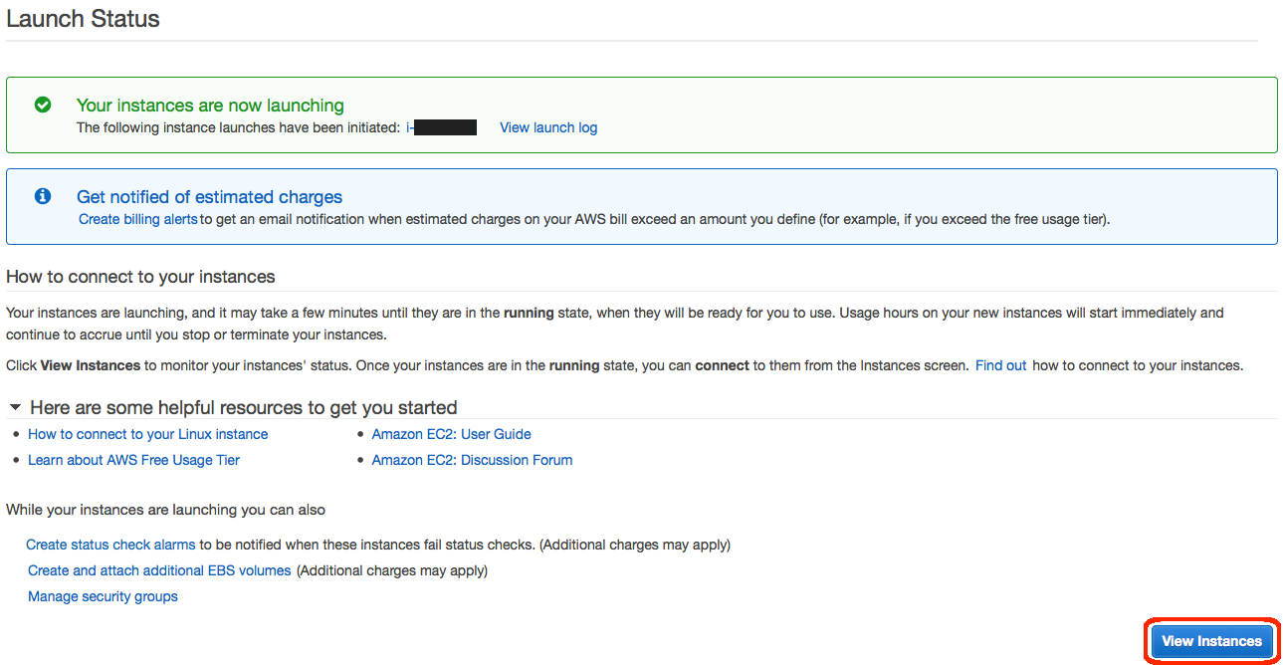
Step 6: View Instances

Slide 16
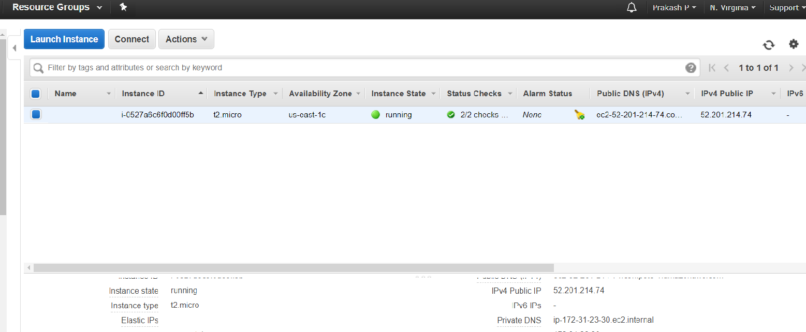
Step 7: Make note of IP address
Make note of the Public IP address of your AWS instance, you will need this to connect to the instance

Slide 17
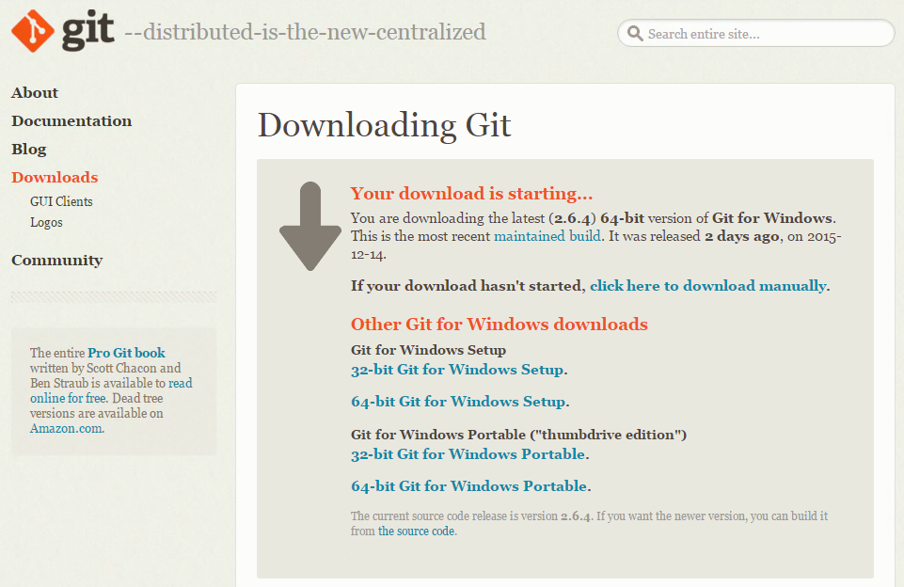
Step 8: Download the Git and Install

Slide 18
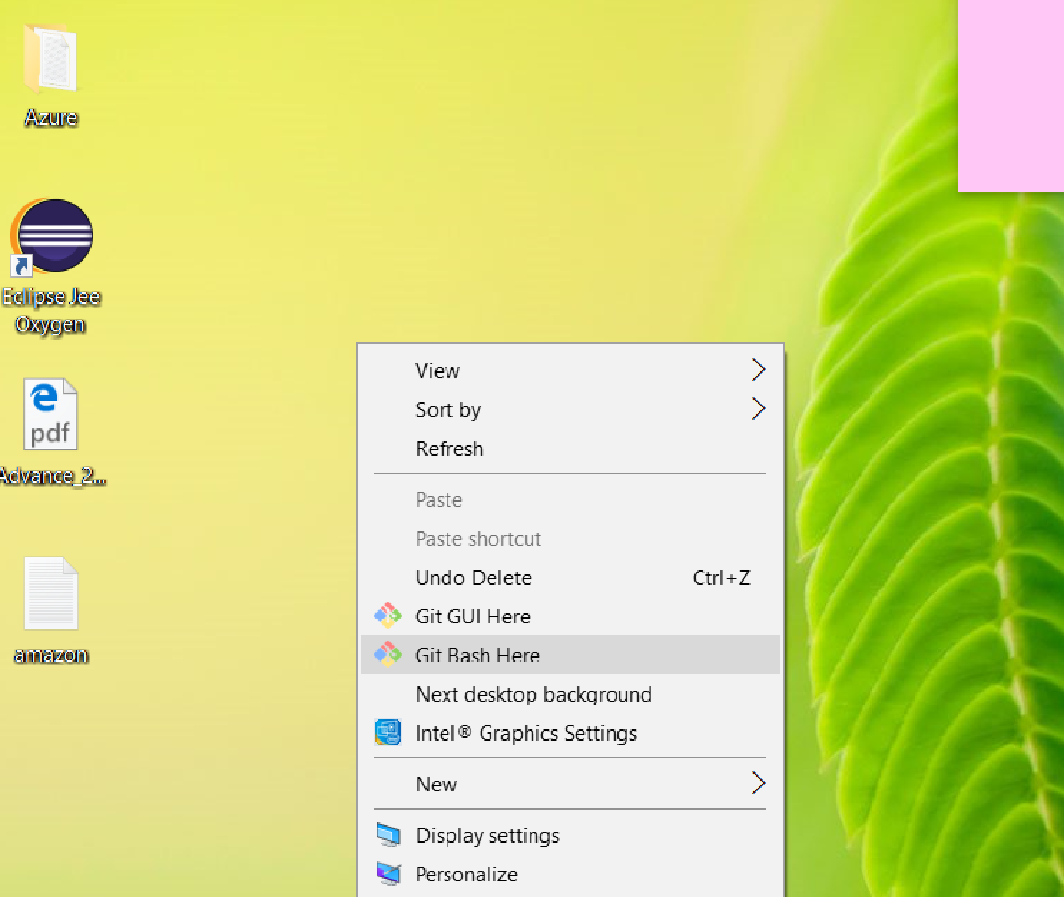
Step 9: Right click → Git Bash Here

Slide 19
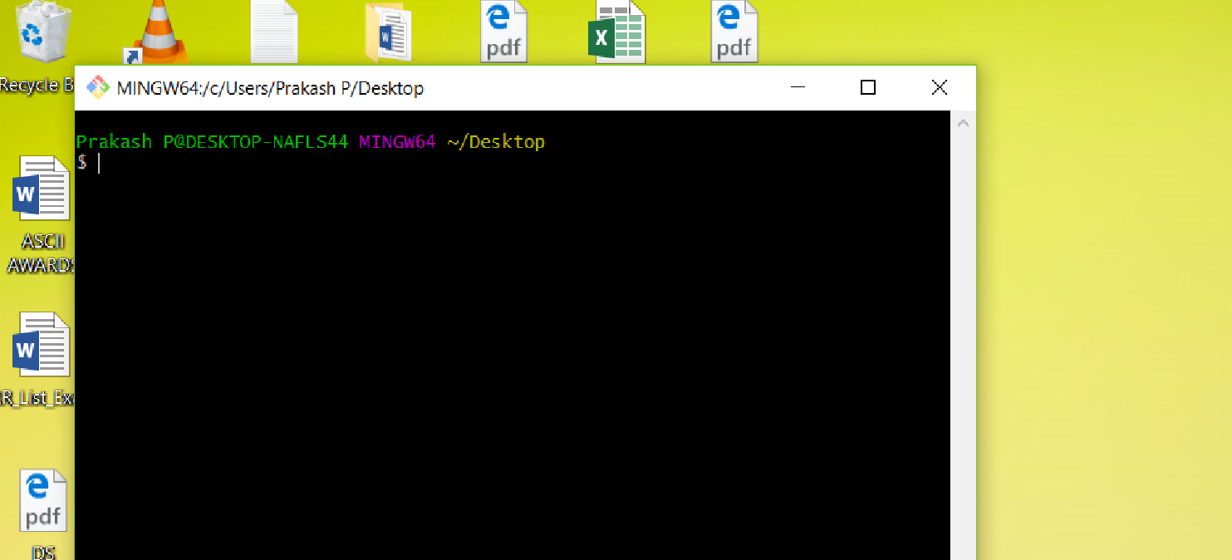
Step 9.1 : Opens Git terminal

Slide 20
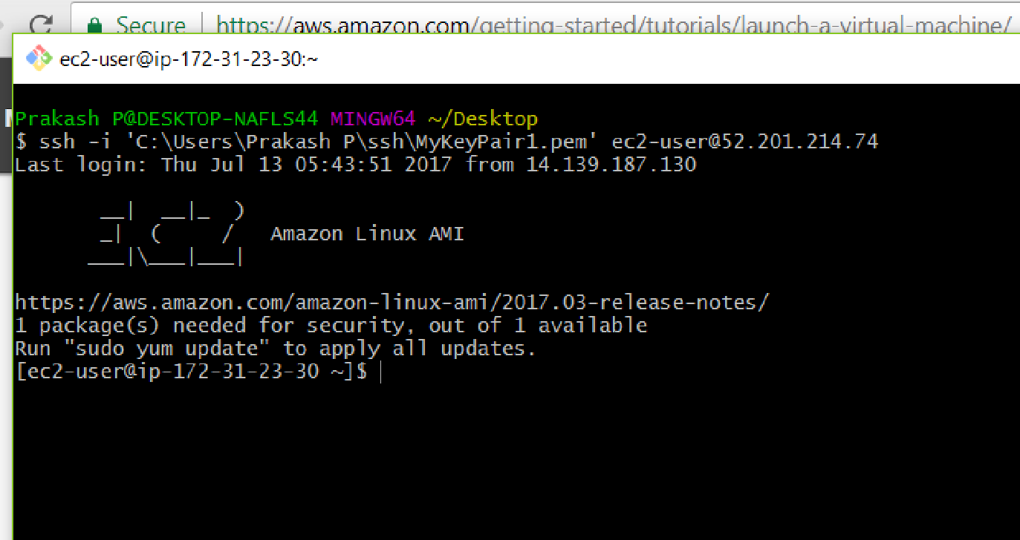
Step 10 : Use SSH to connect to your instance
ssh -i 'c:\users\yourusername\.ssh\MyKeyPair.pem' ec2-user@{IP_Address}
Example : ssh -i 'C:\Users\Prakash P\ssh\MyKeyPair1.pem' ec2-user@52.201.214.74

Slide 21
Step 11: Try to install javac
[ec2-user@ip-172-31-23-30 ~]$ sudo yum update
[ec2-user@ip-172-31-23-30 ~]$ sudo yum grouplist
several packages into groups that you can install with one command to perform a particular task, such as installing a web server or build tools for software compilation.
[ec2-user@ip-172-31-23-30 ~]$ sudo yum groupinstall “Java Development"

Slide 22
Step 12: check and test the javac in Linux VM
[ec2-user@ip-172-31-23-30 ~]$ javac
[ec2-user@ip-172-31-23-30 ~]$ vi sample.java
Type “Hello World” in sample class
[ec2-user@ip-172-31-23-30 ~]$ java sample
☺ Successfully launch the Linux VM and installed the javac ☺

Slide 23
Thanks

