Slide 1

Presentation
Keerthana Vijekumar

Slide 2

Who Am I?
I am me, the best version there will ever be
I’m Keerthana & I’m 25 year old SE graduate from Rattota.
I worked at Sysco labs in the EAG department.
I’m a big fan of gardening.
I’m a very talkative and at the same time super organized person.
Fun fact about me is I am scared of cats.

Slide 3

The Wizarding World of Harry Potter
“We've all got both light and dark inside us. What matters is the part we choose to act on. That’s who we really are.” – The Order of the Phoenix
One of my all time favorite character is Harry Potter.
It always connected with me, brings me back my childhood memories.
always remind me to be brave.
Always taught me stick to what you believe is right.

Slide 4


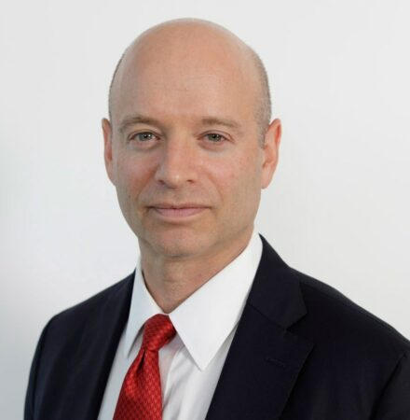


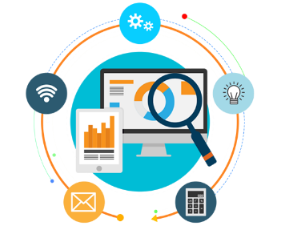

LSEG is a British-based stock exchange and financial markets infrastructure business.
In 2007 London Stock Exchange and Borsa Italiana merge, creating London Stock Exchange Group (LSEG).
CEO – David Schwimmer
Offers Capital Markets, Post-Trade Services, Information Services, and Technology Services
Headquarters at London
In addition to the Group’s own markets, over 35 other organizations and exchanges use the Group’s LSEG Technology trading, surveillance and post trade technology.
Main Market is one of the world's most international and diverse capital markets.

Slide 5

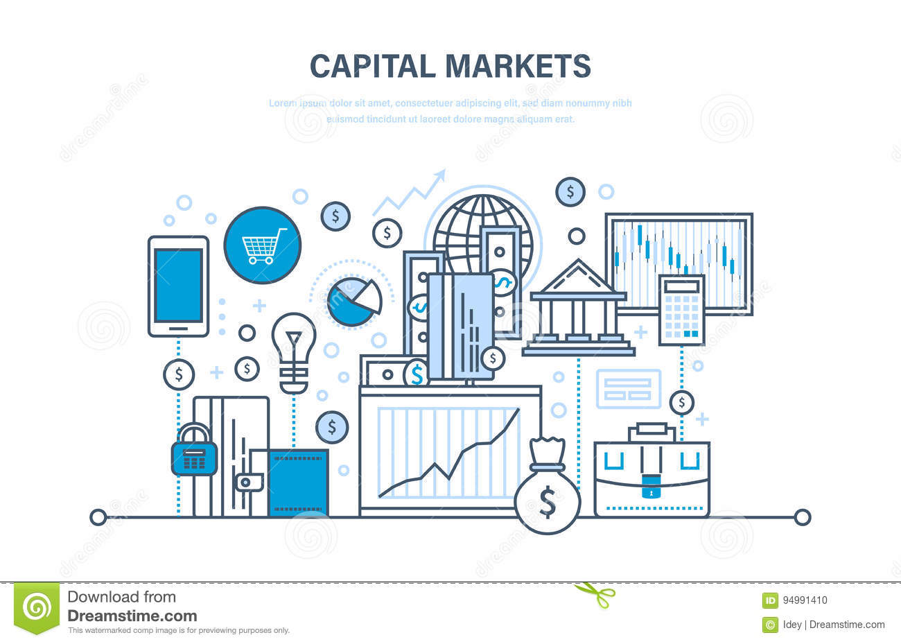

Capital market is a market where buyers and sellers engage in trade of financial securities like bonds, stocks, etc. The buying/selling is undertaken by participants such as individuals and institutions.
It is a venue where savings and investments are channeled between the suppliers who have capital and those who are in need of capital.
Capital markets are composed of primary and secondary markets. The most common capital markets are the stock market and the bond market.

Slide 6
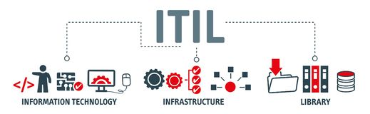
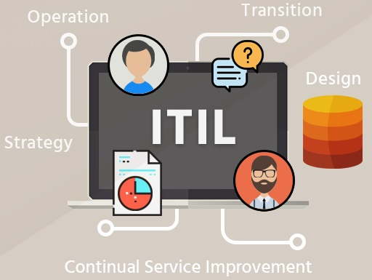
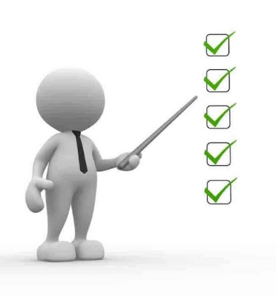
Services - which is delivering value to customers.
ITIL is a set of practices for how you can provide the best services possible,simply an approach to do ITSM.
ITSM is the belief that IT should be delivered as a service to end users.
Stages
Benefits
1. Stronger alignment between IT and the business.
2. Establishing cost-effective systems for managing demand for services.
3. Managing business risk and service disruption or failure.
4. Results in better asset utilization.
5. Consistent, repeatable processes.

Slide 7
Importance of Application Support Engineer
A production support person/team is responsible for monitoring the production servers, scheduled jobs, incident management and receiving incidents and requests from end-users, analyzing these and either responding to the end user with a solution or escalating it to the other IT teams.
When Application breaks, configurations changes happened there should be a dedicated person to fix the issues at a early time.
Application Support Engineer is to be an excellent communicator. where they are being a liaison, who created to bridge the gap between software development teams and IT operations.

Slide 8

Why Application Support Engineer?
I like to developing my career in a forward-thinking role with a well-established company
I found myself interested in this area
I believe my skills are well-suited

