Slide 1

Shri B.V.V. Sangha’s
BASAVESHWAR ENGINEERING COLLEGE, BAGALKOTE
[AICTE Approved, Government-Aided Institution Affiliated To VTU, Belagavi]
DEPARTMENT OF MCA
Seminar on
EXPLAINABLE DATA SCIENCE
MASTER OF COMPUTER APPLICATIONS
2025-2026
Guide Seminar Coordinator HOD
Prof. M. H. Shirur Prof. Karuna Kurbet Prof. S. M. Magi
Submitted by: Keerti Hosamani
USN:2BA24MC014

Slide 2

Explainable

Slide 3
Introduction To Data Science:
Data Science is a field where we use data to find useful information.
It helps in making decisions using data, like predicting results or trends.
Today, many systems use machine learning models to make decisions.
But most of these models are complex and difficult to understand.
Sometimes, we get results from these models, but we don’t know how the result came.
This creates confusion and lack of trust.

Slide 4
Cont’d
Explainable Data Science makes models easy to understand
It explains how and why a result is given
It increases transparency and trust
It helps humans understand decisions

Slide 5
Objectives :
Explain how and why results are generated
Provides clear reasoning behind AI outputs.
Helps users understand the logic used by the model.
2. Build trust in AI systems
Transparent systems make users feel more confident.
Trust increases adoption and acceptance of AI.

Slide 6
3. Detect and reduce errors
Explanations reveal mistakes or unexpected behavior.
Helps developers fix and improve model performance.
4. Ensure fairness and avoid bias
Highlights any biased patterns in decisions.
Supports fair and ethical AI outcomes.

Slide 7
Explainable Data Science Architecture:
An Explainable Data Science Architecture is just a way of designing data systems so that people can understand how decisions are made — not just get results.
What does “explainable” mean?
It means:
You don’t just predict (like “loan approved ❌”)
You also explain why (e.g., “low income + high existing debt”)

Slide 8
Simple Architecture (Step-by-step)
1. Data Collection
Gather data from sources (apps, sensors, databases)
Example: customer age, income, purchase history
Goal: Get clean and relevant data
2. Data Processing
Clean missing values
Remove errors
Transform data into usable format
Goal: Make data ready for analysis

Slide 9
3. Model Building
Train a machine learning model (like decision tree, regression)
Model learns patterns from data
Goal: Make predictions
4. Explainability Layer
This is what makes it “explainable”
Tools/techniques:
Feature importance (which factors matter most?)
methods to explain predictions
Rule-based explanations
Example:
Instead of just saying:
“Customer will churn”
It says:
“Customer likely to churn because: low usage + many complaints”

Slide 10
5. Visualization & Reporting
Show results in dashboards or charts
Provide human-friendly explanations
Goal: Help non-technical people understand
6. Deployment & Monitoring
Use the model in real applications
Keep checking:
  Is it still accurate?
  Are explanations still valid?
Goal: Ensure trust over time

Slide 11
Real-life Example
Imagine a bank system:
Model says: “Loan rejected”
Explainable system says:
  Income too low
  Credit score below threshold
  High existing loans
Now the user understands what to improve
Another Tiny Example
Prediction: “You may be late to work”
Explanation:
Traffic is high 🚦
You left home late ⏰

Slide 12
A data science algorithm is a step-by-step method used to analyze data, find patterns, and make predictions.
Algorithm: Decision Tree
A Decision Tree is one of the easiest and most explainable algorithms.
It works like a series of simple questions (yes/no) to make a decision.
Simple Example: Will you eat an apple?
The model asks questions like:
Is the apple fresh?
  Yes → go next
  No → ❌ Don’t eat
Is it sweet?
  Yes → ✅ Eat
  No → ❌ Don’t eat

Slide 13
🌳 Looks like a Tree
Is apple fresh?
├── No → Don’t eat
└── Yes
├── Is it sweet?
├── Yes → Eat
└── No → Don’t eat

Slide 14
Why is it explainable?
Because:
You can see every step
You know exactly why the decision was made
Example explanation:
“Eat the apple because it is fresh AND sweet”

Slide 15
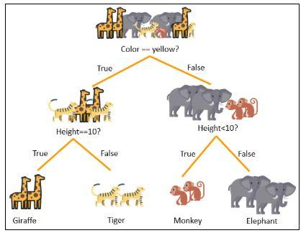
Decision tree works like a flowchart with yes/no conditions.

Slide 16
student pass or fail
from sklearn.tree import DecisionTreeClassifier
# Input Data
X = [[1],[2],[3],[4],[5]]
# Output Data
y = ['Fail','Fail','Pass','Pass','Pass']
# Create Model
model = DecisionTreeClassifier()
# Train Model
model.fit(X,y)
# Predict New Student
prediction = model.predict([[4]])
print("Prediction:", prediction[0])

Slide 17
K-Means Clustering → Grouping Similar Things
Example:
Grouping students based on marks.
High scorers
Average students
Low scorers
Simple explanation:
“This algorithm groups similar data together.”
Real-life example:
Customer grouping
Product recommendation
Student performance analysis

Slide 18
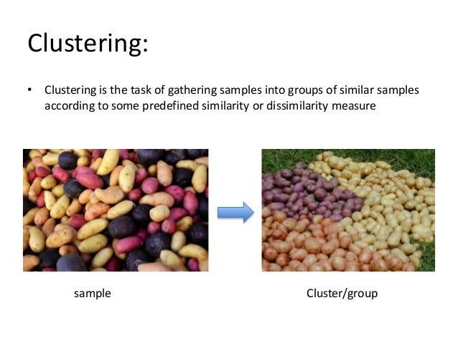

Slide 19
K-Nearest Neighbors (KNN) – Simple Explanation
“KNN is a data science algorithm used to find similar things.”
Very simple meaning:
“It checks nearby similar data and gives result based on that.”
So What is K Exactly?
K means:
👉 Number of nearest data points we check before deciding.

Slide 20
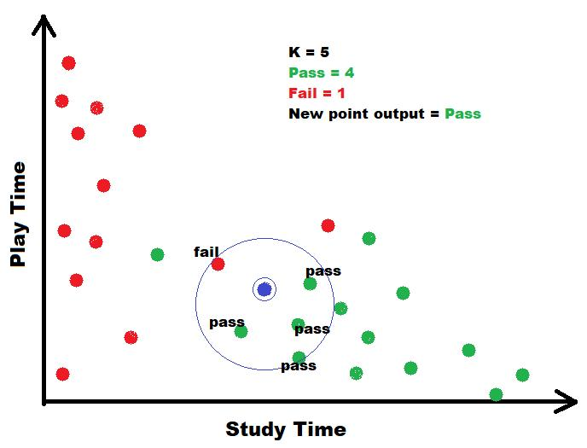

Slide 21
Example in Simple Words
If:
K = 3
Computer checks nearest 3 neighbors.
If:
2 are Pass
1 is Fail
Final prediction:
👉 Pass
Because majority is Pass.

Slide 22
Step 1: Collect Old Data
Now a new student studies 4 hours.
We want to predict:
👉 Pass or Fail?
K = 3
Student | Study Hours | Result
A | 1 hour | Fail
B | 2 hours | Fail
C | 5 hours | Pass
D | 6 hours | Pass

Slide 23
Step : Count Majority
Among nearest 3 students:
Pass = 2
Fail = 1
Pass has higher count.

Slide 24
# Study hours
X = [[1], [2], [5], [6]]
# Results
# 0 = Fail
# 1 = Pass
y = [0, 0, 1, 1]
# Create KNN model
# K = 3 means check nearest 3 neighbors
model = KNeighborsClassifier(n_neighbors=3)
# Train the model
model.fit(X, y)
# New student study hours
new_student = [[4]]
# Prediction
prediction = model.predict(new_student)
# Display result
if prediction[0] == 1:
print("Student may PASS")
else:
print("Student may FAIL")ss

Slide 25
# Explainable Data Science Techniques
1. Feature Importance
*Definition:Feature Importance tells us which input features have the biggest effect on the model's prediction.
*Example: Student Performance Prediction
Suppose a model predicts whether a student will pass an exam.
*Features:
Attendance
Study Hours
Marks
Assignment Score
The model may show:Attendance – 40%, Study Hours – 30%,Marks – 20%,Assignments – 10%**
Explanation:*This means *attendance is the most important factor* in predicting whether the student will pass.*

Slide 26
2. Counterfactual Explanation
Definition:Counterfactual Explanation tells us
what needs to change to get a different prediction.
Example: Loan Approval
Current Result: Loan Rejected
Current Income = ₹20,000
Counterfactual Explanation:> "If your income increases to *₹30,000*, your loan may be approved.“
Why is it useful?
t helps users know what changes are needed to achieve the desired result.

Slide 27
Importance of Explainable Data Science
1. Builds Trust in AI
Explains why a decision or prediction was made.
Helps users feel confident in using AI systems.
2. Better Decision-Making
Users can understand the reasoning behind AI outputs.
Leads to more accurate and reliable decisions.

Slide 28
4. Trustworthiness
Users can trust the model’s decisions.
Reliable results increase confidence in the system.
5. Accountability
The model’s decisions can be checked and justified.
Developers are responsible for the outcomes.
6. Fairness
The model makes unbiased and equal decisions.
It treats all users or groups equally.

Slide 29
3. Provides Clear Understanding
Gives insight into how results are produced.
Removes confusion about how the model works.
4. Ensures Fairness
Helps avoid unfair outcomes.
Promotes equal treatment for all users.
5. Easy for Everyone
Makes results understandable even for beginners.
Non-technical users can easily use the system.

Slide 30
Features :
1. Transparency
The model works in a clear and open way.
Users can see how decisions are made.
2. Interpretability
The results of the model are easy to understand.
Users can quickly make sense of the output.
3. Simplicity
The model is simple and easy to explain.
Less complexity makes it easier to use and trust.

Slide 31
Advantages :
1. Builds Confidence
Helps users feel confident about the results.
Clear explanations make the system more reliable.
2. Improves Decision-Making
Supports smarter and more accurate decisions.
Users can better judge and use AI outputs.

Slide 32
Disadvantages :
1. May Reduce Accuracy
Simplifying models to make them explainable can lower performance.
Complex models often give more accurate results.
2. Hard to Explain Complex Models
Some AI models are too complicated to clearly explain.
Their decision-making process may remain unclear to users.

Slide 33
3. Can Slow Down Performance
Generating explanations may make the system slower.
Extra computation is required to provide understandable results.
4. Balancing Accuracy and Explainability
Hard to maintain both high accuracy and clear explanations.
Improving one may negatively affect the other.

Slide 34
3. Problem Solving
Highlights why a particular outcome occurred.
Helps identify errors and improve models efficiently.
4. Efficiency & Automation
Explains automated decisions so users can trust them.
Saves time while ensuring the AI’s work is understandable.

Slide 35
Applications of Explainable Data Science
1. Healthcare – Disease Prediction
Explains why a patient is at risk of a disease.
Helps doctors understand and trust AI recommendations.
2. Finance – Fraud Detection
Shows why a transaction is flagged as suspicious.
Builds confidence in automated fraud monitoring.

Slide 36
3. Agriculture – Crop Prediction
Explains why certain crops or planting times are advised.
Helps farmers make informed decisions confidently.
4. Manufacturing – Quality Control
Shows why certain products are marked as defective.
Improves trust in automated inspection systems.
5. Social Media – Sentiment Analysis
Reveals why posts are classified as positive, negative, or neutral.

Slide 37
Challenges in Explainable Data Science
1. Data Privacy Issues
Explaining AI decisions may reveal sensitive data.
Must balance transparency with privacy protection.
2. Large Data Handling
Explaining results for huge datasets is difficult.
Requires more computing resources and time.

Slide 38
3. Complexity of Algorithms
Some models are too complex to explain easily.
Trade-off between accuracy and explainability.
4. Extra Time and Effort
Creating explanations adds development time.
Maintaining explanations can be challenging.
5. Incomplete Explanations
Not all AI decisions can be fully explained.
Some reasoning may remain unclear to users.

Slide 39
Future Enhancements & Scope :
1. Advanced Algorithms
New algorithms will not only improve accuracy but also make results easier to explain.
Helps models provide understandable reasoning along with predictions.
2. AI & Machine Learning Integration
More AI and ML systems will include built-in explainability.
Users can see how the system learns and why decisions are made.

Slide 40
3. Big Data Handling
Can explain insights even from very large and complex datasets.
Helps users understand patterns in massive amounts of data.
4. User-Friendly Explanation Tools
Tools will make AI reasoning easy to understand for everyone.
Even non-technical users can interpret results confidently.

Slide 41
Conclusion :
Helps understand how AI models make decisions
Increases trust and confidence in AI systems
Makes it easier to find and fix mistakes
Reduces unfair or biased outcomes
Important in fields like healthcare, banking, and education
Future improvements will make it more useful and easier to use

Slide 42
THANK YOU

