Slide 1
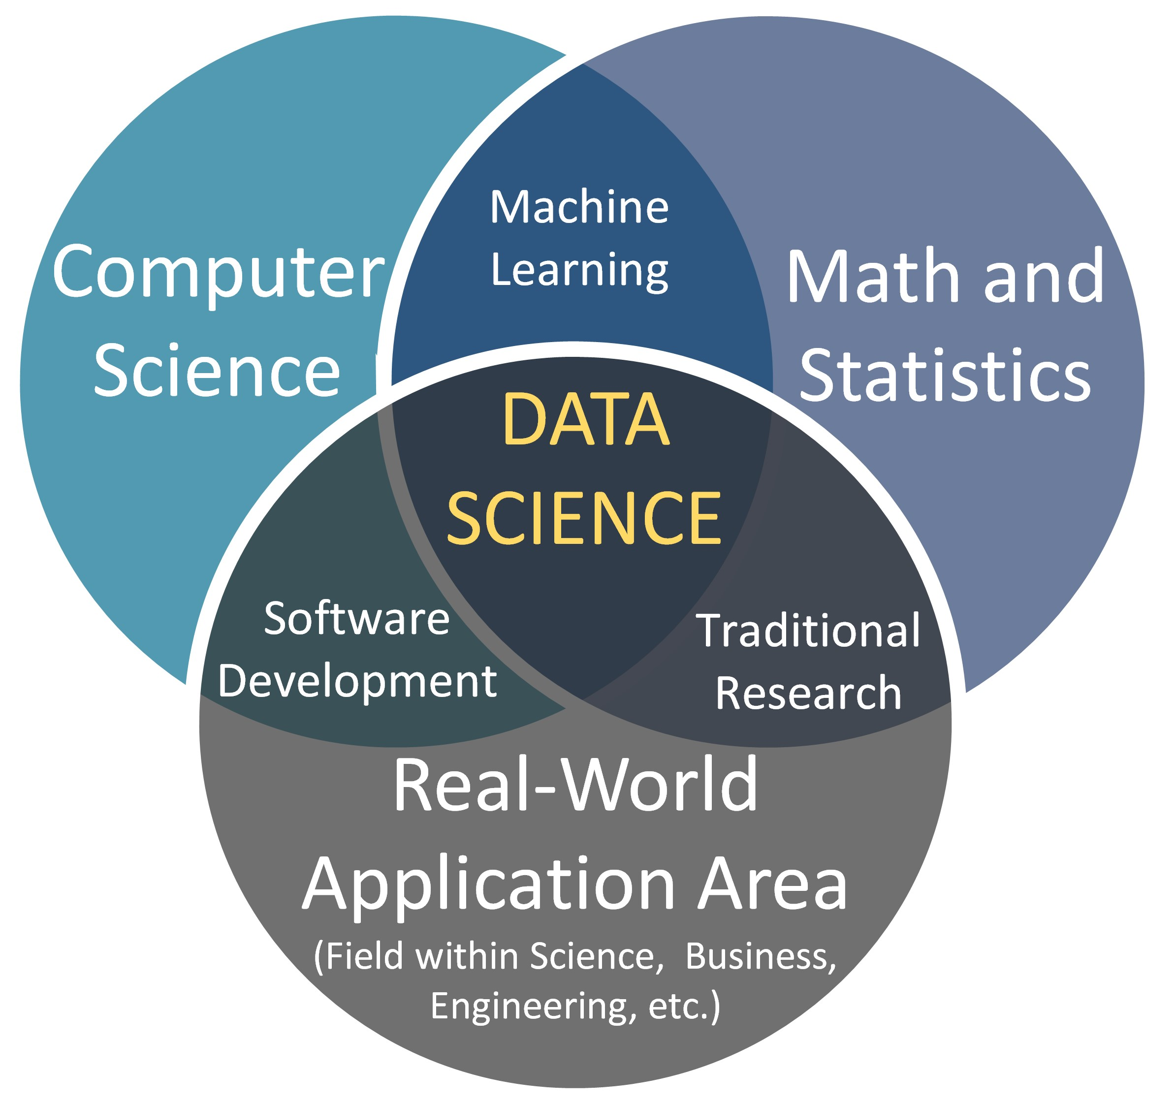
What is Data Science
Data science is an interdisciplinary field that uses scientific methods, algorithms, and systems to extract knowledge and insights from structured and unstructured data.
It combines expertise from statistics, mathematics, and computer science to analyze, visualize, and model data, enabling organizations to predict trends and make data-driven decisions.

Slide 2
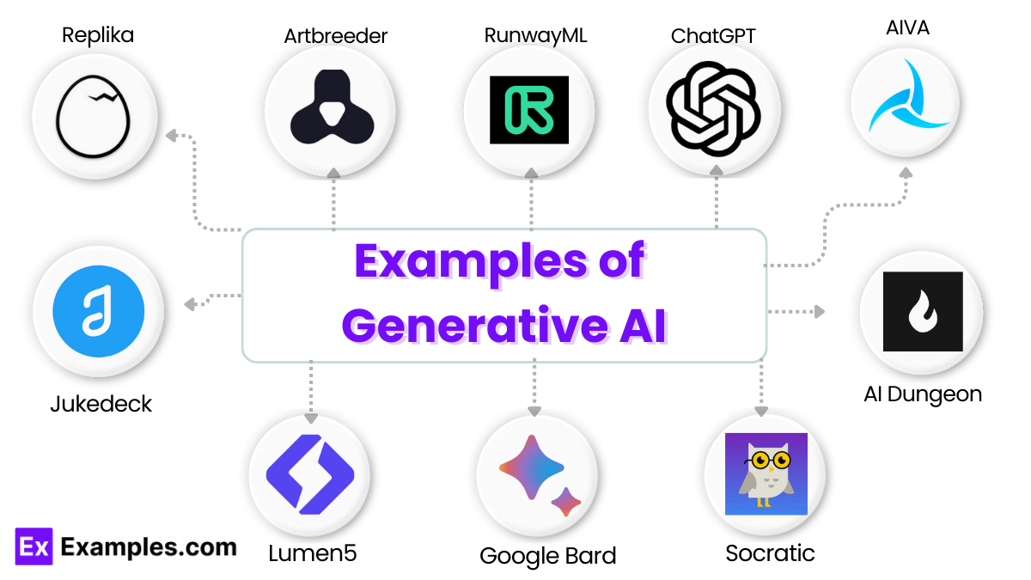
What is AI
Artificial Intelligence (AI) is a field of computer science that enables machines to simulate human intelligence, such as learning, reasoning, problem-solving, and perception.
Using algorithms and vast data, AI systems identify patterns to make decisions, generate content, or automate tasks without constant human intervention.

Slide 3
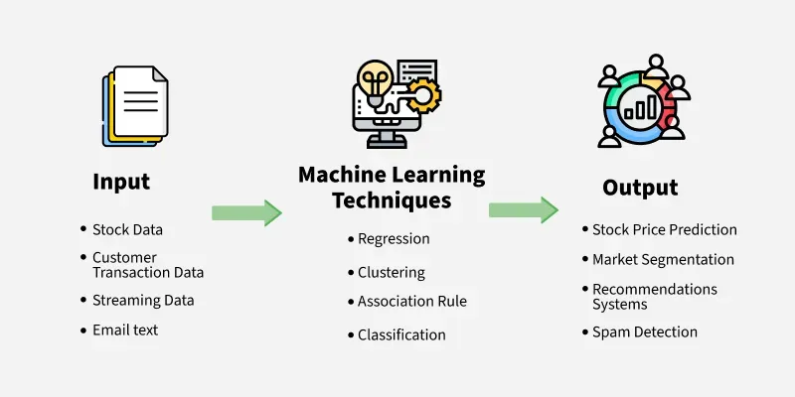
What is ML
Machine Learning (ML) is a subset of Artificial Intelligence (AI)that enables systems to learn from data, identify patterns, and improve performance over time without explicit programming.
It uses algorithms to analyze large datasets and make predictions or decisions, powering applications like recommendation engines, image recognition, and natural language processing.

Slide 4
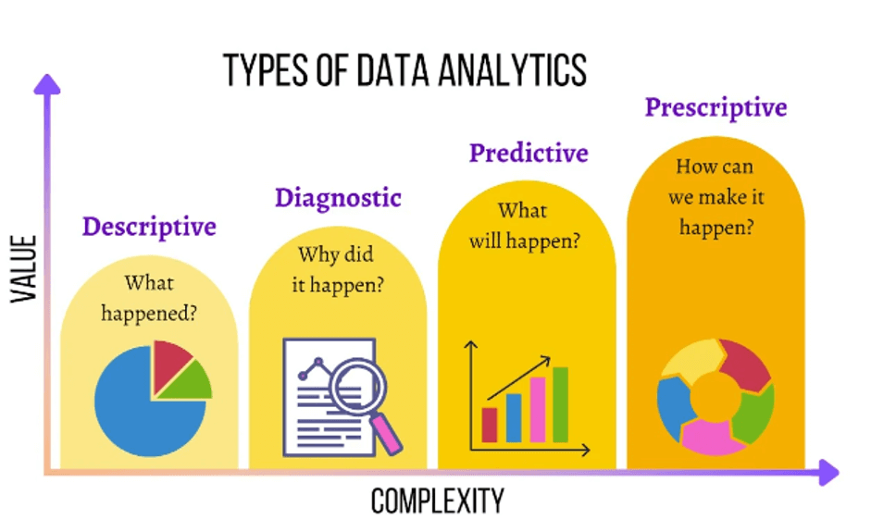
Types of data analysis before the business problem?
Descriptive analytics(what happened)
Diagnostic analytics(why did it happened)
Predictive analytics(what will happen)
Prescriptive analytics(What to do now)

Slide 5
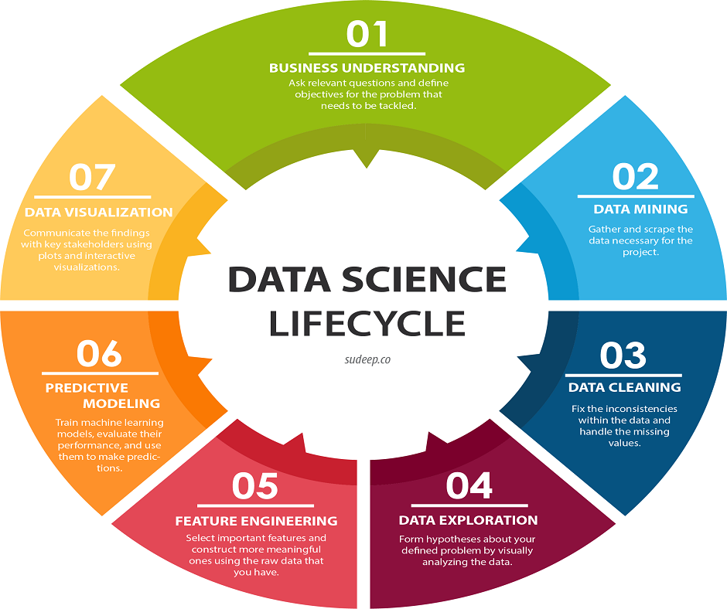
Life cycle of the project
1. Business understanding
2. Data collection
3. Data preparation
4. Data cleaning/data wrangling
5. Exploratory data analysis
6. Feature engineering
7. Model building
8. Model evaluation
9. Model validation
10. Deployment
11. Monitoring and Maintenance

Slide 6
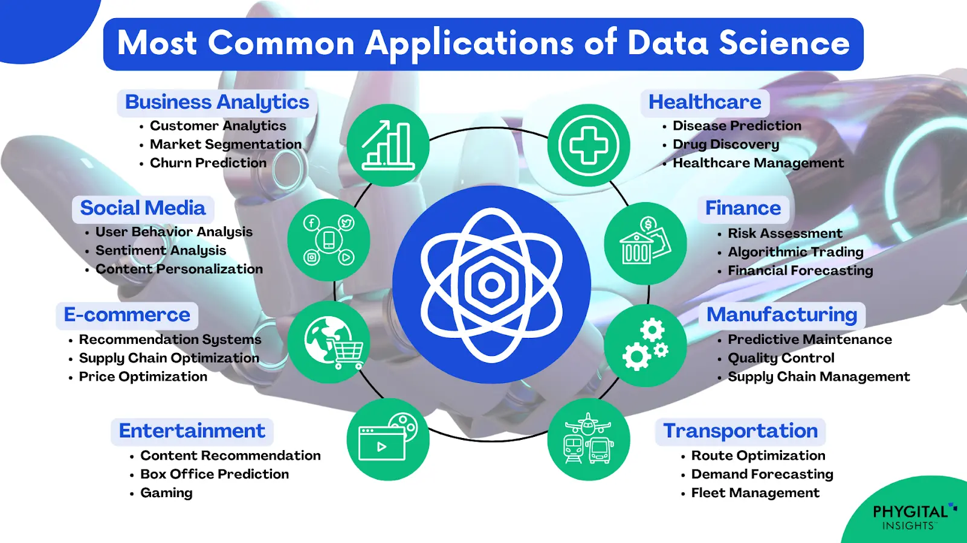
Applications of data science
Banking---fraud detection/credit risk modelling/algorithmic trading
Ecommerce---recommending products/analyzing reviews/customer preferences/price optimization
Transport---route optimization/self driving cars/predict the traffic
Health care---predicting disease/drug discover/medical image analysis/patience monitoring
Education----tracking student performance/grade prediction/Lms/recommendation scores/chatbot student support

Slide 7
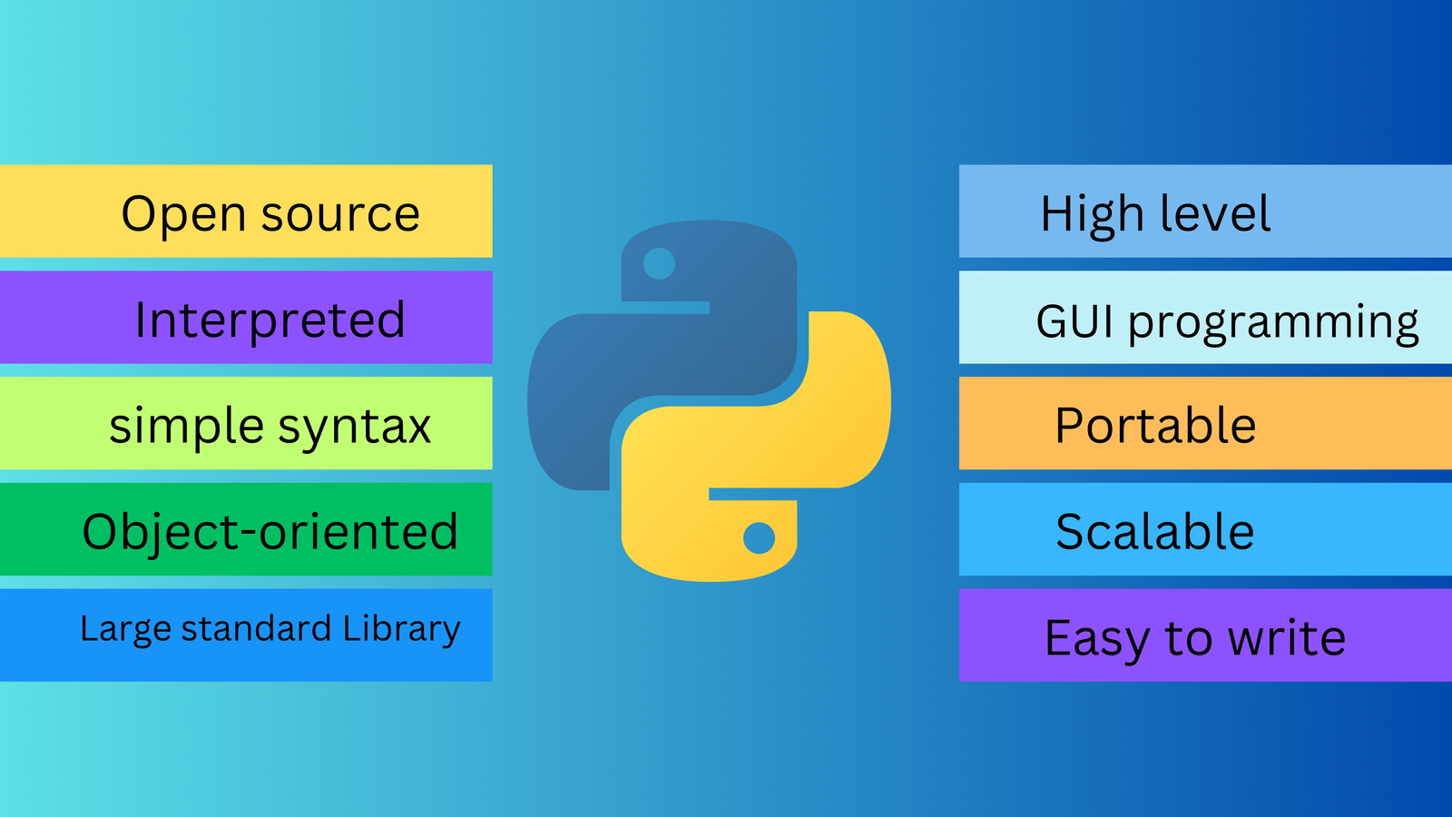
What is python programming
Python is a programming language that is widely used in web applications, software development, data science, and machine learning (ML).
Developers use Python because it is efficient and easy to learn and can run on many different platforms.

Slide 8
What are the advantages
1. Easy to Learn and Use
2. Versatile and Flexible
3. Extensive Libraries and Frameworks
4. Improved Productivity
5. Highly Secure
6. Strong Community Support
7. Supports Multiple Programming Paradigms
8. Used by Top Companies

Slide 9
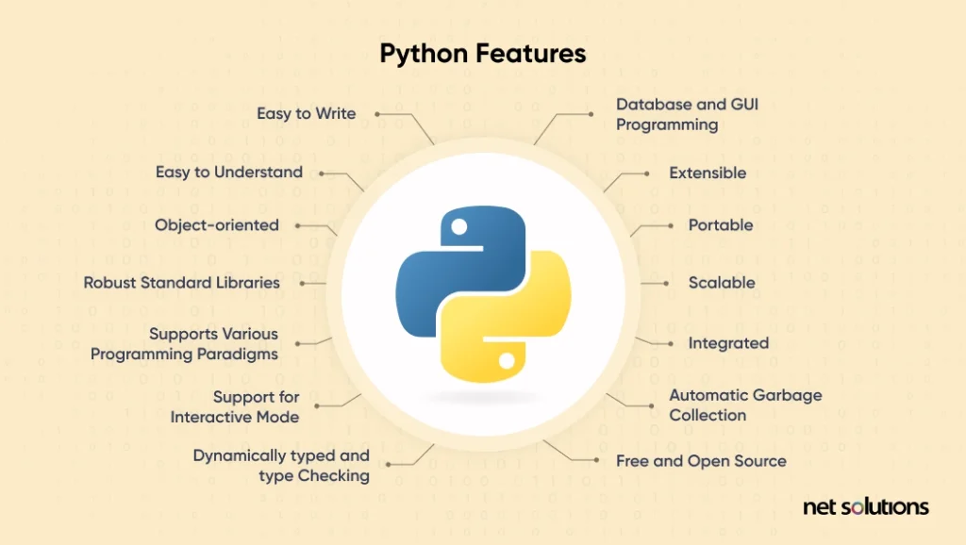
What are the features
Free and open-source
Cross-platform portability
A large standard library
Dynamic typing
Strong support for object-oriented and functional programming.
Wide Application Scope

Slide 10
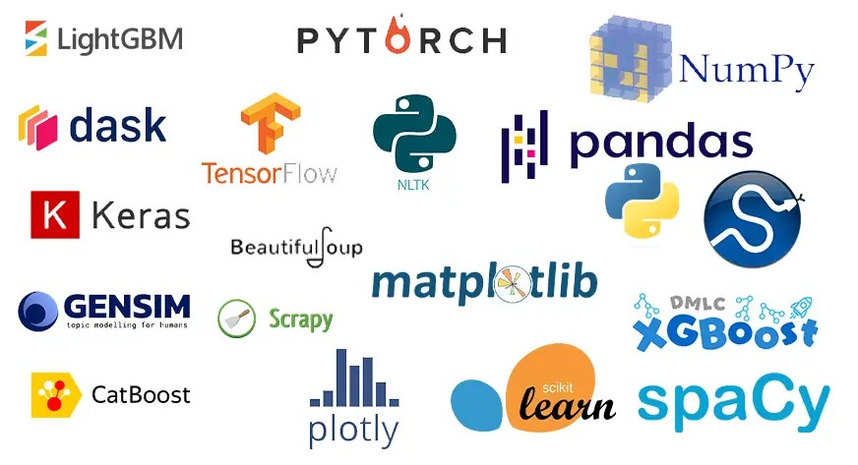
What are the libraries used for data science/ai/ml
NumPy
Pandas
Matplotlib
Seaborn
Scikit-learn
TensorFlow
PyTorch
Keras
XGBoost
LightGBM .

Slide 11
What are the roles we can explore in?
Data analyst
Data scientist
Data engineer
ML engineer
NLP engineer
Business analyst
Bi developer
Analytic engineer
Data architect
Ai engineer
Ai specialist
Product analyst

Slide 12
What are the rules of programming?
1.Each python programming should start with column position 1.
2.Variables are case sensitive.
3.If our statement is expecting some sub statement then the line should end with colon(:).
4.Every sub statement should start at forwarded position to its parent line.
5.All the sub statements of a parent line should be in the same position.

