Slide 1
UE23CS352A – MACHINE LEARNING PROJECT
Project Title : Student Performance Early Warning System
Project Guide : Dr. Prema R
Project Team : A R Keerthana [PES2UG23CS001]
Ananya Lakshmi [PES2UG23CS062]

Slide 2
Outline
Problem Statement
Objectives and Workflow
Dataset overview
Data preprocessing and feature engineering
Three key insights from the data
Understanding the distribution
The Link Between Prior Grades and Final Risk
The Impact of Previous Failures
Models implemented
Model evaluation metrics
Results summary
Recommended model
Actionable insights
Conclusion
Result and Visuals

Slide 3
Problem Statement
Goal:
To predict students at risk of poor performance or dropout using academic, demographic, and social factors.
Why it matters:
  Institutions face difficulty in identifying struggling students early.
  Early intervention can improve retention and success rates.
“Our model acts as an early warning system — enabling educators to intervene before it’s too late.”

Slide 4
Objectives and Workflow
Objectives:
Build a predictive model that categorizes students into High, Medium, and Low risk.
Identify key factors driving academic performance.
Provide actionable insights for educators via interpretable reports.
Evaluate and compare multiple models for accuracy and recall.
Workflow:
Feature Engineering: Create new, insightful features from the data.
Exploratory Data Analysis (EDA): Visualize data to find key patterns.
Modeling: Train and tune four different classification models.
Evaluation: Compare models to find the best performer and identify key risk factors.

Slide 5
Dataset Overview
Dataset : student-por.csv (Portuguese Secondary School Dataset)
Source : UCI Machine Learning Repository
Key Features :
Academic: G1, G2, studytime, failures
Behavioral: absences, freetime, alcohol use
Demographic: parental education, family relations
Target Variable : Final Grade (G3) → Categorized into High, Medium, Low Risk

Slide 6
Data Preprocessing & Feature Engineering
Feature Engineering (Creating Smarter Data):
G_avg: Combined G1 and G2 grades into a single "academic momentum" score.
total_alcohol: Summed workday and weekend alcohol intake for a holistic view.
study_vs_play: Created a ratio of study time vs. free time to measure balance.
Preprocessing Pipeline (Making Data Model-Ready):
Categorical Encoding : Converted text data (like sex, address) into numbers using One-Hot Encoding
Feature Scaling : Standardized all numerical features to ensure fair comparison and improve model performance.

Slide 7
Three Key Insights from the Data
Before building any models, our initial analysis revealed three strong patterns related to academic risk:
Data Imbalance :
The "Medium Risk" category is the largest.
Past Grades :
A student's prior grades are a very strong signal.
Failures :
A history of failing classes dramatically increases risk

Slide 8
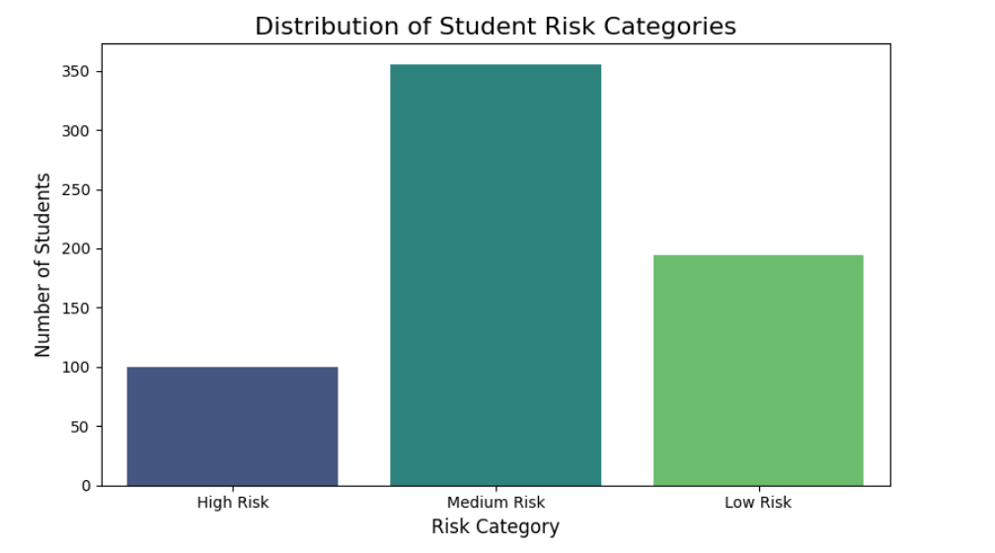
Understanding the Risk Distribution
The dataset is imbalanced:
There are significantly more students in the "Medium Risk" category than in the "High" or "Low" risk groups.
Action Taken:
To prevent our model from being biased, we used class_weight='balanced' during training. This technique forces the model to pay more attention to the under-represented "High Risk" students.

Slide 9
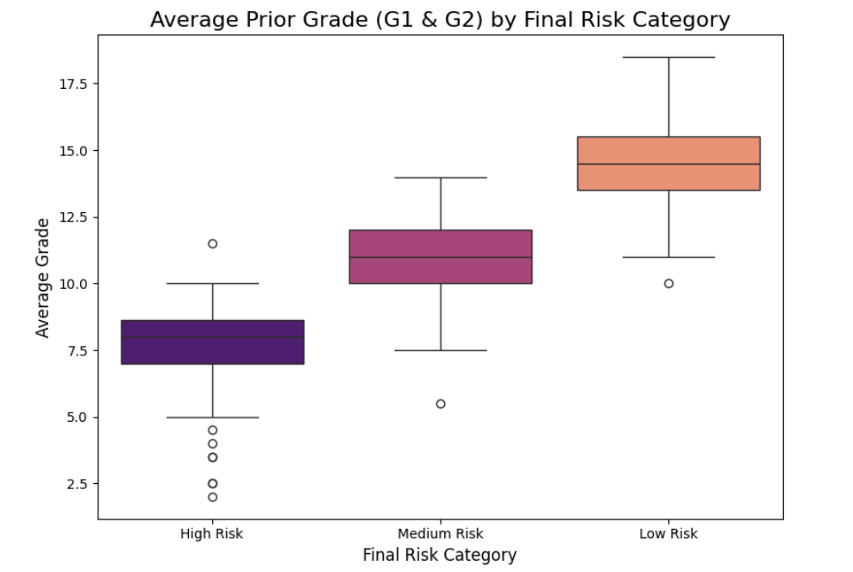
The Link Between Prior Grades and Final Risk
Observation:
There is a clear and direct relationship. Students who end up in the High Risk category have significantly lower average grades from previous periods.
Hypothesis:
A student's academic history is one of the most powerful predictors of their final outcome.

Slide 10
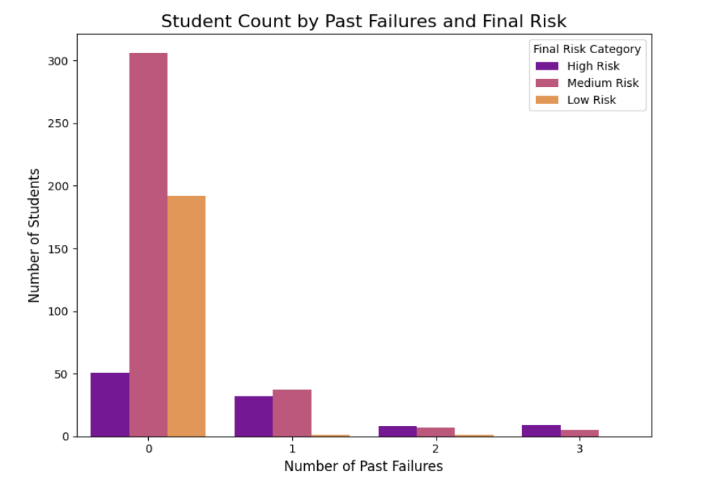
The Impact of Previous Failures
Observation:
Students with zero past failures are overwhelmingly in the Low and Medium risk groups.
As the number of failures increases, the proportion of High Risk students skyrockets. This is a major red flag.

Slide 11
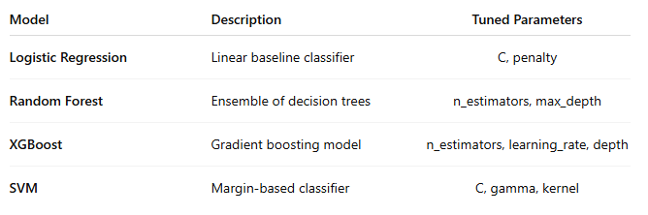
Models Implemented
We trained and tuned four classification models to find the most accurate predictor.
All models tuned with GridSearchCV (5-fold CV)
Used class_weight='balanced' to handle imbalanced classes

Slide 12
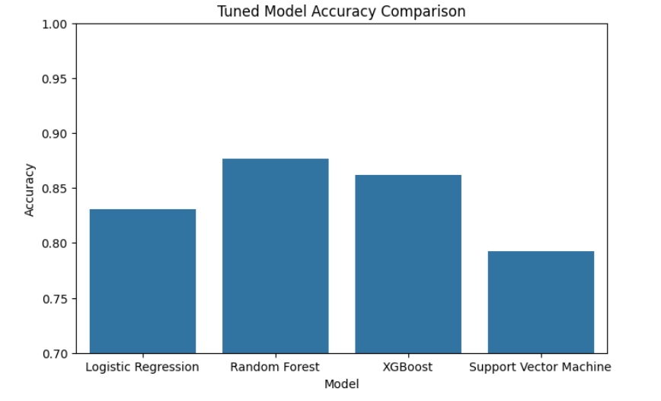
Models Implemented

Slide 13
Model Evaluation Metrics
Metrics Used:
Accuracy
Precision, Recall, F1-score
Confusion Matrix
Overfitting Analysis
For this task, Recall on “High Risk” class was prioritized over overall accuracy.
The Most Important Metric: High-Risk Recall
For this project, overall accuracy was not our primary goal. Our focus was on creating a reliable early-warning system.
Our Priority: Maximize Recall for the "High Risk" Class.
What this means: We tuned our models to be exceptional at finding every student who is truly at high risk.
Why this is crucial:
  A False Negative (missing a high-risk student) is a critical failure. That student might not get the support they need.
  A False Positive (mistakenly flagging a medium-risk student) is acceptable. The consequence is simply providing extra attention to a student who may not have needed it.

Slide 14
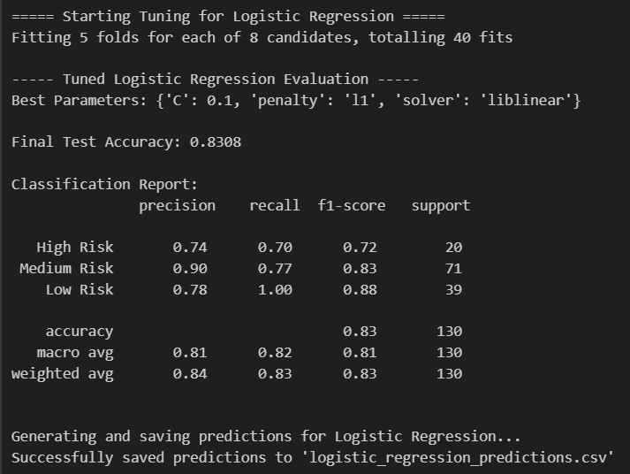
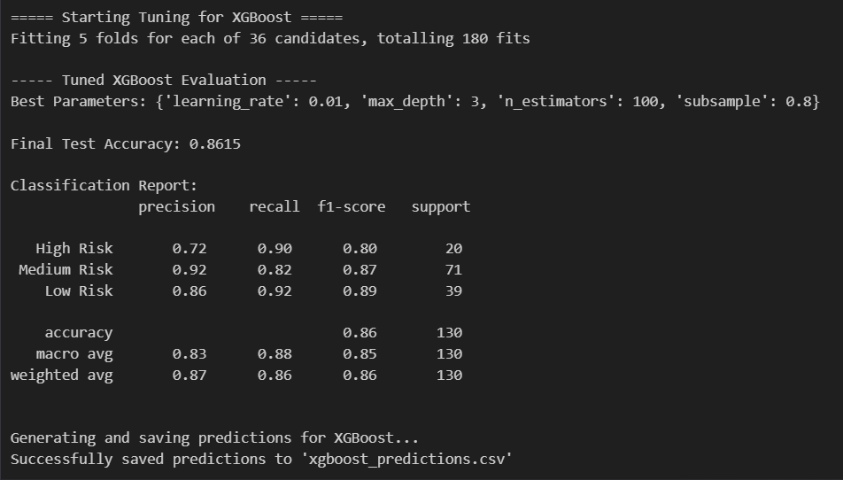
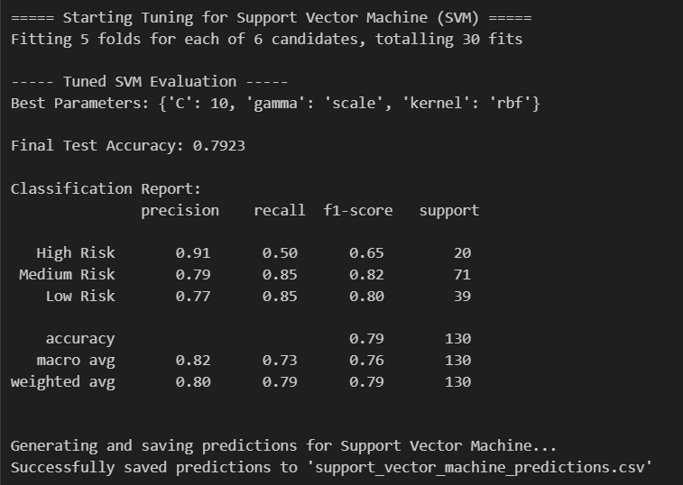
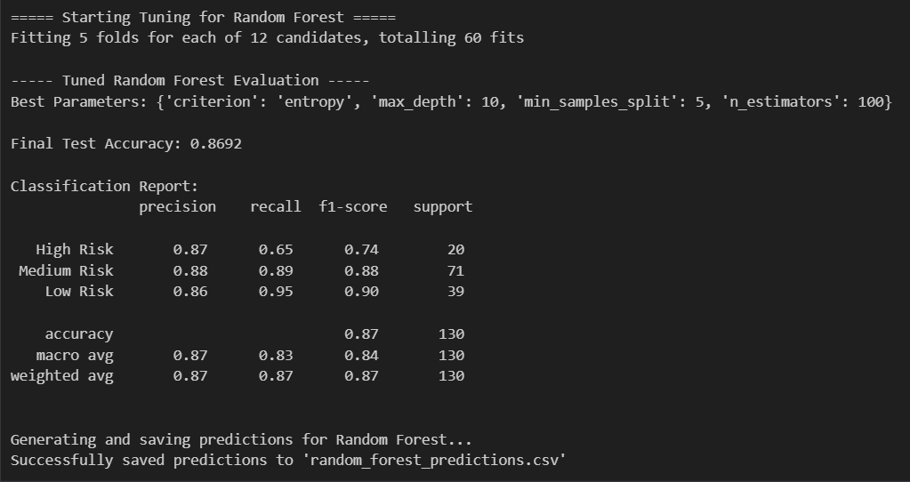
Results Summary
Best Model:
XGBoost
High Recall for High-Risk students
Robust and Generalizable (minimal overfitting)

Slide 15
Recommended Model
The Best Model for the Job : XGBoost
While Random Forest had the highest accuracy, XGBoost is the superior choice. It offers the best balance of high accuracy, strong reliability (no overfitting), and most importantly, it excels at identifying high-risk students.
The Main Story from the Data:
The strongest predictors of a student's future academic risk are their past academic performance (G_avg, failures) and their engagement with school (absences).

Slide 16
Key Predictive Factors
Top 5 Influential Features (from XGBoost):
  G_avg → Prior grades are strongest predictor
  failures → Past failures increase risk
  absences → Proxy for disengagement
  Medu, Fedu → Parental education strongly influences outcomes
  studytime → Direct correlation with performance

Slide 17
Actionable Insights
The generated file: xgboost_predictions.csv
Provides:
  Predicted risk for each student
  Actual vs Predicted category
  Key indicators (G_avg, failures, absences)
How educators can use it:
  Filter “High Risk” students
  Review individual academic patterns
  Offer counseling, extra support, or parental outreach

Slide 18
Conclusion
Developed a reliable early warning system
XGBoost achieved high recall and balanced accuracy
Identified meaningful academic and behavioral drivers
Generated actionable reports for educators
Future Work:
Add real-time dashboard for student monitoring
Integrate dropout prediction pipeline

Slide 19
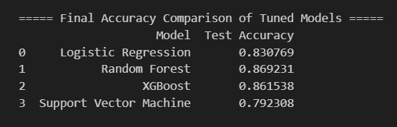
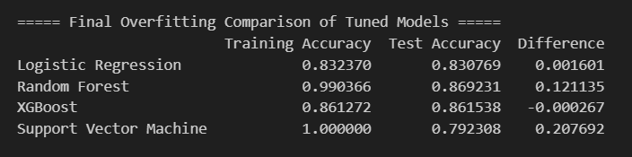
Results & Visualization
Model Performance Summary:

Slide 20
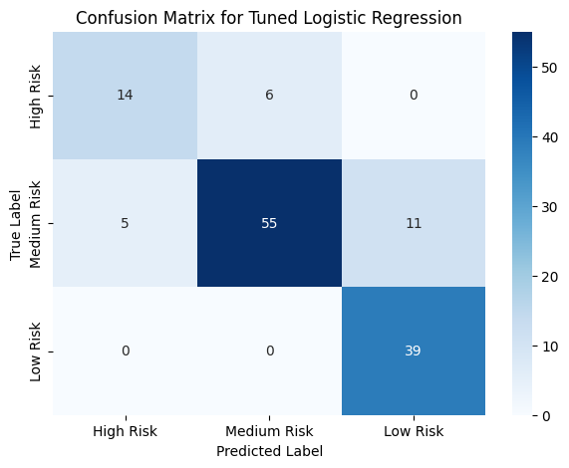
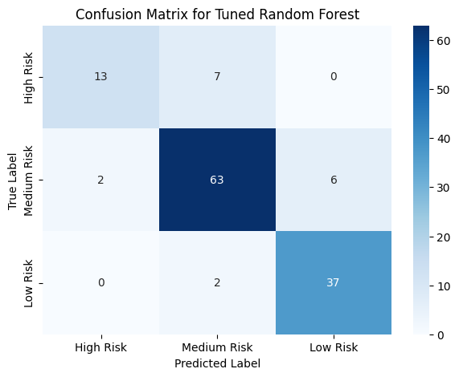
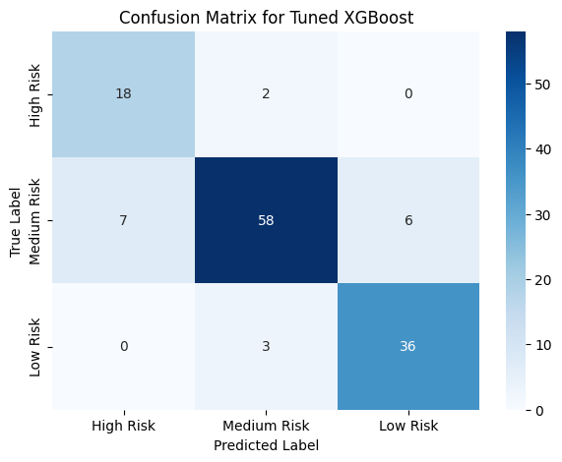
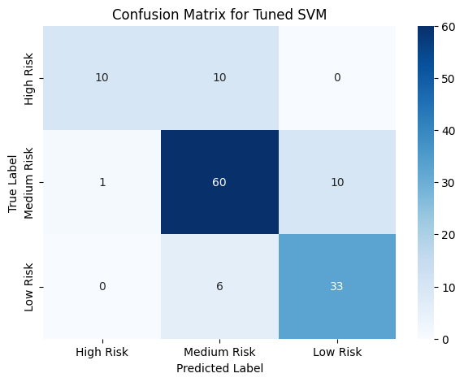
Results & Visualization
Model Performance Summary
Excel Output:
Predicted dropout risk saved in dropout_predictions.xlsx
Contains columns: Student ID, Actual Risk, Predicted Risk, Probability Score
Takeaway:
Gradient Boosting achieved the highest accuracy and recall, effectively identifying high-risk students early.

Slide 21
References & Acknowledgments
GitHub Repository:
https://github.com/ananyalakshmi9/Student-Performance-Early-Warning-System
Faculty: Dr Prema R
Teaching Assistants:
  Rojas Binny
  Keerthana
  Kaamya Jha

Slide 22
Thank You

