Slide 1
Functioneel Denken in C# en Javascript
Een introductie

Slide 2

Agenda ?
Intro
Functioneel Denken
Uitstapjes
Functioneel Programmeren
FP
Higher order functions
Filter, Map And reduce
F#
Pure functionele talen
Sample Solution
F# Als rekenmodule
Immutable data
Closures
Functies als Variabelen
Pure functies
Currying
F# Om mee te unittesten
Category theory
Functional Composition
Partial Application
F# als Scripttaal
Monads
Complete applicatie in F#
Resources
Recursion / Trampolining
Pattern Matching
Memoization
Mixins
Lazy

Slide 3
Sample Solution
https://github.com/KeesDijk/FunctionalThinking
VS2015 met F#
Plugins:
Chutzpah test adapter
Chutzpah test runner context menu extension
BACK

Slide 4
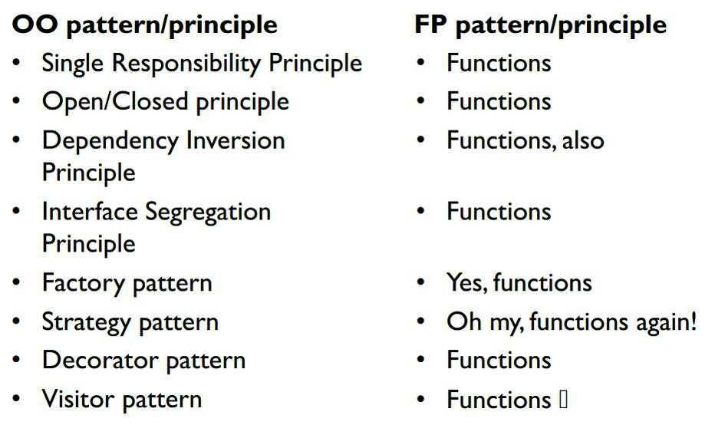
Functioneel Programmeren
Wikipedia:
“a programming paradigm—a style of building the structure and elements of computer programs—that treats computation as the evaluation of mathematical functions and avoids changing-state and immutable data”
Mijn definitie:
“Programmeren met functies als primaire bouwblokken”
Puur functioneel programmeren:
“Programmeren met functies als primaire bouwblokken, deze functies muteren geen state en hebben geen side affects (Referential Transparency)”
BACK

Slide 5
Functioneel Programmeren
Declarative vs. Imperative:
“Imperative: program how something should happen”
“Declarative : program what should happen”
List<int> collection = new List<int> { 1, 2, 3, 4, 5 };
Imperative:
List<int> results = new List<int>();
foreach (var num in collection)
{
if (num % 2 != 0)
results.Add(num);
}
Declarative:
var results = collection.Where(num => num % 2 != 0);
Leesbaar vs. bekend
BACK

Slide 6
Higher Order Functions
“ Functies die functies als resultaat geven, en functies die functies als parameter hebben ”
Paar bekende voorbeelden:
Filter: “ Selecteer elementen uit een lijst”
Map: “ Voer een functie uit op alle elementen uit een lijst ”
Reduce: “ Combineer elementen uit een lijst tot een enkele waarde ”
BACK

Slide 7
Closures
Wikipedia:
" In programming languages, closures (also lexical closures or function closures) are a technique for implementing lexically scoped name binding in languages with first-class functions. Operationally, a closure is a record storing a function[a] together with an environment:[1] a mapping associating each free variable of the function (variables that are used locally, but defined in an enclosing scope) with the value or storage location to which the name was bound when the closure was created.[b] A closure—unlike a plain function—allows the function to access those captured variables through the closure's reference to them, even when the function is invoked outside their scope. "
Stackoverflow met 1 upvote
A variable in a scope
Something constructed inside this scope (typically a function or an object) that uses said variable
That something being passed to somewhere outside the originating scope
BACK

Slide 8
Functional Composition
Simple Compose:
Func<int, int> add2 = x => x + 2;
Func<int, int> mult2 = x => x * 2;
Func<int, int> add2Mult2 = x => add2(mult2(x));
Partial Application
Func<int, int, int> add = (x,y) => x + y;
Func<int, int, int> mult = (x,y) => x * y;
Func<int, int> add2 = x => add(x,2);
Func<int, int> mult2 = x => mult(x, 2);
BACK

Slide 9
Functional Composition
Currying:
public static Func<T1, Func<T2, T3>> Curry<T1, T2, T3>(this Func<T1, T2, T3> f)
{
return a => b => f(a, b);
}
public static Func<T1, Func<T2, Func<T3,T4>>> Curry<T1, T2, T3,T4>(this Func<T1, T2, T3, T4> f)
{
return a => b => c => f(a, b,c);
}
public static Func<T1, Func<T2, Func<T3, Func<T4,T5>>>> Curry<T1, T2, T3, T4, T5>(this Func<T1, T2, T3, T4, T5> f)
{
return a => b => c => d => f(a, b, c, d);
}
BACK

Slide 10
Monads
“ A monad is a parameterized type that implements the `bind` and `return` functions in a way that satisfies the "monad laws ”
Lady Monadgreen's Curse:
“ Once you understand monads, you immediately become incapable of explaining them to anyone else. “
BACK

Slide 11
Recursion
Over Simplified definition
“ Functions calling themselves”
Factorial(x = 3)
(x != 0)
return 3 * Factorial(x = 2);
(x != 0)
return 2 * Factorial(x = 1);
(x != 0)
return 1 * Factorial(x = 1);
(x == 0)
return 1
return 1 * 1 = 1
return 2 * 1 = 2
return 3 * 2 = 6
result = 6
public BigInteger Factorial(int x)
{
if (x == 0)
return 1;
return x * Factorial(x - 1);
}
BACK

Slide 12
Tail Recursion
public BigInteger FactorialTail(int x, BigInteger product)
{
if (x < 2)
return product;
return FactorialTail(x - 1, x * product);
}
Factorial(x = 3, product = 1)
(x >= 2)
return Factorial(x = 2, product = 3);
(x >= 2)
return Factorial(x = 1, product = 6);
(x < 2)
return 6
return 6
return 6
result = 6
BACK

Slide 13
Memoization
“ Memoization is a technique for storing values of a function instead of re-computing them each time the function is called.”
BACK

Slide 14
Mixins
“In object-oriented programming languages, a mixin is a class that contains a combination of methods from other classes. How such a combination is done depends on the language. If a combination contains all methods of combined classes, it is equivalent to multiple inheritance. Mixins are sometimes described as being "included" rather than "inherited.”
BACK

Slide 15
F# als scripttaal
Zie Tutorial in sample solution
Maak programma met .fsx extensie
Run met fsi.exe
Voorbeeld
fsi ShellScriptExample.fsx http://google.com google_homepage
BACK

Slide 16
Resources
Definitions :
FP for .OO devs
Monads:
Javascript
Recursion
What defines a functional language
Functional Principles for Object-Oriented Developers (great !)
The Marvels of Monads
Monad Laws
Don’t fear the monad (video)
Linq loves Monads
Be a better Programmer (short very nice intro videos)
Jumping the trampoline in c#
BACK

