Slide 1
Title Layout
Subtitle

Slide 2
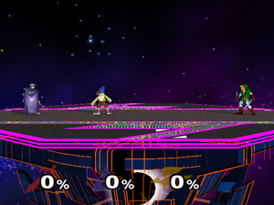
Super Smash Brothers Melee
Fighting game for the Nintendo Gamecube

Slide 3
Problem

Slide 4
Fixing the problem
Machine Learning

