Slide 1
Deepest Learn!
By: Jay Bishop, Jordan Cooper, Brant Chad Dolling, and Kegan McIlwaine

Slide 2
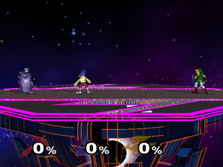
Super Smash Brothers Melee (SSBM)
Fighting game for the Nintendo Gamecube

Slide 3
Problem

Slide 4
Fixing the problem
Machine Learning

Slide 5
Reinforcement Learning

Slide 6
Asynchronous Advantage Actor Critic (A3C)

Slide 7
Reward System

