Slide 1
Rockbuster Stealth Data Analysis
June 2022

Slide 2
Project Overview
Key Questions:
What was the average rental duration for all videos?
Which movies contributed the most revenue gain?
Which are the top 10 countries based on the number of users?
Which are the top 5 countries with the most revenue?
What are the most-watched movies genres?
What are the top rating rented movies? Are the movies watched by adults only or not?

Slide 3

Data Overview
The data is stored in a relational database.
We used SQL to analyze the data and answer key business questions.
All 1000 movies in the database were released in 2006.
English is the only movie language.
PG-13 is the most common movie rating.
1000 Movies | Most Modal rating: PG-13 | Language: English

Slide 4

Rental Duration: Key Numbers
 | Average | Minimum | Maximum
Rental Duration | 5 days | 3 days | 7 days
Movie Length | 115 min | 46 min | 185 min
Rental Price | $2.98 | $0.99 | $29.99

Slide 5
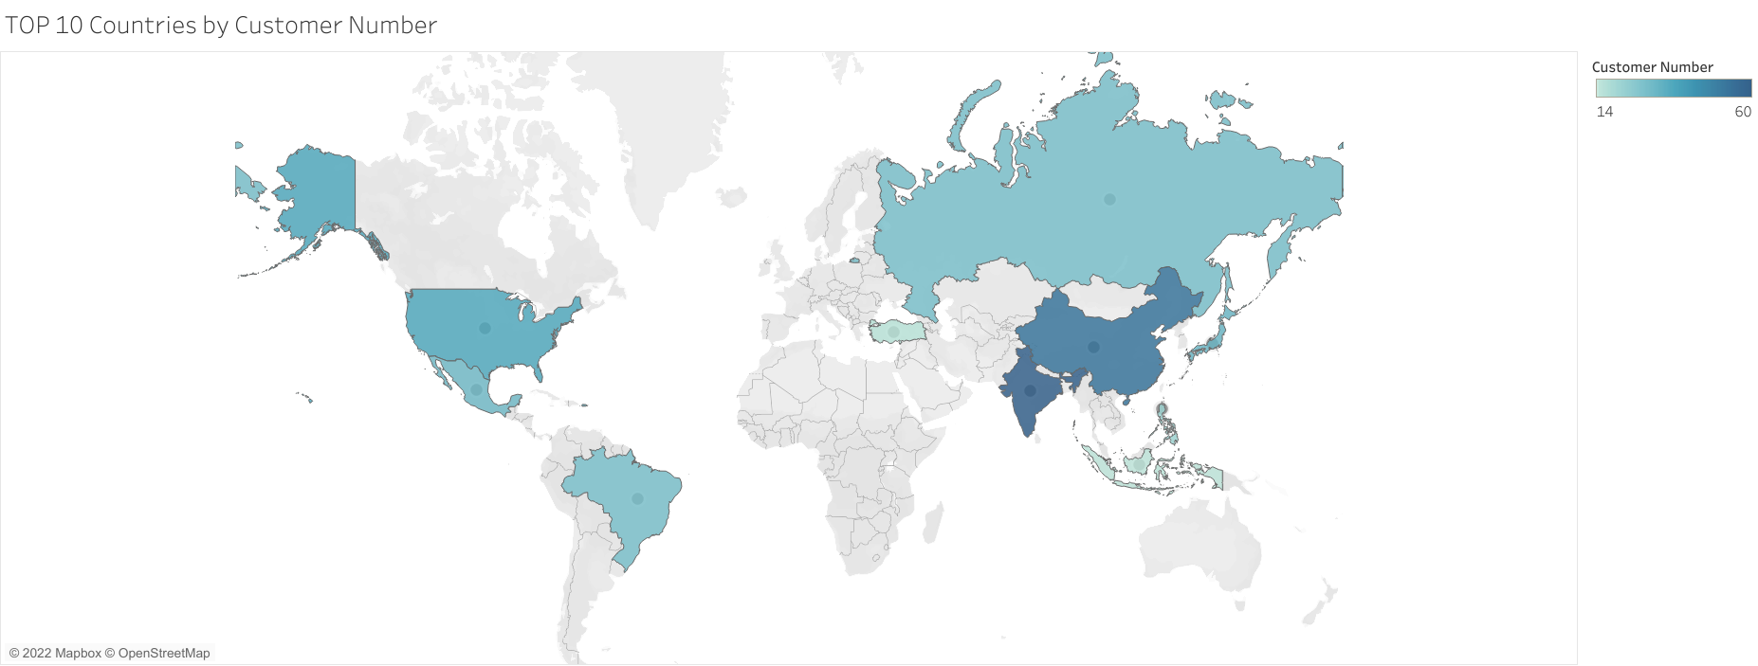
Top 10 countries with more Customer base
Top 10 Countries with the most customer base: (with the biggest to lowest)
India
China
USA
Russia
Mexico
Brazil
Japan
Turkey
Philippines

Slide 6
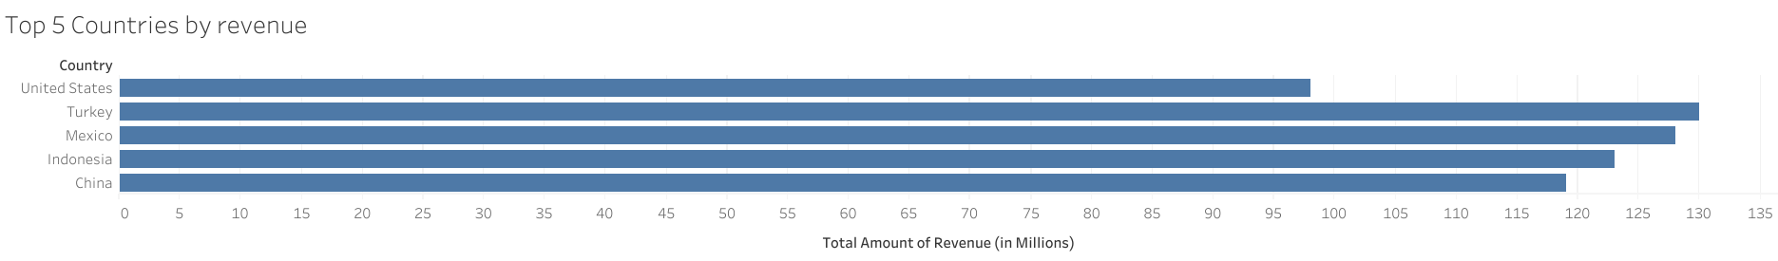
Top 5 countries by Average Revenue
The biggest revenue country is Turkey, despite it has no more users than India, China, and the USA
The USA is in the bottom 5 but still has considerable revenue.

Slide 7
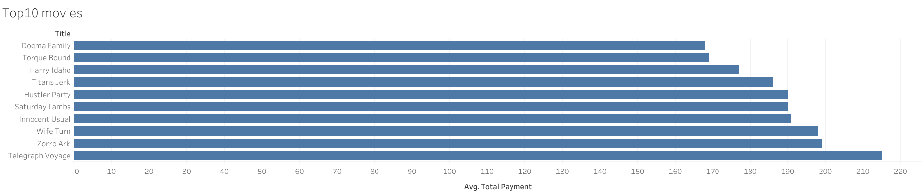
Top 10 Most Rented Movies
The movie list can give a clue on which genre is the most rented.

Slide 8
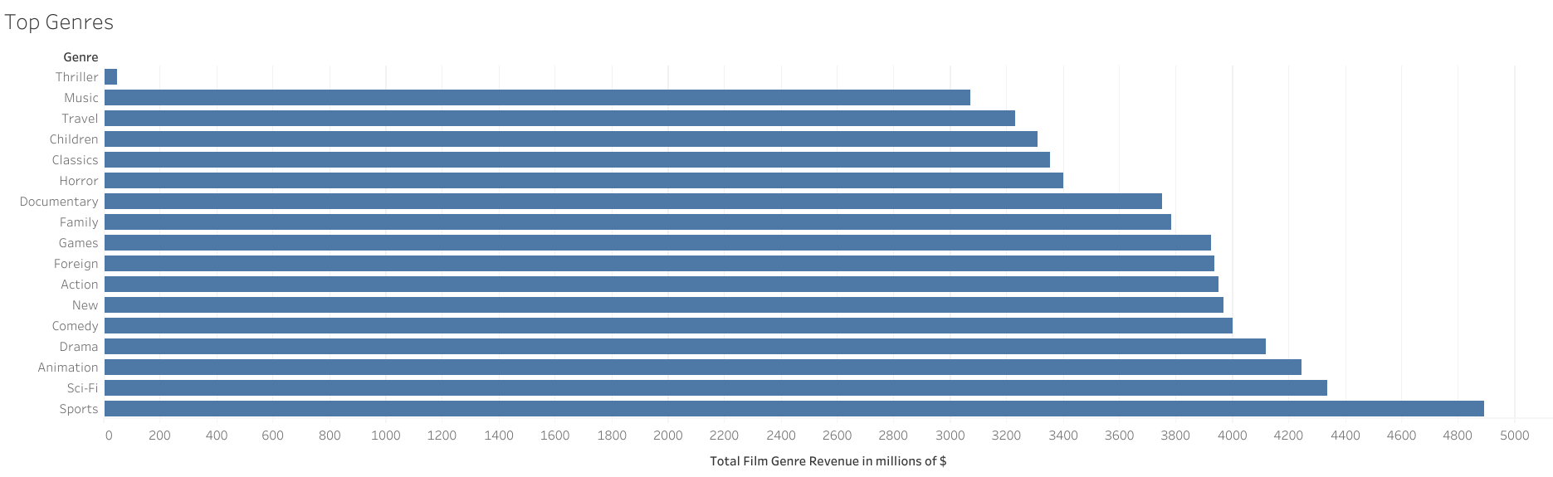
Top 10 Most Rented Genres
People still love to watch more sports themes, followed by Sci-fi and Animation.
Thriller and Music are at the bottom

Slide 9
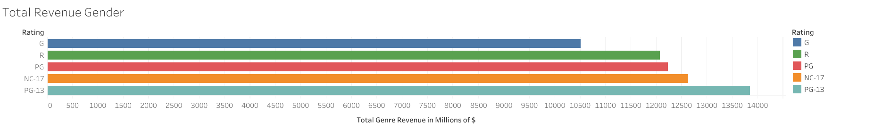
Top 10 Most Rented Rating Movies
It seems that Adults only and parent advisory genres are the most rented movies (NC-17 and Pg-13)
Total Revenue by Rating
The NC-17 and PG-13 have the most revenue by Rating

Slide 10
Recomendations
Spending on movies in the most profitable ratings and genre categories, particularly the PG-13 rating and the Sports, Sci-Fi, and Animation genres.
Consider adding more recent movies
With the international presence of Rockbuster, expand the movie collection to include also local productions
Consider also expanding the language selection. The top languages are Chinese, Hindu, Japanese, Turkish, Spanish, Indonesian, and Portuguese.
The average rental duration is 5 days.
PG-13 rated movies and movies in the Sports genre contributed the most to revenue gains
Rockbuster’s customers are located worldwide, but the 10 countries have the most customer base.

Slide 11
Thank You!
Data Dictionary, Queries, and Query Outputs are available upon request.
Link to Tableau Visualizations: Rockbuster Stealth

