Slide 1
Customer Shopping Behaviour Analysis
Transactional Data Analysis (3,900 Records)
Tools: Python, PostgreSQL, Power BI
Objective: Data-driven business insights

Slide 2
Project Objectives
Analyze customer purchase behavior
Identify spending and product preference patterns
Segment customers based on purchase history
Evaluate discount and subscription effectiveness
Support strategic business decision-making

Slide 3

Dataset Overview
Total Records: 3,900 transactions
Columns: 18 features
Key Data Areas:
  Customer demographics
  Purchase details
  Shopping behavior metrics
Missing Values: 37 in Review Rating

Slide 4
Key Features in the Dataset
Demographics: Age, Gender, Location, Subscription Status
Purchases: Product, Category, Amount, Season, Size, Color
Behavioral Data: Discounts, Purchase Frequency, Ratings, Shipping Type

Slide 5

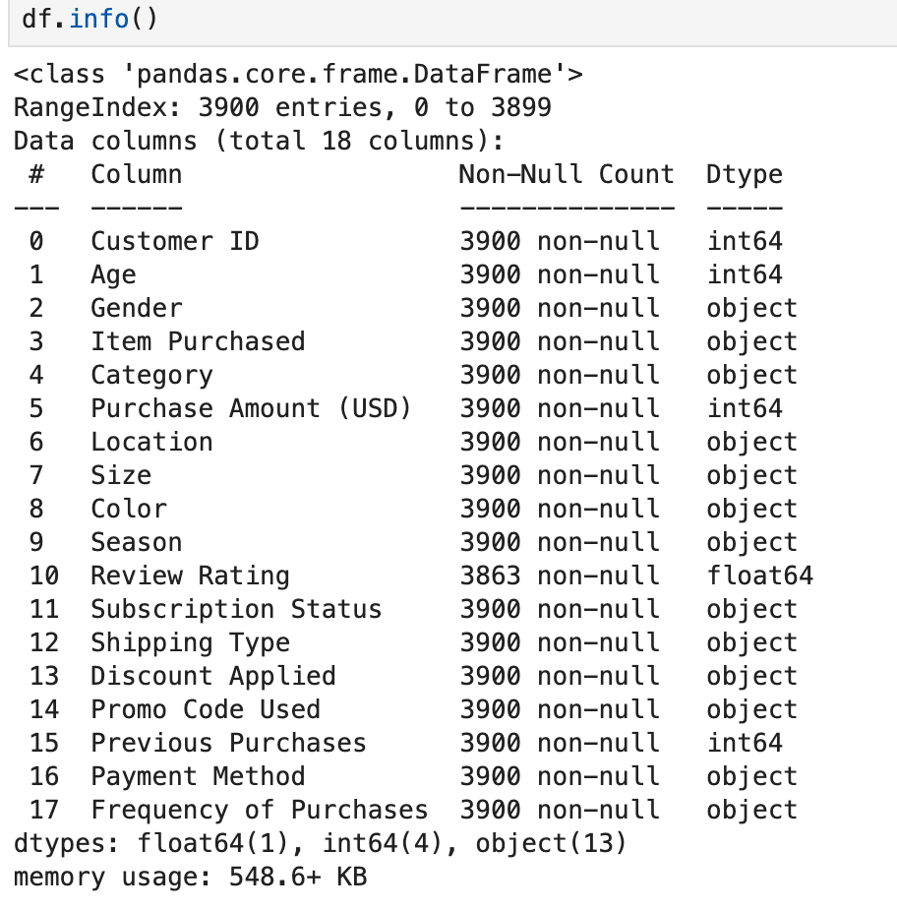
Data Preparation & Cleaning (Python)
Loaded and explored data using Pandas
Imputed missing review ratings using category median
Removed redundant promo code column
Ensured data consistency and quality

Slide 6
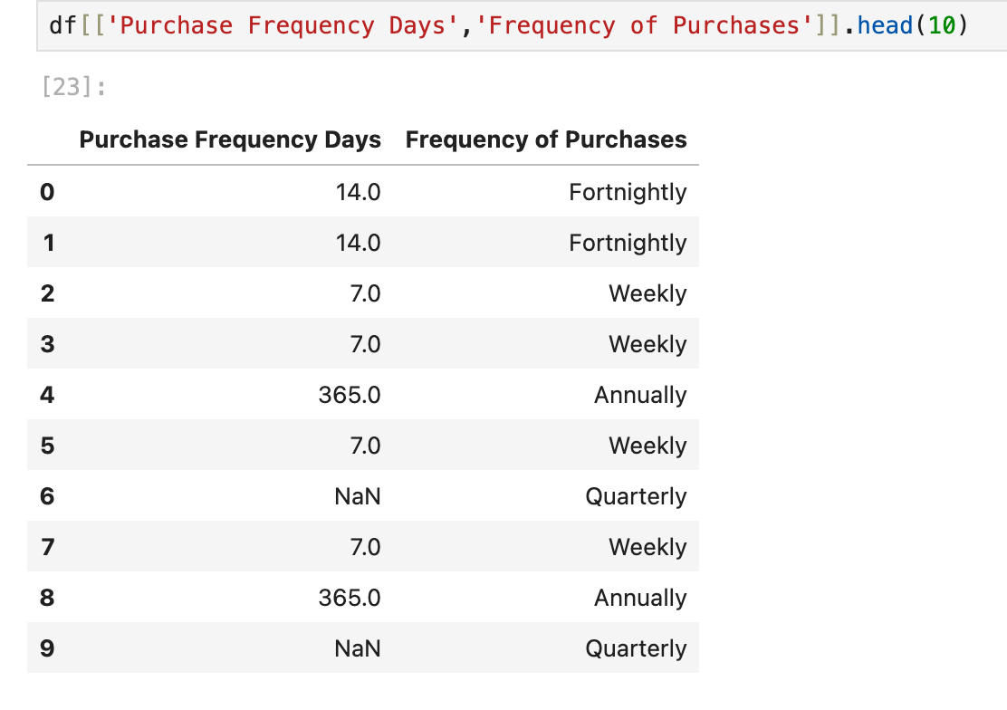
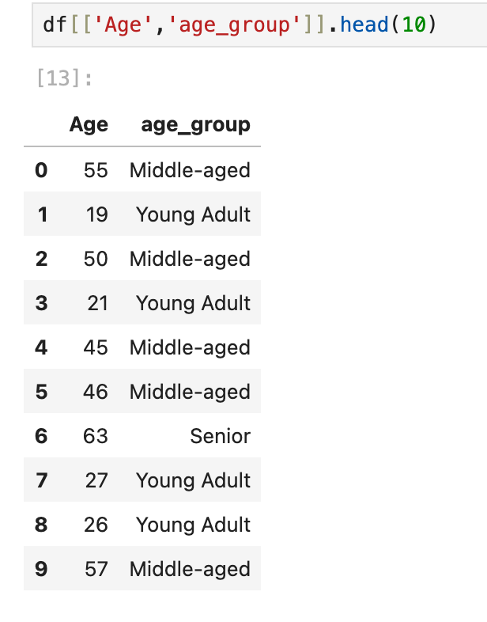
Feature Engineering
Created Age Groups for demographic analysis
Engineered Purchase Frequency (days)
Segmented customers as:
New
Returning
Loyal
Prepared data for SQL-based business analysis

Slide 7

SQL Business Analysis (PostgreSQL)
Key insights derived from SQL queries:
Revenue comparison by gender
Subscriber vs non-subscriber spending
Discount usage vs high spending
Shipping type impact on purchase value
Revenue contribution by age group

Slide 8

Product & Customer Insights
Top 5 products by average review rating
Top 3 products per category
Products highly dependent on discounts
Loyal customers more likely to subscribe
High-value customers still purchase with discounts

Slide 9
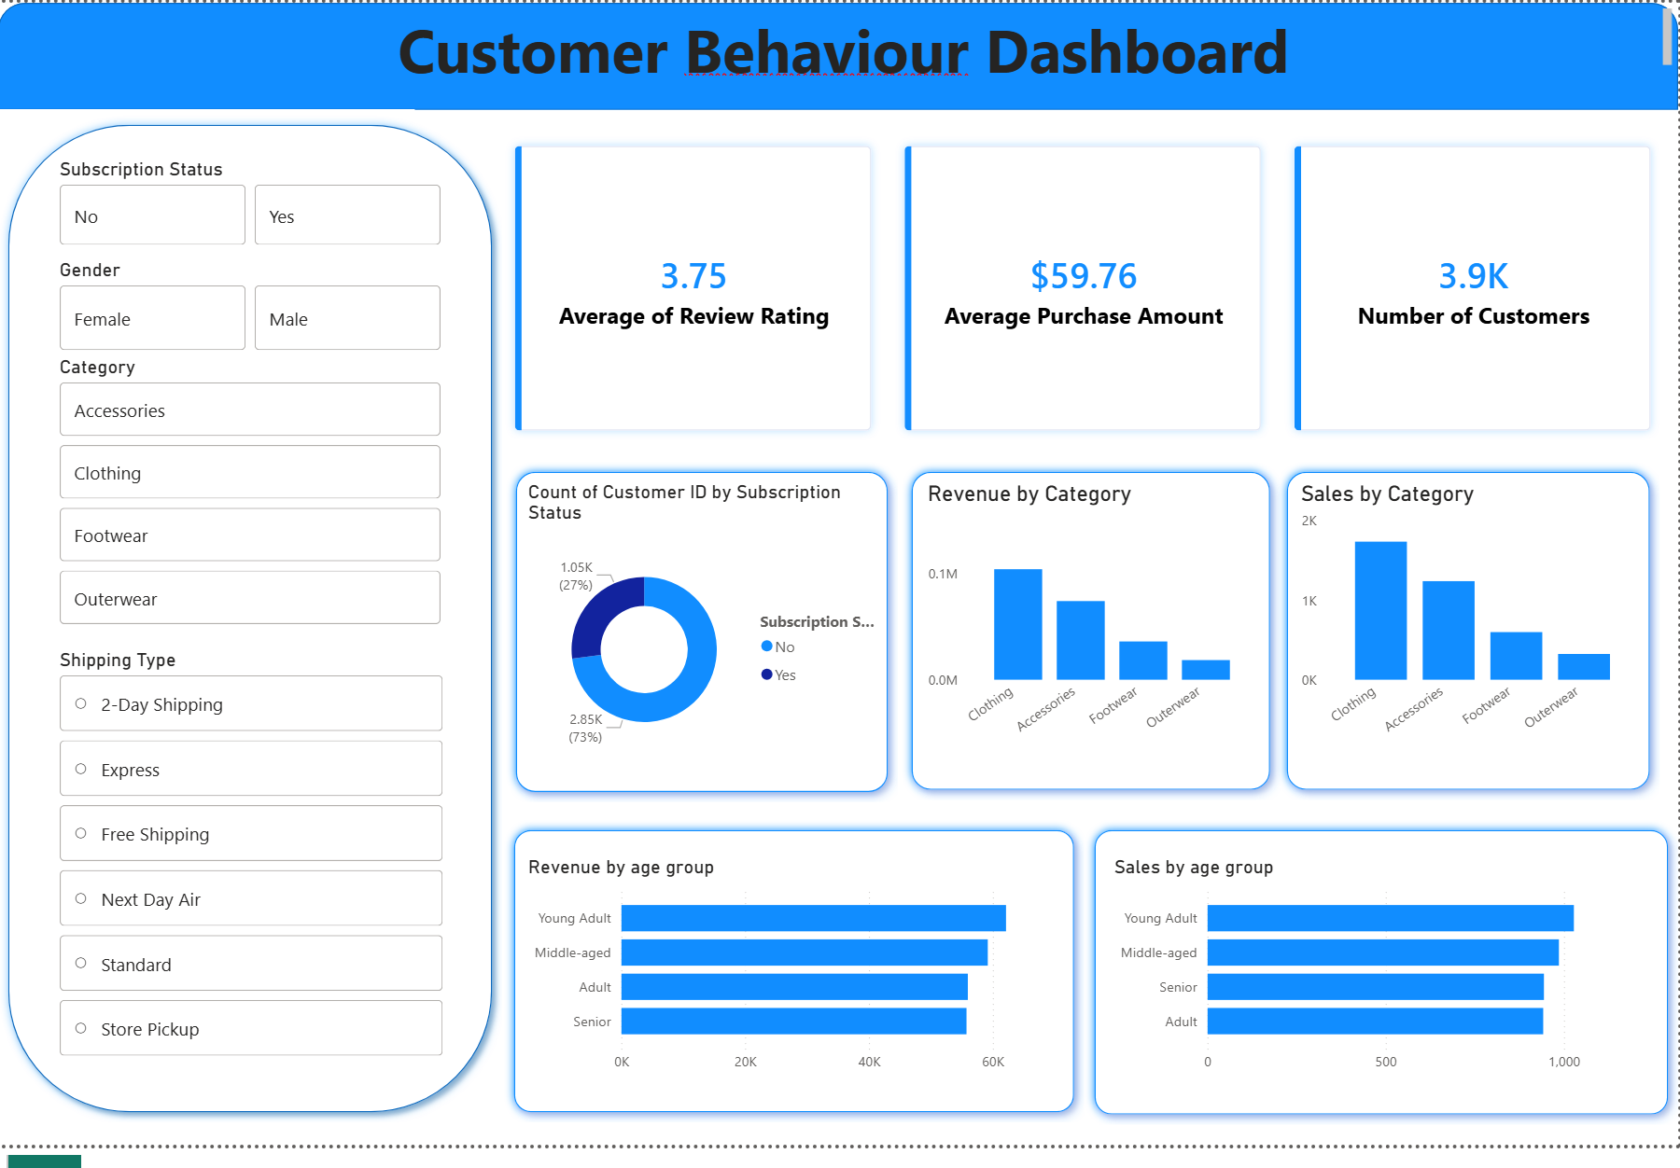
Power BI Dashboard
Interactive visualizations for:
  Revenue trends
  Customer segmentation
  Product performance
  Subscription impact
Enables real-time filtering by demographics and behaviour

Slide 10

Business Recommendations
Promote subscription-only benefits to boost sign-ups
Strengthen loyalty programs to encourage repeat purchases
Optimize discount strategies for profitability
Highlight top-rated and top-selling products
Use targeted marketing for high-revenue age groups and express shipping users

