Slide 1
Unemployment Trends around the world
How female unemployment is calculated?

Slide 2
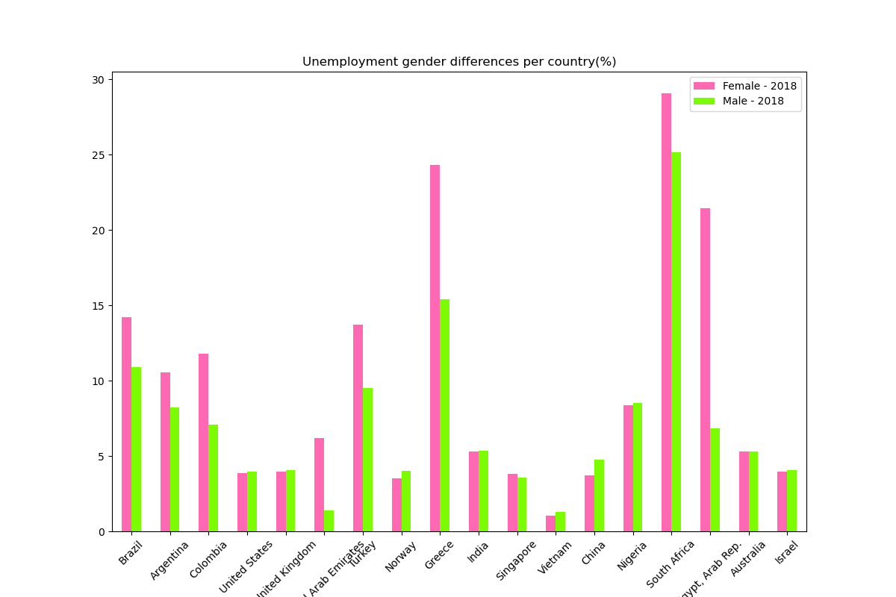

Slide 3
Discrepancies in Female Unemployment
Canada
Euro area
Egypt, Arab Rep.
Greece
India
Israel
Latin America & the Caribbean (IDA & IBRD countries)
Norway
Saudi Arabia
South Africa
South Asia
Sweden
Turkey
United States

