Slide 1
Analysis Of Call Trends By Kehinde Adebisi

Slide 2
iNTRODUCTION
In a bid to improve the services of a call center, this analysis was carried to to investigate the trends and the agents’ performance

Slide 3
Key Performance Indicators (KPIs)
Overall customer satisfaction
Overall calls answered/abandoned
Calls by time
Average speed of answer
Agent’s performance quadrant -> average handle time (talk duration) vs calls answered

Slide 4

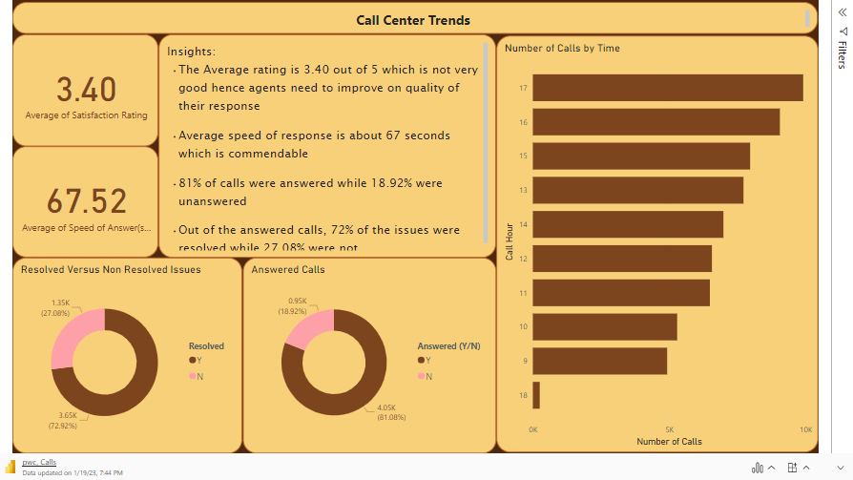

Slide 5

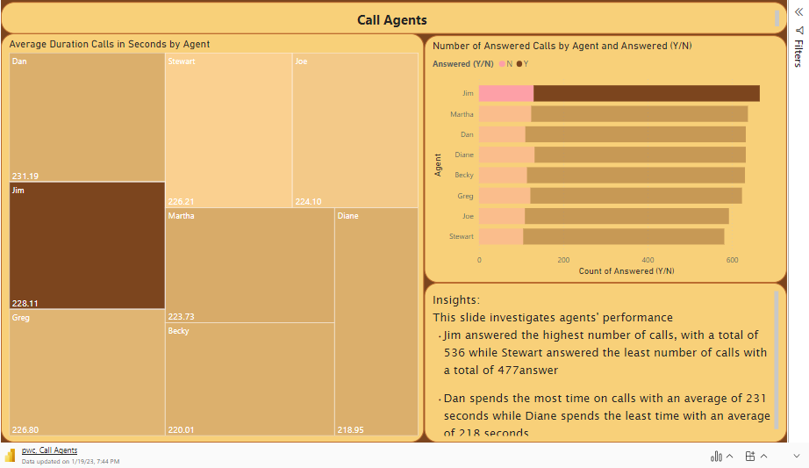
Relaunch the add-in
After you install the add-in, you can launch it by choosing the add-in button on the Insert tab
On the Insert tab
Insert
My Add-ins
Need more help?
Return to your internet browser or copy this link into your browser:
https://pages.store.office.com/addinsinstallpage.aspx?rs=en-US&assetid=WA200003233&isWac=True&ui=en-US&ad=US

Slide 6
Recommendations
Although the rates of answering calls, and efficiency of agents are relatively good, however customers do not seem very satisfied as the ratings are just above average.
Finding out from the horses’ mouth through questionnaires or prompts will help improve the services
Also, assigning more agents at 18hrs as this seems to be the busiest hour will reduce the number of unanswered calls

