Slide 1
Automating Financial Statements in Power BI
By
Kehinde Adebisi

Slide 2
Problem Statement
A firm is collecting a lot of data and producing more reports than it used to. As a result, the team spends so much time on manual work each month to get these reports out and seem to get different answers every time.
Solution:
Automating the report creation process by using Power Bi instead of spreadsheets
Ensuring there is just one version of truth by creating a time stamp that updates each time there is an update
Simple Visualizations for Quick Insights

Slide 3

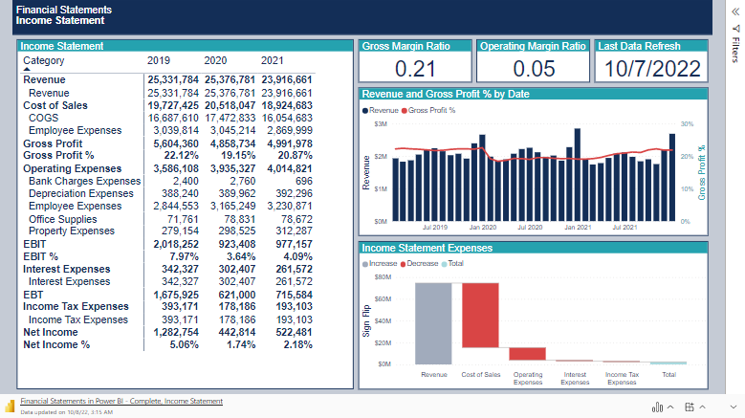

Slide 4

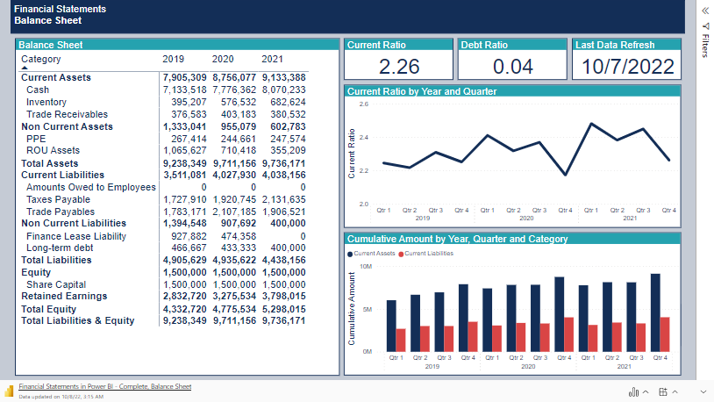
Relaunch the add-in
After you install the add-in, you can launch it by choosing the add-in button on the Insert tab
On the Insert tab
Insert
My Add-ins
Need more help?
Return to your internet browser or copy this link into your browser:
https://pages.store.office.com/addinsinstallpage.aspx?rs=en-US&assetid=WA200003233&isWac=True&ui=en-US&ad=US

Slide 5
Conclusion
Financial Statements are a crucial part of every organization. However, the constant need to update the values as the organization runs can prove difficult and easily result in errors which can lead to poor decision-making with the potential to cause a huge loss for organizations.
Automating the process of generating the reports will ensure the company can focus on adding value, rather than creating reports while improving data integrity
View SQL Script used to extract data

