Slide 1

Riby Case Study by Kehinde Adebisi

Slide 2
Introduction
About Riby
Riby is a FinTech company that automates Cooperatives. The company offers financial management services for cooperatives and their members. Partnering with banks and payment service providers, the firm gives its customers channels for near cash experiences (Easy savings and lending system) and more money.
The Case
Riby currently works with a large e-commerce company in the United States. The firm, over the years, has done billions of dollars worth of transactions but there is a need to prioritize its investments across different regions. Portfolio managers and regional managers have different (and sometimes contradictory) opinions on which regions should receive which preference.
The team has been saddled with the responsibility to use data to help influence the decision of the top leadership on the firm. A 500,000 data set of previous transactions which represent orders across different regions has been provided for analytics and intelligence.

Slide 3

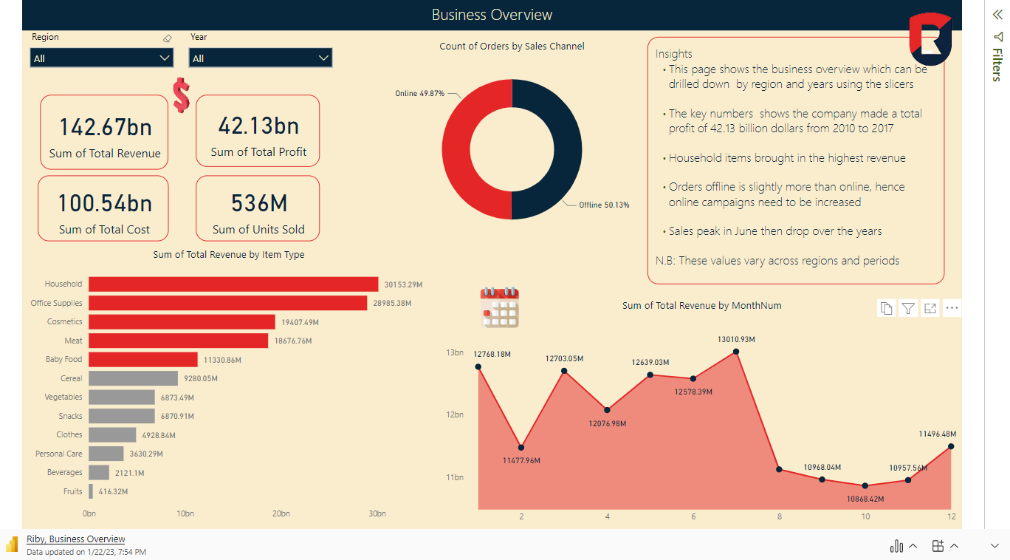
Microsoft Power BI

Slide 4

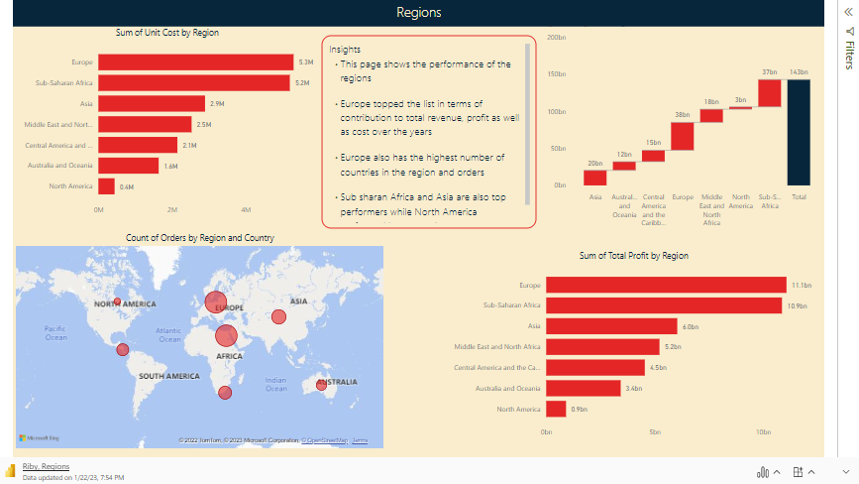
Relaunch the add-in
Microsoft Power BI
After you install the add-in, you can launch it by choosing the add-in button on the Insert tab
On the Insert tab
Insert
My Add-ins
Need more help?
Return to your internet browser or copy this link into your browser:
https://pages.store.office.com/addinsinstallpage.aspx?rs=en-US&assetid=WA200003233&isWac=True&ui=en-US&ad=US

Slide 5
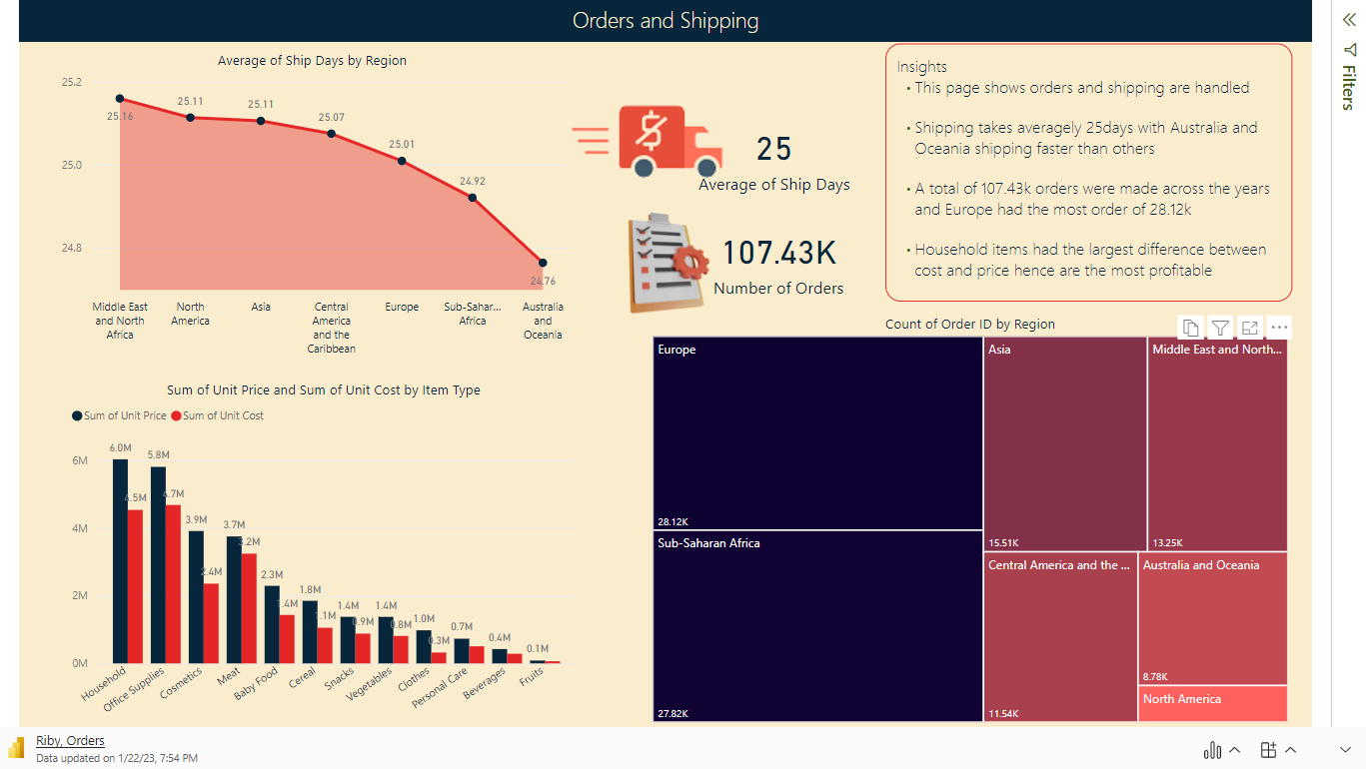

Slide 6
Recommendations
Online marketing campaign should be carried out to improve the orders from 49% to at least 60% as particularly in North America as wider reach is possible this way
Discounts should be offered in months when sales reduce like July to attract customers
Complementary items with high sales like household items should be paired with low sales with subsidized prices to boost low performing products
Low-performing regions have the least number of countries hence improved outlets in countries including online campaigns in Australia, Oceania, etc. will boost sales tremendously
Europe and Sub-saharan performed top across all indices apart from order processing reward systems probably due to their high population, Reward for Referrals will further boost sales in these regions
Reduction of the number of days it takes to process orders, especially in the Middle east and North Africa as well as the other regions

Slide 7
Conclusion
In Conclusion, Although, Europe and Sub-Saharan Africa should be given priority as they contribute over 50% of the company’s income and profit, other regions also have untapped opportunities like the online market. Also, the Shipping time should be reduced across all regions particularly Middle East and North Africa. Discounts, Referral Rewards, and Complementary Offers will further boost sales in both low and high-performing regions

