Slide 1
Power System Fault Detection and Classification
CAPSTONE PROJECT
Presented By:
Saurya Sircar-Jadavpur University-Electrical Engineering

Slide 2
OUTLINE
Problem Statement (Should not include solution)
Proposed System/Solution
System Development Approach (Technology Used)
Algorithm & Deployment
Result (Output Image)
Conclusion
Future Scope
References

Slide 3
Problem Statement
Stable power systems are a vital part of a modern society, and swift maintenance of faults is paramount for ensuring reliability.
Traditional fault detection relies on analog instruments and manual monitoring, which leads to increased response times, and using an automated system to identify faults based on electrical parameters can lead to faster resolutions.

Slide 4
Proposed Solution
An Artificial Neural Network can be leveraged to identify and classify faults based on the available electrical parameters (Voltage and Current)
Artificial neural networks offer excellent generalization capabilities and immunity to noise, which reduces the impact of variations in power system parameters
Accuracy and fast execution times are prioritized, to ensure reliable and timely detection of faults

Slide 5
Data Gathering and Preprocessing
For the purposes of this model, a generated through a MATLAB simulation of transmission lines under normal and fault conditions
https://www.kaggle.com/datasets/esathyaprakash/electrical-fault-detection-and-classification
The dataset contains LG fault only with phase A, LL faults only between phase B and C, and LLG faults only with phases A and B. This is a major roadblock for real-world viability, but serves as an appropriate training set for a proof of concept.
The first four columns [G, C, B, A] contain binary values that denote whether each phase is part of a fault
These columns are replaced with a “Fault Type” column programmatically using a python script, which shall act as labels for classification.
Github link for data preprocessing: https://github.com/Kei74/ibm-cloud-project

Slide 6
System Approach
IBM Cloud’s Watsonx.ai Studio is utilized to test algorithms and train the model
Watsonx.ai Runtime is used as hardware for training and testing,
IBM Cloud Pak for Data is used to conduct the AutoAI experiment for selecting, training and testing the algorithm through a no-code approach

Slide 7
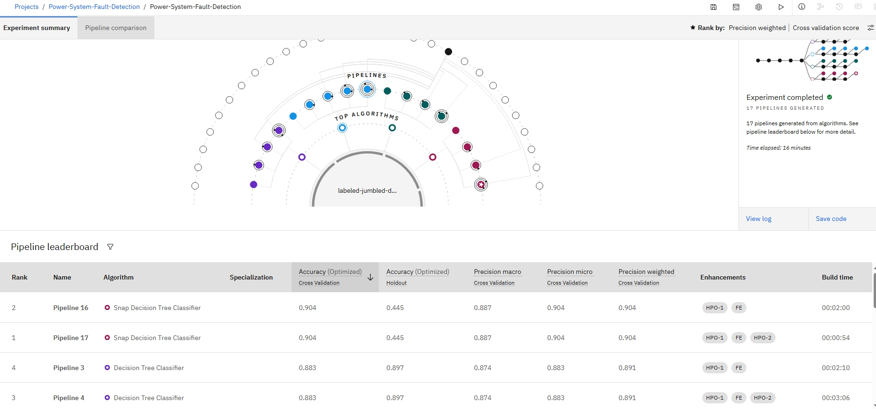
Algorithm & Deployment
The AutoAI experiment’s results are used to select the algorithm;

Slide 8
Algorithm & Deployment
Algorithm Selection:
Accuracy is the primary priority, and Snap Decision Tree Classifier appears to have the highest accuracy score
However the poor accuracy vs holdout data indicates overfitting
Hence Decision Tree Classifier is chosen as the algorithm
Training method
Since Pipeline 3 offers identical accuracy to pipeline 4 at a lower build time, it is selected as the training pipeline, with the enhancements of Feature Engineering and 1st hyperparameter optimization

Slide 9
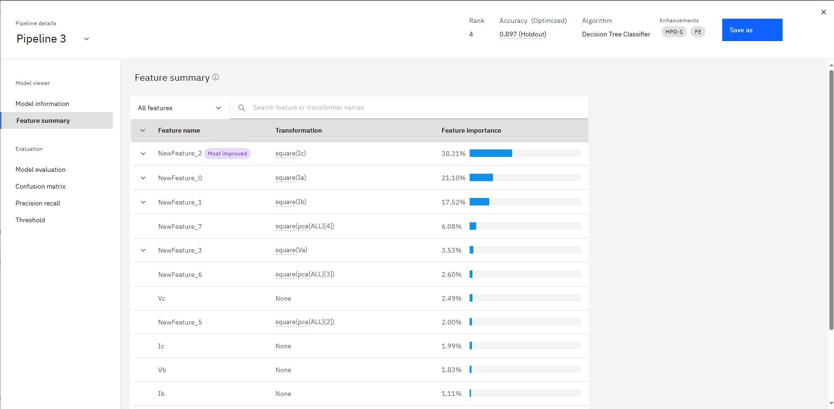
Algorithm & Deployment
Feature Summary:
As seen below, the more important features are identified as the square of Currents, which are directly correlated with the absolute values of the currents which are the primary parameter for detecting line faults through traditional means
Thus, the model allows for detection and classification of faults based on measured electrical parameters

Slide 10
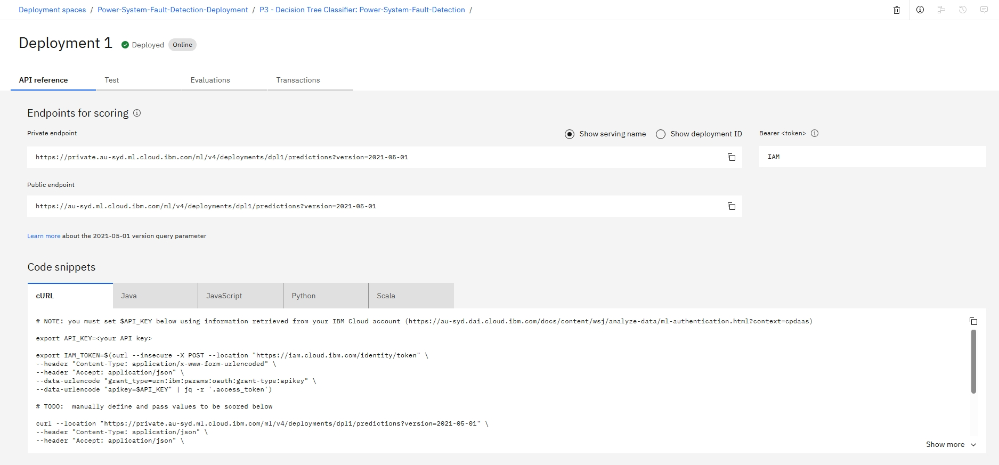
Algorithm & Deployment
Deployment
The model is saved as a watsonx.ai Runtime model asset, and promoted to a newly created deployment space
A new deployment is then created for the model
Public Endpoint: https://au-syd.ml.cloud.ibm.com/ml/v4/deployments/dpl1/predictions?version=2021-05-01
API Key: pfcv1TZzZcD3E066ohHuRwHhu_DZwamQV6FcJnL3okBV

Slide 11
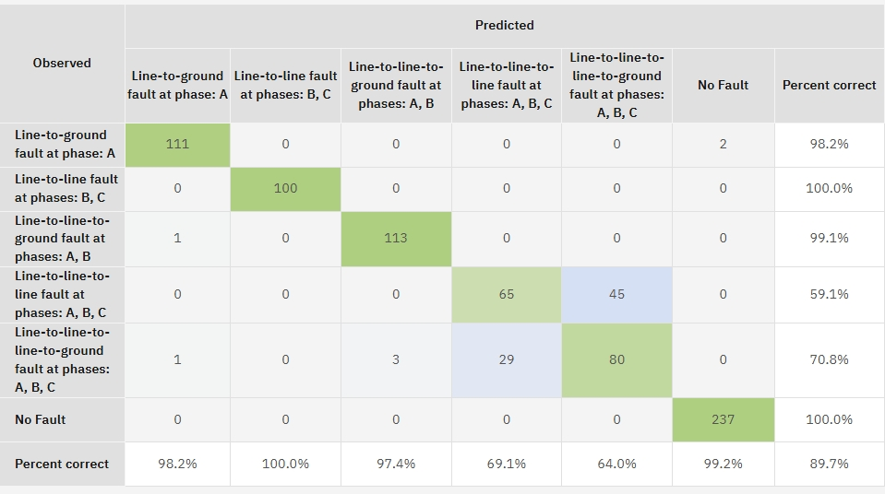
Result
As seen below from the confusion matrix, the model has >98% accuracy for labels other than three-phase faults, and only has a low accuracy for distinguishing between LLL and LLLG faults.

Slide 12
Conclusion
The model is able to classify between single line, line-to-line and three-phase faults with >98% accuracy
Limitations:
Classification between LLL and LLLG faults is not accurate
Workaround: This can be compensated for using specialized analog instruments such as GFRs (Ground Fault Relays)
The model is trained with a dataset not containing faults between phases A & B or between phases A & C, or single line faults with either B or C
Workaround: Given the model was observed to have very high precision, it might be possible to train and utilize three separate models together in parallel, specialized for each phase, in order to ensure coverage of all forms of line faults.

Slide 13
Future scope
Three Phase extension:
The current model is specialized for detecting LG faults for Phase A and LL faults between phases B and C
Given availability of training data including faults between other phases, the model can be extended to allow prediction of LG and LL faults between all 3 phases
Line Breakage and Transformer Fault:
The current model is specialized for predicting line-line or line-ground faults
Line breakage and Transformer failures can also be incorporated given sufficient training data
Incorporation of weather and maintenance data:
Rough weather conditions and poor maintenance frequency can contribute to faults, which are real-time datapoints that can be incorporated into the prediction model

Slide 14
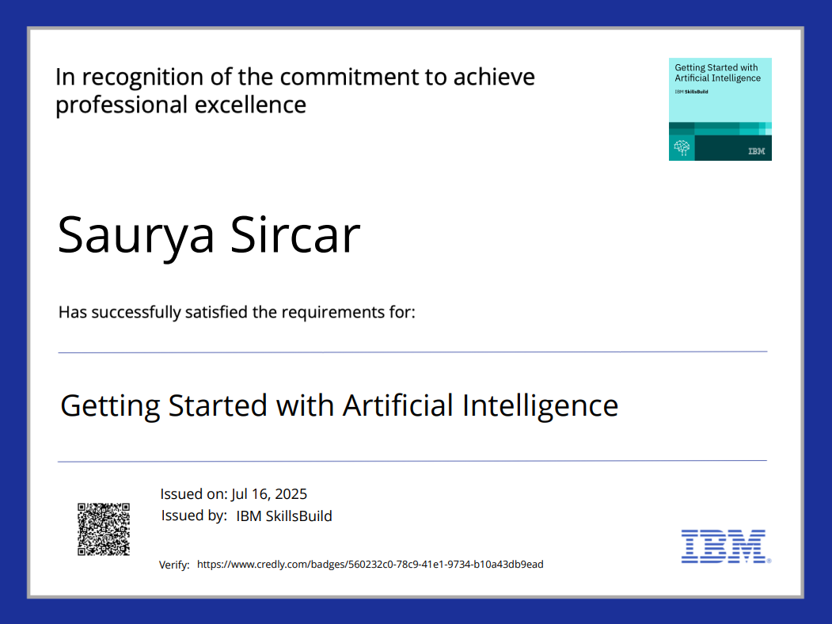
IBM Certifications

Slide 15
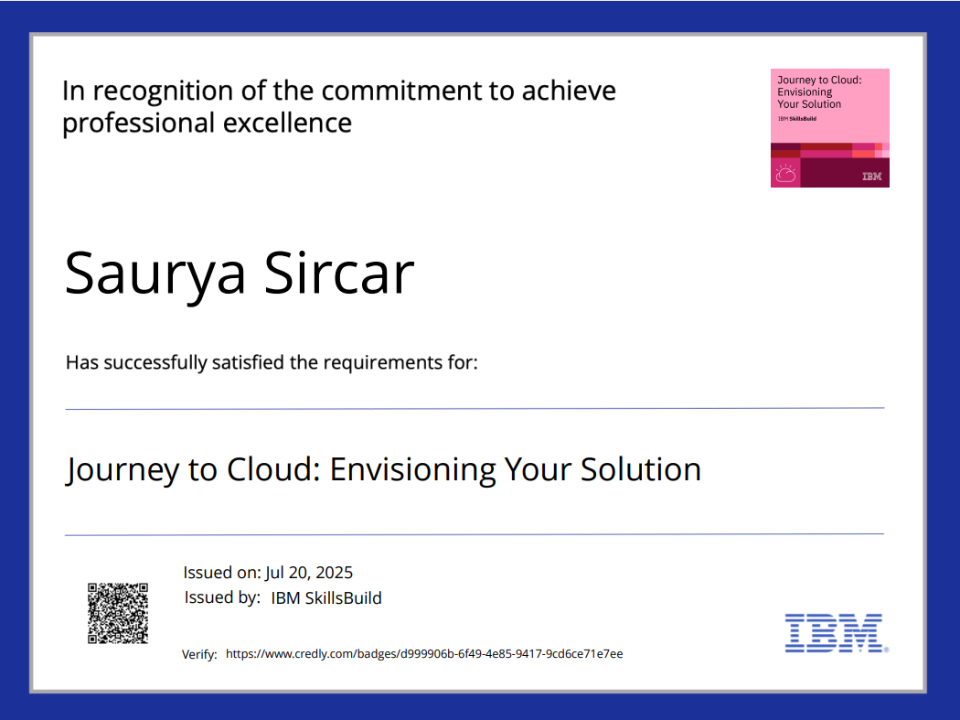
IBM Certifications

Slide 16
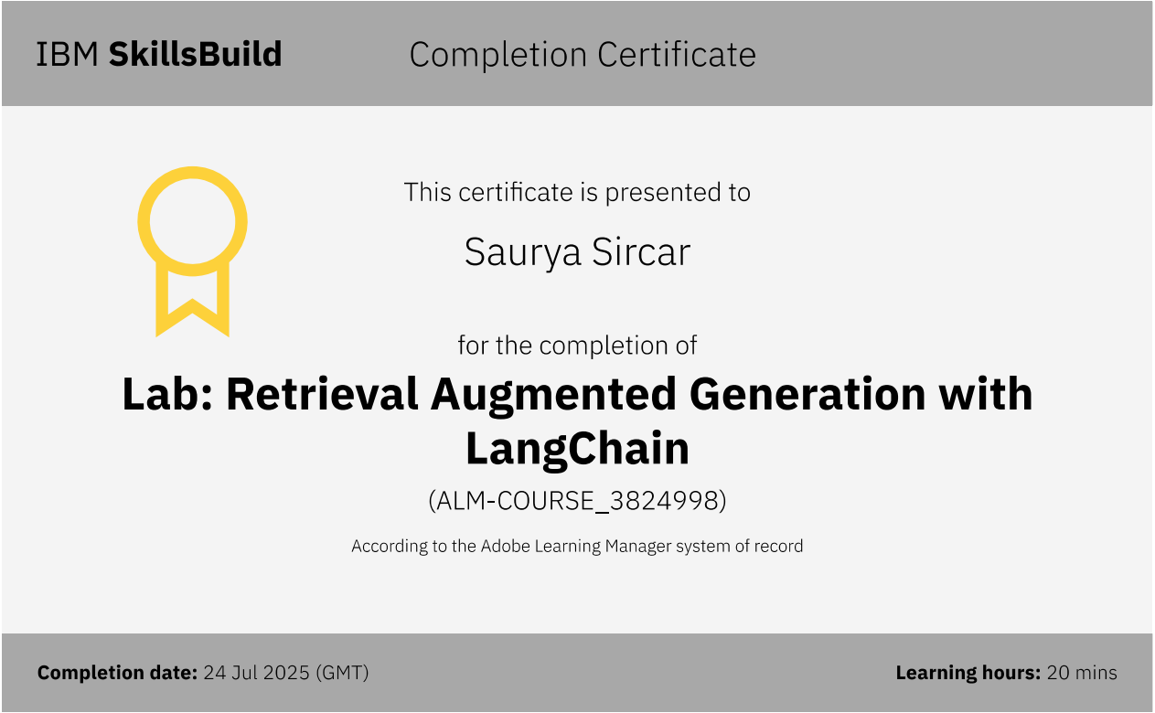
IBM Certifications

Slide 17
THANK YOU

