Slide 1
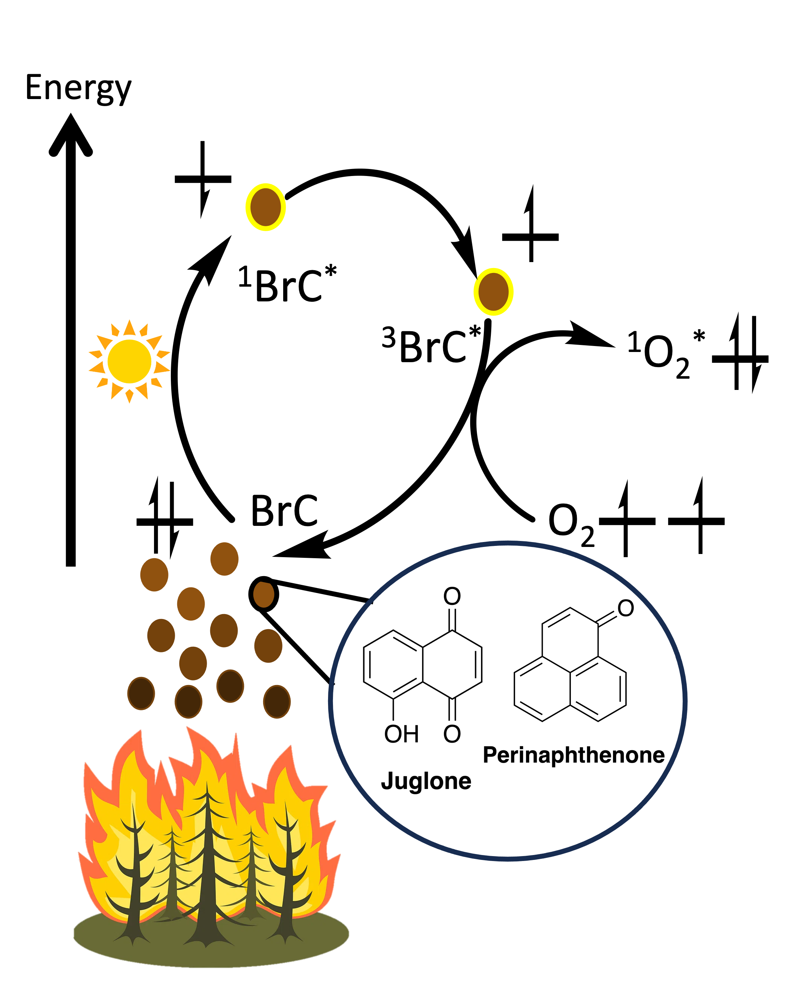
Why These Photosensitizers?
Quinones (Juglone) are associated with BrC formation (Manfrin et al., ES&T, 2019)
Perinaphthenone (PN) is a well studied sensitizer and is atmospherically relevant (Samburova et al., Sci. Total Environ., 2016 ; Schmidt et al., J. Photochem. Photobiol. A: Chem., 1994)
Notes:
Mention terms:
- photosensitizer or sensitizer is BrC
- Triplet state is 3BrC

Slide 2




Predicting ¹O₂* Generation
Recipe to make a lot of ¹O₂*:
Low excited triplet state energy, E_{T} (Gollnick et al., Ann. N. Y. Acad. Sci., 1970)
Low excited state reduction potential E^{o*} (Schweitzer et al., J. Phys. Chem. A, 2003)
$π$ ---> $π$* orbital transition (Darmanyan et al., J. Phys. Chem., 1993)

Slide 3
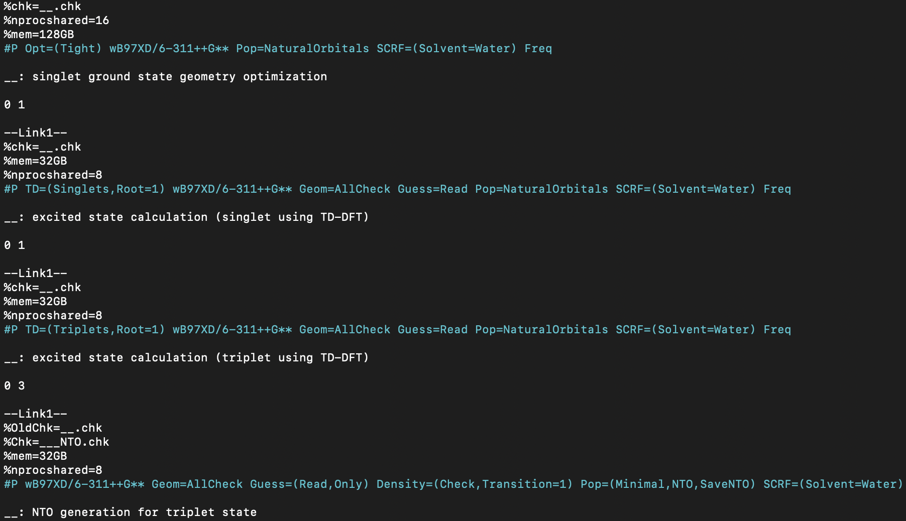
What does a TDDFT input file look like?
1. Optimize ground state geometry (S₀)
Molecule cartesian coordinates (x,y,z) go here
2. Calculate first Singlet excited state (E_{S1})
Indicates charge and spin multiplicity
3. Calculate Triplet excited state (E_{T1})
4. Generate natural transition orbitals for visualization

Slide 4
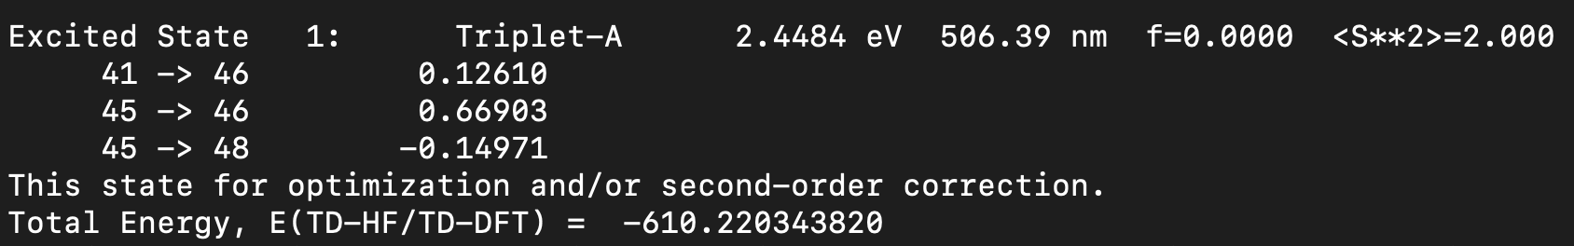
What does a TDDFT Output file look like?
Spin Multiplicity
S₀ ---> T₁ Excitation Energy
Coefficients of the wavefunction for each excitation
Orbitals Excited
From → To
Coefficients indicate strength of the transition and help determine the type of orbital transition
Largest coefficient means higher contribution to the overall transition

Slide 5
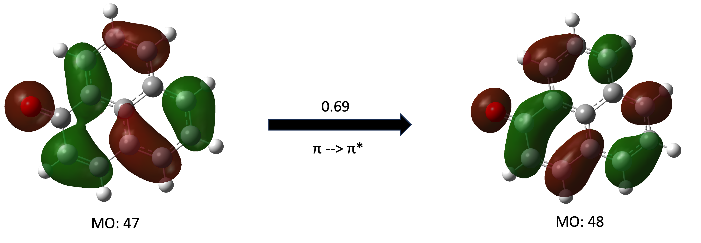
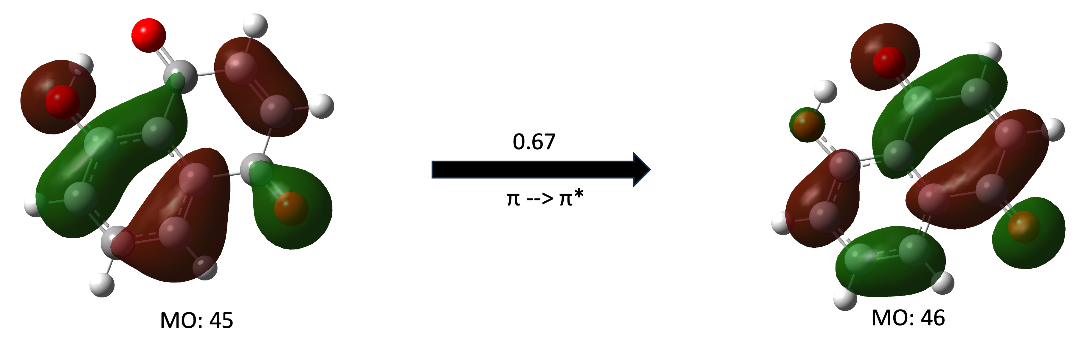
Juglone and Perinaphthenone Orbitals
Perinaphthenone
Juglone

