Slide 1
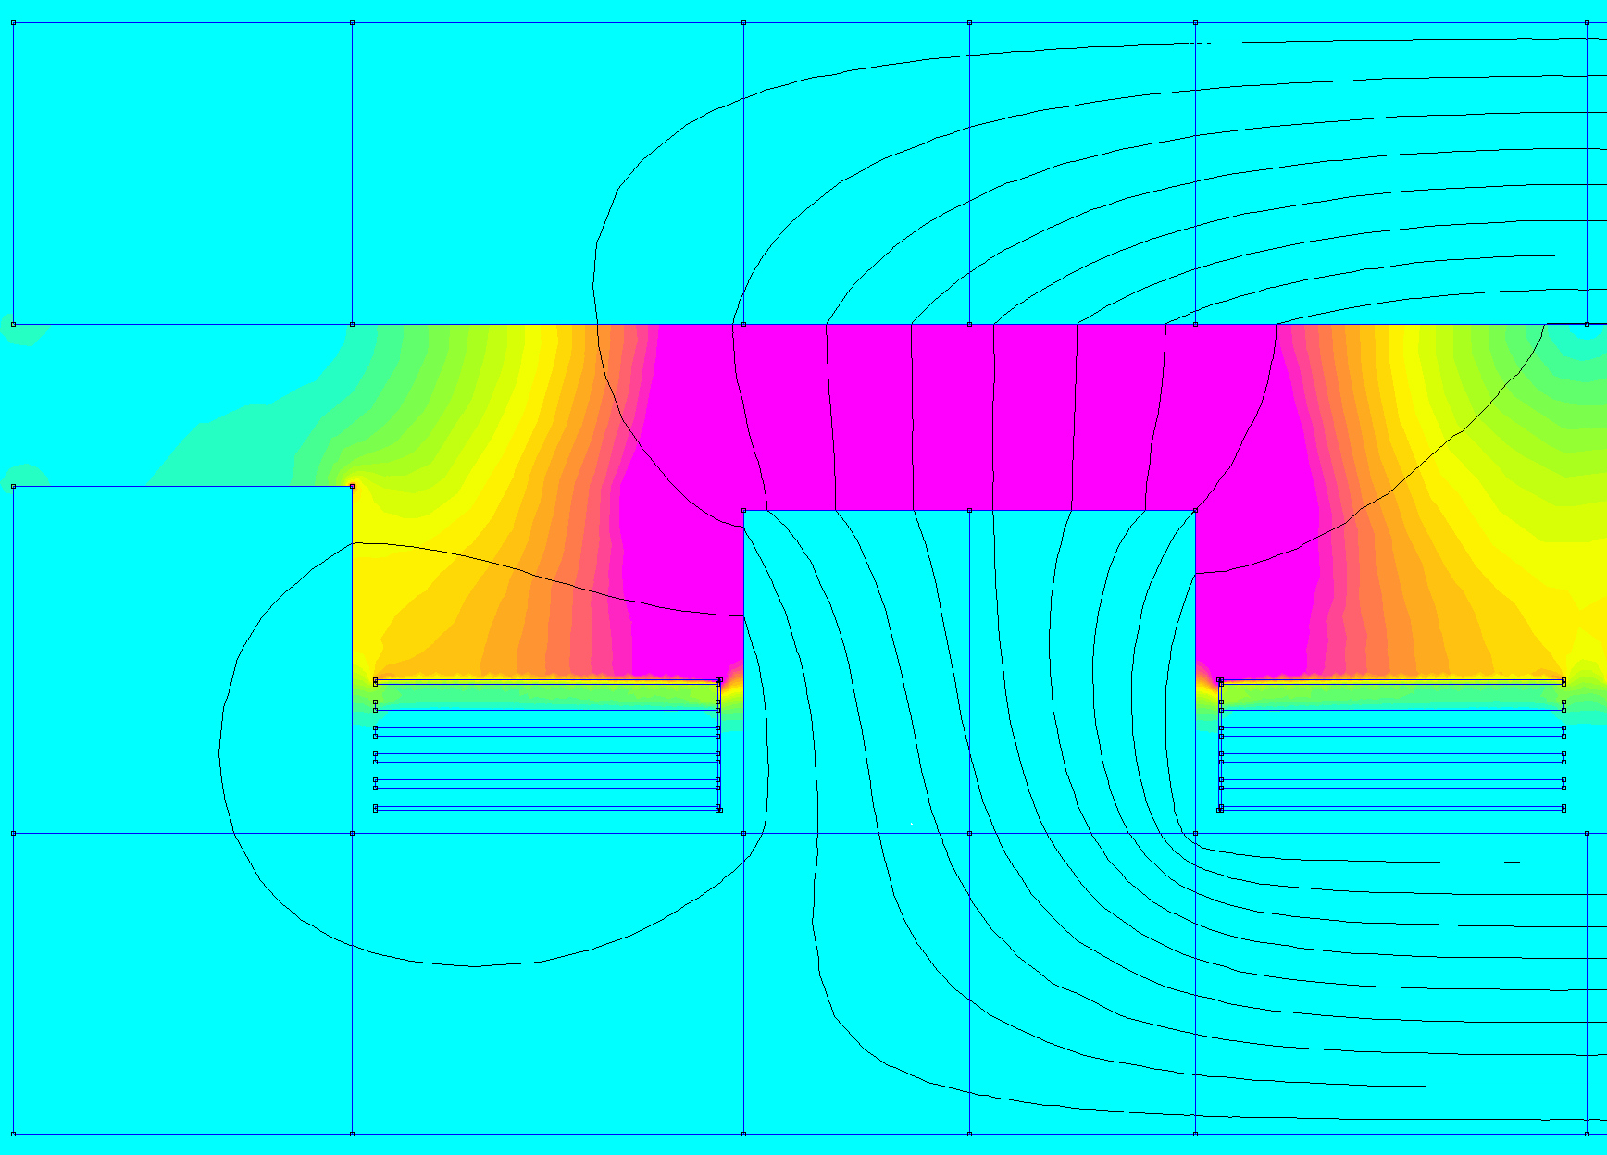

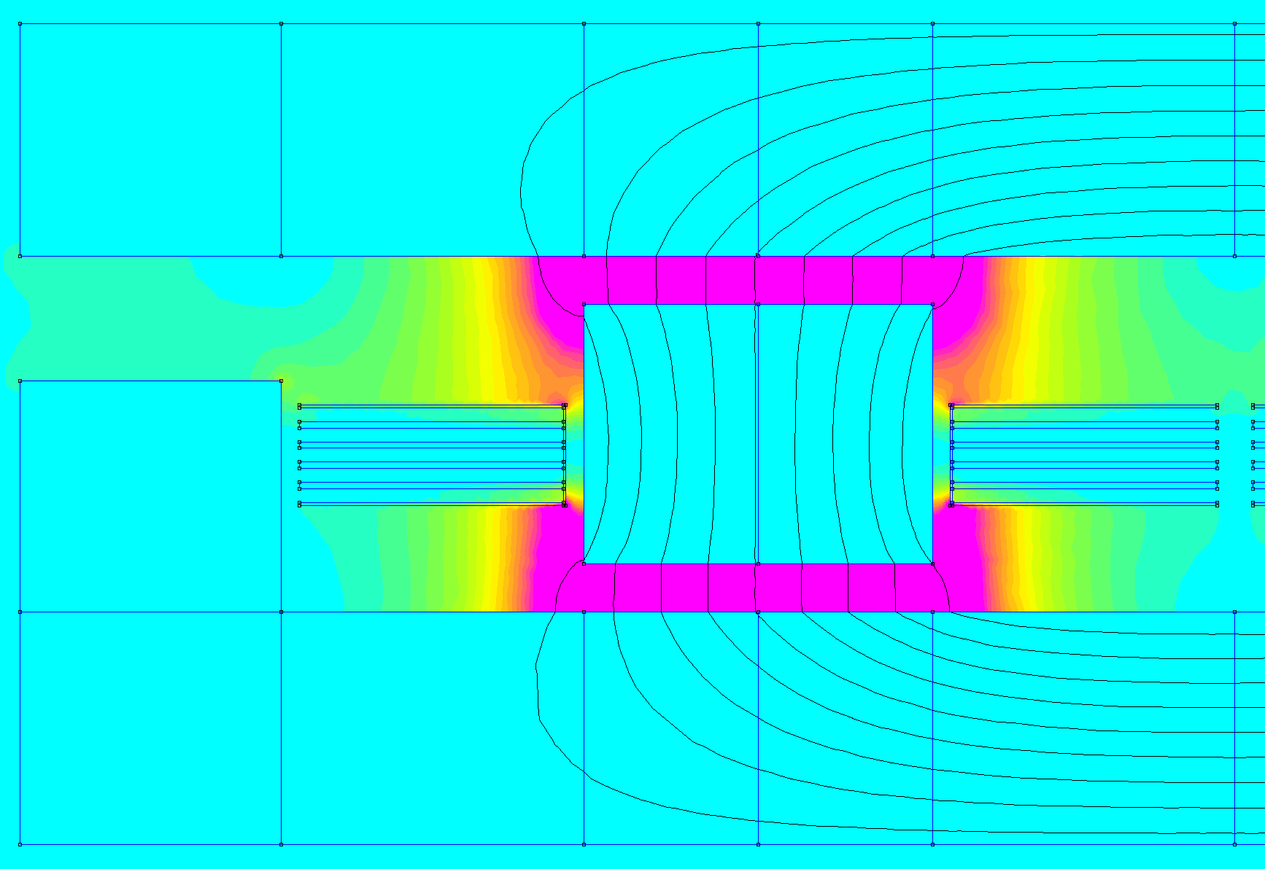

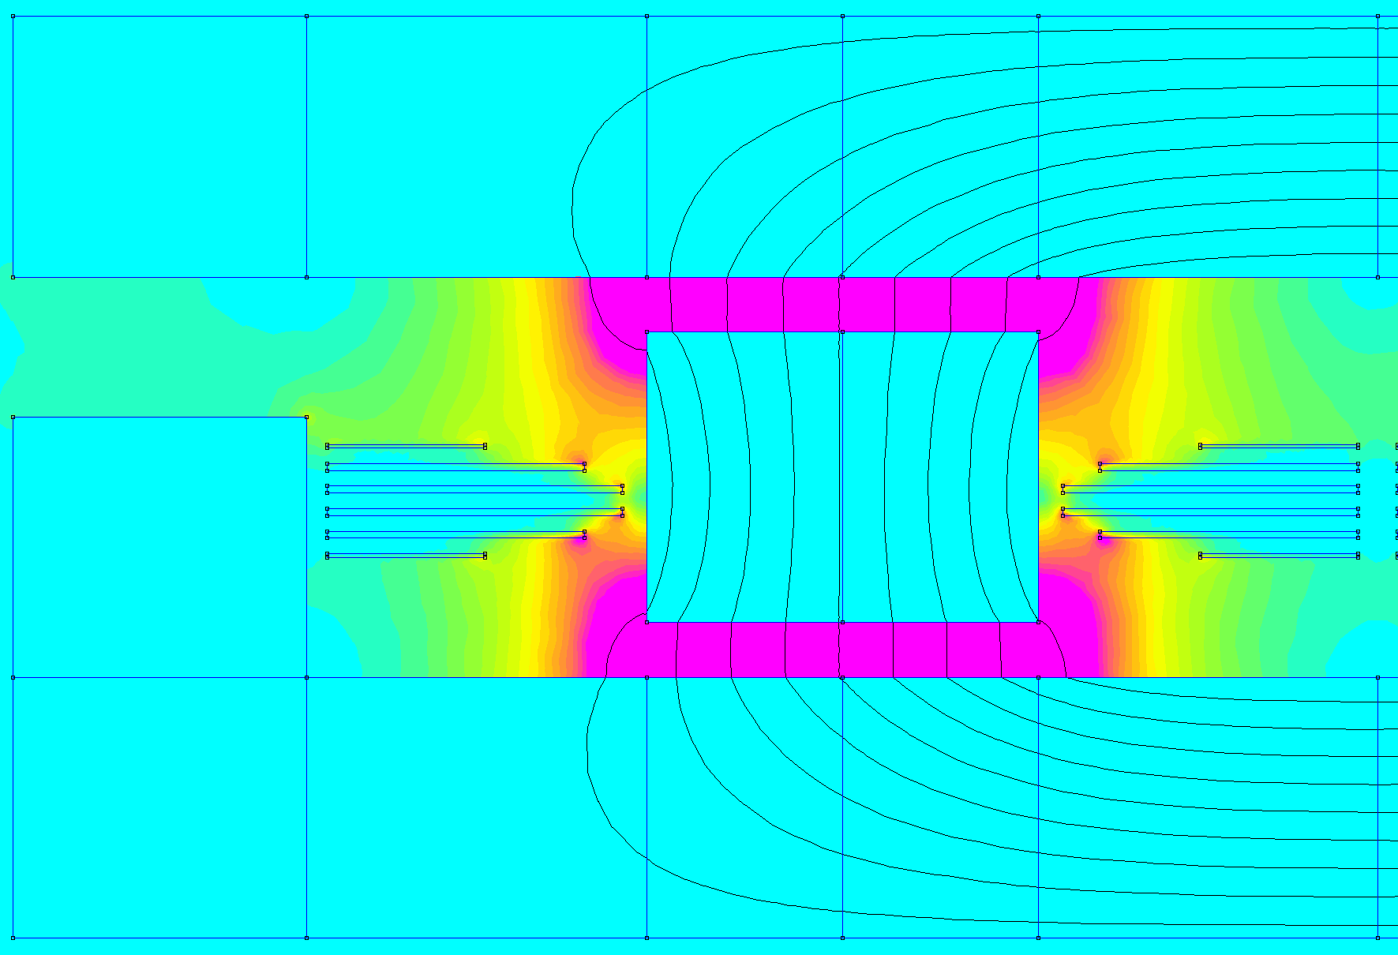

(a) Air-Gap at the top
(b) Air-Gap on top and bottom
(c) Air-Gap on top and bottom with optimized windings
0 |  | 2 |  | 4 |  | 6 |  | 8 |  | 10
0 |  | 60 |  | 120 |  | 180 |  | 240 |  | 300
H [A/mm]
J [A/mm²]

