Slide 1
(a) Double-PQ with Dual Air Gap
(b) Four-Pole with Dual Air Gap
(c) Modified EE
(d) Vertical Gap
Additional Air Gap

Slide 2
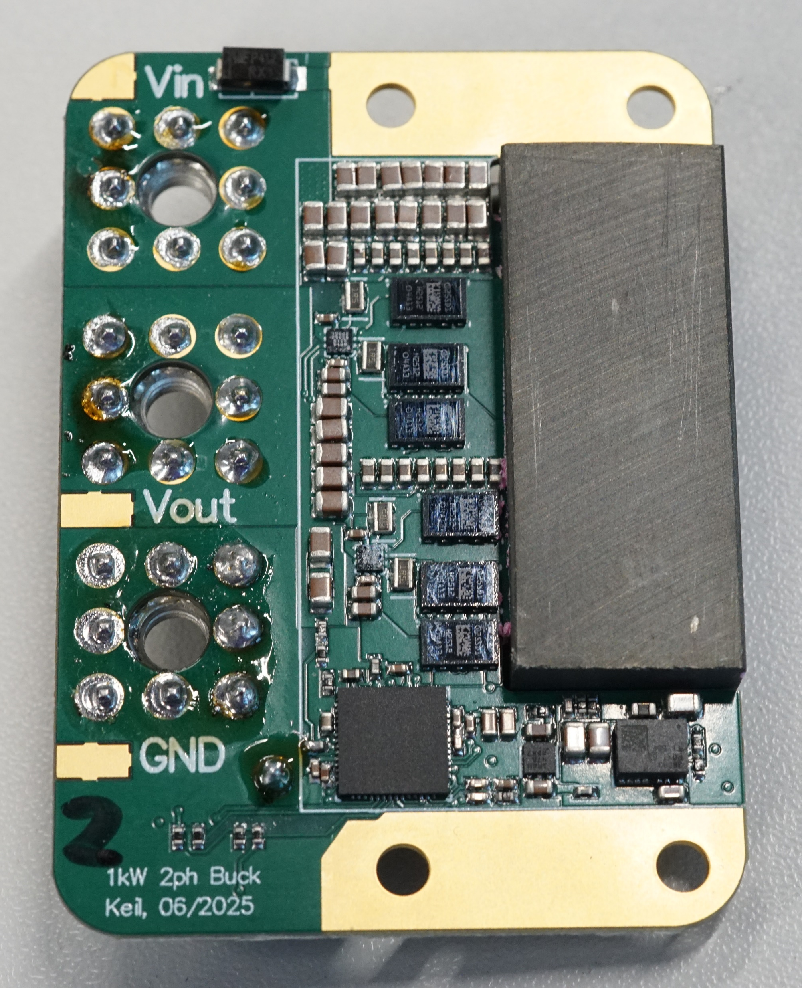
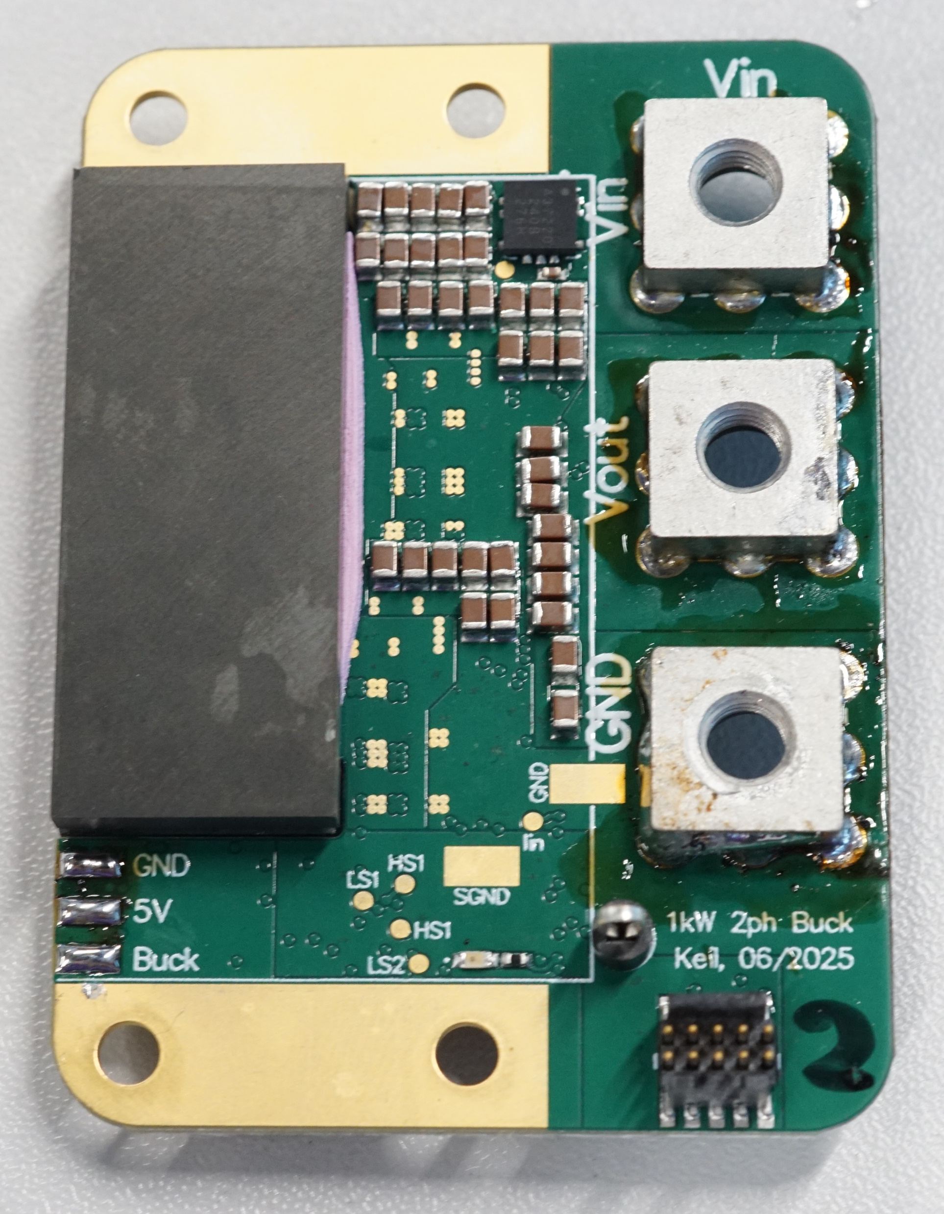
45 mm
29 mm

Slide 3
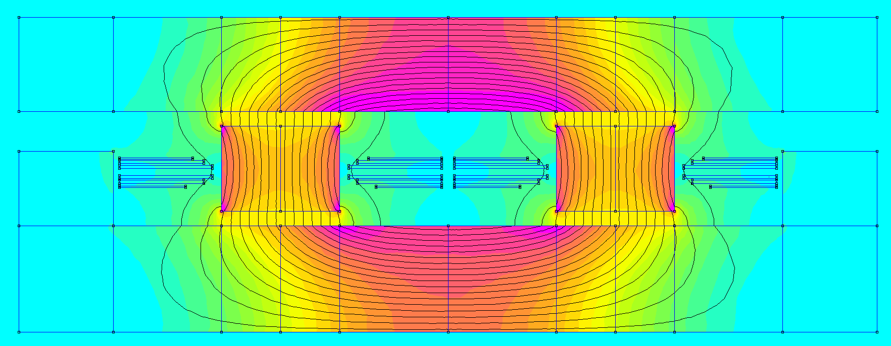
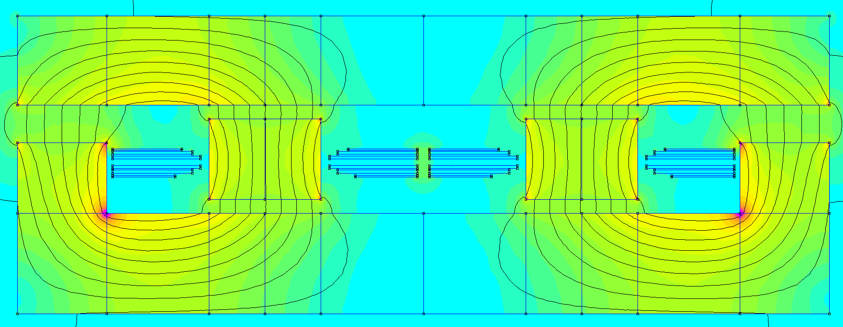
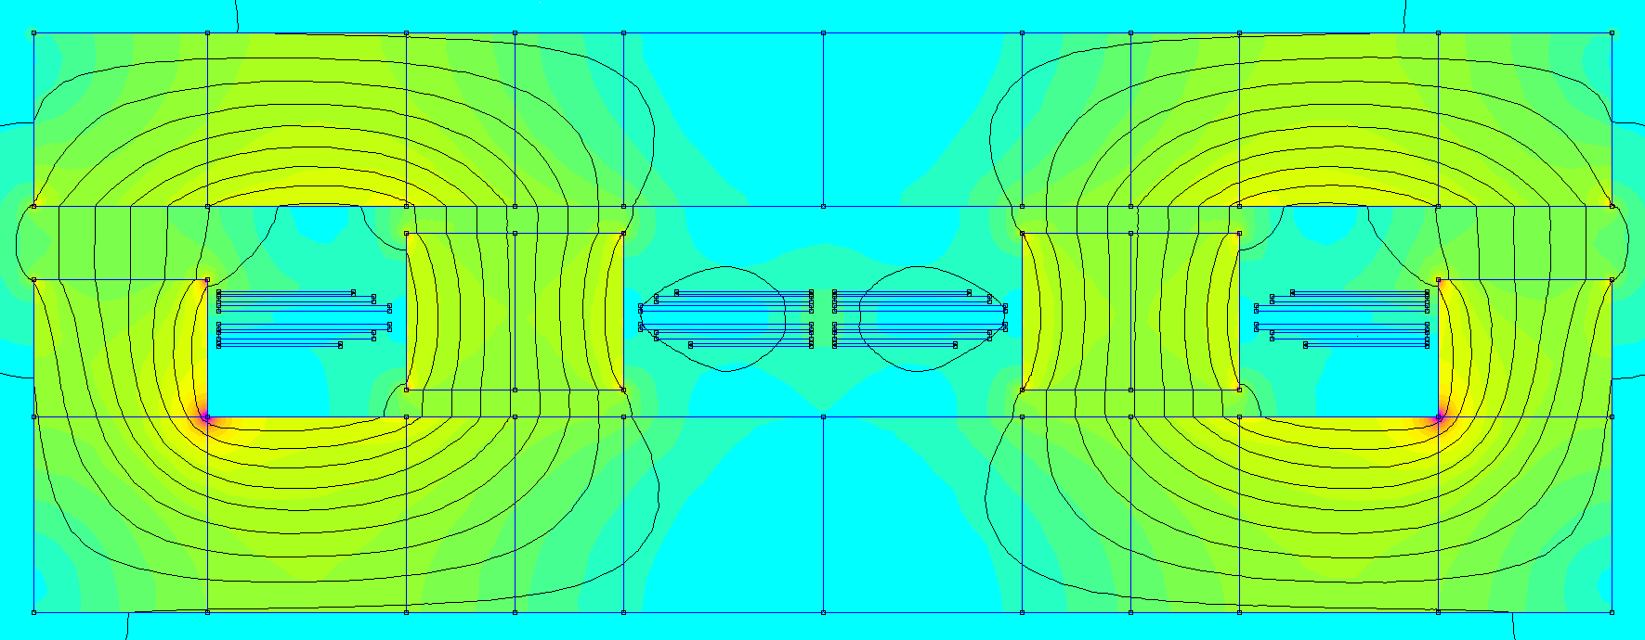
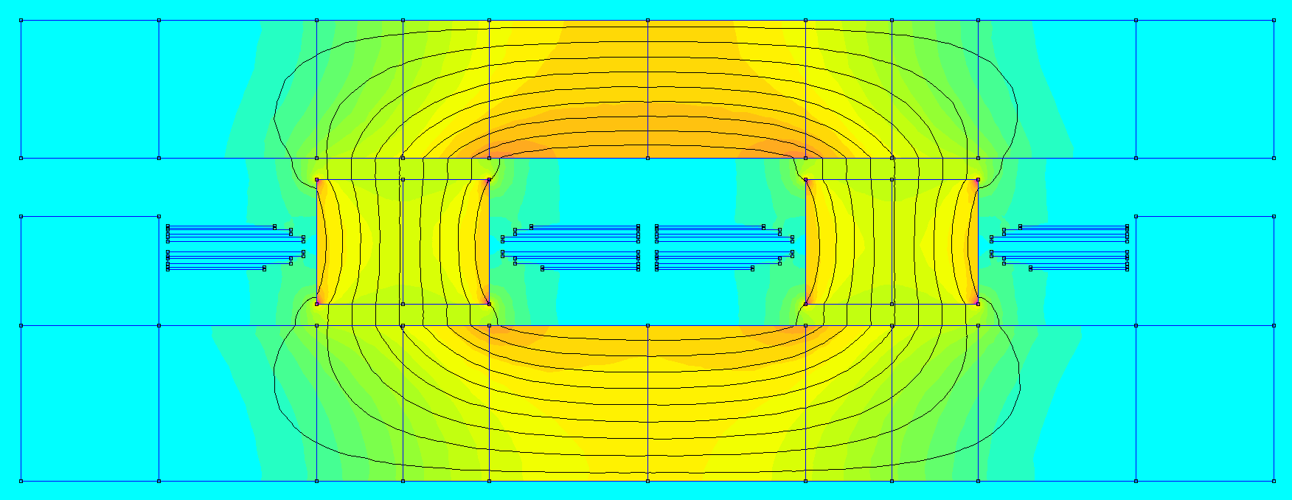
(a) Pos. Coupling DC
(b) Pos. Coupling Fundamental
(c) Neg. Coupling DC
(d) Neg. Coupling Fundamental
0 |  | 20 |  | 40 |  | 60 |  | 80 |  | 100
B[mT]

Slide 4
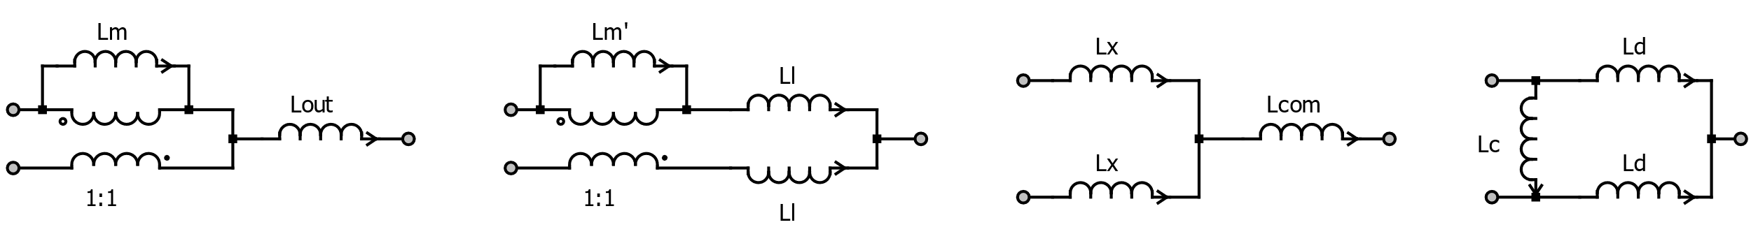
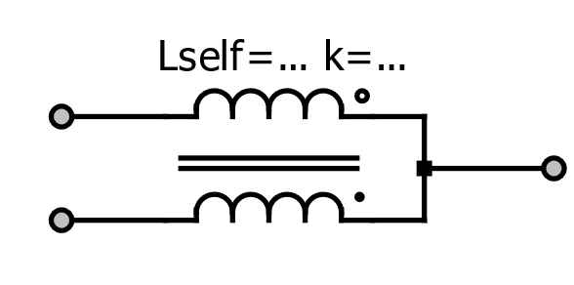
i_{m}
v_{a}
i_{out}
i₁
v₁
v₂
v₁+v₂
v_{out}
i₂
2
v_{b}
(a) Coupled Inductor
(b) Transformer Model

