Slide 1
(a) Double-PQ
(b) Four-Pole
(c) Modified EE
(d) Vertical Gap

Slide 2
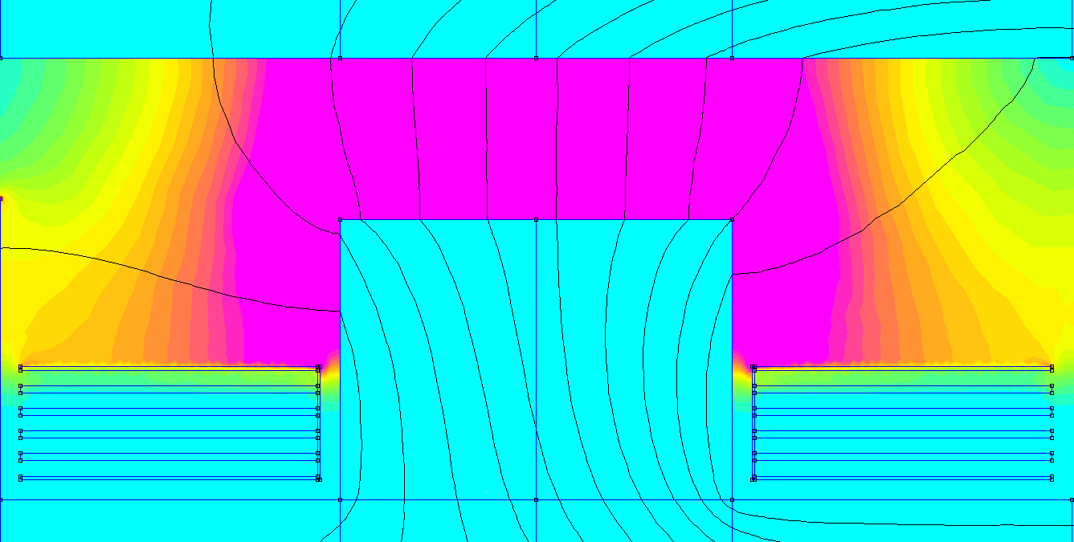
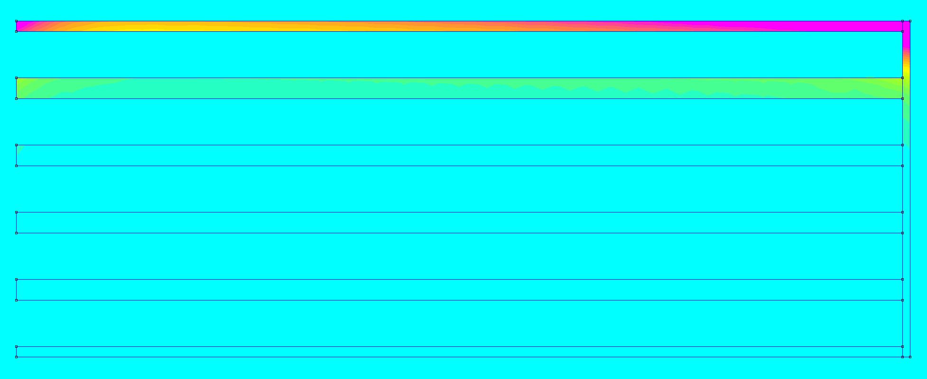
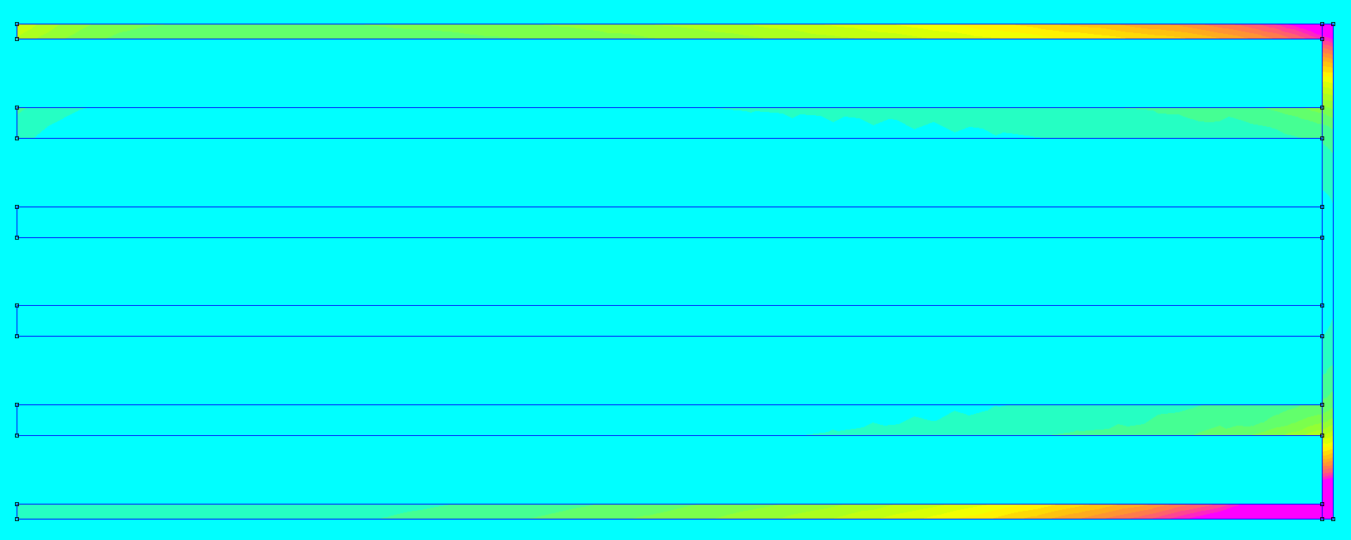
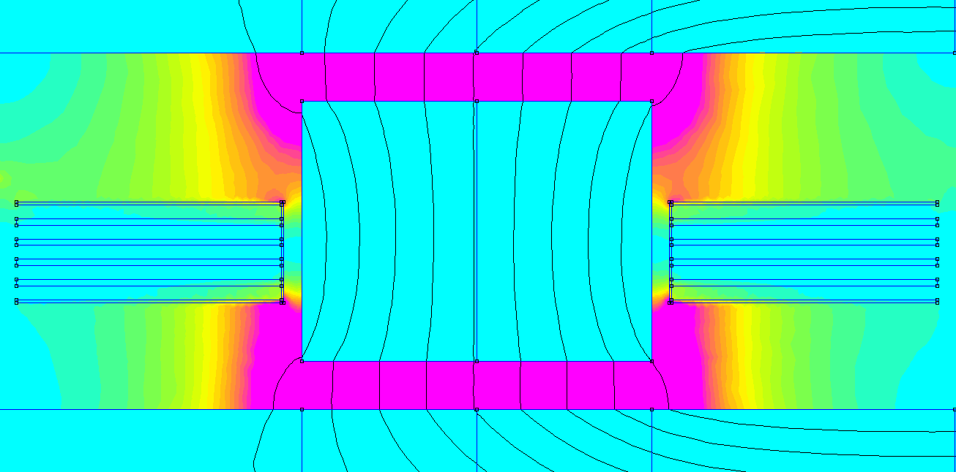
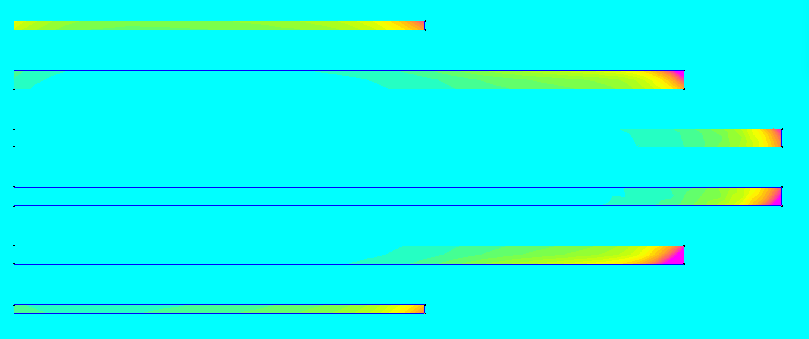
Field intensity (0 – 10 kA/m)
Current density (0 – 300 A/mm^2)

