Slide 1
Compact Single-Turn Coupled Inductor for MHz-Range Buck Converters with Zero-Voltage Switching
May 31 - June 4, 2026
June 2, 2026 - O6-5-03
Adrian Keil¹, Gean Maia de Sousa², Vincent Lorentz³, Thomas Heckel¹, Marcelo Lobo Heldwein²
¹ Fraunhofer Institute for Integrated Systems and Device Technology IISB, ² Chair of High-Power Converter Systems, Technical University of Munich
³ Chair of Electronics for Electrical Energy Storage, University of Bayreuth

Slide 2
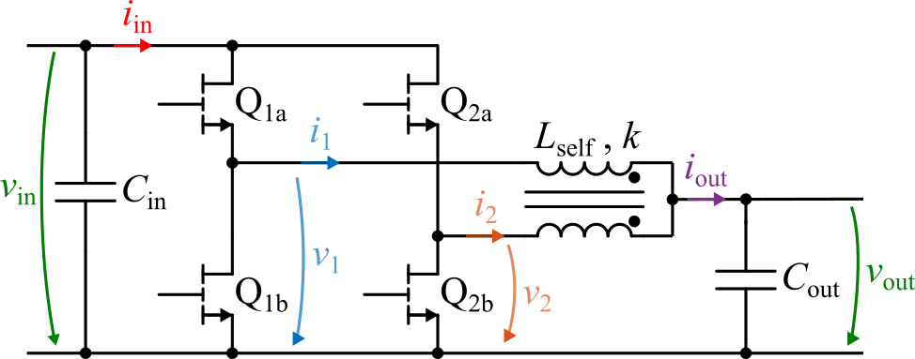
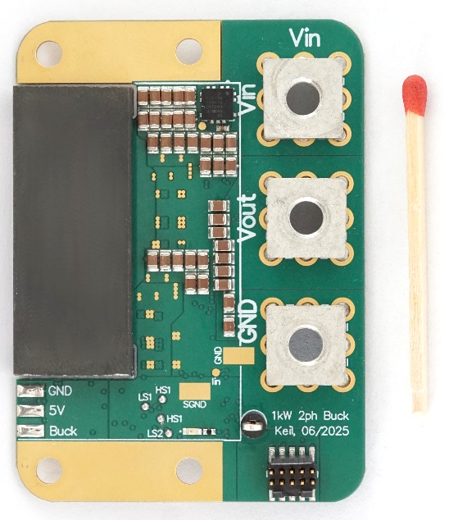
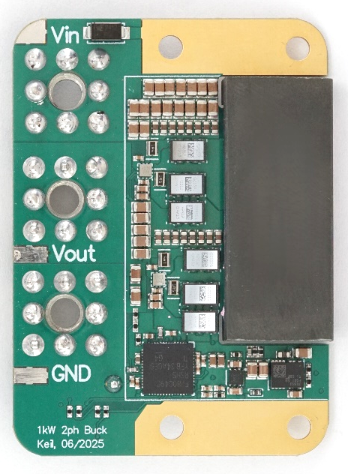
Table of Contents
Motivation
Introduction to the Coupled Inductor Buck Converter
Working Principle
Modelling using the Transformer Model
Effects of Coupling
Inductor Design
Potential geometries
Influence of coupling on the flux distribution
Air-Gap and Winding Optimization
Design Comparison
Experimental Prototype
Conclusion

Slide 3
Motivation
Need for 48 V to 12 V Point-of-Load converters with very high power-density
Dominated by resonant converters (mostly LLC)
Limited range of output regulation, often fixed-ratio
Buck
Low power-density and efficiency when hard-switched
Solution: High frequency and soft-switching in Triangular-Current-Mode (TCM)
Challenge: Inductor design
Air gap fringing effect
No interleaved windings
Core DC-bias
Solution: Planar single-turn coupled inductor
1.2 kW LLC, f_{s}=1 MHz, η=96.3 % ¹
copper loss
600 W Buck, f_{s} =500 kHz, η=95.2 % ²
[1] EPC9174: https://epc-co.com/epc/products/evaluation-boards/epc9174
[2] EPC9143: https://epc-co.com/epc/products/evaluation-boards/epc9143

Slide 4
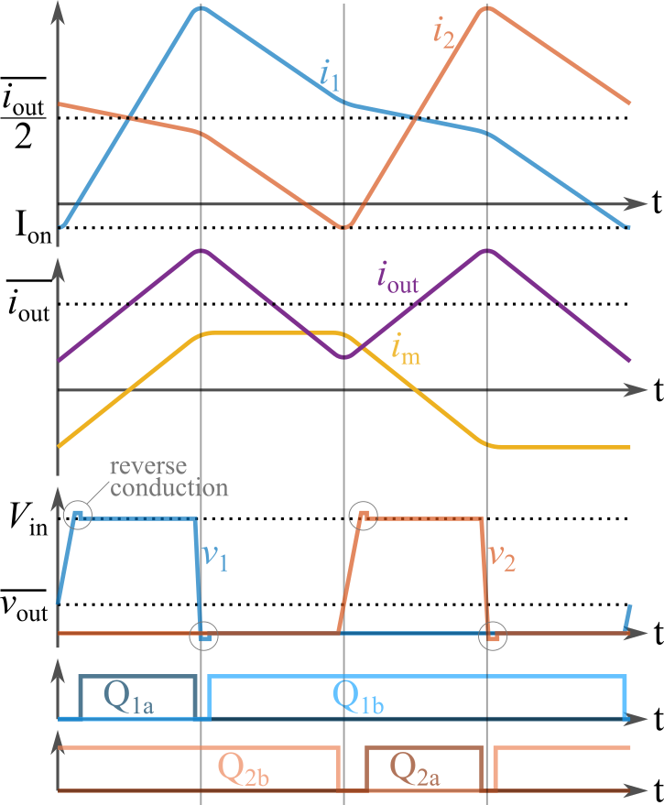
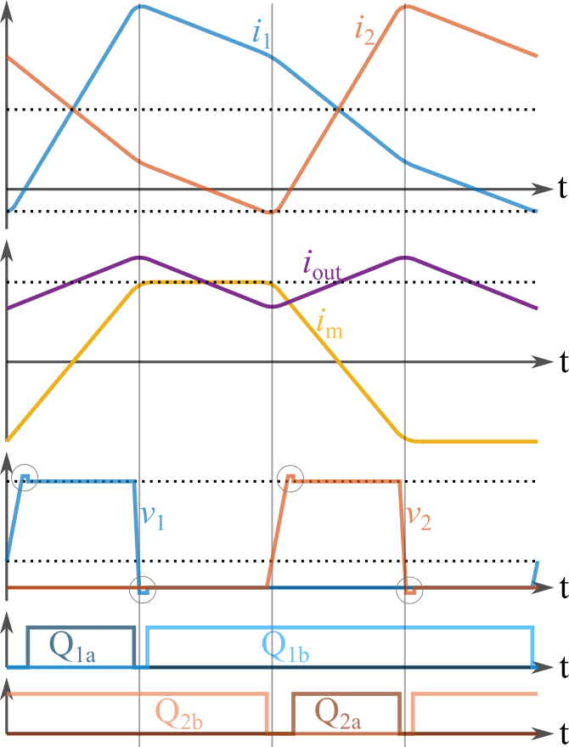
Introduction – Working Principle
Same Modulation as 2ph Buck
Coupling causes change of the slopes when other leg is pulled to v_{in}
Zero-Voltage-Switching turn-on
Negative Coupling
Positive Coupling

Slide 5
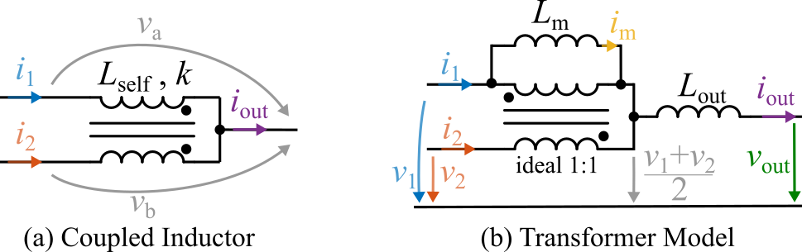
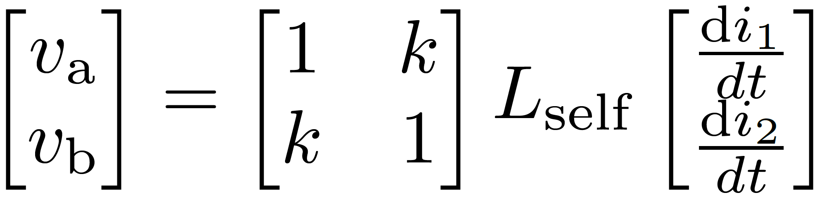
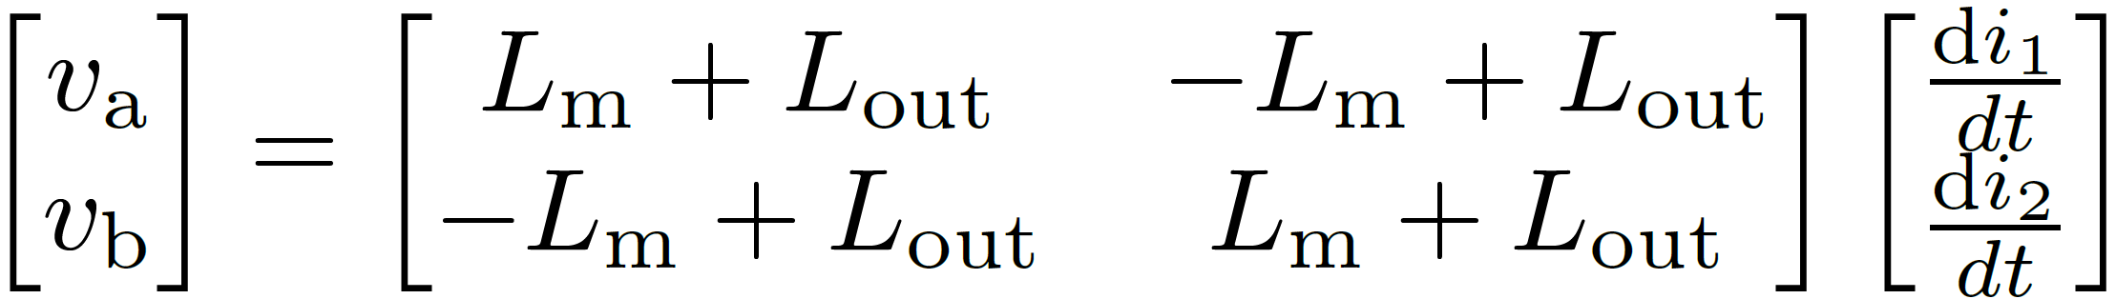
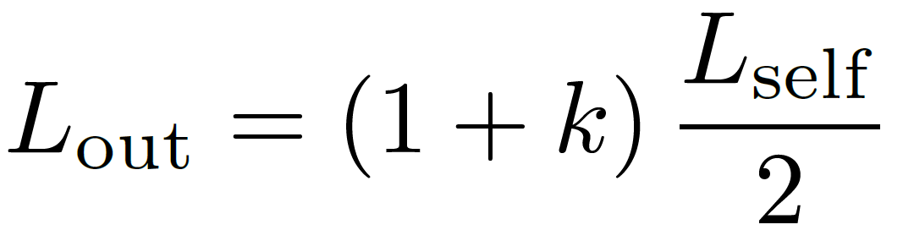
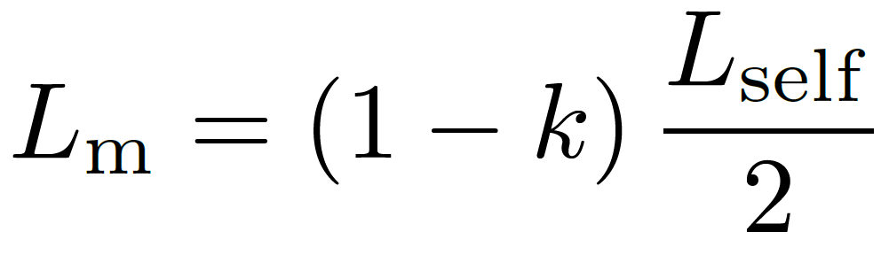
Introduction – Effects of Coupling
Modelling the coupled inductor as an ideal transformer and two inductors
Voltages across the two inductors become independent!
L_{self}
L_{out}
L_{m}
k
-1
0
1

Slide 6
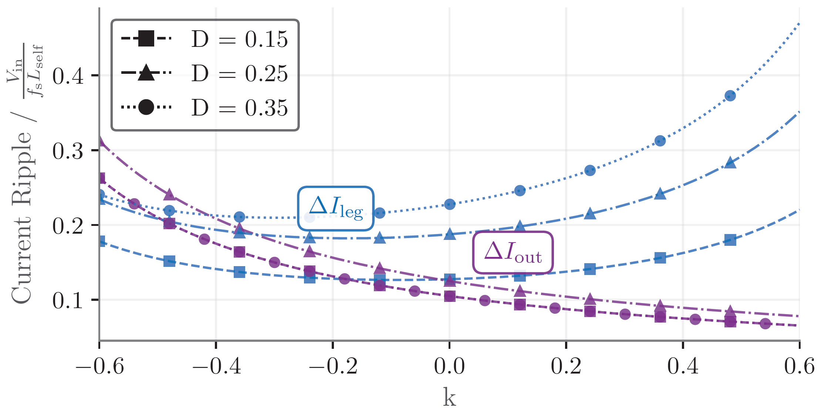
Introduction – Effects of Coupling
Modelling the coupled inductor as an ideal transformer and two inductors
Voltages across the two inductors become independent!
L_{self}
L_{out}
L_{m}
k
-1
0
1

Slide 7
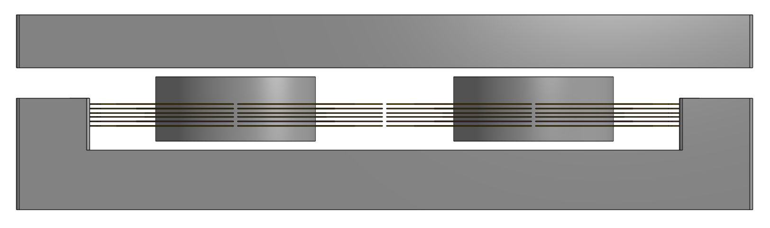
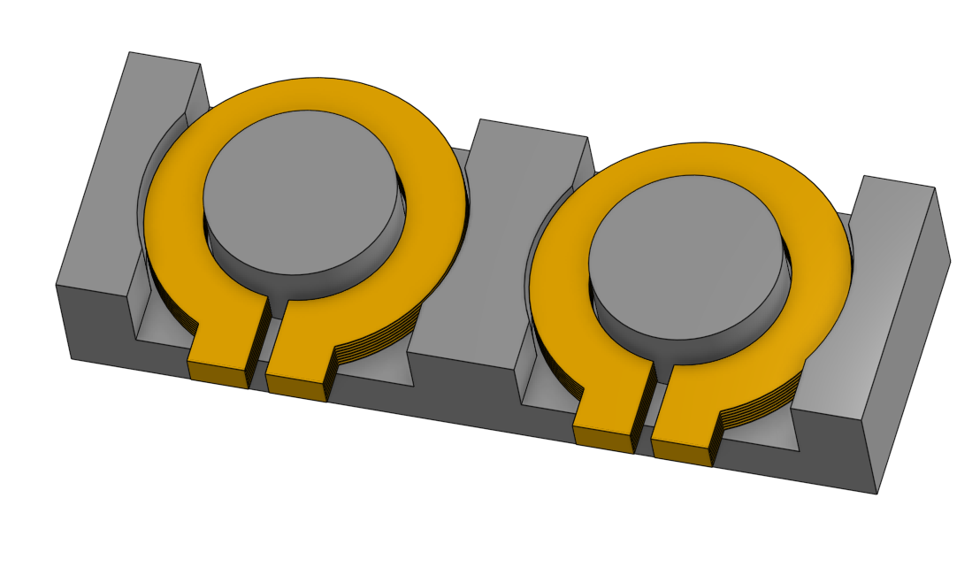
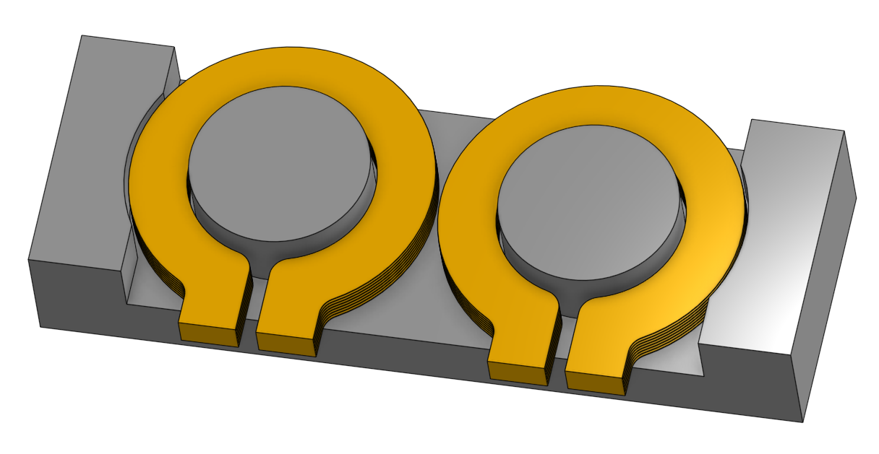
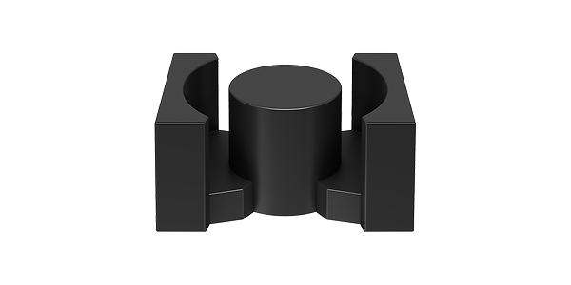
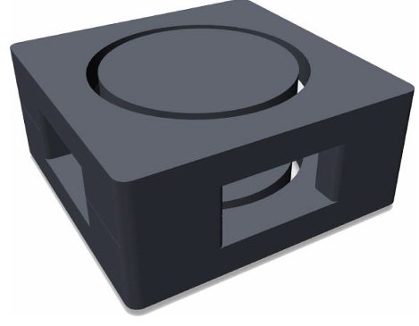
Inductor Design – Potential Geometries
Investigation of 4 different designs
(a) and (b): Coupled
(c) and (d): Uncoupled
Design Goals:
P_{out} = 1 kW
V_{in} = 48 V, V_{out} = 12 V
I_{ripple} = 100 A
f_{s} = 1 – 3 MHz
L_{self} ≈ 70 nH
(a) Double-PQ with Dual Air Gap¹
(b) Four-Pole with Dual Air Gap²
(c) PQ
(d) Vertical Gap³
Additional Air Gap
[1] S. Wang et al. “PCB Winding-Based Coupled Inductor for a High-Frequency DC/DC Converter with 99% Efficiency” Mar. 2023
[2] M. Hua et al. “Ultra-thin Coupled Inductor for a GaN-Based CRM Buck Converter” Aug. 2021
[3] J. Schäfer et al. “Novel Highly Efficient/Compact Automotive PCB Winding Inductors Based on the Compensating Air-Gap Fringing Field Concept” Sep. 2020

Slide 8
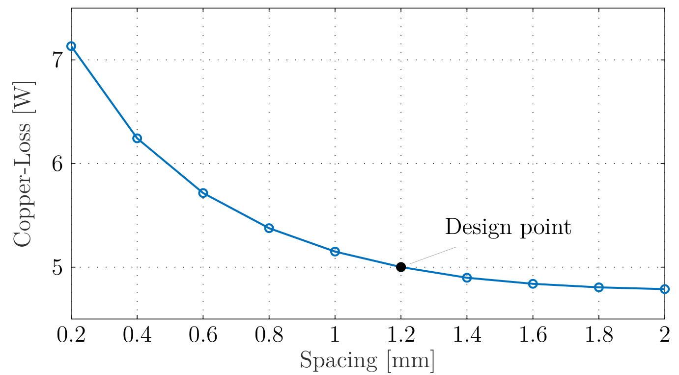
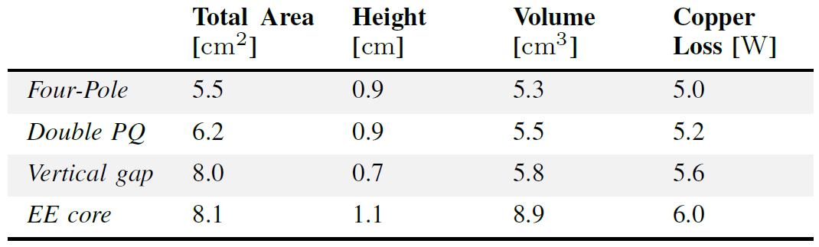
Inductor Design – Comparison between Geometries
Coupled Designs are smaller.
Four-Pole Structure performs best while having the lowest copper-loss.
(a) Double-PQ with Dual Air Gap
(b) Four-Pole with Dual Air Gap
(c) PQ
(d) Vertical Gap
PQ

Slide 9
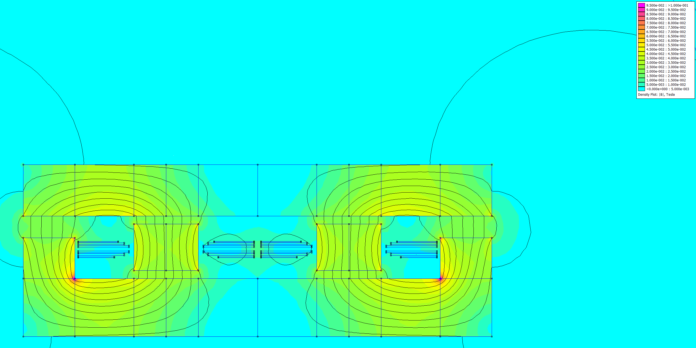
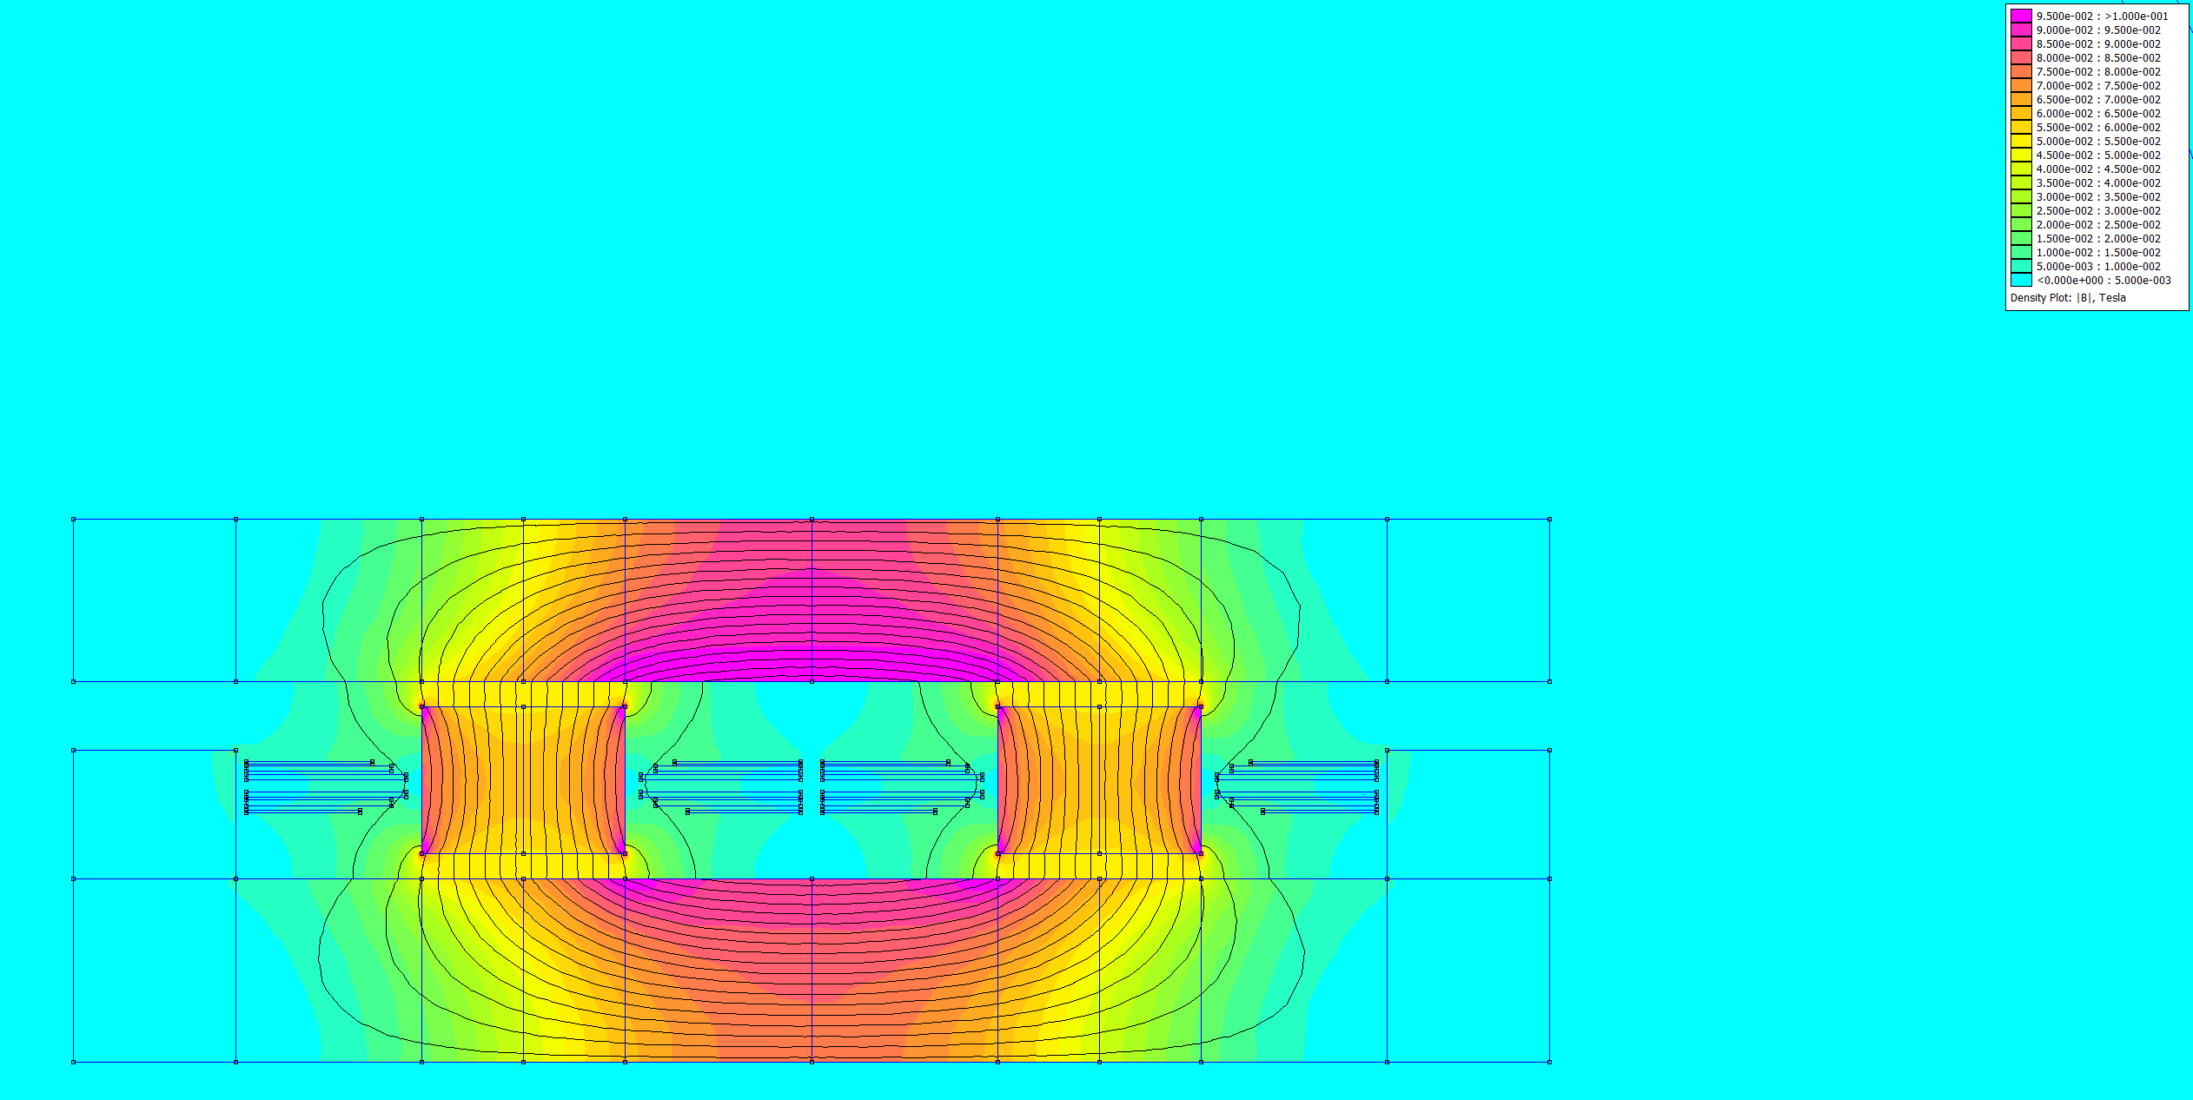
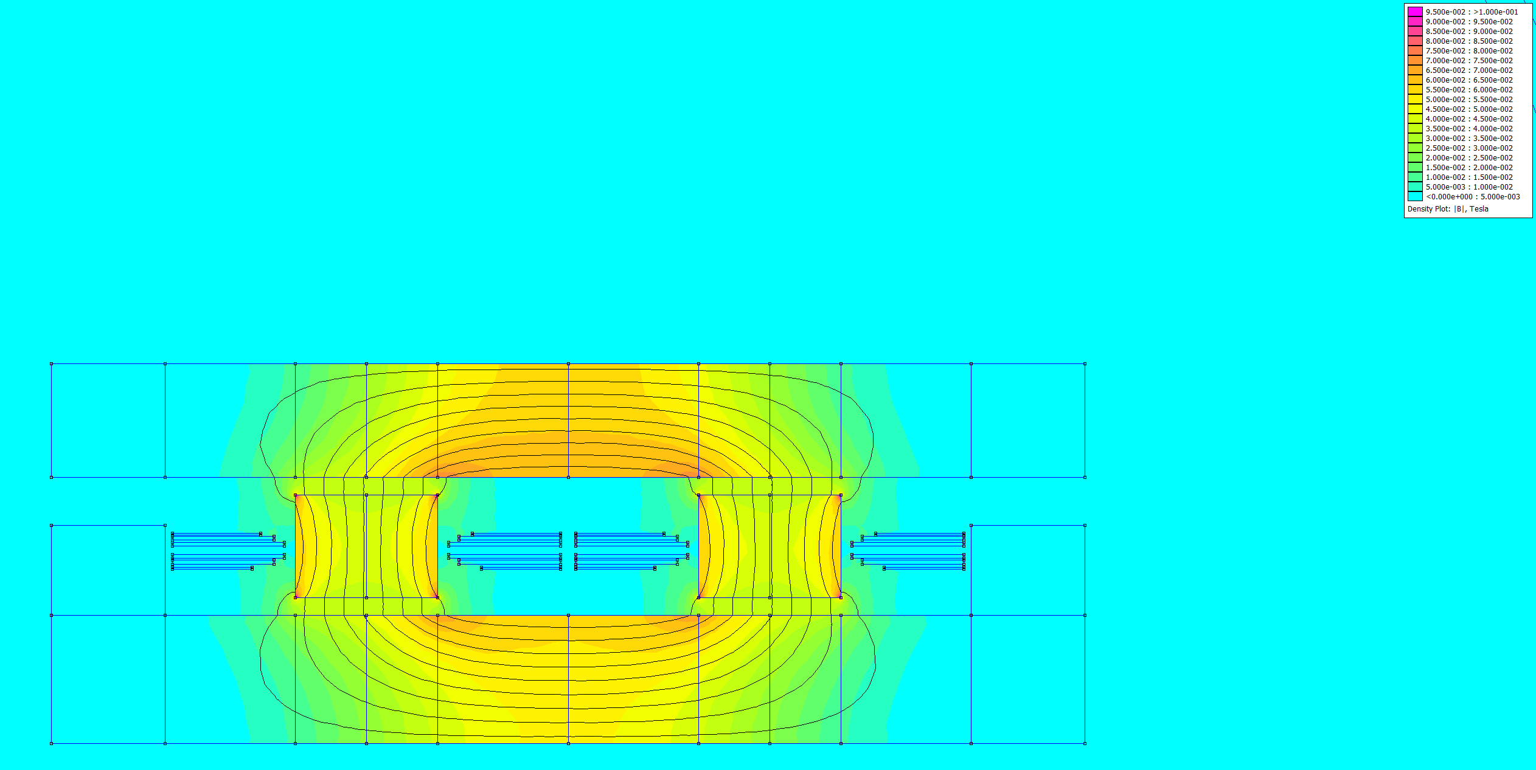
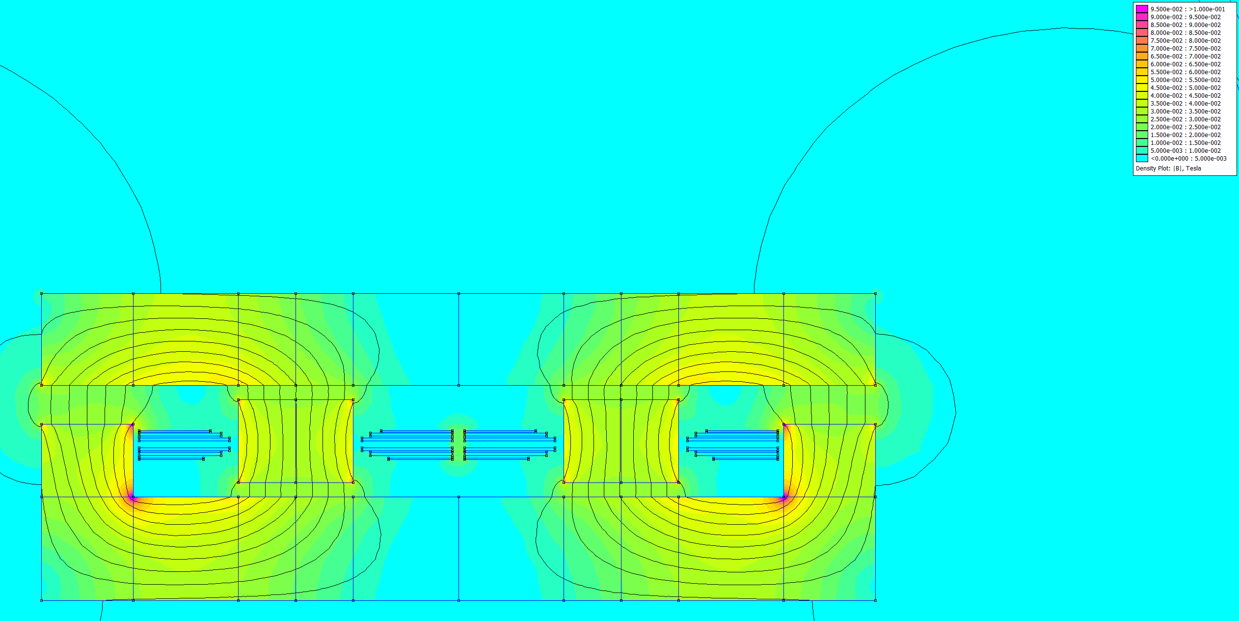
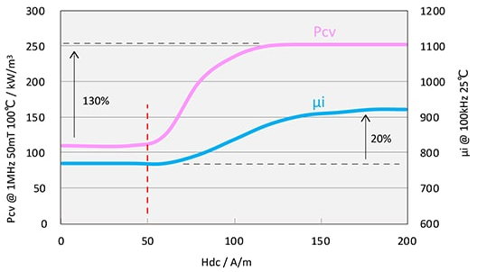
Inductor Design – Flux Distribution
Different Flux-Path for DC and Fundamental
Pos. Coupling: High DC-Flux but low AC
Neg. Coupling: Low DC-Flux but high AC
Neg. Coupling DC
Pos. Coupling DC
Neg. Coupling AC (Fundamental)
Pos. Coupling AC (Fundamental)
0 |  | 20 |  | 40 |  | 60 |  | 80 |  | 100
B[mT]

Slide 10
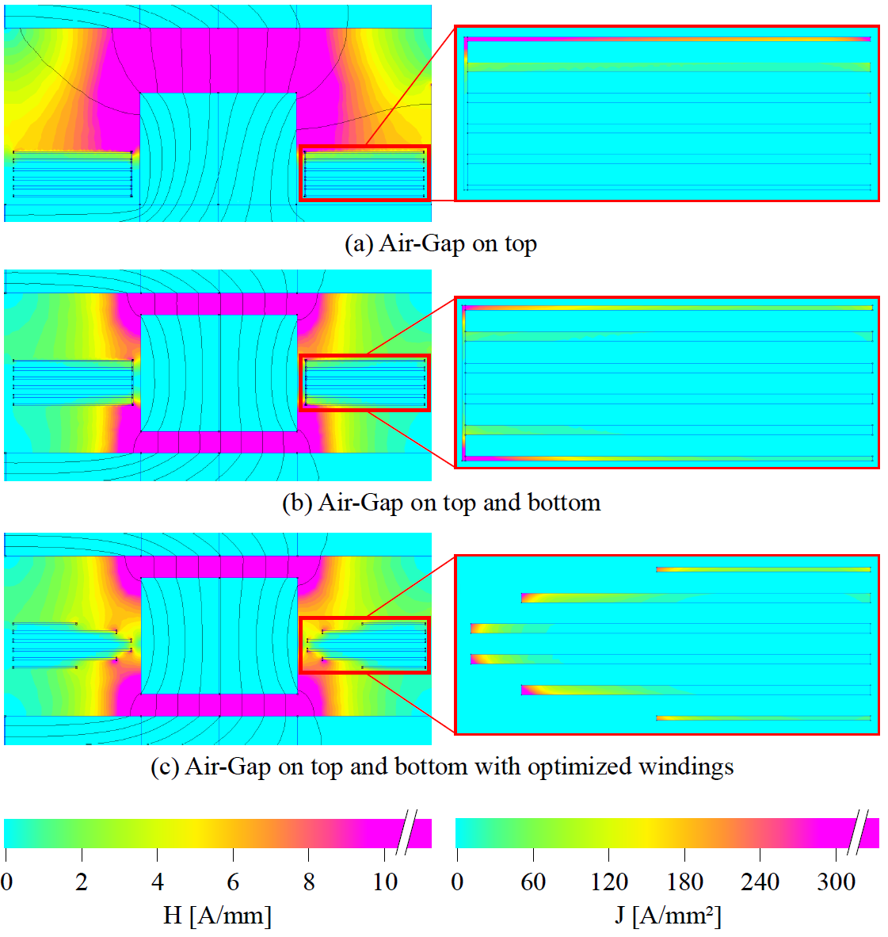
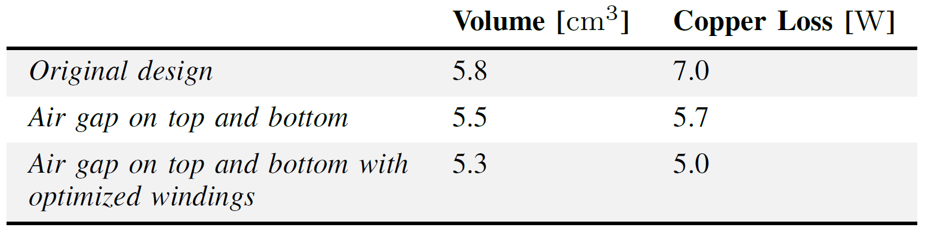
Inductor Design – Air-Gap and Winding Optimization
Current crowds in areas of large H-field
Dual Air-Gap improves field distribution
Different winding widths avoid areas of high H-field

Slide 11
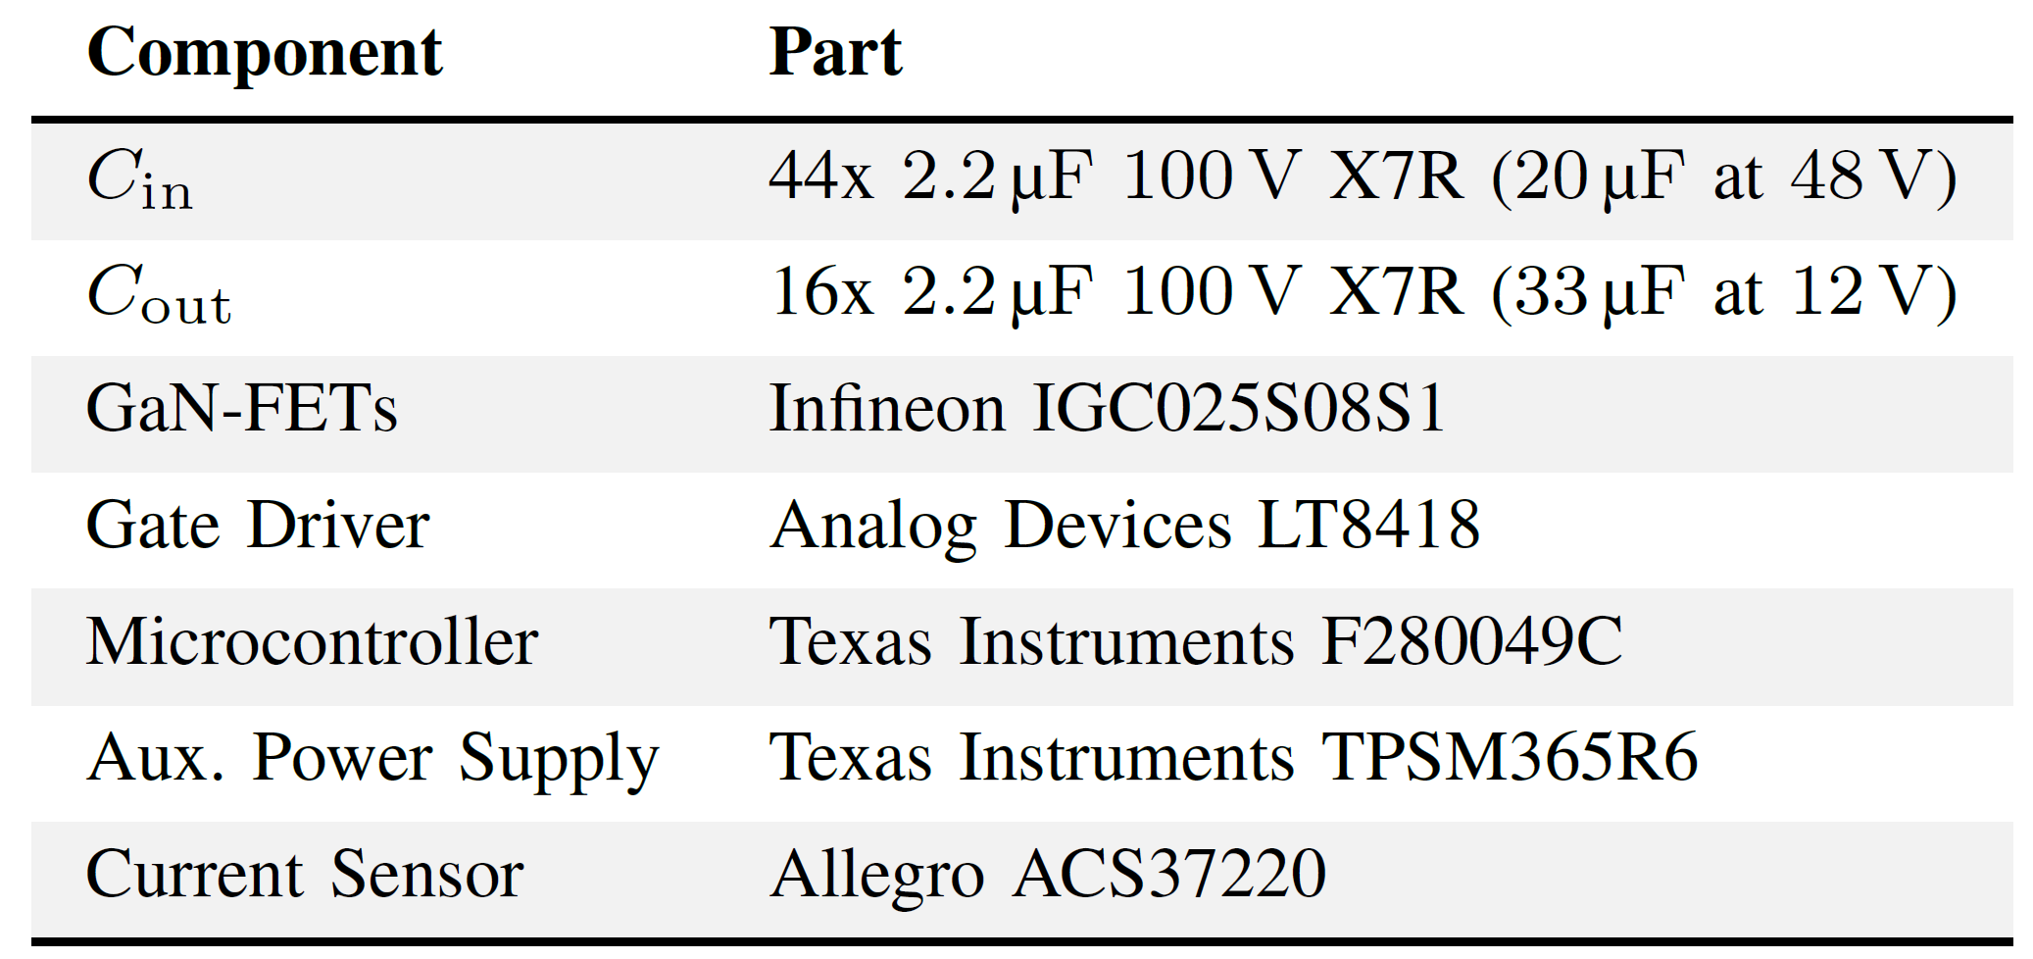
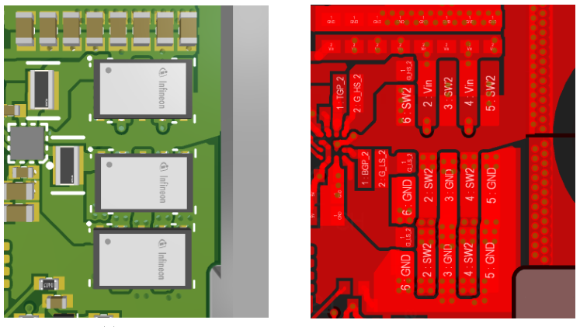
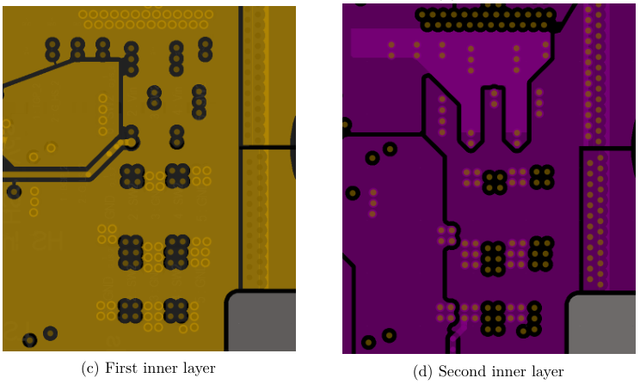
Experimental Prototype – Build
45 x 29 x 9.5 mm

Slide 12
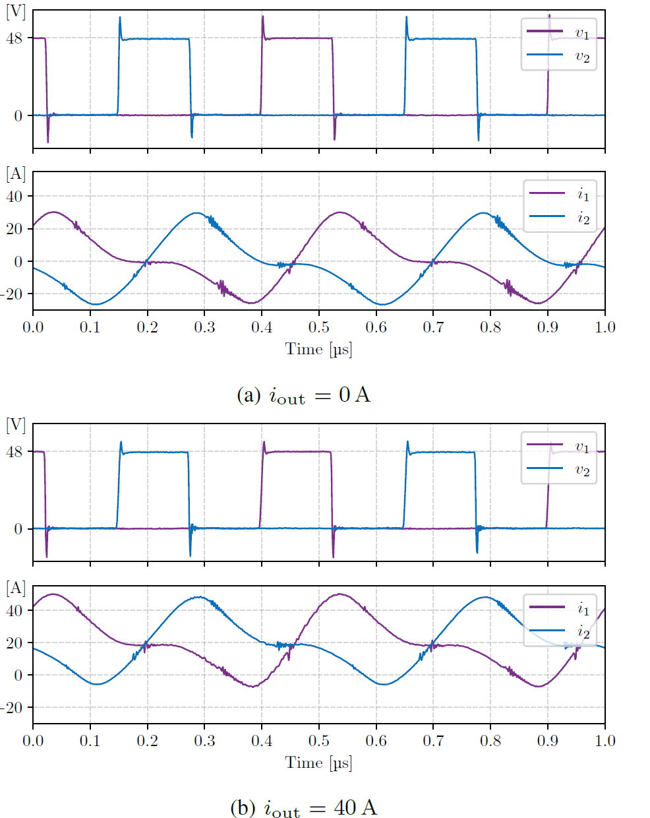
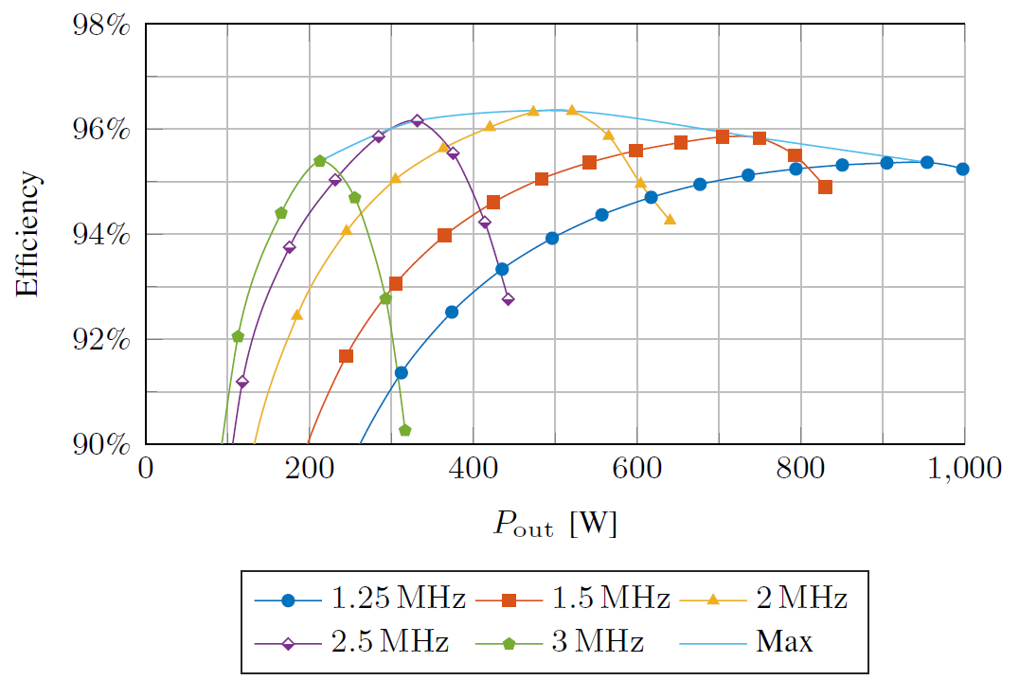
Experimental Prototype - Measurements
Power density: 80 kW/L (1300 W/in³)
Boxed volume: 12.4 cm³
Maximum efficiency: 96.3% at 550 W.
Soft-switching at all loads with variable frequency

Slide 13
Experimental Prototype - Measurements
Power density: 80 kW/L (1300 W/in³)
Boxed volume: 12.4 cm³
Maximum efficiency: 96.3% at 550 W.
Soft-switching at all loads with variable frequency
Similar power-density and efficiency to LLC
Promising option for real-world applications
Converter | Power | Power-Density | Efficiency
Proposed Converter | 1.0 kW | 80 kW/L | 96.3 %
Cai et al.¹ | 1.0 kW | 38 kW/L | 96.0 %
Ahmed et al.² | 1.0 kW | 42 kW/L | 97.8 %
Flexpower³ | 1.3 kW | 52 kW/L | 97.0 %
EPC⁴ | 1.2 kW | 90 kW/L (requires ext. C) | 97.3 %
[1] Y. Cai, M. H. Ahmed, Q. Li, and F. C. Lee, “Optimal Design of Megahertz LLC Converter for 48-V Bus Converter Application” Mar. 2020
[2] M. H. Ahmed, A. Nabih, F. C. Lee, and Q. Li, “Low-Loss Integrated Inductor and Transformer Structure and Application in Regulated LLC Converter for 48-V Bus Converter” Mar. 2020
[3] FlexPower, “BMR480 series DC-DC Converters Input 45-60 V, Output up to 108.3 A / 1300 W” Mar. 2019.
[4] EPC “EPC9174 – 40 – 60 VIN, 10 – 15 V, 100 A Output 1.2 kW 1/8th Brick Reference Design Board” 2022

Slide 14
Conclusion
Transformer model provides intuitive understanding of 2-phase coupled inductors
Coupled inductor with four-pole structure allows compact core
Dual air gaps and stepped conductor widths improve current distribution
30% reduction in copper loss
Experimental prototype: 80 kW/L (1300 W/in³) at 1 kW output and 96.3% peak efficiency
Current Research: Calorimetric core loss characterization and core optimization
Notes:
Positive Coupling is beneficial in most cases as it reduces AC flux
Negative coupling when DC-flux matters (high-frequency materials). Reduces core size by 50% in this case.

Slide 15

May 31 - June 4, 2026
CONTACT US
Adrian Keil¹, Gean Maia de Sousa², Vincent Lorentz³, Thomas Heckel¹, Marcelo Lobo Heldwein²
¹ Fraunhofer Institute for Integrated Systems and Device Technology IISB, ² Chair of High-Power Converter Systems, Technical University of Munich
³ Chair of Electronics for Electrical Energy Storage, University of Bayreuth

Slide 16
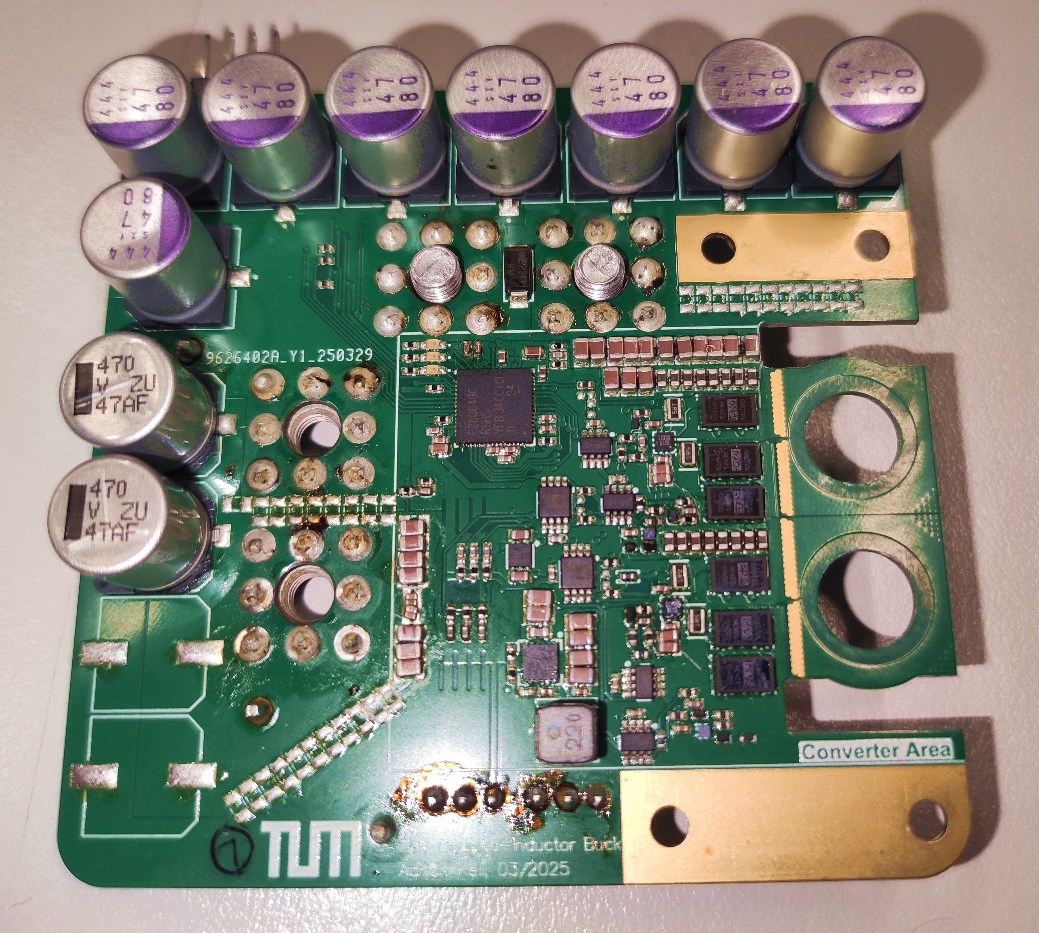
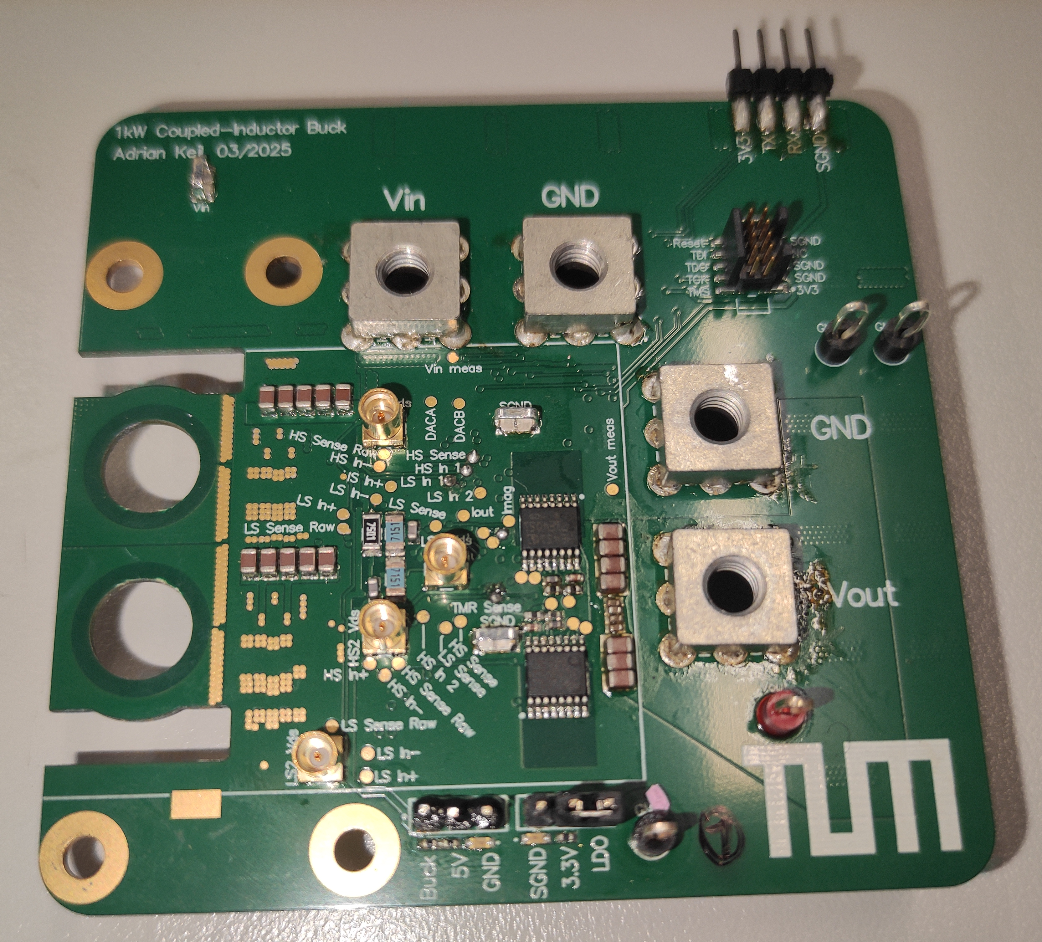
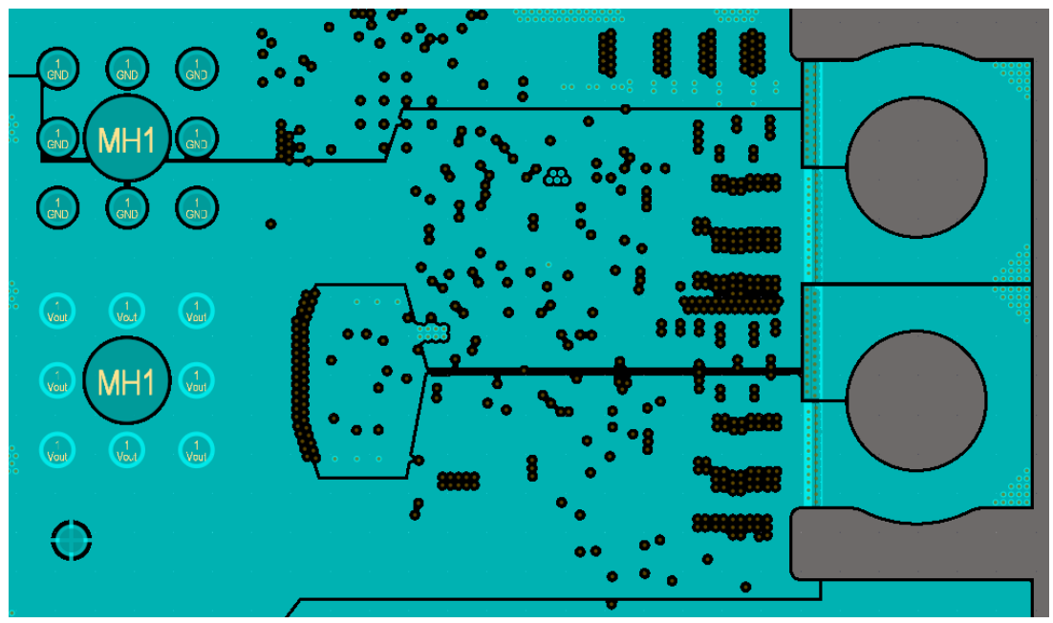
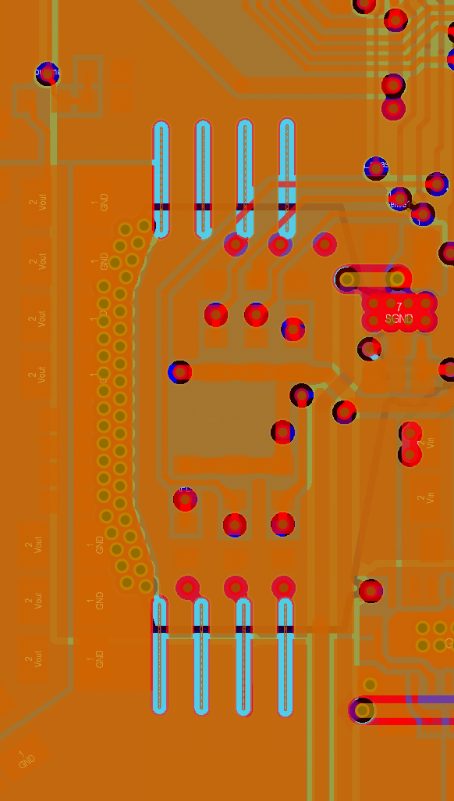
Current Sensing
First-Generation Board included TMR Current Sensors

Slide 17
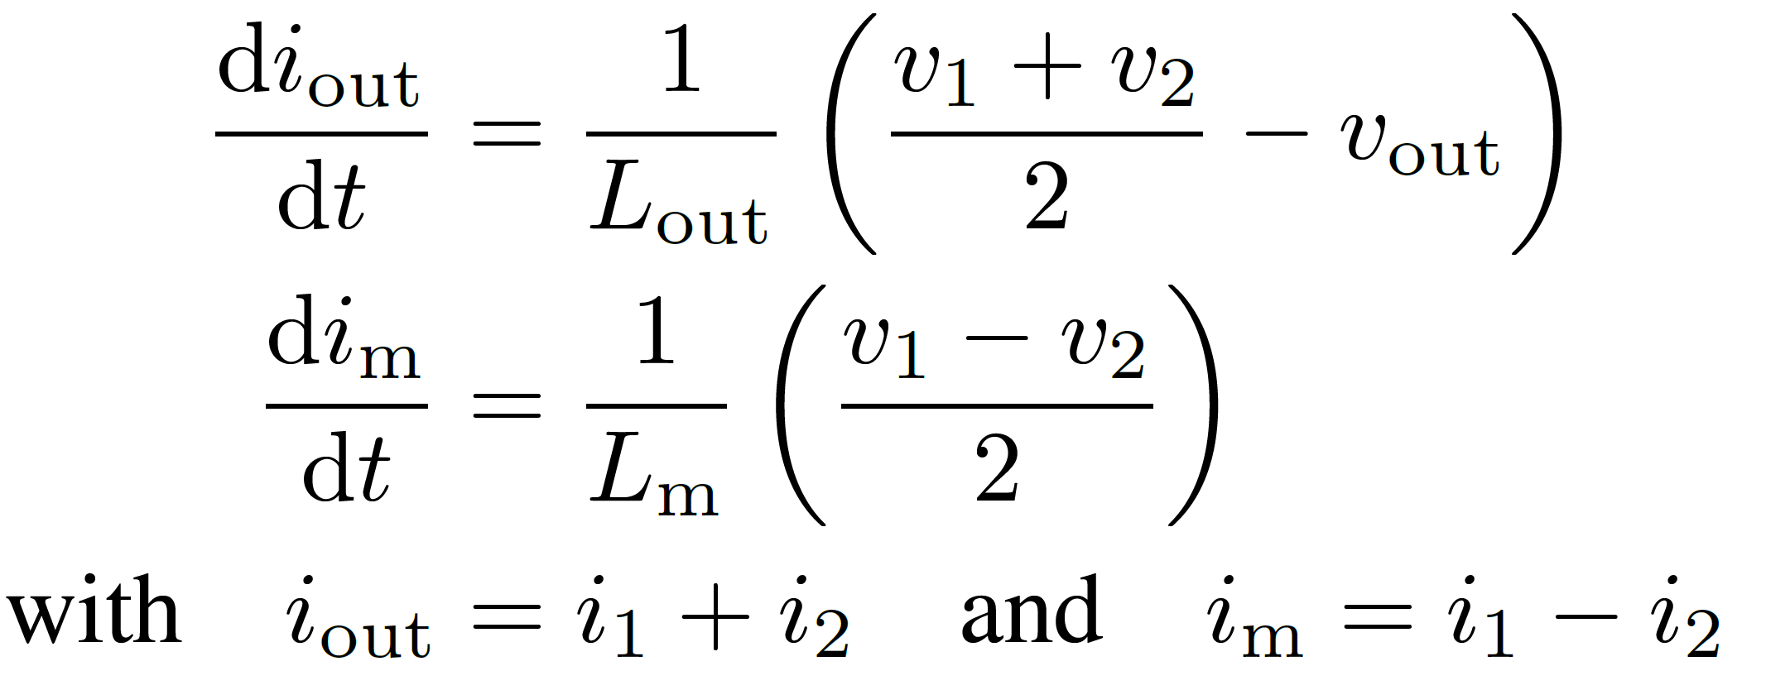
Introduction – Modelling using the Transformer Model
Modelling the coupled inductor as an ideal transformer and two inductors
Voltages across the two inductors become independent!

