Slide 1
(a) Double-PQ with Dual Air Gap
(b) Four-Pole with Dual Air Gap
(c) Modified EE
(d) Vertical Gap
Additional Air Gap

Slide 2
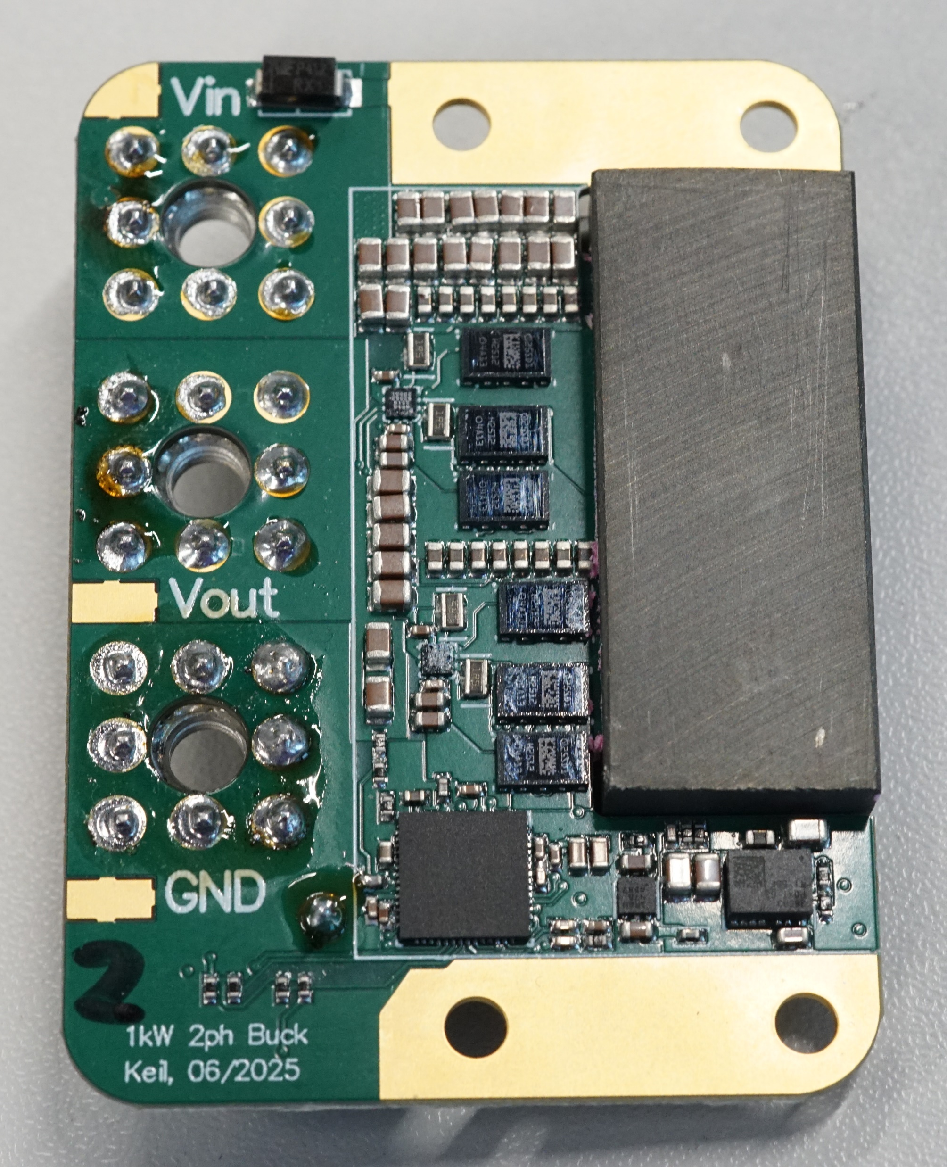
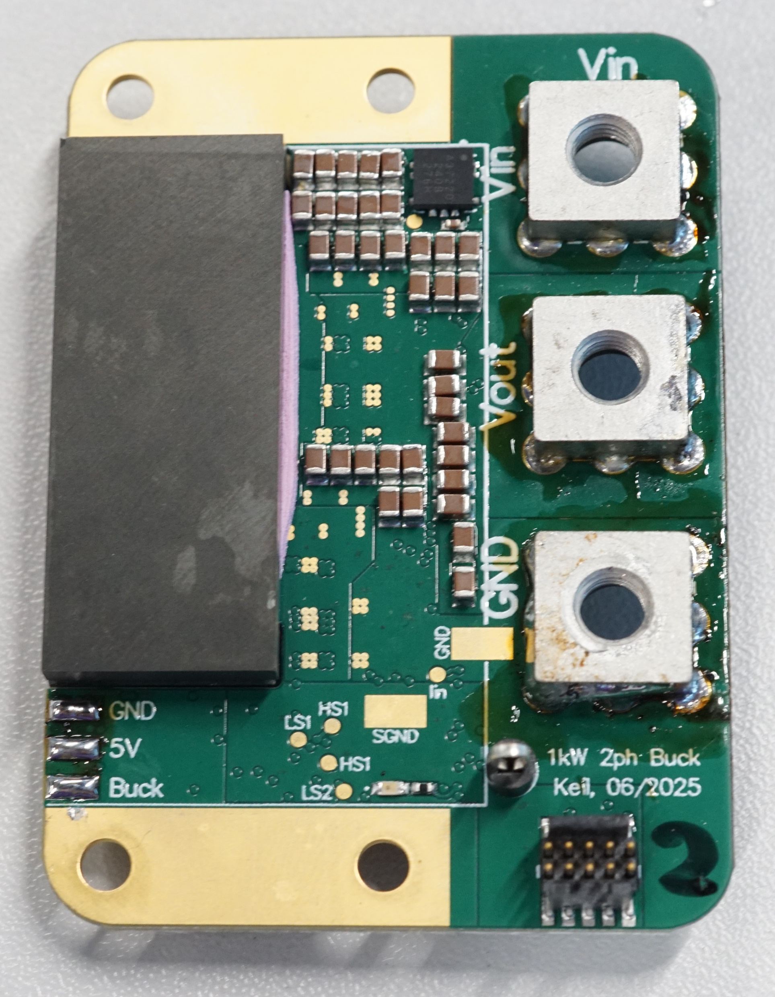
45 mm
29 mm

Slide 3
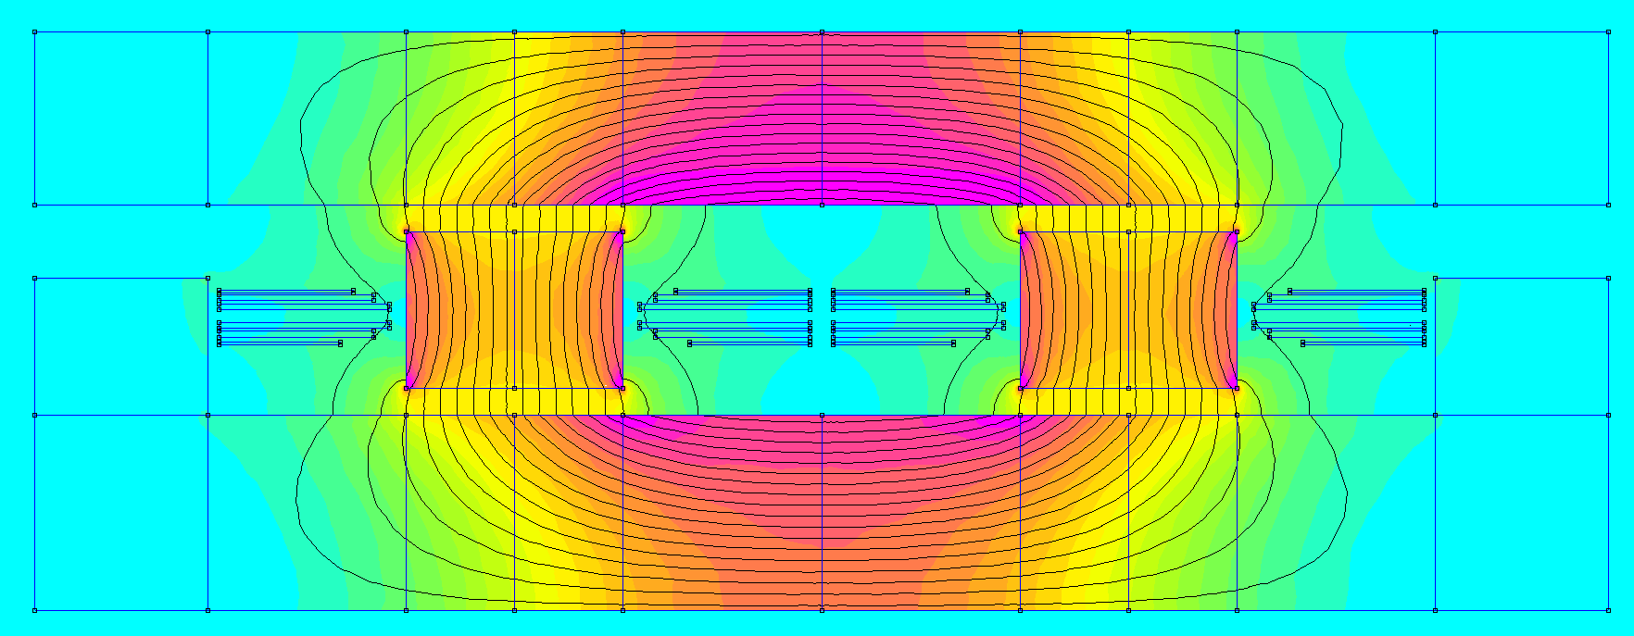
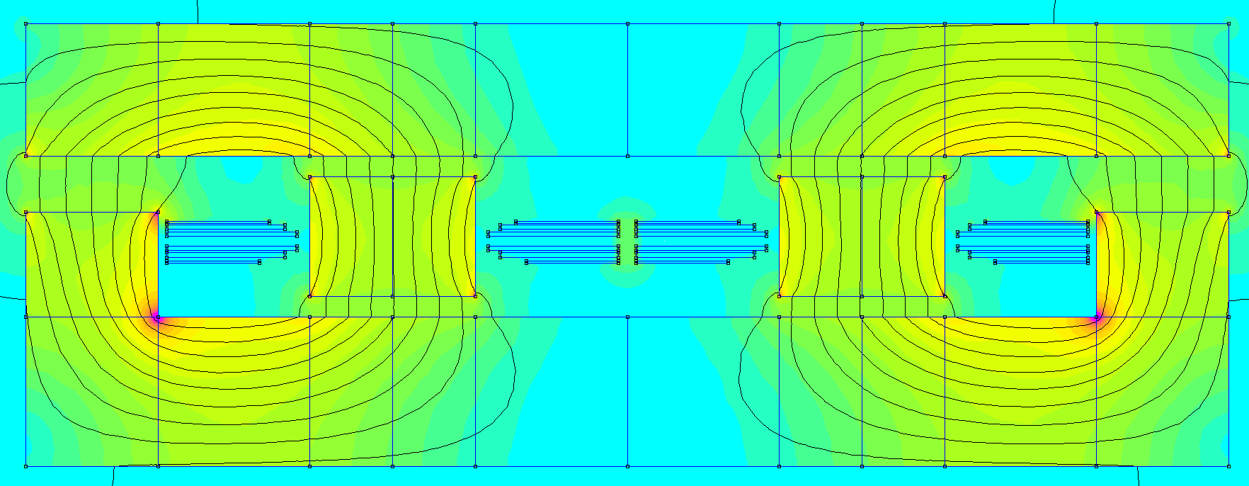
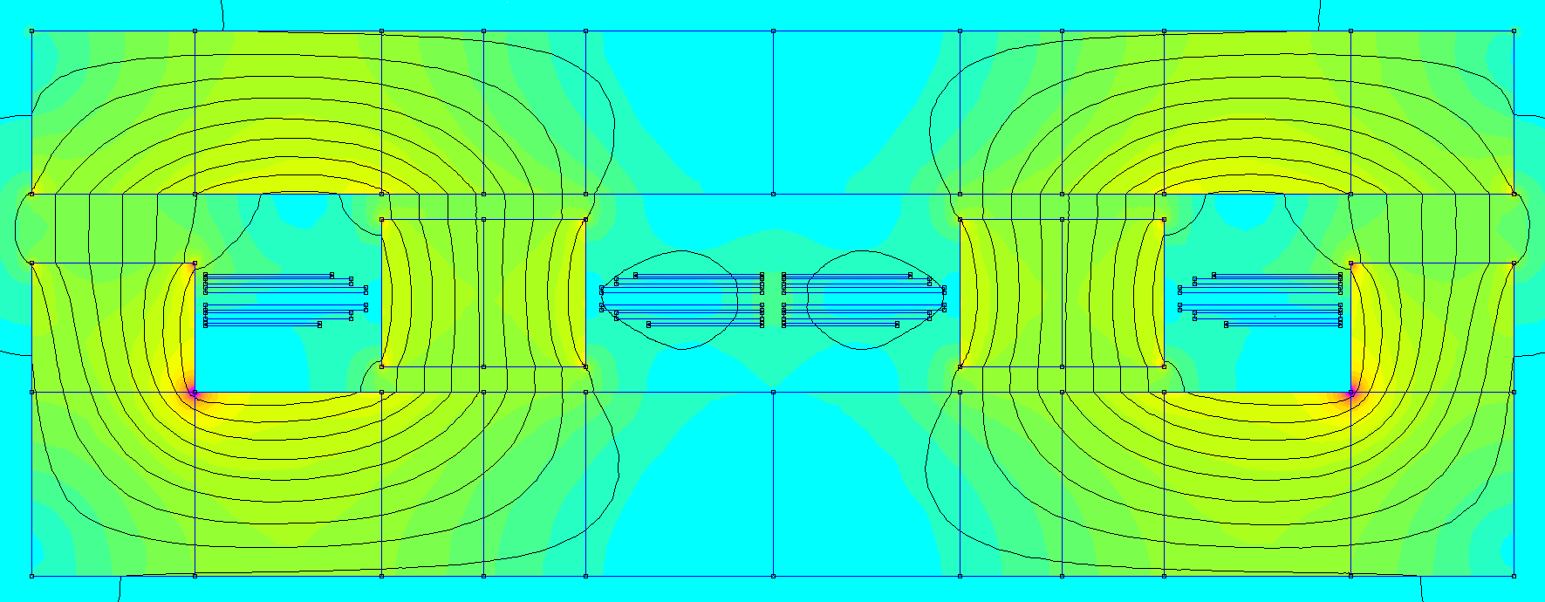
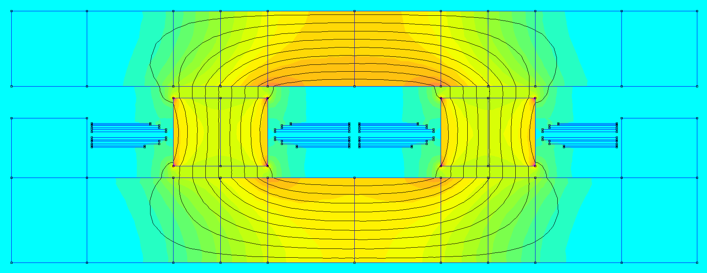
(a) Pos. Coupling DC
(b) Pos. Coupling Fundamental
(c) Neg. Coupling DC
(d) Neg. Coupling Fundamental
0 |  | 20 |  | 40 |  | 60 |  | 80 |  | 100
B[mT]

Slide 4
(a) Neg. Coupling DC
(b) Pos. Coupling DC
(c) Neg. Coupling Fundamental
(d) Pos. Coupling Fundamental
0 |  | 20 |  | 40 |  | 60 |  | 80 |  | 100
B[mT]

