Slide 1

G2M Case Study
Virtual Internship
21-Oct-2024

Slide 2
Background –G2M(cab industry) case study
XYZ is a private equity firm in US. Due to remarkable growth in the Cab Industry in last few years and multiple key players in the market, it is planning for an investment in Cab industry.
Objective : Analyze the provided data to identify which cab company is more feasible for investment.
The analysis has been divided into four parts:
Exploration and data analysis
Seasonality and demand analysis
Profitability comparison between companies
Data-driven investment recommendations

Slide 3
Data Exploration
Timeframe of the data: 2016-01-31 to 2018-12-31
Total data: 359392
Assumptions:
There are outliers in the charged price, so analyzing the data shows a positive correlation,
which suggests that the price depends on the kilometers, and some customers took atypical, long-duration trips.
With the data cleaning, we identified that all the data was correct, and we will not encounter inconsistent values.
We obtained the profits by subtracting the charged price from the cost of the trip
to continue analyzing the requested information.
Using the customer ID data, we identified the number of users in each company.
Cab_Data.csv
Customer_ID.csv
Transaction_ID.csv
City.csv
Final cab data

Slide 4
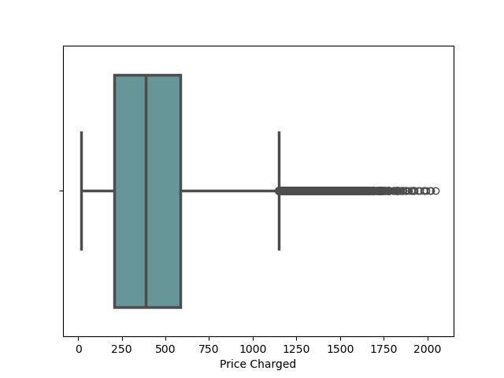
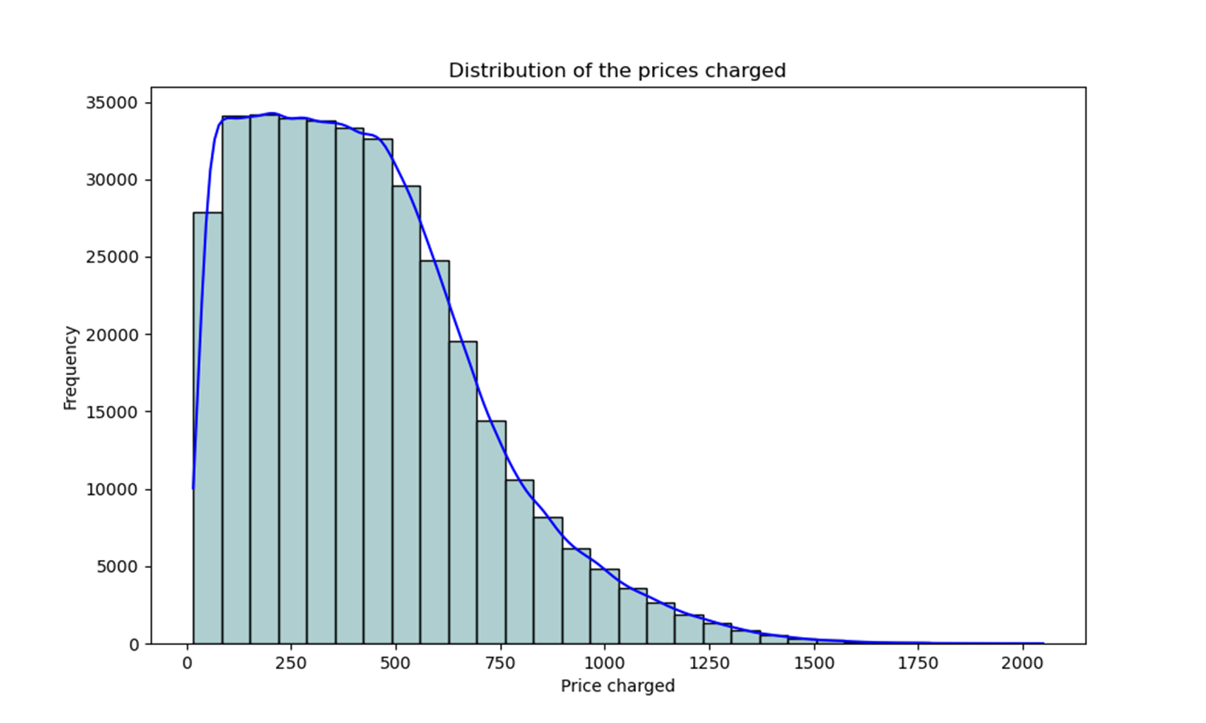
Price most frequent

Slide 5
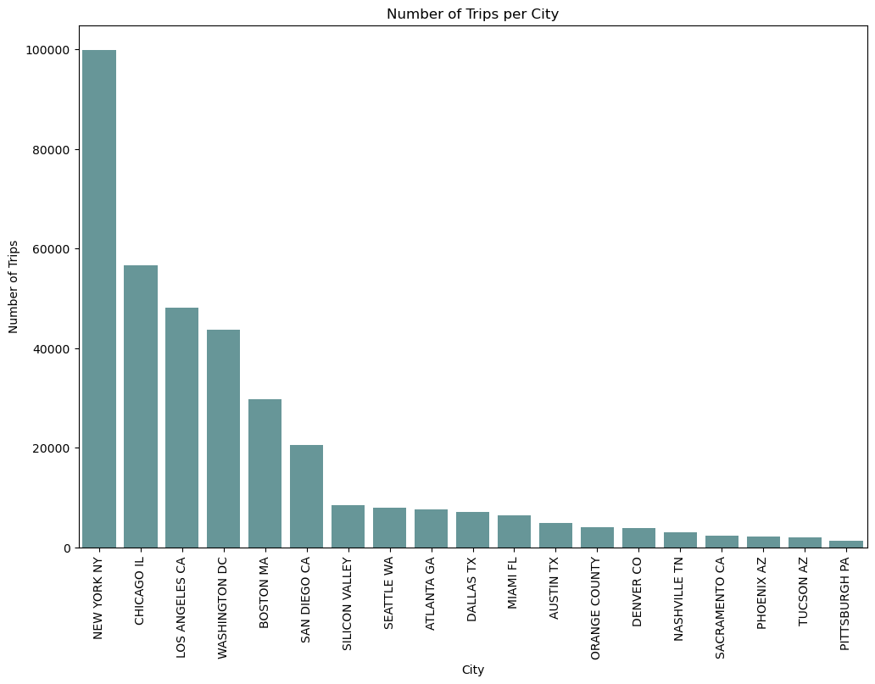
Most demanded city per trips

Slide 6
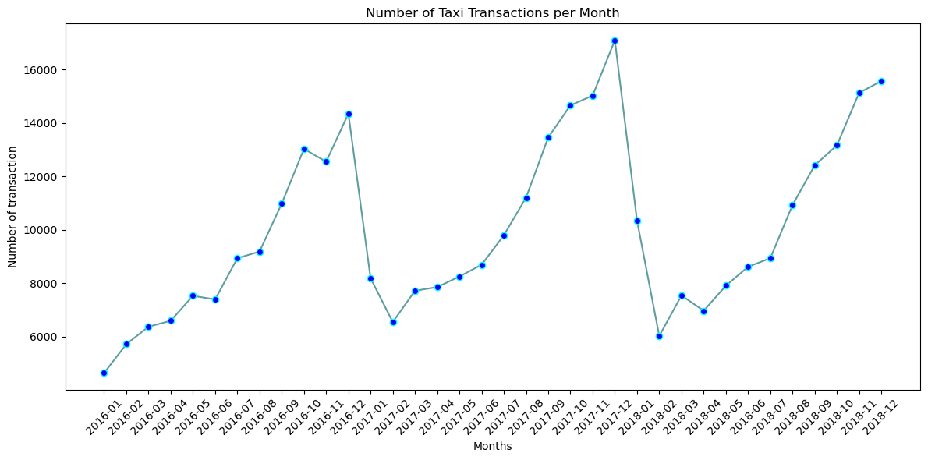
Seasonality Analysis per months

Slide 7
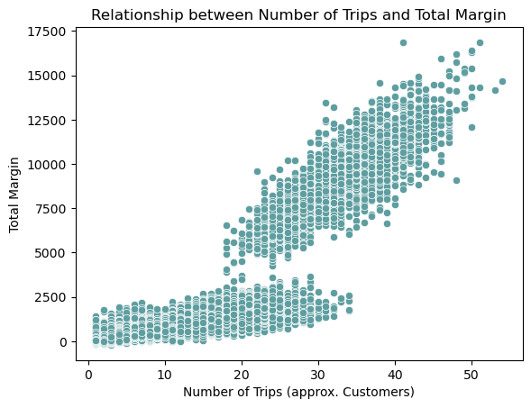
Analysis between total margin and number of trips

Slide 8
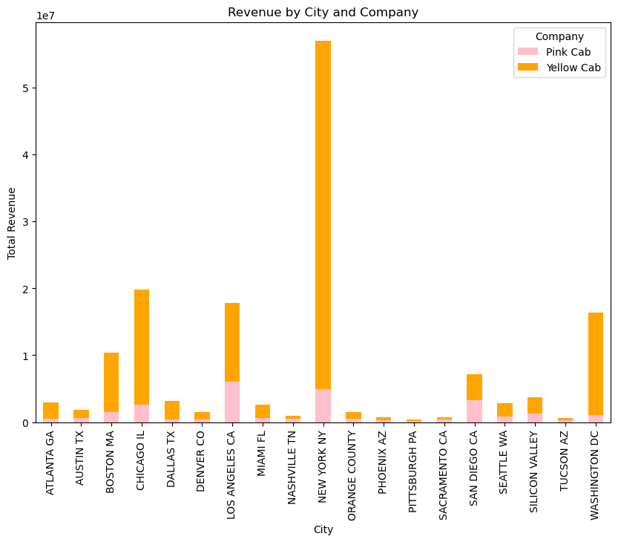
Revenue by city and company

Slide 9
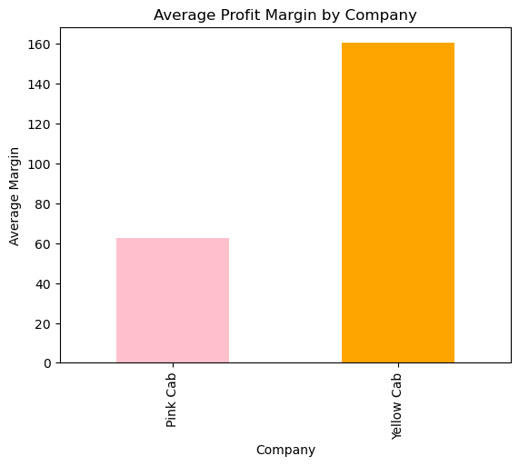
Profit Analysis
Profit Analysis
The pink color refers to the Pink Cab company, while the orange color refers to the Yellow Cab company.

Slide 10
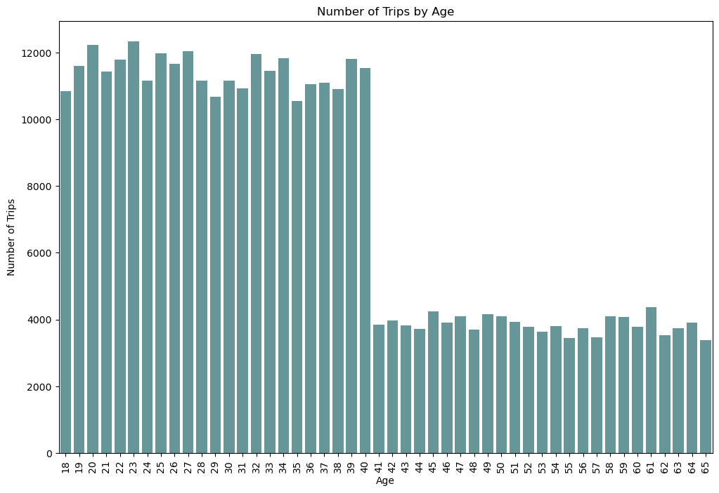
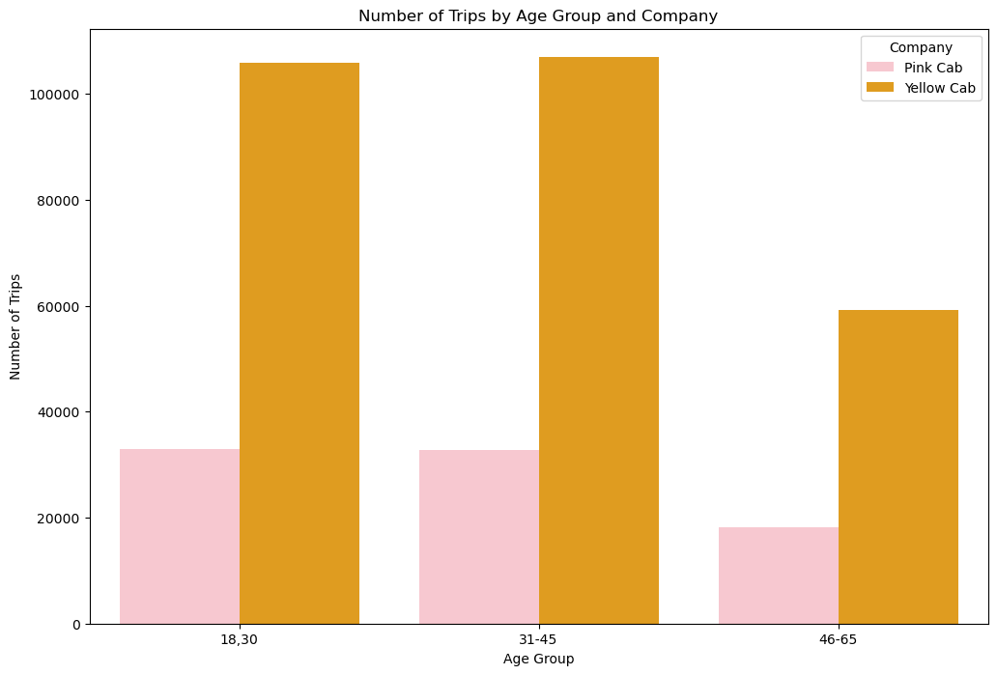
Age GroupWise And Customer Base Analysis

Slide 11
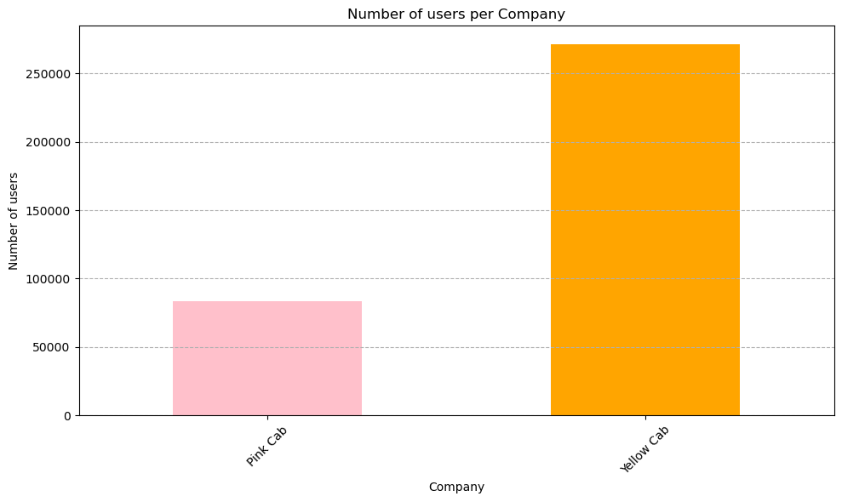
Number of users per company

Slide 12
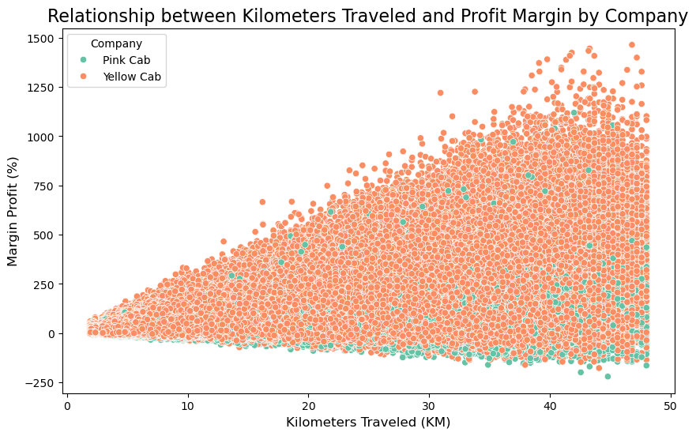
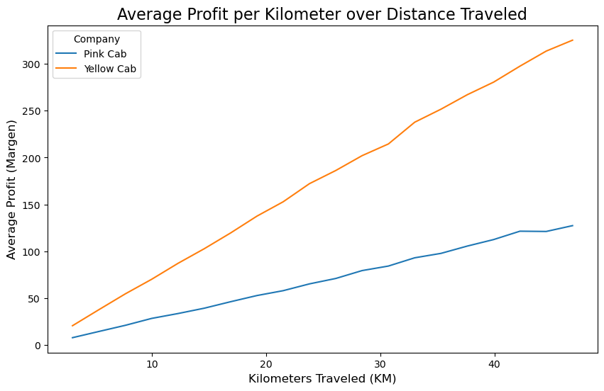
Relationship between km traveled and profit.

Slide 13
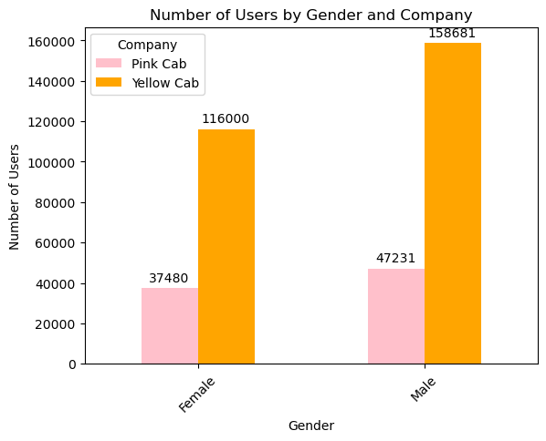
Number of user by Gender and Company

Slide 14
Recommendations
We have evaluated both the cab companies on following points and found Yellow cab better than Pink cab:
Most in-demand company: Yellow Cab is the most in-demand company among people who use this service in all cities, making it the one with the most customers and, therefore, the one that generates the most profit, while Pink Cab is the opposite.
Profit by Company: It can be observed that Pink Cab has experienced losses on certain trips, and the profit per trip does not increase significantly per kilometer, while Yellow Cab shows profit growth for each kilometer, making it a good option to quickly recover the invested money.
Age wise Reach : It is observed that the age range that uses the service the most is between 18 and 40 years old and the majority of customers are men
Income wise Reach :Both the cabs are very popular in high and medium income class but here also Yellow cab is performing better than Pink cab in offering their services to all the three income class group (low, medium and high)
Payment Methods: It is evident that the most popular method among customers is credit card payments, and this is likely to increase each year with technological advancements. Currently, there are other payment methods available, which can be implemented as well.

Slide 15
Thank You

