Slide 1
OptimAG
Rigid business solutions

Slide 2
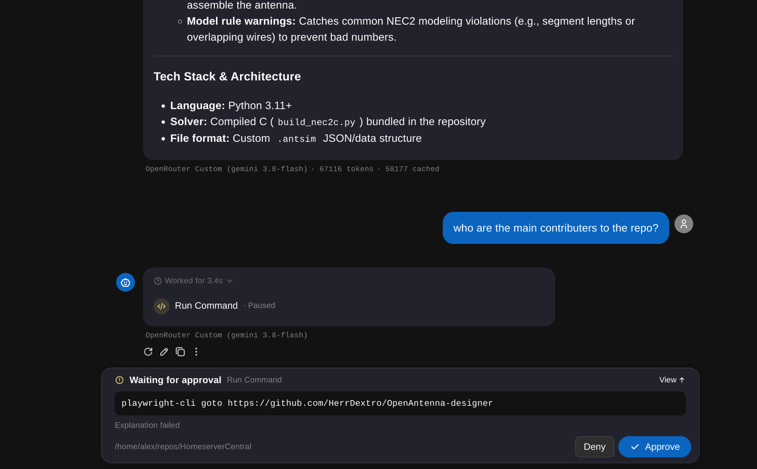
The problem
OptimAG – Straub, Münger, de Vries, Dijkstra

Slide 3
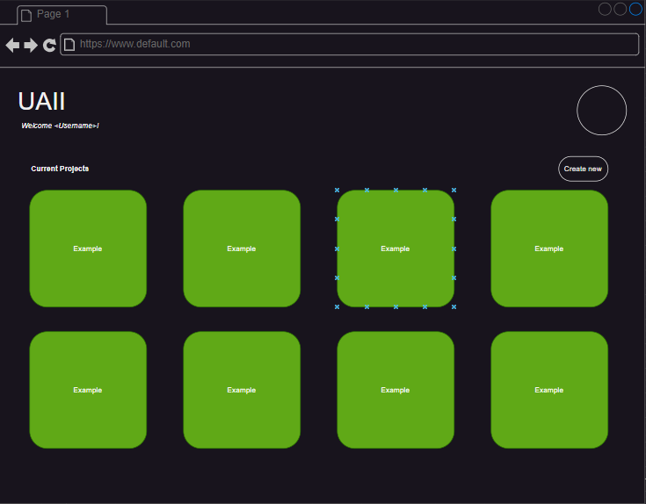
Our solution
OptimAG – Straub, Münger, de Vries, Dijkstra

Slide 4
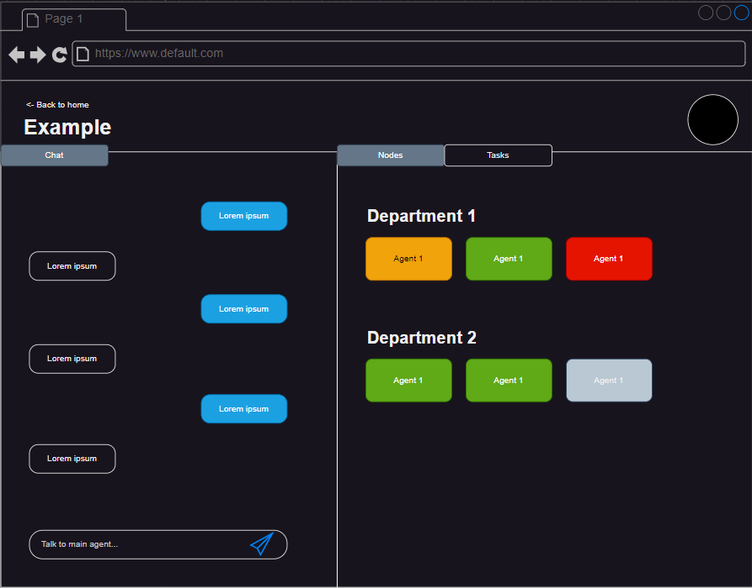
Our solution
OptimAG – Straub, Münger, de Vries, Dijkstra

Slide 5
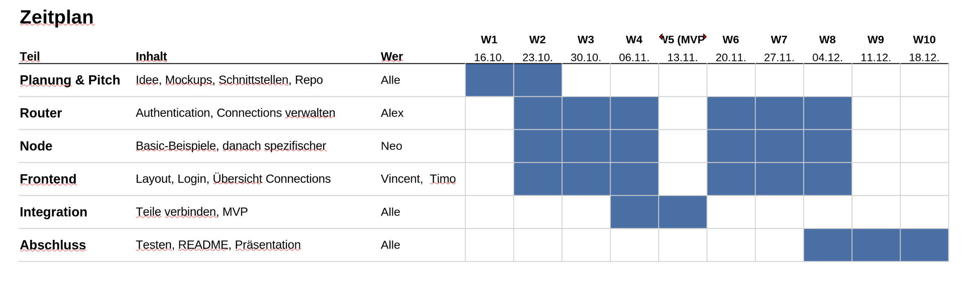
The plan
OptimAG – Straub, Münger, de Vries, Dijkstra

Slide 6

Why us?
Fachkompetent
Sicherheitsbewusst
Zukunftsorientiert
OptimAG – Straub, Münger, de Vries, Dijkstra

Slide 7
OptimAG
Rigid business solutions

