Slide 1
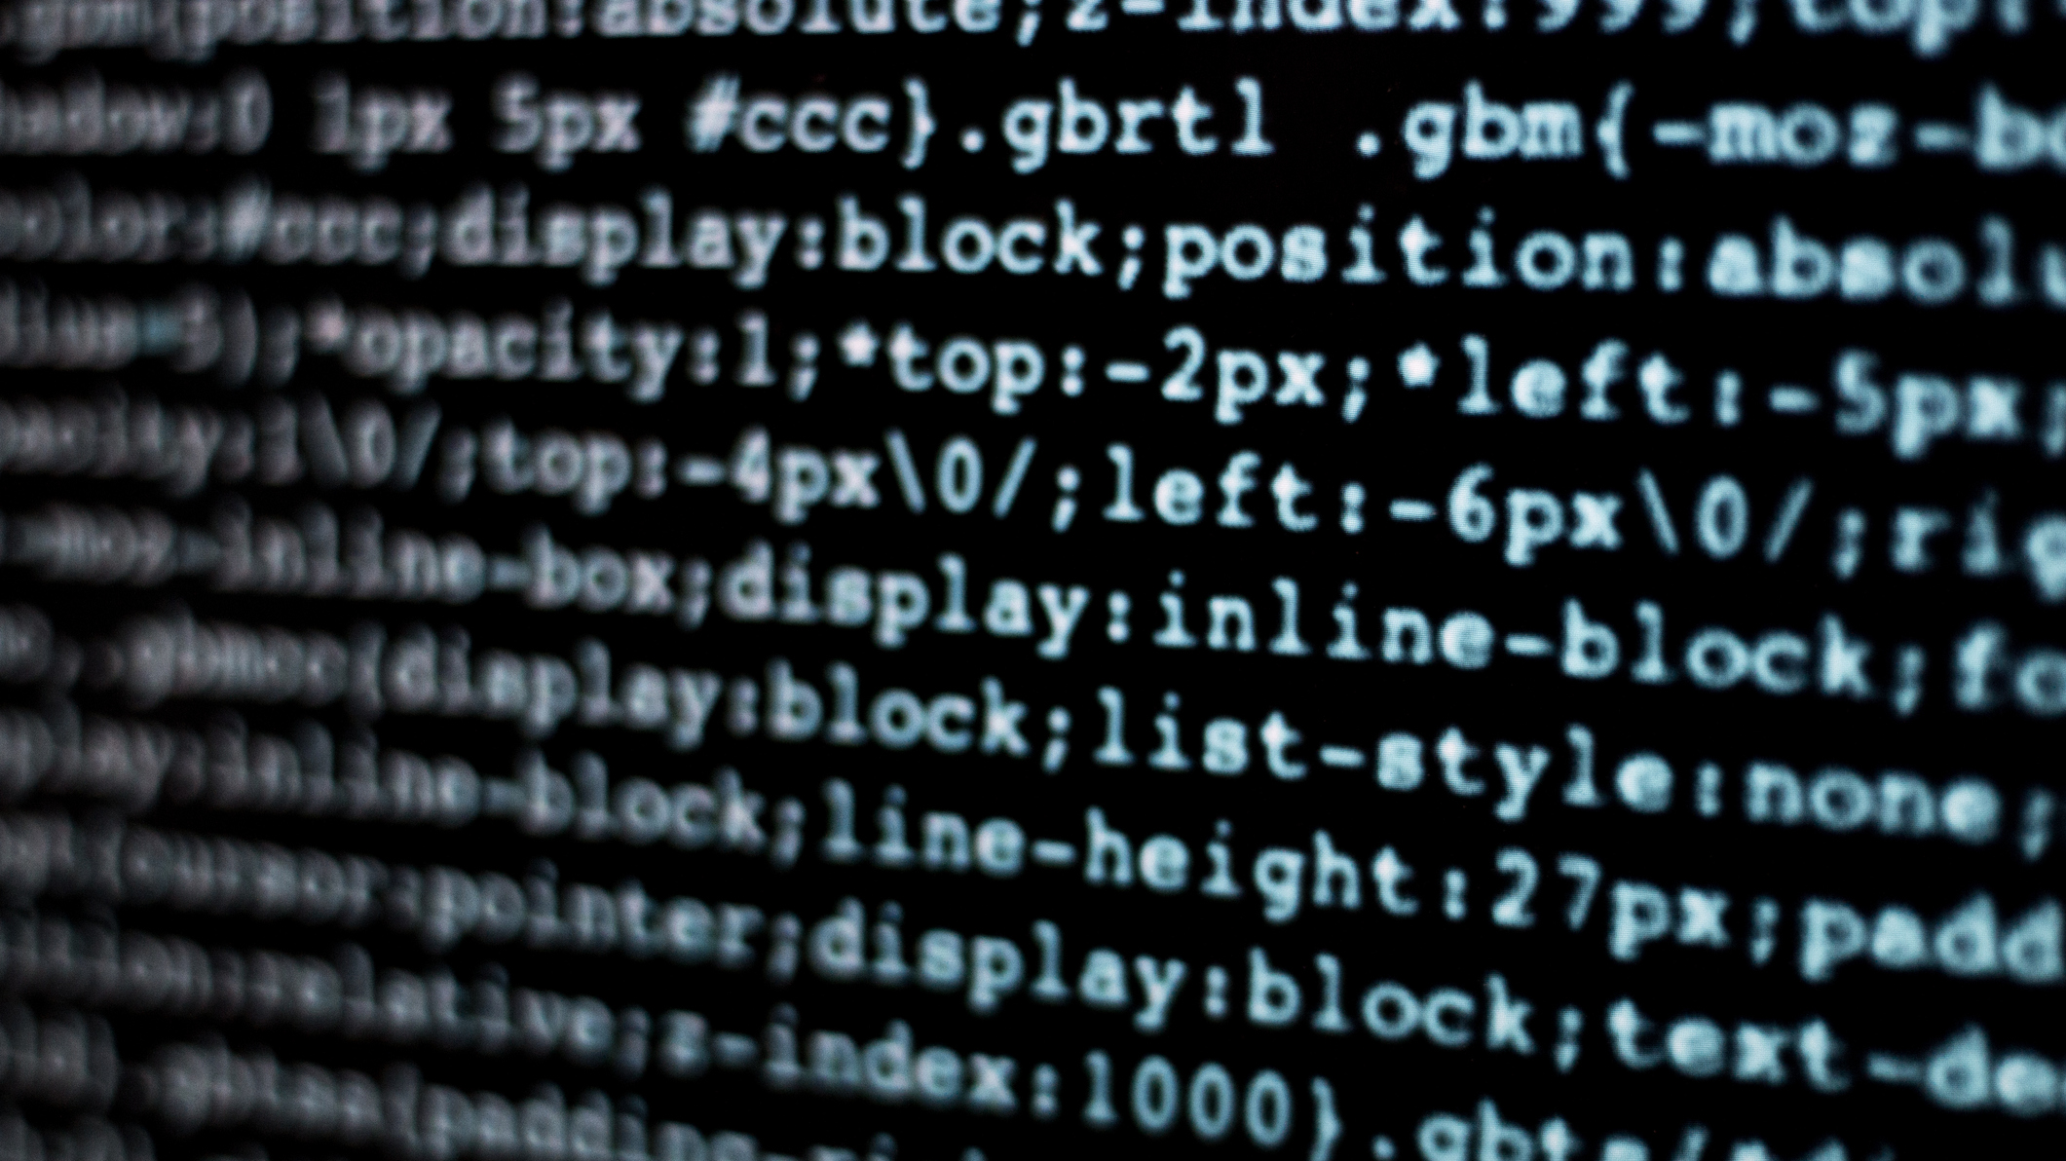
Essentials of SD
Keira Hancock

Slide 2

Components of the computer
Lesson 1

Slide 3
RaM
Random Access Memory.
Where data/files are stored (similar to the hard drive), with small storage space for instant access.
If your computer has 1000 gigabytes of storage space in your hard drive, it likely has 16 gigabytes worth of RAM.

Slide 4
CPU
Central Processing Unit.
Reading and arranging data, and doing calculations needed to run programs.
Often referred to as the “Brain of the Computer”.

Slide 5
Graphics card
Graphics Processing Unit.
Figures out what pixels need to light up on your screen, as well as the colour and time.
A standalone computer.

Slide 6

Timeline history
Lesson 2

Slide 7
The first hard drive
Created in 1957.
It made it possible for any computer user to quickly and easily store, access, alter, and erase data without training or manual intervention.
The RAMAC held 5mB of data.
The first hard drive was as big as a 2 refridgerators.

Slide 8
mp944
Created in 1970.
The Mp944 represented a breakthrough in terms of the size and cost of a computer system.
The world’s first microprocessor.
The Mp944 was used on US military aircrafts like the F-14 fighter jets.

Slide 9
Intel 4004
Created in 1971, made by Federico Faggin.
Enabled the creation of small , powerful, and affordable electronic devices.
The first commercially available microprocessor.
Maximum clock rate was 740 kHz, able to directly address 640 bytes of RAM.

Slide 10

Failures in the computer industry
Lesson 3

Slide 11
ILOVEYOU
Tens of millions of people around the world recieved an e-mail with the subject “ILOVEYOU”. The hidden malware would destructively overwrite files on the computer.
The malware caused $8 billion in damages and $15 billion to remove from computer systems.
Improved cybersecurity and awareness could’ve potentially prevented hacking.
The file was called “LOVE-LETTER-FOR-YOUTXT.vbs”.

Slide 12
Ariane-5
The Ariane-5 exploded due to a software bug.
40 seconds after launched, the rocket exploded, losing 7 billion dollars and 10 years of work.
The programmers based their numbers on the Ariane-4 coding which was much slower than the Ariane-5, reevaluating the numbers could’ve prevented this.
The only error in the otherwise perfect coding was a line of code that tried to fit a 64 bit number into a 16 bit space.

Slide 13
Boeing737 max
The software system MCAS was implemented to avoid the increased cost of pilot retraining for the new characteristics on the plane.
Two planes and 346 lives were lost.
If the pilot retraining had been done, the software MCAS would not have been added, therefore potentially preventing the damage.
Since these crashes, the 737-MAX has been grounded worldwide and is not allowed to fly passengers.

Slide 14

careers
Lesson 4

Slide 15
Machine learning engineer
Combining software engineering and data science.
Making sure the data coming in is interpreted properly and then implemented in the company’s programs and applications so that someone is able to use it.
Job outlook: predicts a 23% growth rate from 2022-2032.
Salary: $114k

Slide 16
Computer network architect
Creating new networks and new ways of transferring big data communication at the company.
Work on ways for the company to move, interpret and send data.
Sending data securely.
Job outlook: predicts a 13% growth rate from 2023-2033.
Salary: $120k

Slide 17
Blockchain developer
Building decentralized applications using blockchain technology.( ex: Cryptocurrency, creating a decentralized currency.)
Designing blockchain protocols, designing and developing blockchain solutions, conducting research, and ensuring security.
Job outlook: predicts a 59.9% growth rate from 2023-2030.
Salary: $154k

Slide 18

SCRIPTING vs programming
Topic chosen from “10 Things a Programmer Should Know”

Slide 19
Scripting programming
Interpreter-based languages.
Involve very low maintenance.
Require very few and short coding lines.
Requires host for execution.
Help in combining the existing components of an application.
Complier-based languages.
Involve high maintenance.
Require numerous lines of coding for a single function.
Does not require any host.
Help in developing anything from scratch.

Slide 20
Thank you
Sept 20 2024

