Slide 1
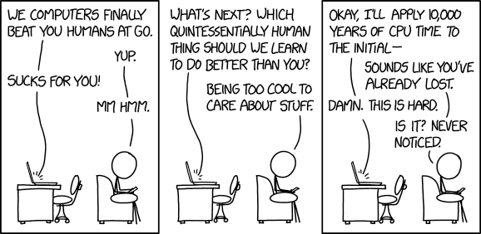
https://xkcd.com/1875/

Slide 2
COMP 309
Machine Learning Tools and Techniques
This course explores a range of machine learning tools and techniques for analysing data and automatically generating applications. The course will address tools for classification, regression, clustering and text mining, and techniques for pre-processing data and analysing the results of machine learning tools. Students will gain practical experience in applying a range of tools to a range of different data sets from different domains.

Slide 3
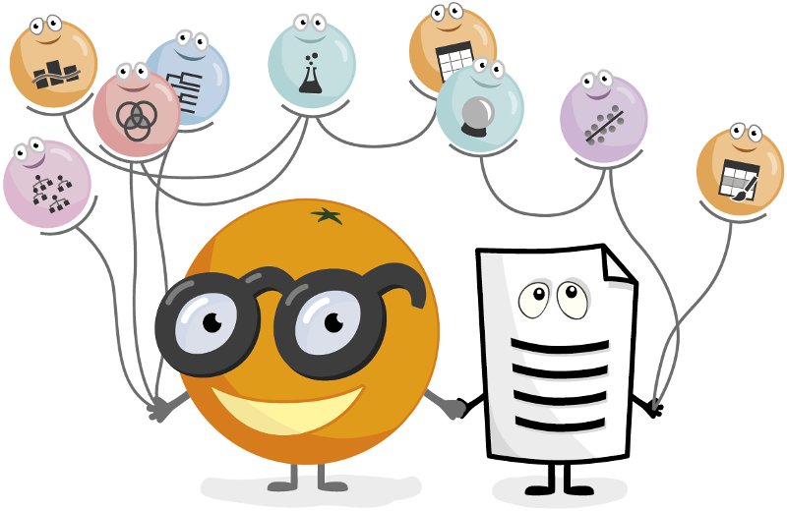


Machine Learning
An exciting and potentially far-reaching development in computer science is the invention and application of methods of machine learning (ML). These enable a computer program to automatically analyse a large body of data and decide what information is most relevant. https://www.cs.waikato.ac.nz/ml/index.html
https://orange.biolab.si/
Notes:
Delegation (‘leave me alone’)
The friend (‘be my buddy’)
The expert guide (‘tell me what to do’)
The coach (‘steer my ambition’)
The quality controller (‘keep me sharp’)
The editor (‘help me write’)

Slide 4
What Is The Difference Between Artificial Intelligence And Machine Learning?
Artificial Intelligence is the broader concept of machines being able to carry out tasks in a way that we would consider “smart”.
And,
Machine Learning is a current application of AI based around the idea that we should really just be able to give machines access to data and let them learn for themselves.
Vague
https://www.forbes.com/sites/bernardmarr/2016/12/06/what-is-the-difference-between-artificial-intelligence-and-machine-learning/
Notes:
Delegation (‘leave me alone’)
The friend (‘be my buddy’)
The expert guide (‘tell me what to do’)
The coach (‘steer my ambition’)
The quality controller (‘keep me sharp’)
The editor (‘help me write’)

Slide 5
Machine Learning?
Machine learning is the science of getting computers to act without being explicitly programmed.
In the past decade, machine learning has given us self-driving cars, practical speech recognition, effective web search, and a vastly improved understanding of the human genome. Machine learning is so pervasive today that you probably use it dozens of times a day without knowing it.
General
https://www.coursera.org/learn/machine-learning/
Notes:
Delegation (‘leave me alone’)
The friend (‘be my buddy’)
The expert guide (‘tell me what to do’)
The coach (‘steer my ambition’)
The quality controller (‘keep me sharp’)
The editor (‘help me write’)

Slide 6
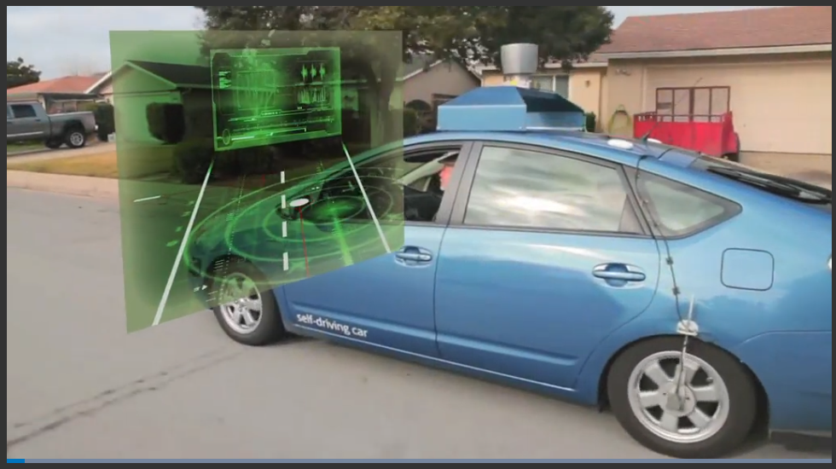
Machine Learning
Machine learning is a method of data analysis that automates analytical model building.
It is a branch of artificial intelligence based on the idea that systems can learn from data, identify patterns and make decisions with minimal human intervention.
https://www.sas.com/en_nz/insights/analytics/machine-learning.html
Notes:
Delegation (‘leave me alone’)
The friend (‘be my buddy’)
The expert guide (‘tell me what to do’)
The coach (‘steer my ambition’)
The quality controller (‘keep me sharp’)
The editor (‘help me write’)

Slide 7
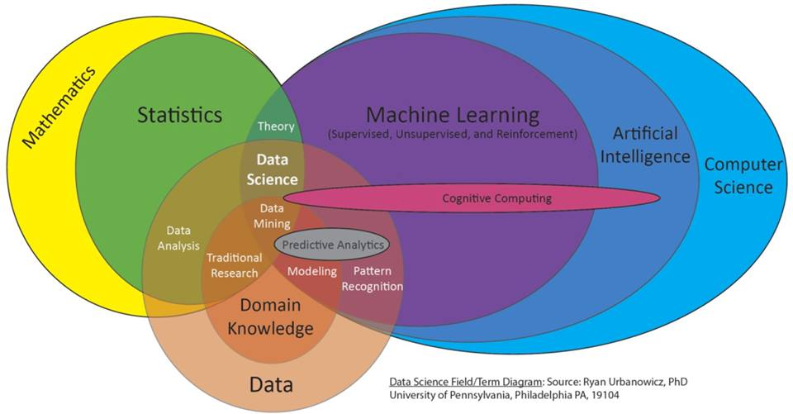
Machine learning

Slide 8
Machine learning
Traditional Programming
Machine Learning
Data
Computer
Target Output
Algorithm
Data
Computer
Algorithm
Target Output
homes.cs.washington.edu/~pedrod/smlr.pptx

Slide 9
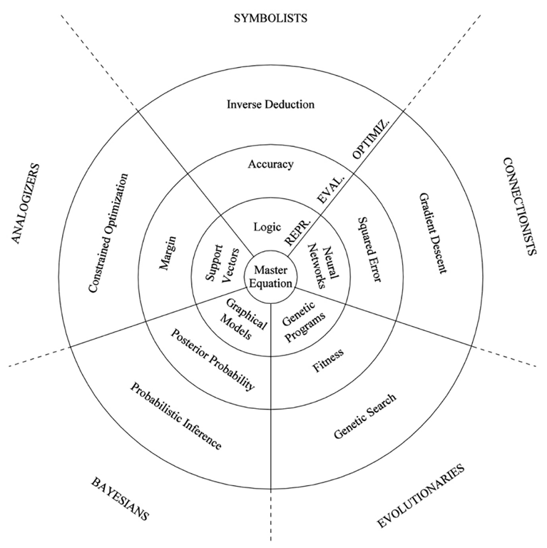
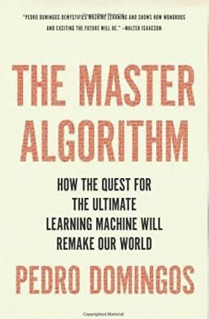
5 Tribes of AI
https://medium.com/42ai/the-5-tribes-of-the-ml-world-670ebce96b4c

Slide 10
5 Tribes of AI
The purpose of Machine Learning, according to the author, is to create The Master Algorithm: an algorithm capable of finding knowledge and generalizing from any kind of data. The algorithm must use paradigms and techniques from each and every tribe.
“One Algorithm to rule them all, One algorithm to find them,
One Algorithm to bring them all and in the darkness bind them,
In the Land of Learning where the Data lies”
https://medium.com/42ai/the-5-tribes-of-the-ml-world-670ebce96b4c

Slide 11
5 Tribes of AI
five basic methods of computer knowledge acquisition:
filling in gaps in existing knowledge
mimicking the human brain
simulating the evolutionary process
reducing uncertainties
making contrast between old and new sets of information
https://medium.com/42ai/the-5-tribes-of-the-ml-world-670ebce96b4c

Slide 12
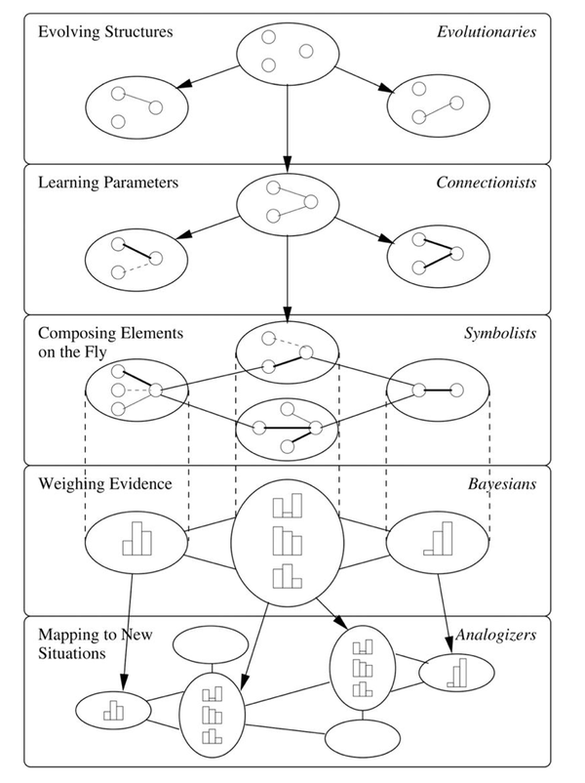
5 Tribes of AI
https://medium.com/42ai/the-5-tribes-of-the-ml-world-670ebce96b4c

Slide 13
The Symbolists
The Symbolises work on the premise of inverse deduction.
Instead of starting with the premise and looking for the conclusions, inverse deduction starts with some premises and conclusions, and essentially works backward to fill in the gaps.
The system has to ask itself “what is the knowledge that is missing?” and acquire that knowledge through analysis of existing data sets.
“It’s an ever-growing virtual circle of knowledge,”
http://www.dataversity.net/pedro-domingos-on-five-machine-learning-tribes/

Slide 14
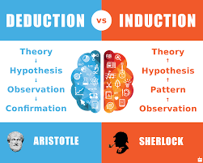
Inverse Deduction (i.e. Induction)
Deduction
Induction
Socrates is human
+ Humans are mortal .
―――――――――――
= ?
Socrates is human
+ ?
―――――――――――
= Socrates is mortal
――――――――――
――――――――――

Slide 15
Connectionists
“Connectionists” want to reverse engineer the brain.
Create artificial neurons and connect them in a neural network.
Neurons work on a weighted value of inputs, and how binary results can be enhanced into a “continuous value” with methods like back propagation. All of this leads the computer to be able to learn more about a given set of information criteria – in this case, about what is and is not a cat, to be able to more correctly label random sets of images.
http://www.dataversity.net/pedro-domingos-on-five-machine-learning-tribes/

Slide 16
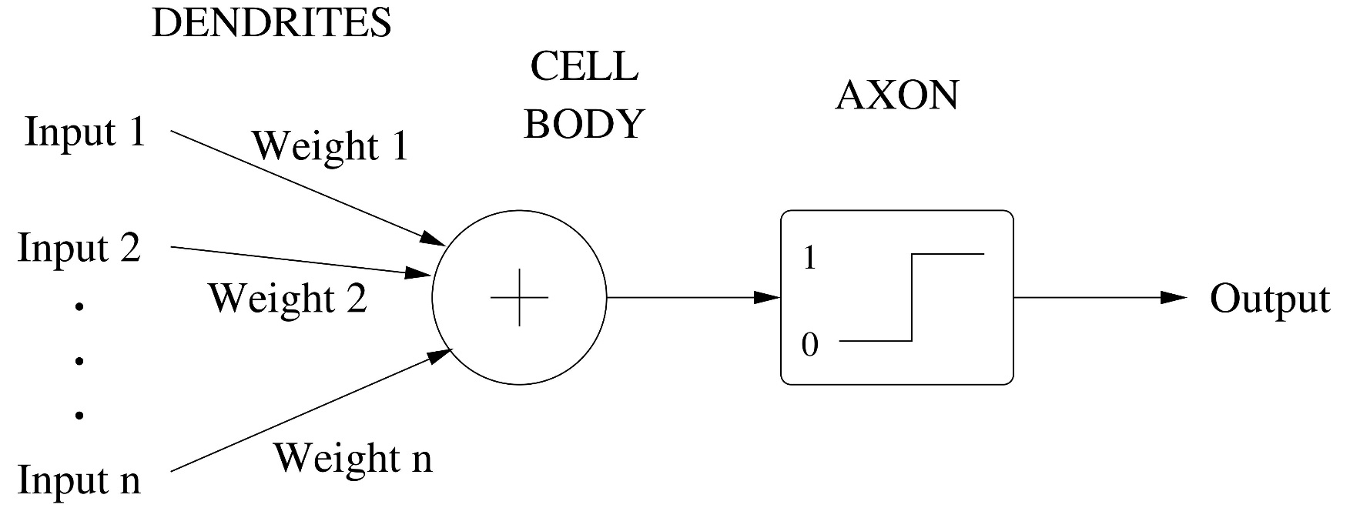
An Artificial Neuron

Slide 17
The Evolutionaries
“Evolution made your brain and everything else,”
Evolutionaries are applying the idea of genomes and DNA in the evolutionary process to data structures.
The survival and offspring of units in an evolutionary model are the performance data. An algorithm for an evolutionary learning project would mimic those processes in key ways.
http://www.dataversity.net/pedro-domingos-on-five-machine-learning-tribes/

Slide 18
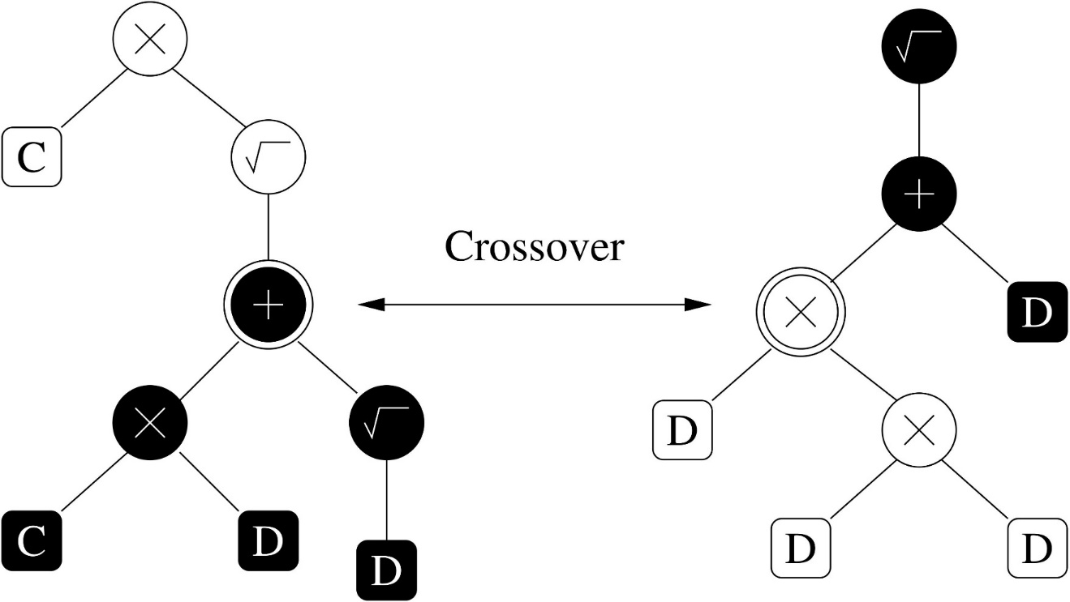
Genetic Programming

Slide 19
The Bayesians
Bayesian deal in uncertainty and solutions.
Their master algorithm solution is called probabilistic inference.
Take a hypothesis and apply a type of “a priori” thinking, believing that there will be some outcomes that are more likely.
Update a hypothesis as you see more data to make some hypotheses become more likely than others.
As a sort of scientific process, the probabilistic models do bring a certain concrete result to Machine Learning.

Slide 20
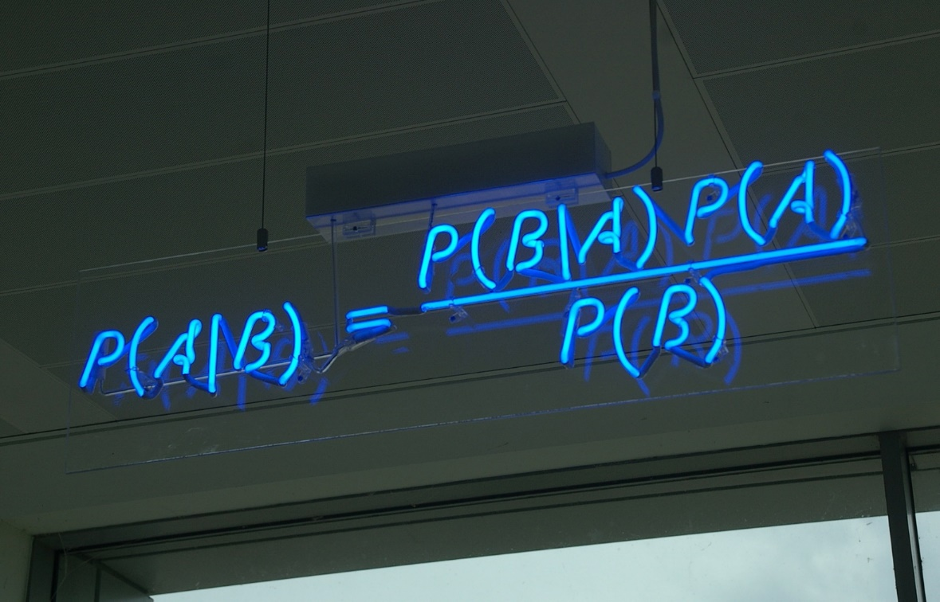
Probabilistic Inference

Slide 21
The Analogizers
The analogizers, or pioneers in the field of matching particular bits of data to each other.
“all intelligence is nothing but analogy.”
Douglas Hofstadter
The master algorithm is the “nearest neighbor” principle. “generalizing from similarity”
It’s a very nice type of similarity-based learning and useful:
One third of Amazon sales are based on recommendations.
http://www.dataversity.net/pedro-domingos-on-five-machine-learning-tribes/

Slide 22
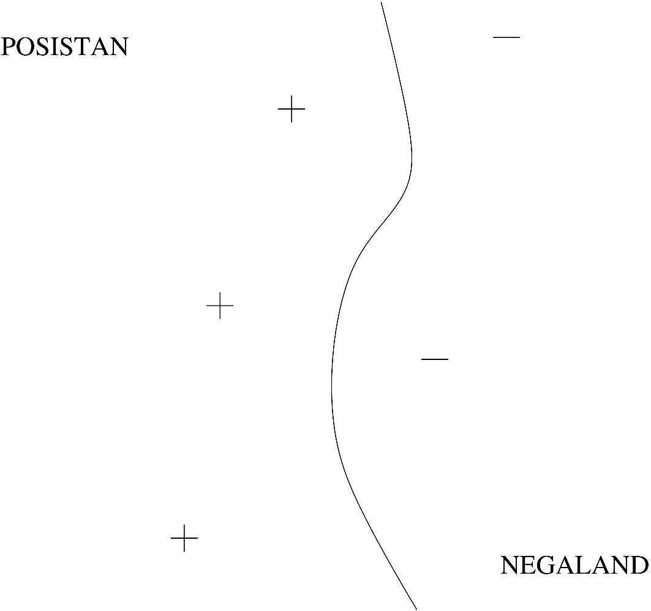
Kernel Machines
Decision boundary

Slide 23
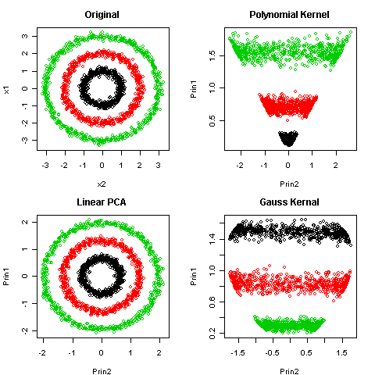
Kernel Machines
https://programmingsas.wordpress.com/2010/02/06/sas-implementation-of-kernel-pca/

