Slide 1
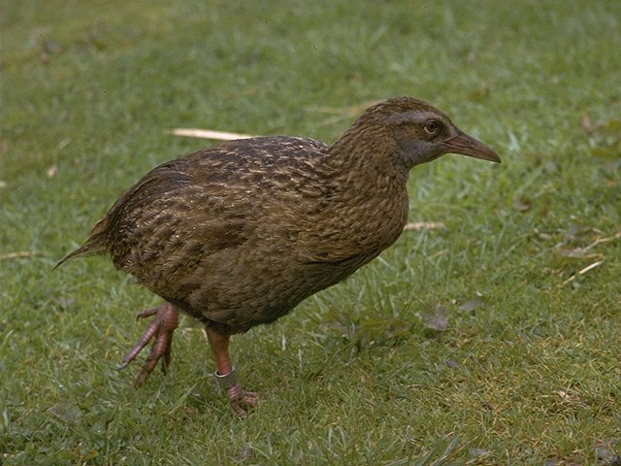
Waikato Environment
For
Knowledge Analysis

Slide 2
Outline
Rationale
Introduction
Getting started
Exploring the Explorer
Preprocessing
Learning
Visualization
Take Home Message

Slide 3

Rationale
Hmm….
Integral part of syllabus
Great Data Mining Tool
Applied in real-life applications
Freely available under GNU license
Ease of use due to its graphical user interfaces
A comprehensive collection of data preprocessing and modeling techniques
Jobs hunting
Source [1]
Notes:
University of Wales, Cardiff, U.K

Slide 4
Outline
Rationale
Introduction
Getting started
Exploring the Explorer
Preprocessing
Learning
Visualization
Take Home Message

Slide 5
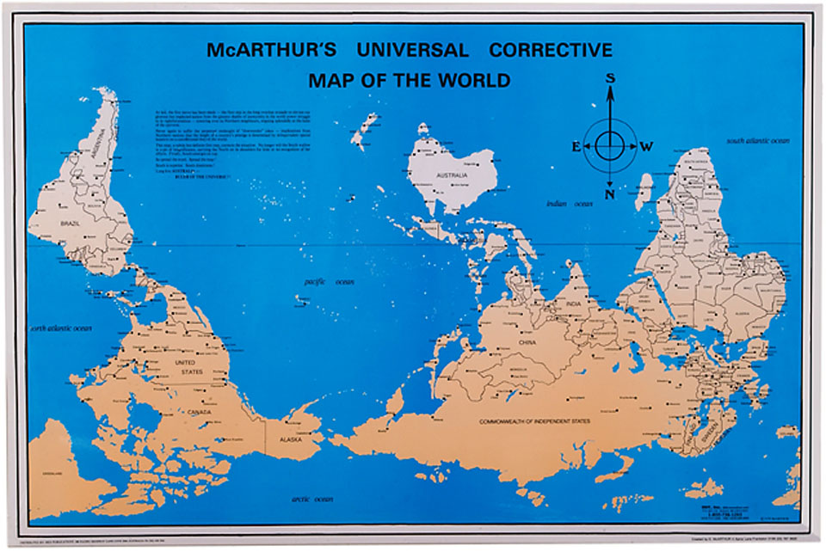
Introduction

Slide 6



Introduction
Hamilton

Slide 7
Introduction . . .
Collection of state-of-the-art machine learning algorithms and data processing tools
Support for the whole process of experimental data mining
Preparation of input data
Statistical evaluation of learning schemes
Visualization of input data and the result of learning

Slide 8
Introduction . . .
49 data preprocessing tools
76 classification/regression algorithms
8 clustering algorithms
15 attribute/subset evaluators
10 search algorithms for feature selection
3 algorithms for finding association rules
3 graphical user interfaces
“The Explorer” (exploratory data analysis)
“The Experimenter” (experimental environment)
“The KnowledgeFlow” (new process model inspired interface)

Slide 9
Introduction . . .
Interpretation
Identify a problem
Transform into data
Evaluation
Choose appropriate DM technique
Apply to data

Slide 10
Outline
Rationale
Introduction
Getting started
Exploring the Explorer
Preprocessing
Learning
Visualization
Take Home Message

Slide 11
Getting Started
Installation
Support
Website
https://www.cs.waikato.ac.nz/ml/weka/
https://en.wikipedia.org/wiki/Weka_(machine_learning)
Notes:
The propensity of a specific cognitive process, or a neural function, to be performed more efficiently and precisely by one hemisphere as compared to the other is called hemispheric lateralization. Hemispheres have distinct functionality, neurochemistry, neuroanatomy, and composition at micro-level. The analysis of the patients with severed corpus callosum, known as ``split-brain'' patients, has provided a striking demonstration of hemispheric lateralization. Since the left visual field is controlled by the right hemisphere. It has been reported that if an object, e.g. a key, is presented in the region of the left visual field. The split-brain patients can draw it by left hand as well as can distinguish the key from a collection of objects. However, the patients cannot say that they have seen a key because they are totally unaware that they saw the key.
Old fashioned view of LH and RH brain not quite right e.g. change occurs in both

Slide 12

Getting Started
Notes:
The propensity of a specific cognitive process, or a neural function, to be performed more efficiently and precisely by one hemisphere as compared to the other is called hemispheric lateralization. Hemispheres have distinct functionality, neurochemistry, neuroanatomy, and composition at micro-level. The analysis of the patients with severed corpus callosum, known as ``split-brain'' patients, has provided a striking demonstration of hemispheric lateralization. Since the left visual field is controlled by the right hemisphere. It has been reported that if an object, e.g. a key, is presented in the region of the left visual field. The split-brain patients can draw it by left hand as well as can distinguish the key from a collection of objects. However, the patients cannot say that they have seen a key because they are totally unaware that they saw the key.
Old fashioned view of LH and RH brain not quite right e.g. change occurs in both

Slide 13
Getting Started
Data Formats
ARFF, CSV, C4.5, binary
Filters
Discretization
Normalization
Resampling
Attribute selection
Transforming & combining attributes
Notes:
The propensity of a specific cognitive process, or a neural function, to be performed more efficiently and precisely by one hemisphere as compared to the other is called hemispheric lateralization. Hemispheres have distinct functionality, neurochemistry, neuroanatomy, and composition at micro-level. The analysis of the patients with severed corpus callosum, known as ``split-brain'' patients, has provided a striking demonstration of hemispheric lateralization. Since the left visual field is controlled by the right hemisphere. It has been reported that if an object, e.g. a key, is presented in the region of the left visual field. The split-brain patients can draw it by left hand as well as can distinguish the key from a collection of objects. However, the patients cannot say that they have seen a key because they are totally unaware that they saw the key.
Old fashioned view of LH and RH brain not quite right e.g. change occurs in both

Slide 14
Outline
Rationale
Introduction
Getting started
Exploring the Explorer
Preprocessing
Learning
Visualization
Take Home Message

Slide 15
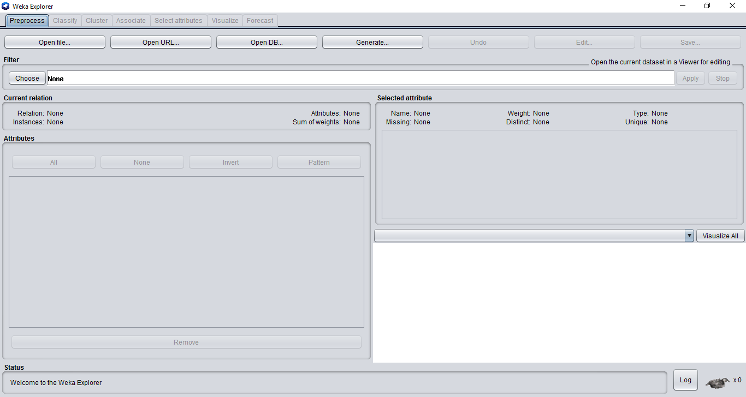
Explorer
Notes:
The propensity of a specific cognitive process, or a neural function, to be performed more efficiently and precisely by one hemisphere as compared to the other is called hemispheric lateralization. Hemispheres have distinct functionality, neurochemistry, neuroanatomy, and composition at micro-level. The analysis of the patients with severed corpus callosum, known as ``split-brain'' patients, has provided a striking demonstration of hemispheric lateralization. Since the left visual field is controlled by the right hemisphere. It has been reported that if an object, e.g. a key, is presented in the region of the left visual field. The split-brain patients can draw it by left hand as well as can distinguish the key from a collection of objects. However, the patients cannot say that they have seen a key because they are totally unaware that they saw the key.
Old fashioned view of LH and RH brain not quite right e.g. change occurs in both

Slide 16
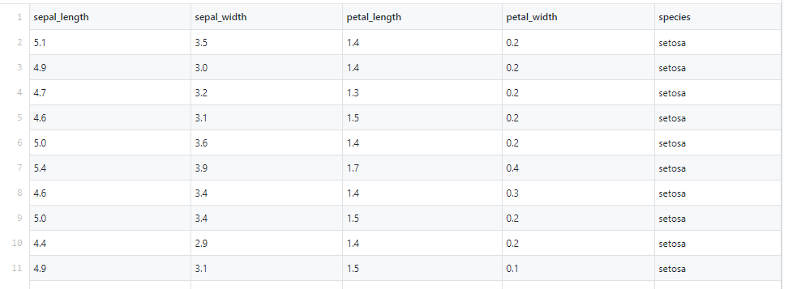
Explorer
Notes:
The propensity of a specific cognitive process, or a neural function, to be performed more efficiently and precisely by one hemisphere as compared to the other is called hemispheric lateralization. Hemispheres have distinct functionality, neurochemistry, neuroanatomy, and composition at micro-level. The analysis of the patients with severed corpus callosum, known as ``split-brain'' patients, has provided a striking demonstration of hemispheric lateralization. Since the left visual field is controlled by the right hemisphere. It has been reported that if an object, e.g. a key, is presented in the region of the left visual field. The split-brain patients can draw it by left hand as well as can distinguish the key from a collection of objects. However, the patients cannot say that they have seen a key because they are totally unaware that they saw the key.
Old fashioned view of LH and RH brain not quite right e.g. change occurs in both

Slide 17
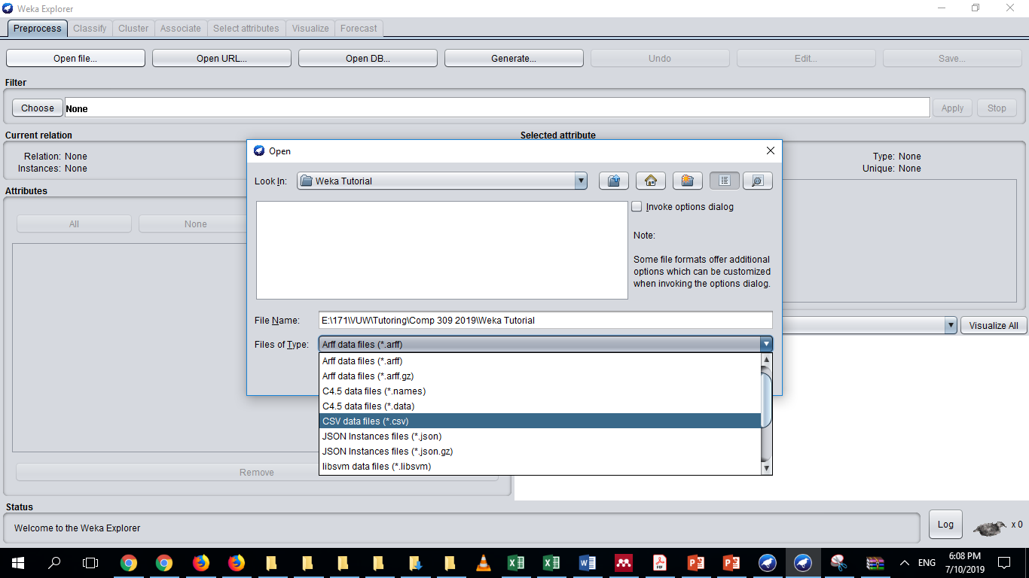
Explorer
Notes:
The propensity of a specific cognitive process, or a neural function, to be performed more efficiently and precisely by one hemisphere as compared to the other is called hemispheric lateralization. Hemispheres have distinct functionality, neurochemistry, neuroanatomy, and composition at micro-level. The analysis of the patients with severed corpus callosum, known as ``split-brain'' patients, has provided a striking demonstration of hemispheric lateralization. Since the left visual field is controlled by the right hemisphere. It has been reported that if an object, e.g. a key, is presented in the region of the left visual field. The split-brain patients can draw it by left hand as well as can distinguish the key from a collection of objects. However, the patients cannot say that they have seen a key because they are totally unaware that they saw the key.
Old fashioned view of LH and RH brain not quite right e.g. change occurs in both

Slide 18
Outline
Rationale
Introduction
Getting started
Exploring the Explorer
Preprocessing
Learning
Visualization
Take Home Message

Slide 19
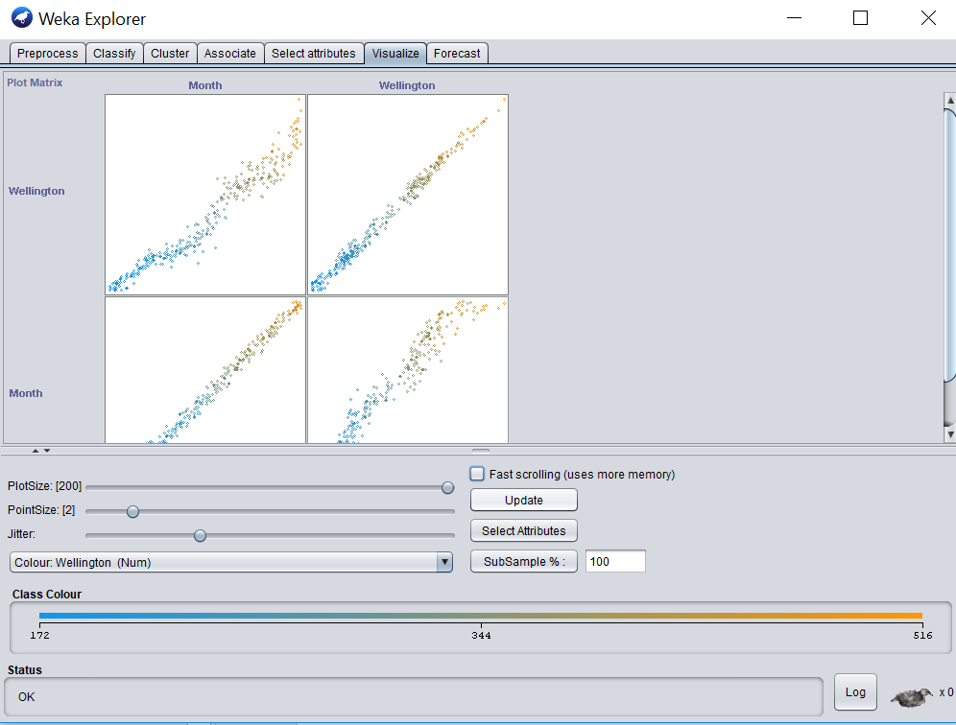
Visualization
Notes:
The propensity of a specific cognitive process, or a neural function, to be performed more efficiently and precisely by one hemisphere as compared to the other is called hemispheric lateralization. Hemispheres have distinct functionality, neurochemistry, neuroanatomy, and composition at micro-level. The analysis of the patients with severed corpus callosum, known as ``split-brain'' patients, has provided a striking demonstration of hemispheric lateralization. Since the left visual field is controlled by the right hemisphere. It has been reported that if an object, e.g. a key, is presented in the region of the left visual field. The split-brain patients can draw it by left hand as well as can distinguish the key from a collection of objects. However, the patients cannot say that they have seen a key because they are totally unaware that they saw the key.
Old fashioned view of LH and RH brain not quite right e.g. change occurs in both

Slide 20
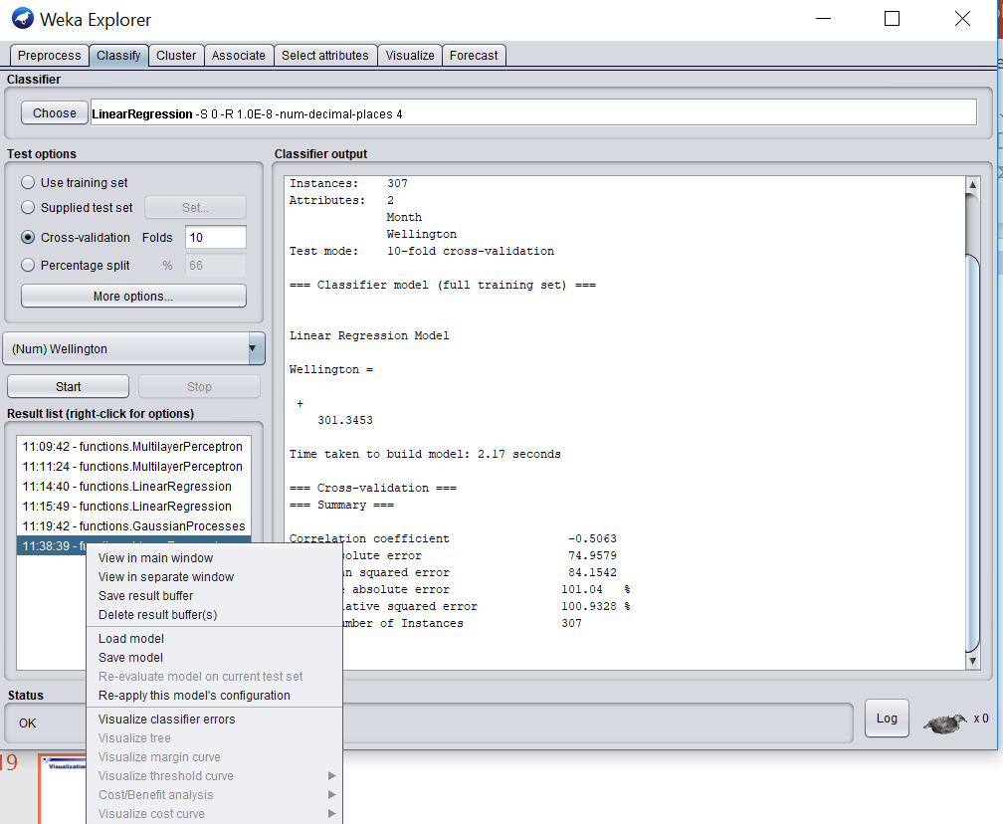
Visualization
Notes:
The propensity of a specific cognitive process, or a neural function, to be performed more efficiently and precisely by one hemisphere as compared to the other is called hemispheric lateralization. Hemispheres have distinct functionality, neurochemistry, neuroanatomy, and composition at micro-level. The analysis of the patients with severed corpus callosum, known as ``split-brain'' patients, has provided a striking demonstration of hemispheric lateralization. Since the left visual field is controlled by the right hemisphere. It has been reported that if an object, e.g. a key, is presented in the region of the left visual field. The split-brain patients can draw it by left hand as well as can distinguish the key from a collection of objects. However, the patients cannot say that they have seen a key because they are totally unaware that they saw the key.
Old fashioned view of LH and RH brain not quite right e.g. change occurs in both

Slide 21
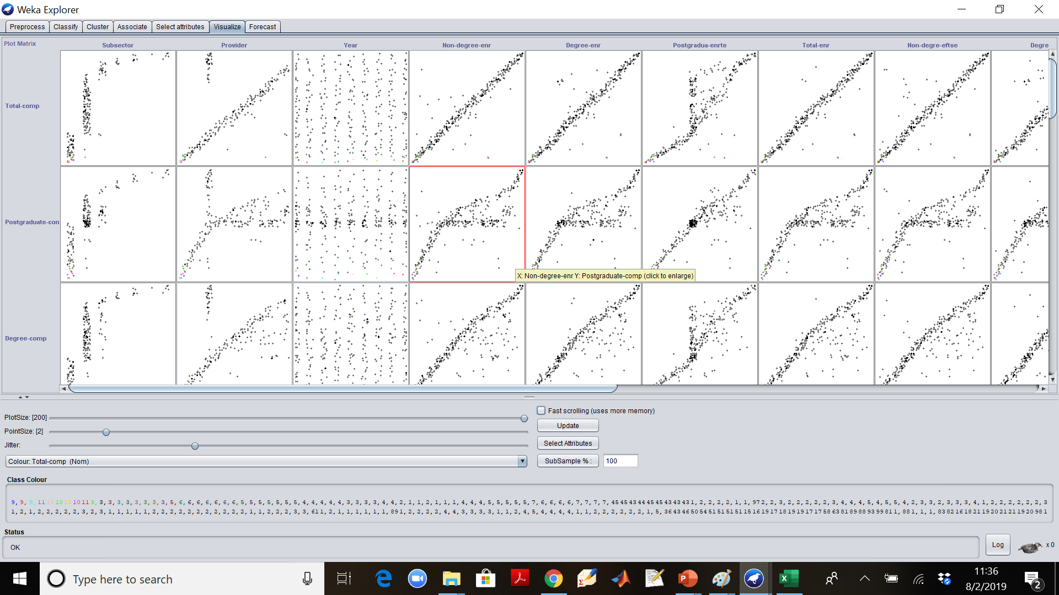
Visualization
Notes:
The propensity of a specific cognitive process, or a neural function, to be performed more efficiently and precisely by one hemisphere as compared to the other is called hemispheric lateralization. Hemispheres have distinct functionality, neurochemistry, neuroanatomy, and composition at micro-level. The analysis of the patients with severed corpus callosum, known as ``split-brain'' patients, has provided a striking demonstration of hemispheric lateralization. Since the left visual field is controlled by the right hemisphere. It has been reported that if an object, e.g. a key, is presented in the region of the left visual field. The split-brain patients can draw it by left hand as well as can distinguish the key from a collection of objects. However, the patients cannot say that they have seen a key because they are totally unaware that they saw the key.
Old fashioned view of LH and RH brain not quite right e.g. change occurs in both

Slide 22
Take Home Message
Weka is a Great Data Mining Tool
Analyze the data
Visualize data patterns
Visualize Decision Trees
A large collection of data mining tools can easily be applied on a variety of application

