Slide 1
Csc 102 algorithm assignment
MARTINS KEISHA MEJIRO
20120612141
^{APRIL 2021}

Slide 2
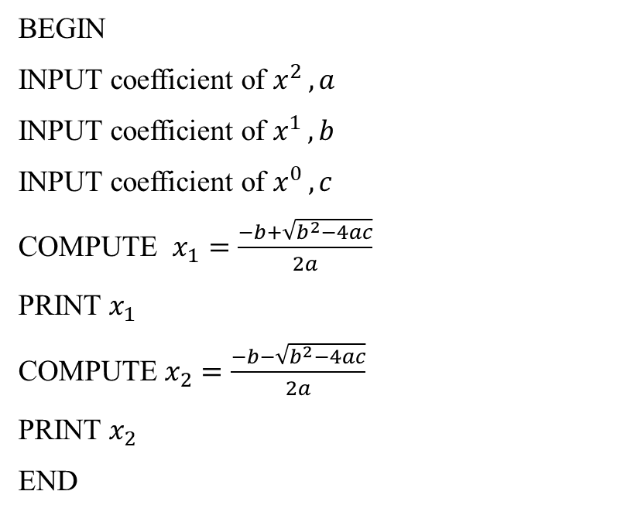
PSEUDOCODE TO FIND THE ROOTS OF A QUADRATIC EQUATION
BEGIN
Input coefficient of $x^{2 }, a$
Input coefficient of $x^{1 }, b$
Input coefficient of $x^{0 }, c$
COMPUTE $x_{1}=\frac{−b+\sqrt{b^{2}−4ac}}{2a}$
PRINT $x_{1}$
COMPUTE $x_{2}=\frac{−b−\sqrt{b^{2}−4ac}}{2a}$
PRINT $x_{2}$
END

Slide 3





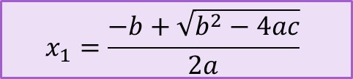
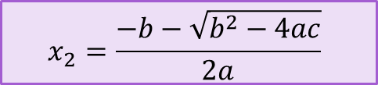
START
FLOWCHART TO FIND THE ROOTS OF A QUADRATIC EQUATION
Input coefficient of $x^{2 }, a$
Input coefficient of $x^{1 }, b$
Input coefficient of $x^{0 }, c$
$$x_{1}=\frac{−b+\sqrt{b^{2}−4ac}}{2a}$$
PRINT $x_{1}$
$$x_{2}=\frac{−b−\sqrt{b^{2}−4ac}}{2a}$$
PRINT $x_{2}$
STOP

Slide 4
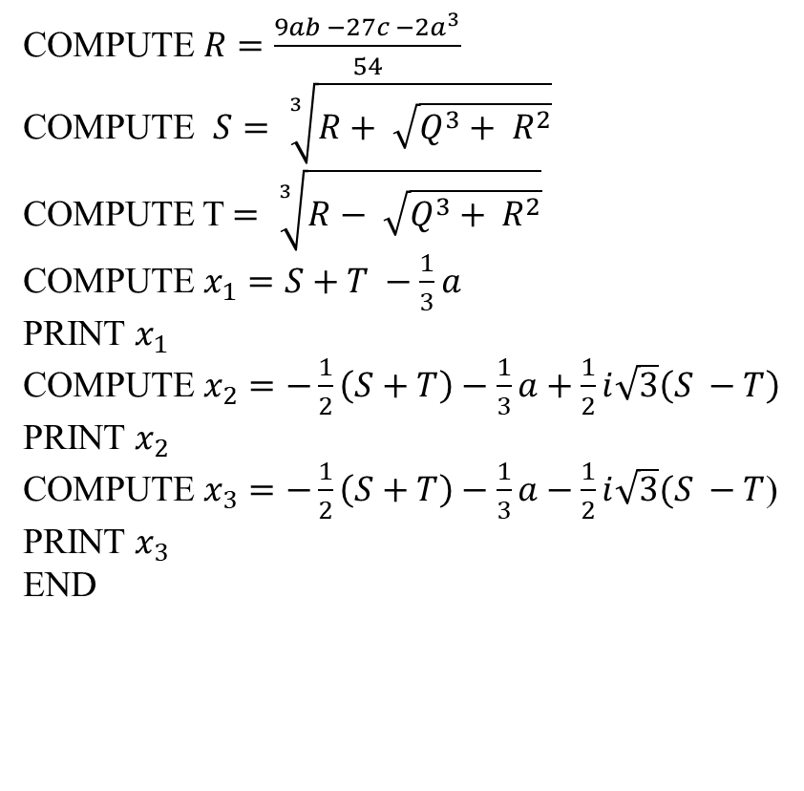
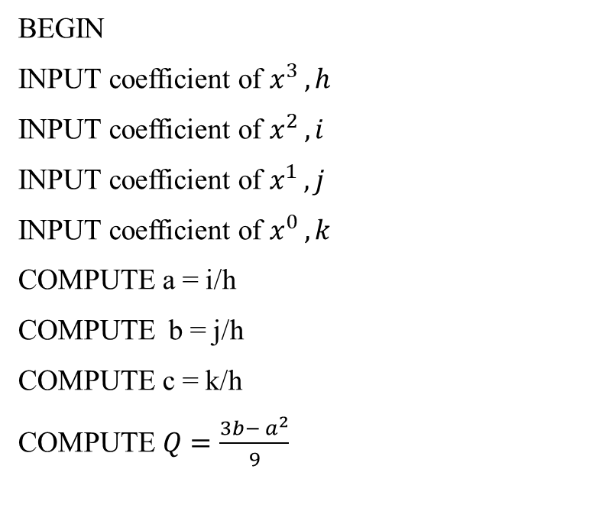
PSEUDOCODE TO FIND THE ROOTS OF A CUBIC EQUATION
BEGIN
Input coefficient of $x^{3 }, h$
Input coefficient of $x^{2 }, i$
Input coefficient of $x^{1 }, j$
Input coefficient of $x^{0 }, k$
Compute a = i/h
Compute b = j/h
Compute c = k/h
Compute $Q=\frac{3b− a^{2}}{9}$
COMPUTE $R=\frac{9ab −27c −2a^{3}}{54}$
COMPUTE $S= \sqrt[3]{R+ \sqrt{Q^{3}+ R^{2}}}$
COMPUTE T $= \sqrt[3]{R− \sqrt{Q^{3}+ R^{2}}}$
COMPUTE $x_{1}=S+T −\frac{1}{3}a$
PRINT $x_{1}$
COMPUTE $x_{2}=−\frac{1}{2}\left(S+T\right)−\frac{1}{3}a+\frac{1}{2}i\sqrt{3}\left(S −T\right)$
PRINT $x_{2}$
COMPUTE $x_{3}=−\frac{1}{2}\left(S+T\right)−\frac{1}{3}a−\frac{1}{2}i\sqrt{3}(S −T$)
PRINT $x_{3}$
END

Slide 5




START
FLOWCHART TO FIND THE ROOTS OF A CUBIC EQUATION
Input coefficient of $x^{3 }, h$
Input coefficient of $x^{2 }, i$
Input coefficient of $x^{1 }, j$
Input coefficient of $x^{0 }, k$
a = i/h
b = j/h
c = k/h

Slide 6
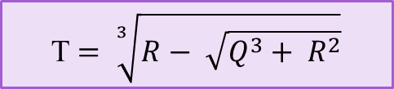

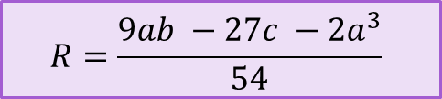
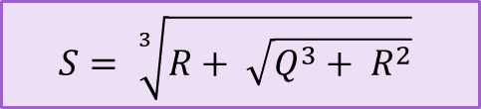
$$Q=\frac{3b− a^{2}}{9}$$
$$R=\frac{9ab −27c −2a^{3}}{54}$$
$$S= \sqrt[3]{R+ \sqrt{Q^{3}+ R^{2}}}$$
T $= \sqrt[3]{R− \sqrt{Q^{3}+ R^{2}}}$

Slide 7

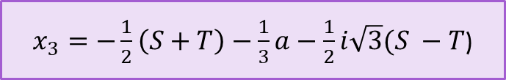



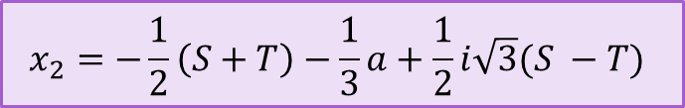
$$x_{1}=S+T −\frac{1}{3}a$$
PRINT $x_{1}$
$$x_{2}=−\frac{1}{2}\left(S+T\right)−\frac{1}{3}a+\frac{1}{2}i\sqrt{3}(S −T)$$
PRINT $x_{2}$
$x_{3}=−\frac{1}{2}\left(S+T\right)−\frac{1}{3}a−\frac{1}{2}i\sqrt{3}(S −T$)
PRINT $x_{3}$
STOP

Slide 8
PSEUDOCODE TO FIND THE LARGEST OF THREE NUMBERS
BEGIN
Input a
Input b
Input c
If a > b is true:
Then IF a>c is true:
Print a is the largest number
END IF
IF a>c is FALSE
THEN END IF
IF a>b is FALSE:
THEN IF b>c is TRUE
PRINT b is the largest number
END IF
IF THEN b>c is FALSE
PRINT c is the largest number
END IF
END

Slide 9
START
FLOWCHART TO FIND THE LARGEST OF THREE NUMBERS.
Input a number, a
Input a number, b
Input a number, c
TRUE
FALSE
Is a > b ?
Is a>c?
TRUE
TRUE
FALSE
Is b > c ?
PRINT a is the largest number
FALSE
PRINT b is the largest number
PRINT c is the largest number
STOP

Slide 10
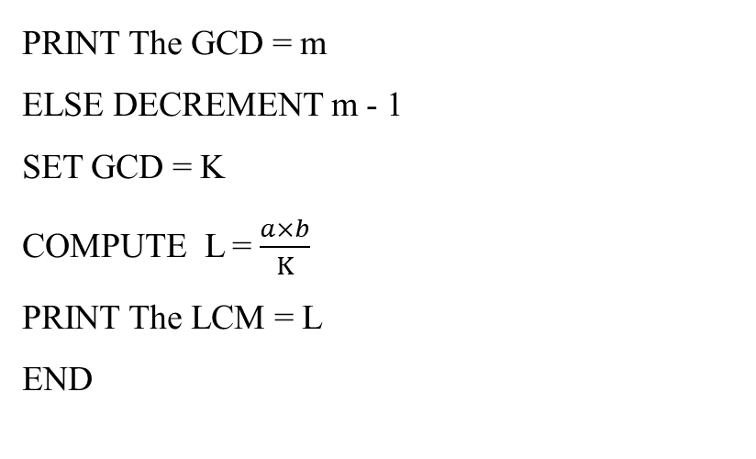
PSEUDOCODE TO FIND THE GCD AND LCM OF TWO NUMBERS
BEGIN
INPUT a
Input b
If a > b then print smaller number,c = b
Else print smaller number,c = a
COMPUTE m = RANGE(c+1)
If a%m = 0 and b%m = 0
PRINT The GCD = m
ELSE DECREMENT m - 1
SET GCD = K
COMPUTE L = $\frac{a×b}{K}$
PRINT The LCM = L
END

Slide 11
START
FLOWCHART TO FIND THE GCD AND LCM OF TWO NUMBERS
INPUT a
INPUT b
IS a>b?
PRINT Smaller number, c = a
PRINT Smaller number, c = b
m = Range(c+1)

Slide 12

IS a%m=0 AND b%m=0?
DECREMENT m - 1
PRINT The GCD = m
SET GCD = K
L = $\frac{a×b}{K}$
PRINT The LCM = L
STOP

Slide 13
PSEUDOCODE TO FIND FACTORIAL OF A NUMBER, N
BEGIN
INPUT n
INITIALIZE f=1
WHILE (n>=1) DO
f=f*n
n= n-1
END WHILE
PRINT f
END

Slide 14
START
FLOWCHART TO FIND THE FACTORIAL OF A NUMBER, n
INPUT n
INITIALIZE F = 1
WHILE N>=1
FALSE
TRUE
n = n - 1
F = F * n
PRINT F
STOP

