Slide 1
Profile
Project by Keith Driscoll x14346081

Slide 2
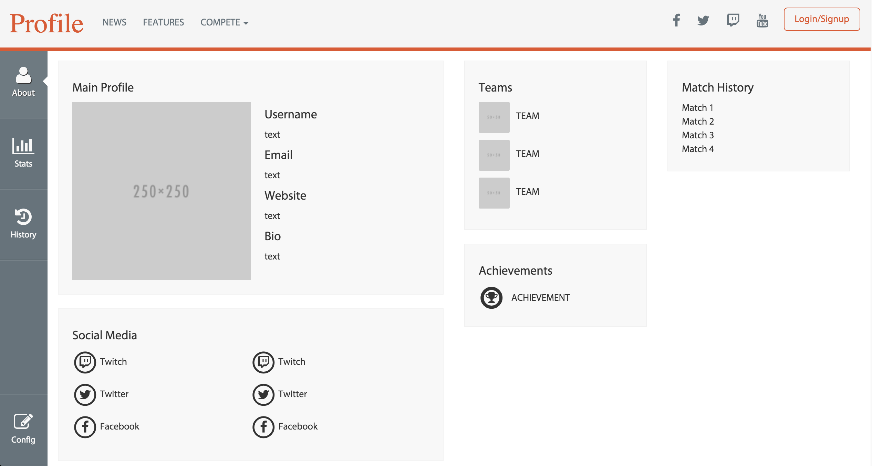
Main Page
This is the main page of my web application.
Here you can view all your player information displayed in a grid-like layout.

Slide 3
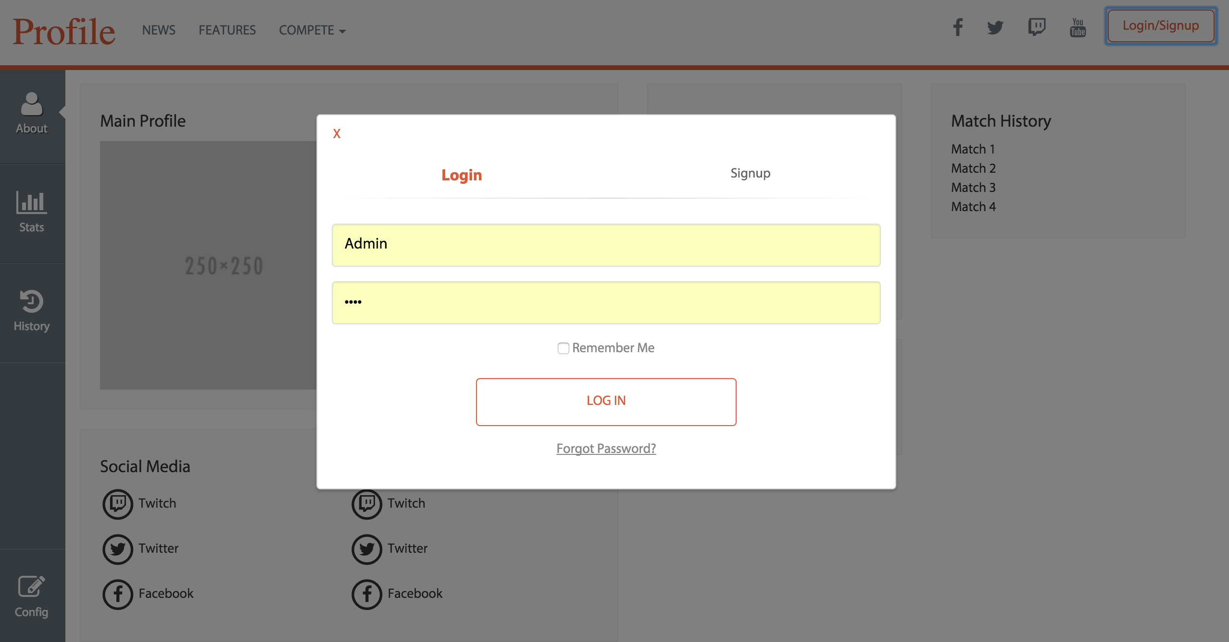
Login Popup (Upon activation)
There is a login feature so that you can view your own profile or create a new account if you don’t already have one.
The login form has validation checks.

Slide 4
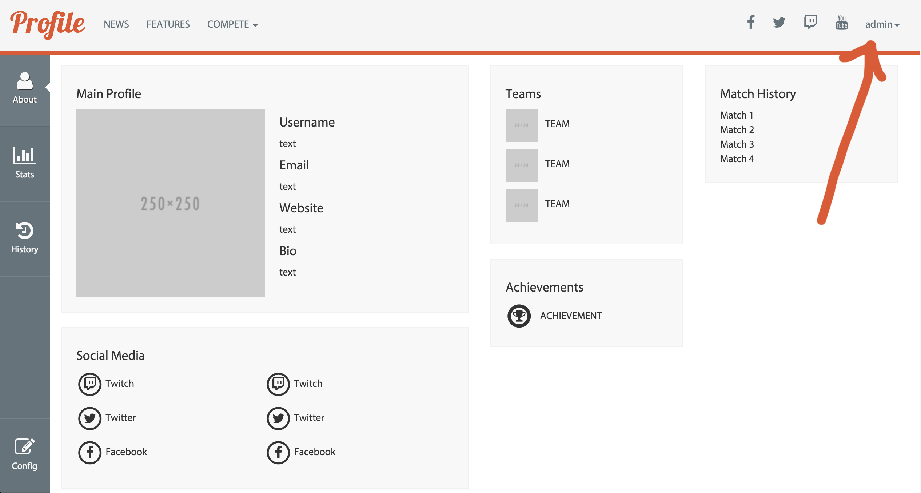
Logged In
When you’re logged in, you will see your username appear in the top right-hand side of the screen.

Slide 5
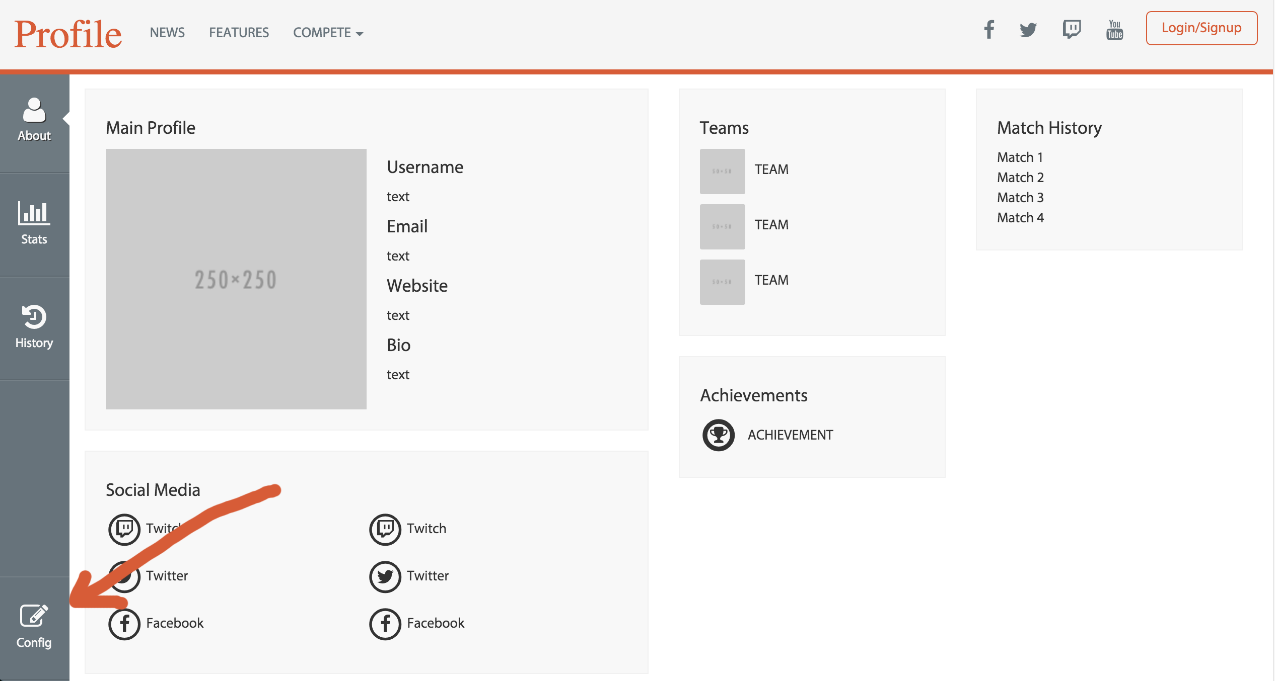
Configuration
To edit your profile information, clicking the ‘config’ button will enable to use of html’s ‘ContentEditable’ attribute to allow you to change the text throughout your profile.
When finished, changes will be saved and uploaded to the server.

Slide 6
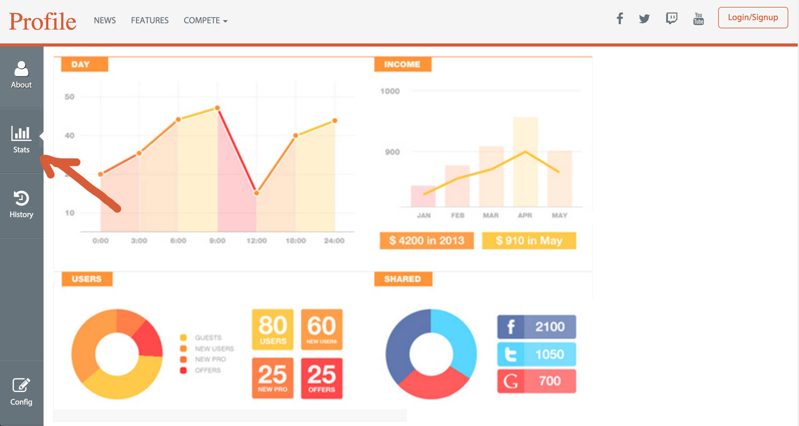
Profile Tabs
The profile has multiple tabs which can all be viewed without leaving your profile page.
This tab allows you to see your player stats.

Slide 7
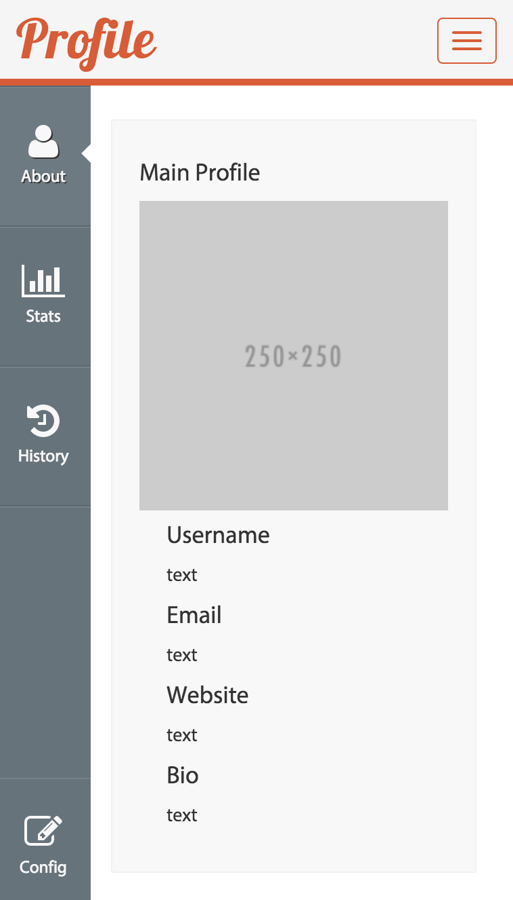
Responsive
Using Bootstrap’s framework made it easy to create a responsive layout so the webpage can be viewed across multiple devices

Slide 8
Any Questions

