Slide 1
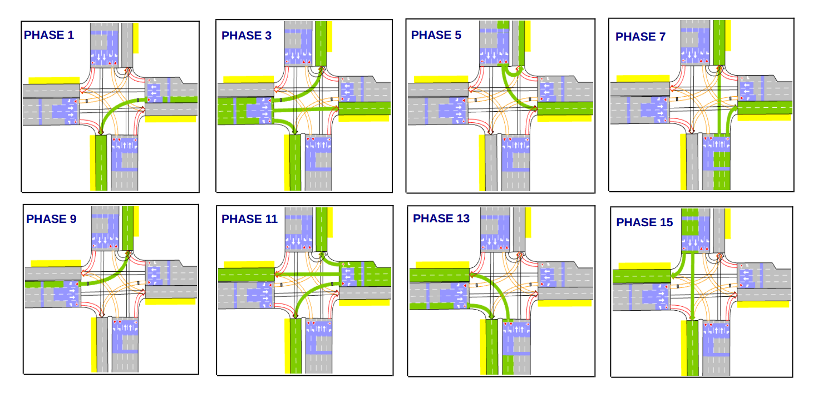

Changes made
1. Maximum and minimum green for turn and through movements are set based on FHWA Traffic Signal Timing Manual.
2. Cycle Lengths are not “pre-set”.
3. Action space:
4. Changed reward from flow/occupancy to stop time

Slide 2
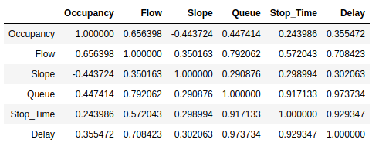
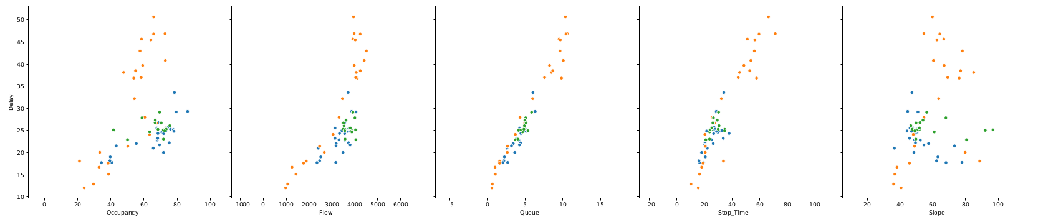
Queue and Stop_Time has stronger correlation with our goal – Avg approach delay
See Pairplots

Slide 3
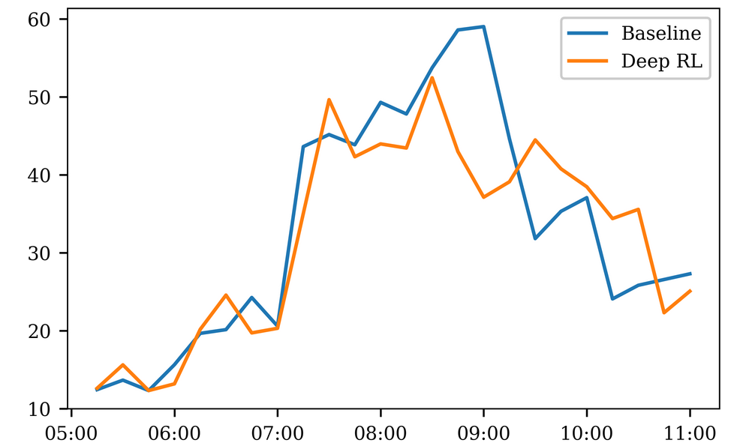
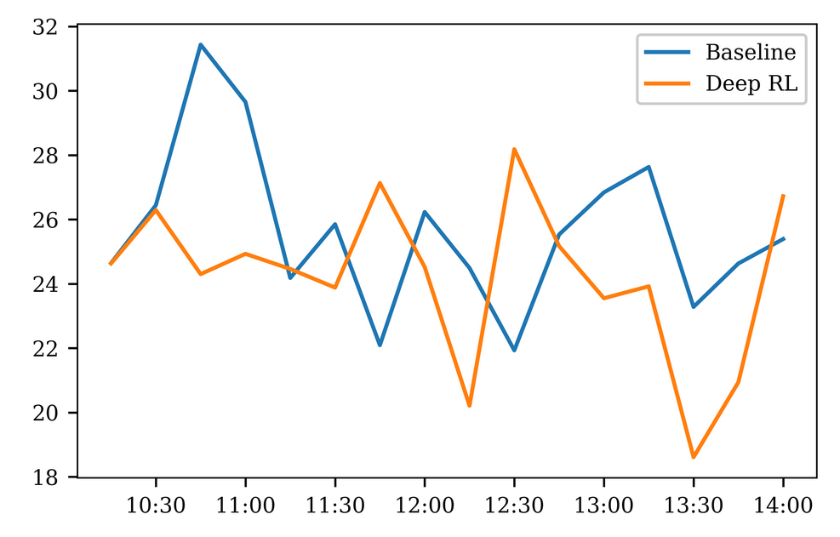
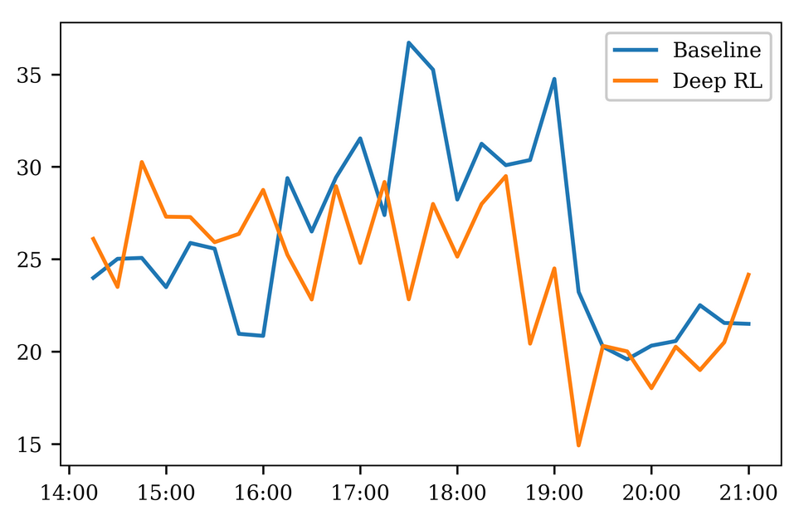
Deep RL agent is now better against baseline
*Reward used: negative sum of stop times
AM Scenario
3.38 % Delay reduction
Noon Scenario
5.56 % Delay reduction
PM Scenario
6.73 % Delay reduction

Slide 4
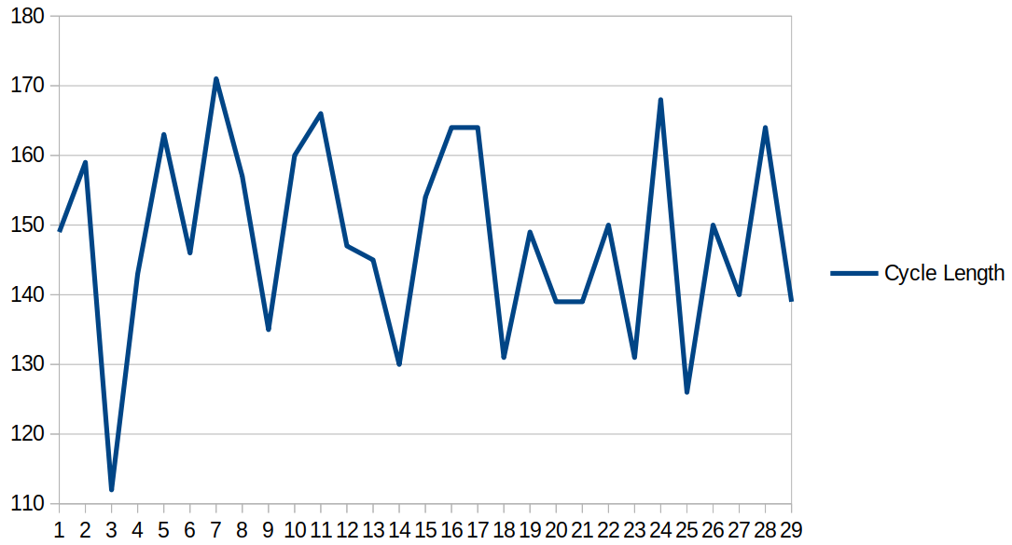
Phase pairs that include through movements now has greater splits than turn movements
Phase timings in AM Scenario
Cycle Length over time
5:00 AM – > 11:00 AM
Max green (Through) = 70 secs
Max green (Turn) = 30 secs
Min green (Through) = 15 secs
Min green (Turn) = 5 secs

Slide 5
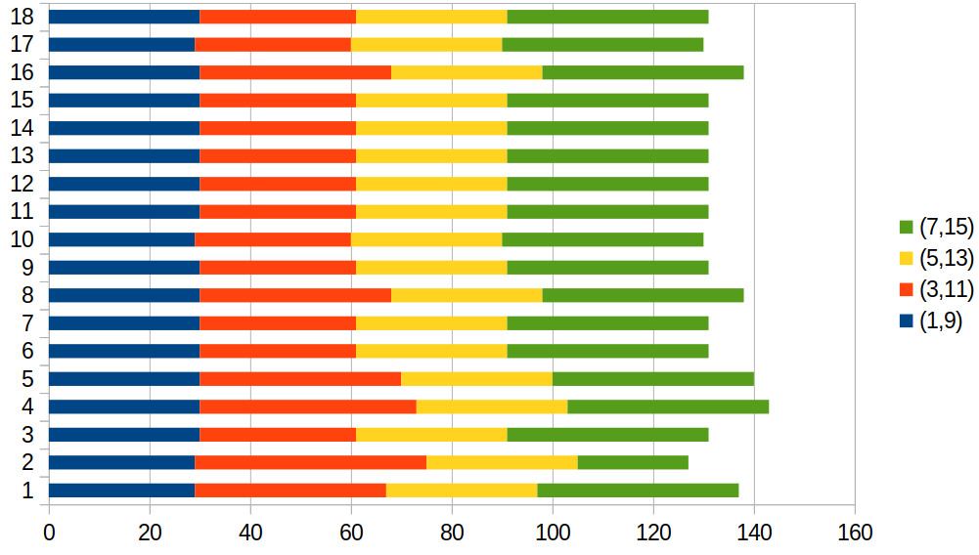
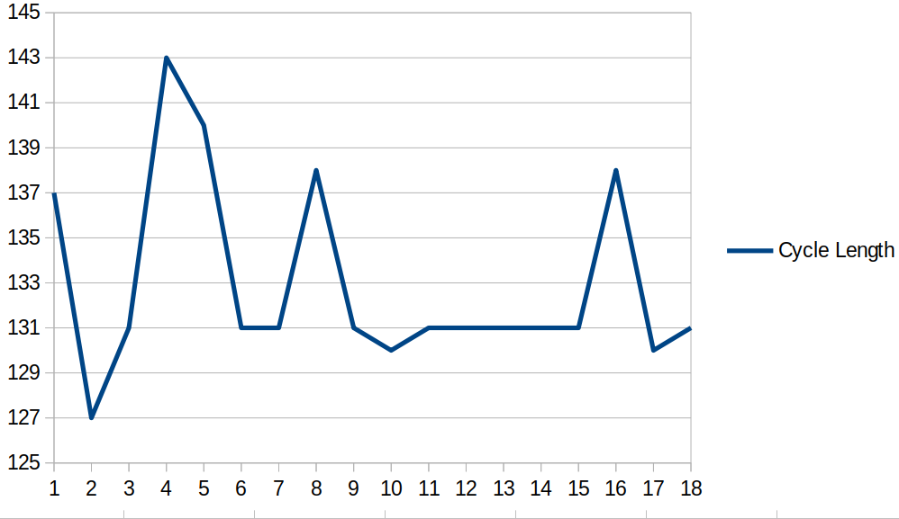
Phase pairs that include through movements now has greater splits than turn movements
Phase timings in Noon Scenario
Cycle Length over time
10:00 AM – > 2:00 PM
Max green (Through) = 70 secs
Max green (Turn) = 30 secs
Min green (Through) = 15 secs
Min green (Turn) = 5 secs

Slide 6
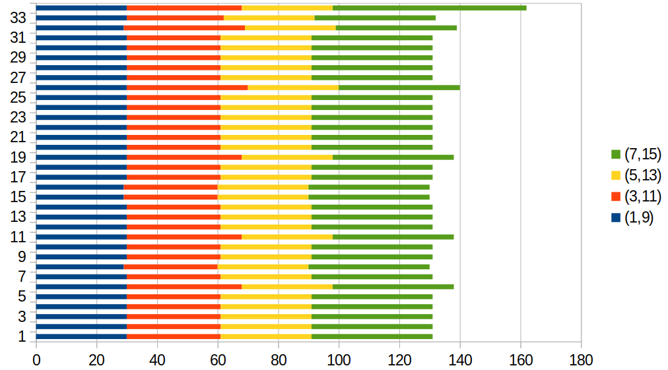
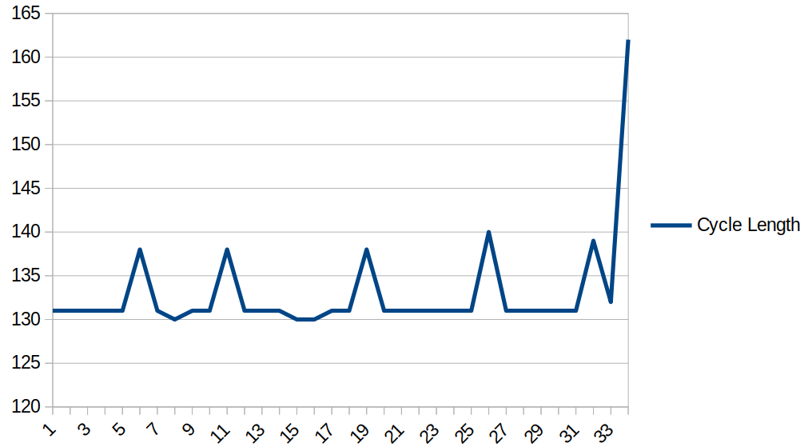
Phase pairs are more balanced in PM Scenario
Phase timings in PM Scenario
Cycle Length over time
2:00 PM – > 9:00 PM
Max green (Through) = 70 secs
Max green (Turn) = 30 secs
Min green (Through) = 15 secs
Min green (Turn) = 5 secs

Slide 7
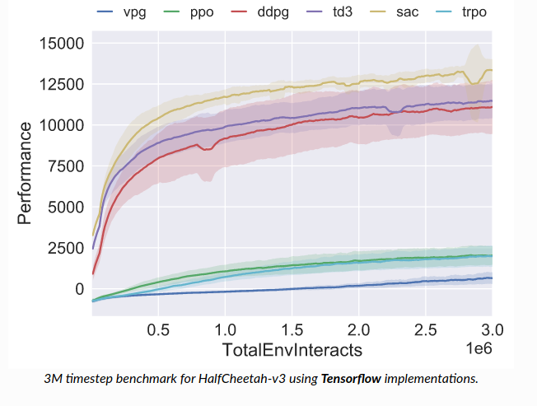
Next steps
1. Verify the results by running more realizations of the simulation (~100 runs)
2. If the result in the latter is unsatisfactory (e.g. high variance), train more.
3. Check out other algorithms (A3C, DDPG) – checkout this link
4. Suggestions?
Notes:
ss

