Slide 1

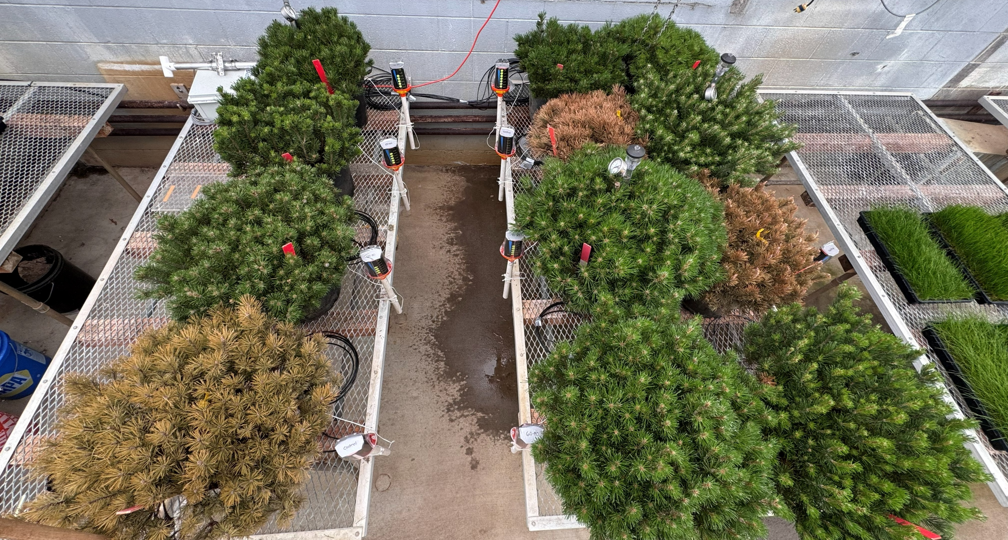
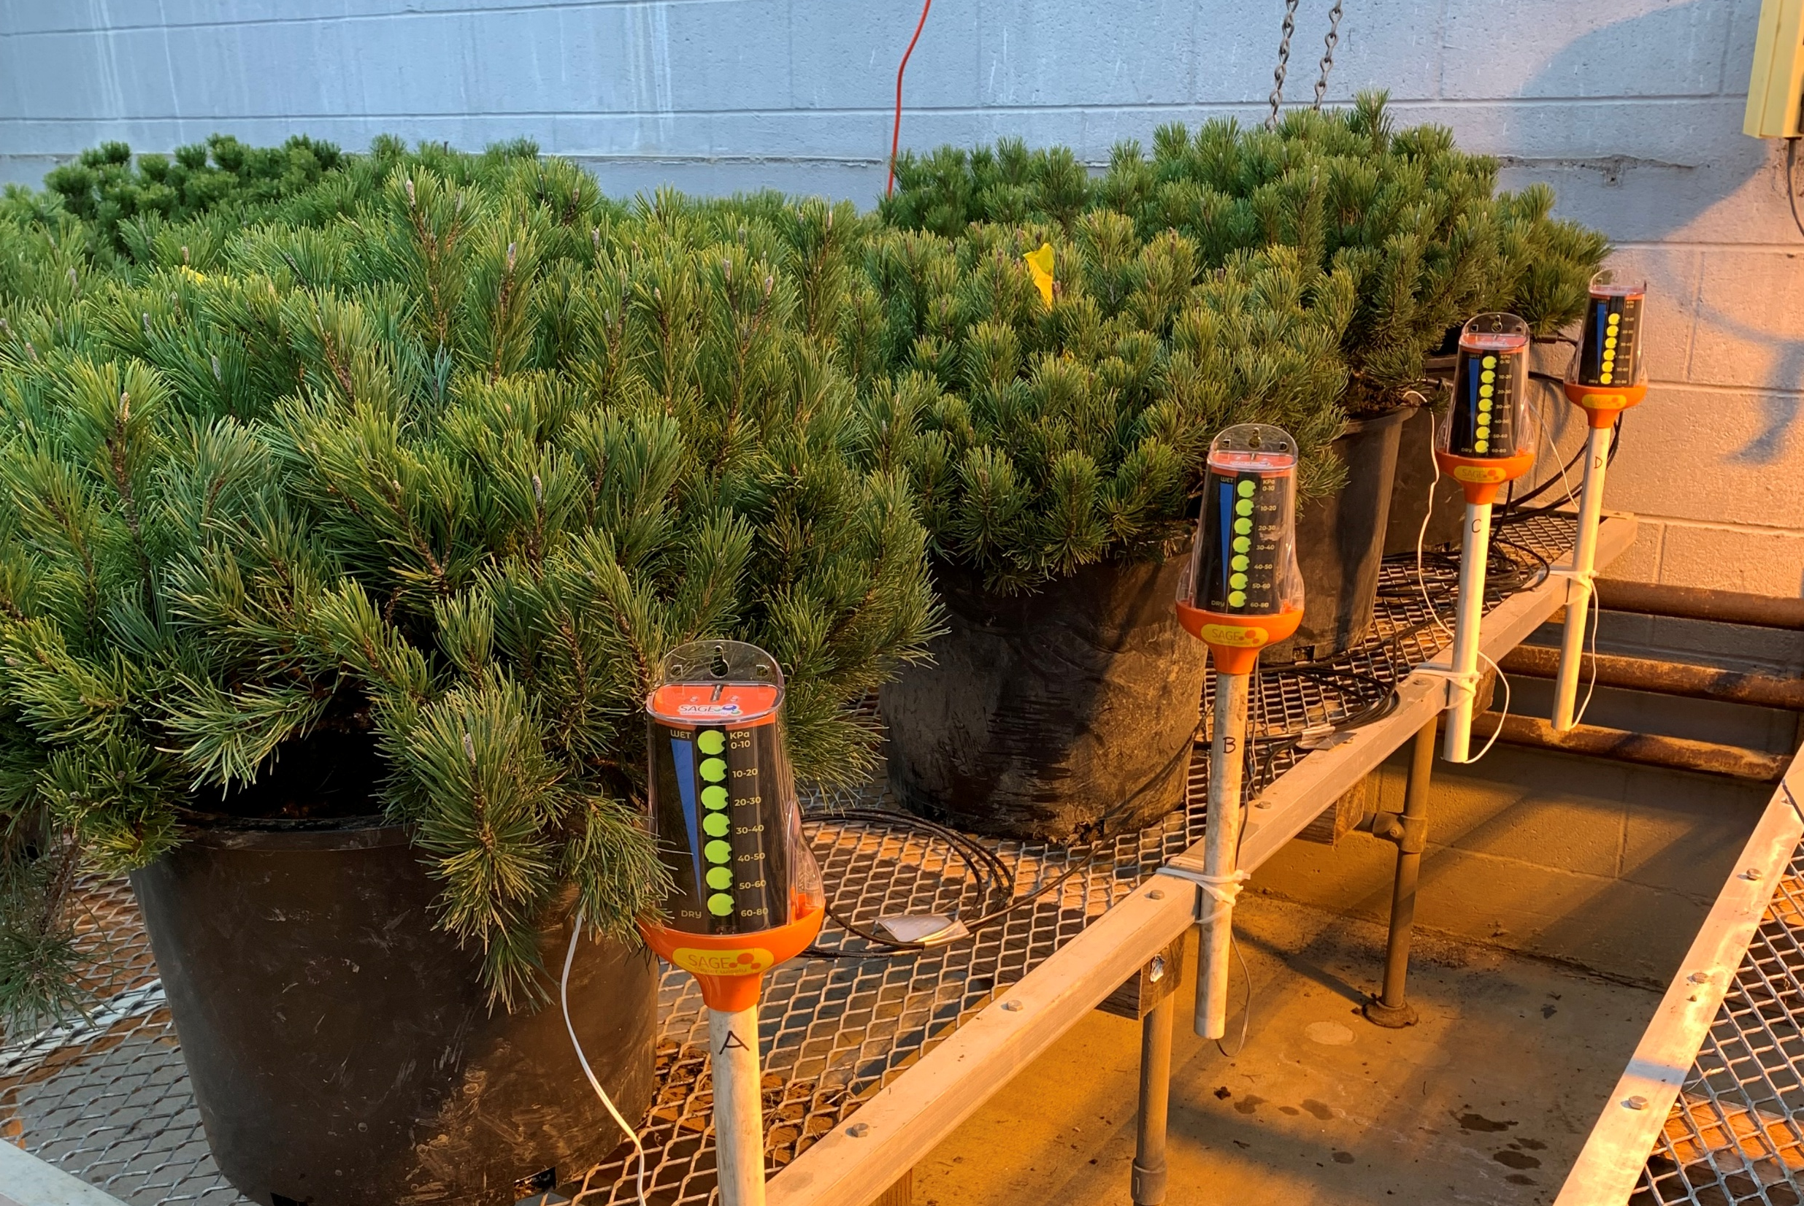

Evaluating drought tolerance and critical moisture point of Pinus mugo potted in native silt loam soil
S.B. Leffler, A.R. Kowalewski, B.K. Bellingham
Department of Horticulture, Oregon State University, Corvallis, OR 97331, U.S.A
Introduction
Results
Identifying critical water content levels is essential for cultivating pot grown conifers, like Mugo pine (Pinus mugo), as drought stress in these species is often not visual until after the plant has been irreversibly damaged. In-pot cultivation requires careful monitoring of soil moisture levels for the proper care of different economically significant landscape species. Mugo pine is a slow-growing and drought tolerant species commonly seen in both commercial and residential landscapes.
The interaction between time and irrigation had a significant effect on Mugo pine quality and NDVI (Figure 1A and 1B). As of February 27, 2026, all control treatments died, while all other treatments were acceptable or high quality. All treatments that received irrigation, regardless of the kPa threshold level, produced very high NDVI values of 0.8 or greater, with 1.0 being the highest possible reading, and high visual quality ratings suggesting that irrigation applied when tensiometer readings reached 60-80 kPa or a volumetric water content of 6.4 to 7.5% was adequate to sustain mugo pine.
Irrigation treatments that maintain soil volumetric water content above 5.8% keep ‘Pumilio’ Mugo pine alive (Figure 1C). When irrigation was not applied and volumetric water content were less than 5.8% the Mugo pines died. This corresponded to the control (no irrigation) treatments on Feb 11, 2026, just over 30 days without irrigation. It is important to note that the 60-80 kPa irrigation threshold treatments regularly reached as low as 5.9% between irrigation events. Major reduction in quality were observed on Feb 11, 2026, and significant reductions in NDVI started short after (Feb 13, 2026). The 60-80 kPa irrigation threshold also maintained the soil moisture at an average level of 9.9%, while the 50-60 kPa and 40-50 kPa irrigation thresholds resulted in an average volumetric water content of 10.5% and 12.0%, respectively.
Objective
The objective of this research was to establish critical moisture levels for potted ‘Pumilio’ Mugo pine determined using root suction (kPa) and volumetric water content (%).
Materials and Methods
Experimental design was a randomized complete block with three replications. Treatments included irrigation events applied when SAGE readings reached the following threshold levels: 40-50, 50-60, and 60-80 kPa, compared to a no irrigation control. Irrigation treatments were initiated 2 January 2026.
Response variables included normalized difference vegetation index (NDVI) and visual plant health (1-9, 1 = dead and 9 greatest quality possible) ratings collected weekly, and soil water tension (kPa) and volumetric water content recorded every Monday, Wednesday and Friday (Image 1). Soil water tension was monitored using the SAGE (Stevens Water Monitoring Systems Inc, Portland, OR), while volumetric water content was monitored using the Hydra Probe System (Stevens Water Monitoring Systems Inc, Portland, OR). Both were placed within each potted plant at a 8 cm depth.
Figure 2: Irrigated Mugo pine (green plants) and non-irrigated Mugo pine (brown plants) on 4 March 2026 in Corvallis, OR.
Figure 1: Effects of SAGE irrigation threshold value over time on ‘Pumilio’ Mugo pine visual quality (A), NDVI (B), and soil volumetric water cotent (C) over time 9 Jan to 8 May 2026 in Corvallis, OR, grown in greenhouse conditions. Irrigation rates average 1.5” per plant applied when the SAGE threshold values were reached; control = no irrigation. Overlapping error bars are not significantly different at 0.05 level of probability.
Figure 1: Normalized difference vegetation index quantified using the Field Scout CM 1000 NDVI Meter (left), and soil water tension (kPa) monitored using the SAGE, pot-grown Mugo pine in Corvallis, OR in January 2026.
Acknowledgements
Funding provided by Stevens Water Monitoring Systems Inc.

