Slide 1
PORTFOLIO SAMPLE
Before you paste, classify.
A 30-second habit for remote teams using AI and shared files.
One-page cheat sheet + 15-minute module.
Keith Byne - a portfolio sample, not a named client project.
Notes:
This is a 30-second habit at the keyboard.
I want a desk page, and a short module for people who do not have the habit yet.
[Start with the request. Not a contents list.]
[Do not call this AI awareness training.]

Slide 2
The problem is a paste
1
Just drop this into ChatGPT and tidy it.
2
Put it on my personal Drive so the contractor can edit overnight.
Both are faster than the allowed path. Both create GDPR and leak risk.
Click a choice.
Paste it now
Name the data first
Wrong
That is the leak.
Right
Classify, then choose a path.
Notes:
Two shortcuts leak data.
Drop it in ChatGPT and tidy it.
Put it on a personal Drive so the contractor can edit overnight.
Both are faster than the allowed path.
Both create GDPR and leak risk.
[Do not invent an incident or a fine.]
[Click Paste it now, then Name the data first.]

Slide 3
The 30 seconds that matter
Who
Knowledge workers on a distributed EU team.
Click
When
Before any prompt, paste, or file share.
Click
Not
A long compliance course. Not IT-only.
Click
Notes:
Same people as the later Rise module.
The page lives on the desk.
The module is for people who do not yet have the habit.
[Click each Click bar. It slides off to the right.]

Slide 4
What we need them to do
Click to reveal each step.
01
Name the kind of data.
02
Approved tool, stripped example, or no AI.
03
Ask if unsure.
Count fewer unapproved AI pastes and fewer personal-drive shares. We will not invent a percentage.
Notes:
If they already know the rule, a page is enough.
If they do not stop to name the data, they need the short module.
We count actions, not quiz scores.
[Click three times. Each cover slides off.]

Slide 5
Why not just send the policy PDF
Instead of
A 40-page acceptable-use policy
A 45-minute intro to AI
A manual for every AI product
We ship
One page at the desk
A 10 to 15 minute module: name the data, then take a path
Three checks that still work when the tools change
Notes:
Tool names go stale.
The habit does not.
[Do not invent an approved-tool brand list.]
[Leave the ask-role as TO CONFIRM. Do not name Slack, Microsoft, or ChatGPT.]

Slide 6
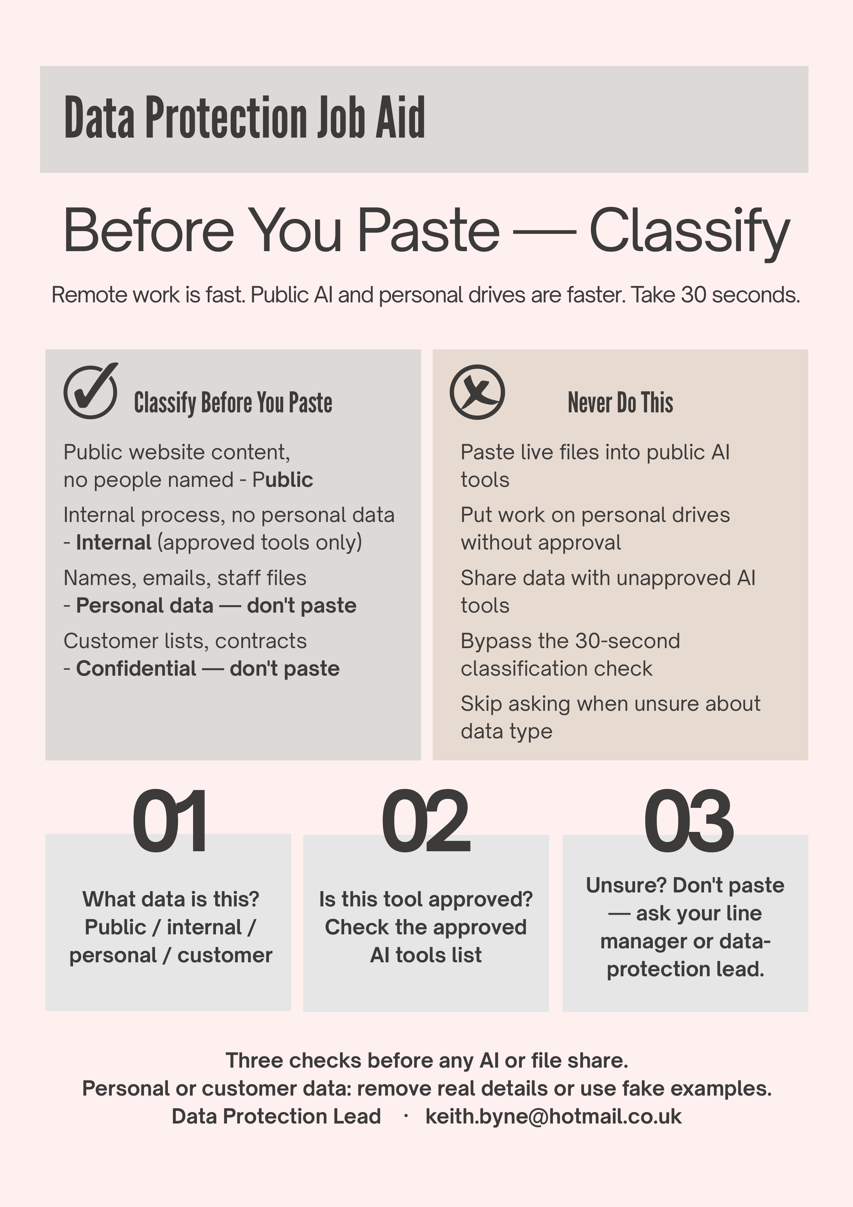
What the worker sees
Three checks. Classify table. Stop rules.
This stays next to the desktop. The module is not the reminder.
Notes:
Walk the three checks aloud.
This slide is the product for the worker.
The module is not the reminder.

Slide 7
The 15-minute module
A map only. Do not play it in this meeting.
Safe AI and data handling for remote enterprise teams
1 Welcome
2 Classify (a live decision)
3-4 Two paths: careful path, or a correction then rejoin
5 Three checks, everyone together again
6 One marked scenario
7 Point to the cheat sheet and finish
Notes:
This is a map only.
One decision. One marked question. Ten to fifteen minutes.
[Do not play the module in this meeting.]
[Storyline is a later piece.]

Slide 8
What you need them to decide
1
The habit. Classify, then an allowed path, then ask.
Click
2
The ask-if-unsure person: [TO CONFIRM: DPO / line manager / other]
Click
3
Where the page will live. Intranet, or a pinned PDF, somewhere they already look.
Click
Notes:
I need three decisions from you.
The habit.
Who they ask if they are unsure.
Where the page will live.
[End on a decision. Not "any questions?"]
[If they will not name who to ask, do not invent a job title.]
[Click each Click bar.]

