Slide 1

EDA G2M Cab Investment Firm
Virtual Internship
20-Oct-2024

Slide 2

Agenda
Executive Summary
Approach
EDA
EDA Summary
Recommendations

Slide 3
Executive Summary
Business Requirements: XYZ-private firm is planning for an investment in Cab industry. They want to investigate and research deeply in this industry.
Objective: Based on the industry datasets, transform and analyze data to identify insights.
Delivery:
The report for this analysis
Identifying actionable insights
Recommendations for investment

Slide 4
Executive Summary
Brand Popularity in 20 US Cities: Customers show a clear preference for Yellow Cab over other services.
Profit Comparison of Two Cab Brands:
City-wise Profit: Yellow Cab consistently earned significantly higher profits than Pink Cab in most cities.
Profit per Kilometer Traveled: Yellow Cab's revenue per kilometer traveled was much higher than Pink Cab's, even when both had a similar number of customers.
Customer Demographics:
Gender: Both Yellow and Pink Cabs were chosen by more males than females.
Age Group: The 20-40 age group generated the highest profit for both companies.
Seasonal Trends: Customers tended to use cab services more frequently from the end of the year through the beginning of the next year, as well as during major vacations and holidays, resulting in a substantial increase in transactions during these times.

Slide 5
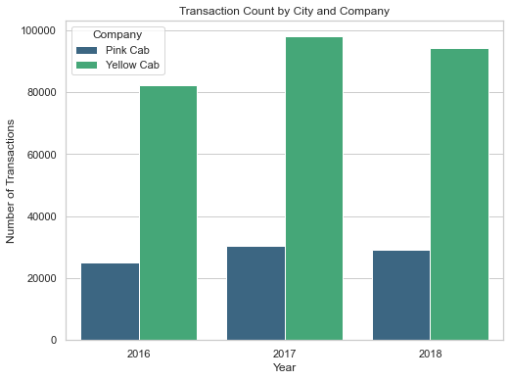
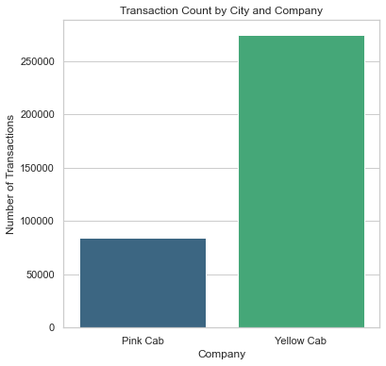
General Cheking
- The chart shows the total Transactions by Company during three year.
- Yellow Cab was highly prominent than Pink Cab

Slide 6
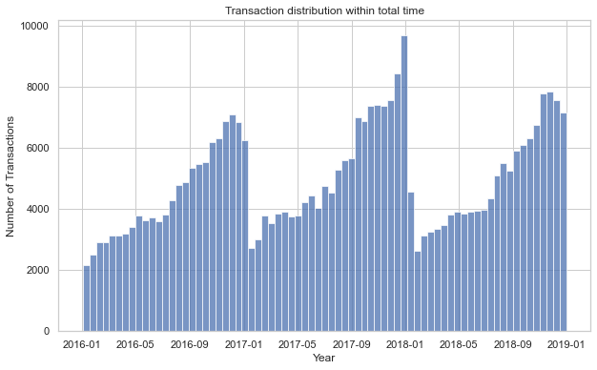
General Cheking
The distribution of transactions is periodic and predictable.

Slide 7
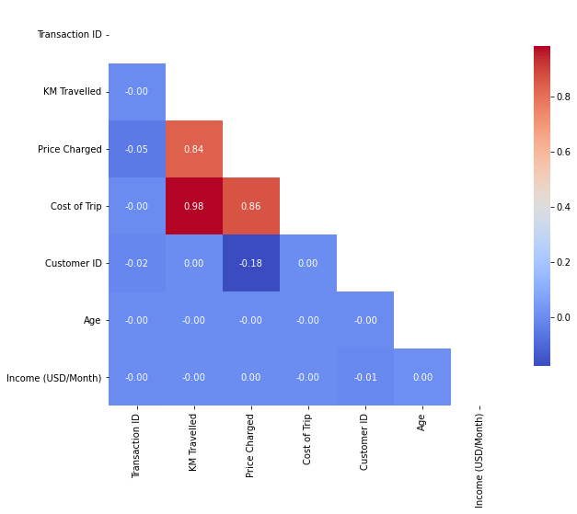
General Cheking
The strongest correlation is between two features “KM Travelled” and “Cost of Trip”

Slide 8
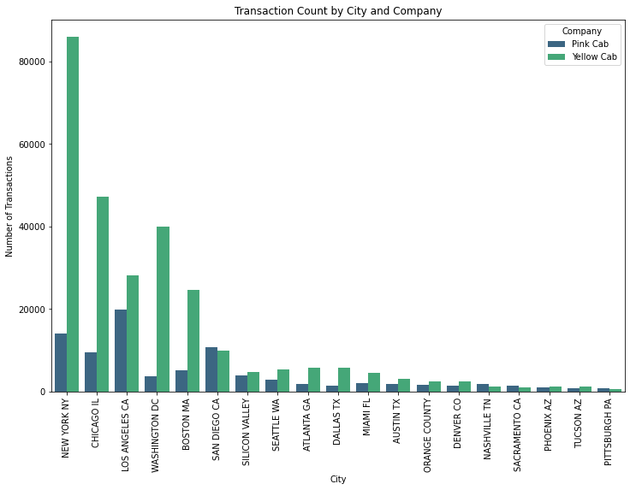
Transactions by City
Yellow Cab has built a strong reputation in many of the largest cities, as evidenced by the high volume of transactions.

Slide 9
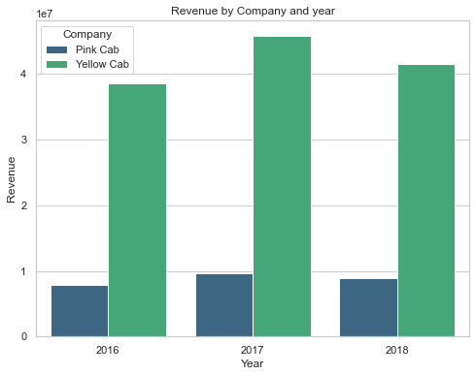
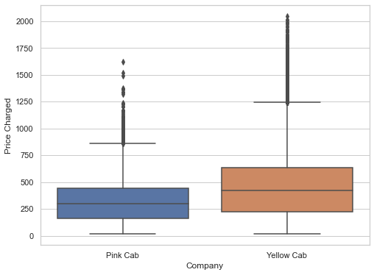
Revenue and Profit Analysis
Yellow Cab generate significantly more revenue than Pink Cab throughout the duration. It’s understandable given that their average of price charged is higher than that of Pink Cab.

Slide 10
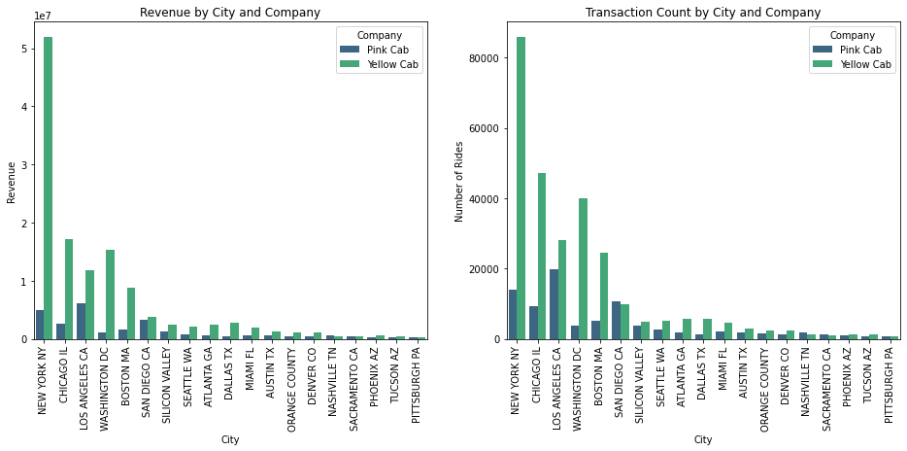
Revenue and Profit Analysis

Slide 11
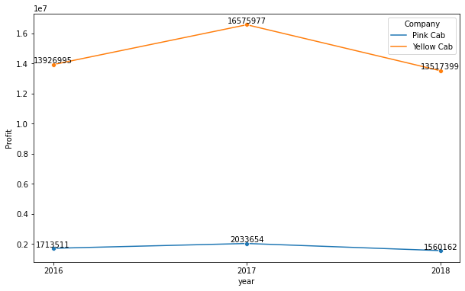
Revenue and Profit Analysis
Both of two companies experienced a decrease in profit compared to the initial year.

Slide 12
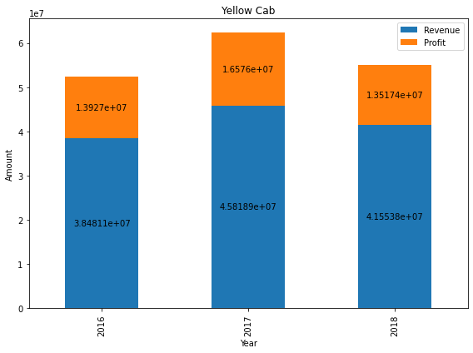
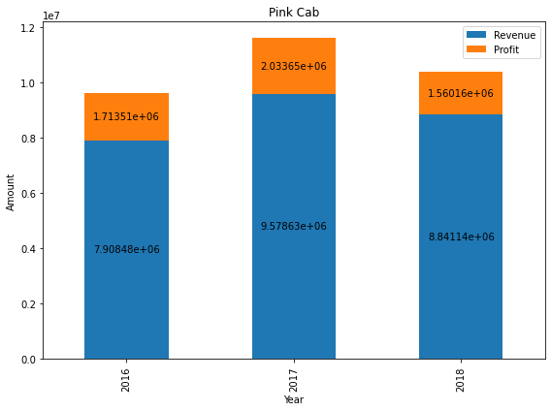
Revenue and Profit Analysis
Yellow Cab achieved a much higher profit margin compared to Pink Cab.

Slide 13
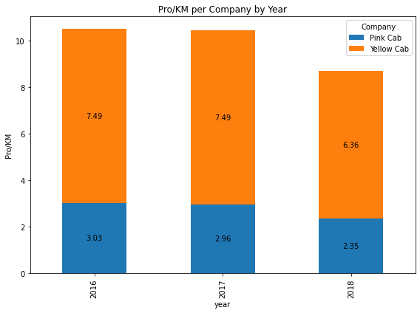
Revenue and Profit Analysis
Yellow Cab generated profit per kilometer that was three times higher than Pink Cab’s.
Why are there such a huge difference?

Slide 14
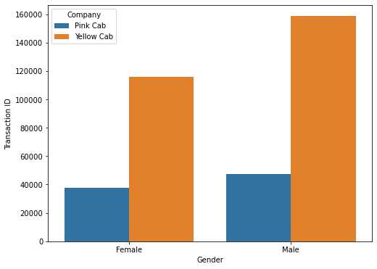
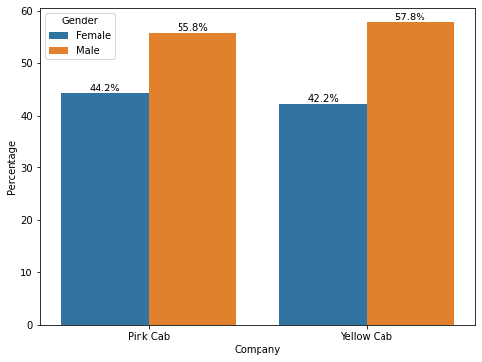
Customer Demographic – Gender Impact
Transactions volume generated from different genders showed a large gap between the two companies
It can be observed that the male group uses cab services more frequently than the female group.

Slide 15
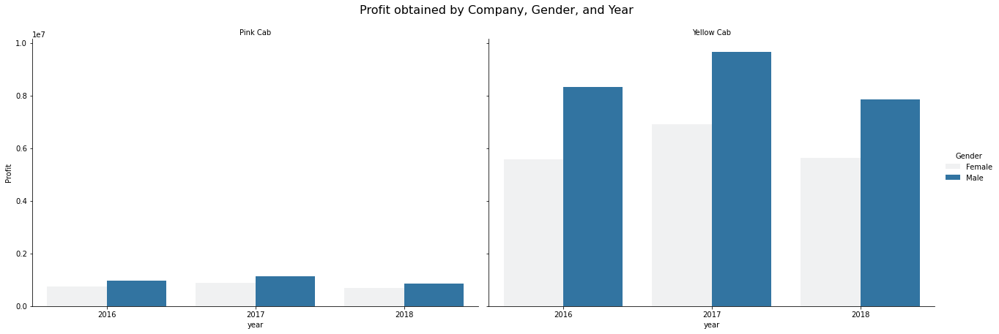
Customer Demographic – Gender Impact
Obviously, Yellow Cab obtained significantly higher profits from both genders than Pink cab.
There was a clear difference in the profits generated by each gender for Yellow Cab, while Pink Cab showed no such difference

Slide 16
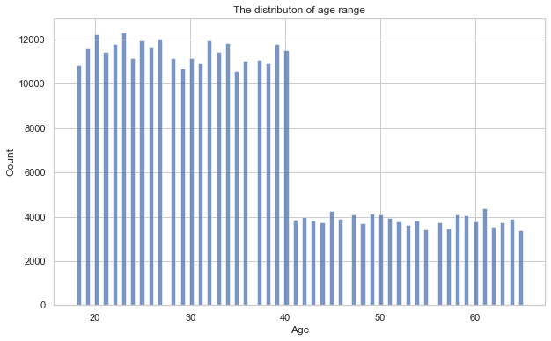
Customer Demographic – Age group Impact
The chart indicates that the majority of customers are heavily concentrated within the age rage of 20 to 40

Slide 17
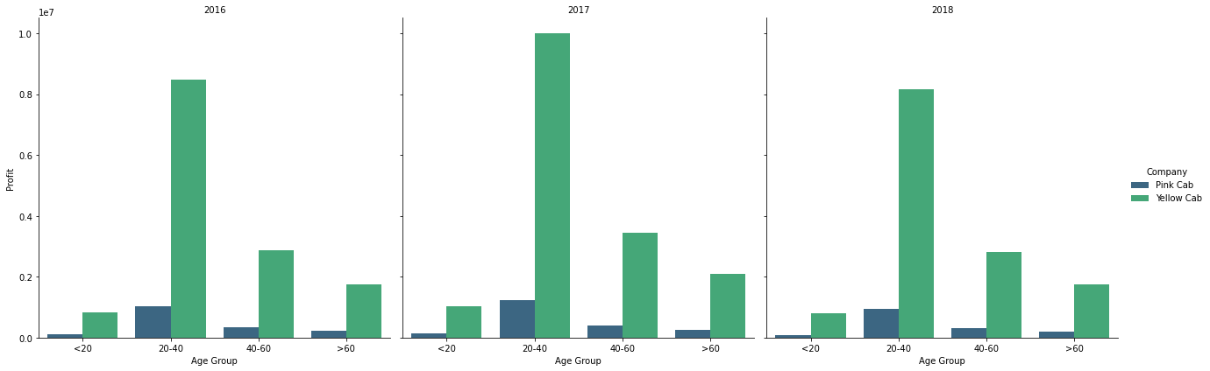
Customer Demographic – Age group Impact
As expected, the majority of profits for both companies came from the 20 to 40 age group.

Slide 18
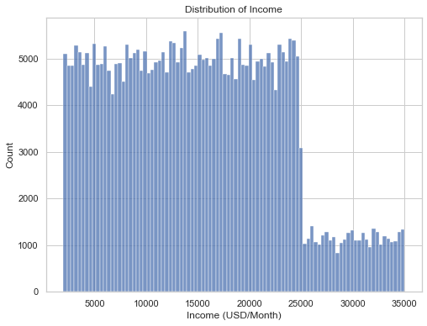
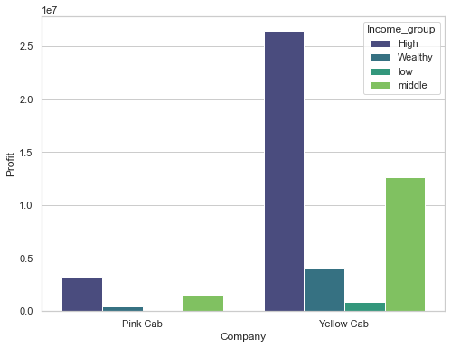
Income Impact
High-income customers generated the majority of profits for both companies.

Slide 19
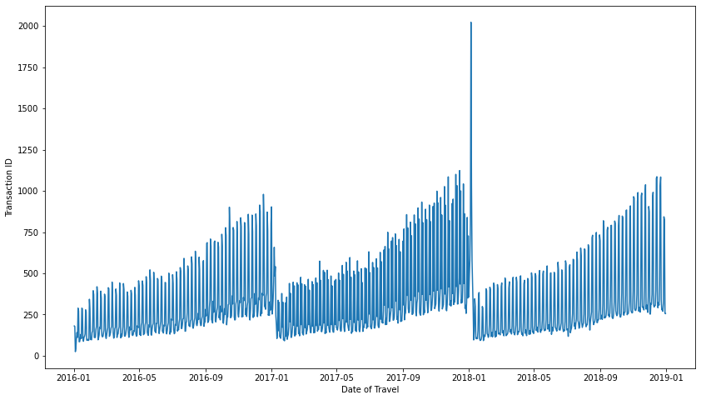
Season trends
The breakthrough in rides occurred at the beginning of 2018, as evidenced by the higher demand for travel among users.

Slide 20
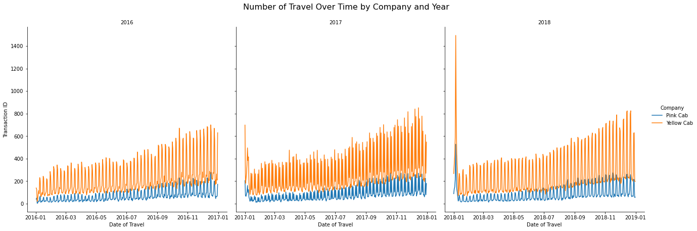
Season trends
In the first year of investigation, the volume of rides was relatively casual, but in the following two years, rides became concentrated from the end of the year to the beginning of the next

Slide 21
Hypothesis tests
Hypothesis 1:
H0: There is no difference between the profits of males and females
H1(alternative): There is a difference between the profits of males and females
yellow t_stat: 10.37503739501431 yellow p-value: 3.2583323717893763e-25
pink t_stat: 1.5760762050772872
pink p-value: 0.11501217119514037
Validation:
For Yellow Cab, since the p-value << α, we reject H0 and accept H1: There is a difference between the profits of males and females
In contrast, for Pink Cab, the p-value > α, reject H1, pick H0: There is no difference between the profits of males and females

Slide 22
Hypothesis tests
Hypothesis 2:
H0: Age group has no effect on profit
H1(alternative): Age group has effect on profit
yellow f_stat: 7.520495874122722 yellow p-value:4.985984600296644e-05
pink f_stat: 0.6541844725069808
pink p-value: 0.5802174820952017
Validation:
For Yellow Cab, since the p-value << α, we reject H0 and accept H1: Age group has effect on profit
In contrast, for Pink Cab, the p-value > α, reject H1, pick H0: Age group has no effect on profit

Slide 23
Hypothesis tests
Hypothesis 3:
H0: Payment Mode has no effect on profit
H1(alternative): Payment Mode has effect on profit
yellow t_stat: -1.049402391138175 yellow p-value: 0.29399404036970817
pink t_stat: 0.2660986911387631 pink p-value: 0.7901639572170616
Validation:
For Yellow Cab, since the p-value > α, we reject H1 and accept H0: Payment Mode has no effect on profit
In contrast, for Pink Cab, the p-value > α, reject H1, pick H0: Payment Mode has no effect on profit

Slide 24
Recommendations
Let's put yourself on the shoes of an investor who wants to invest in the cab firm, We will consider the following information:¶
Focus on Yellow Cab Operations:
The Yellow Cab are more prominent and dominant in the market compared to Pink Cab, The customer tended to use Yellow services. Therefore, it's essential to delve deeper into Yellow Cab's operation to extract meaningful insights and understand the factors driving its success.
Profit Generation Concentrated in Key Cities:
Yellow Cab generates significantly more profit than Pink Cab, particularly in large cities such as New York, Washington DC, Chicago, and Los Angeles. These cities represent high-demand areas for cab services, and Yellow Cab's strong presence here is a key profit driver. Analyzing Yellow Cab’s market strategy and operational efficiency in these cities will be critical to sustaining and expanding profits.

Slide 25
Recommendations
Price Trends and Market Strategy:
As The table shows that the "price charged" for each company are quite different and tended to decline since 2016, reflecting a competitive effort to attract more customers with lower prices. Although Pink Cab offered lower average price per Kilometer travelled, its transactions volume was still substantial lower than the Yellow Cab. It’s important to investigate whether Yellow Cab’s premium pricing is tied to its superior service quality and brand loyalty.
Service Quality as a Key Differentiator:
Despite of similar customer volumes, Yellow Cab generated much higher profits, indicating that it has uncovered a formula which will satisfy the customer, perhaps came from the good services include employee attitudes, cleaner and more well-maintained vehicles, the faster services or other convenient…etc.
Customer Demographics and Profit Generation:
The age groups influence: There are significant differences between these groups, The 20-40 group contributed the most to both Companies, followed by '40-60' group. Younger and older age group ('<20' and '>60') are less profitable. This suggests that targeting working-age individuals, who are frequent cab users, with tailored services and marketing could drive further growth.

Slide 26
Recommendations
Gender Preferences:
Males tended to use Cab services, especially with the Yellow Cab. Males gained more profit than females, but the difference is extreme distance between two company. The gender gap is notably wider between the two companies, indicating that Yellow Cab has a stronger appeal to male customers. Understanding and leveraging this demographic difference could enhance targeted marketing strategies.
Income-Based Customer Segments:
Both of the companies attracted the large amount number of customers in the medium and high-income segments. This indicates that customers are willing to pay for the convenience and comfort provided by these cab services for their purposes.
Seasonal Demand Pattern:
Cab usage peaked during the period from the end of year to the beginning of the next, aligning with holidays and vacation periods. This suggests an opportunity for both companies to capitalize on increased demand through targeted promotions or enhanced services during this time.

Slide 27
Thank You

