Slide 1
Track 2: Data Science and the Seven Seas
Team Arctonyx

Slide 2
Tasks
Produce a clustering algorithm that took time and movement into consideration
Not cluster points from same vessel into group
Associate space-time clusters into potential interaction pairs
Task 2: User interaction pairs to identify type of interactions and use classifier to identify type of interaction from the location, time, and other features

Slide 3
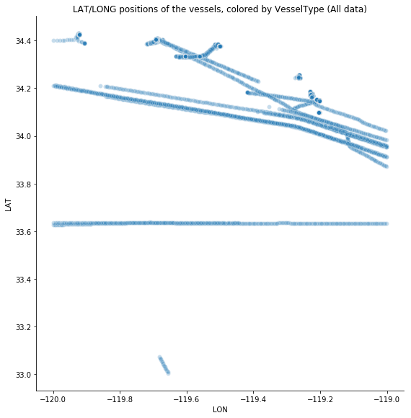
Full Paths

Slide 4
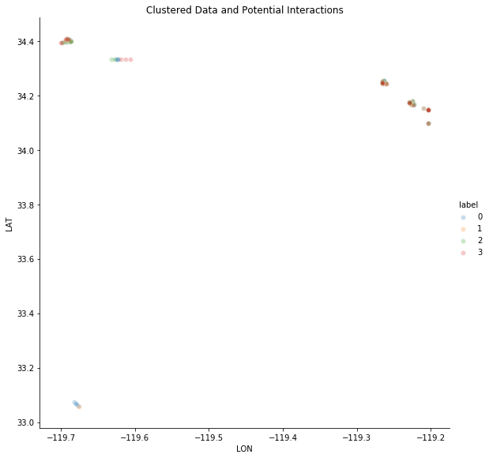
Clustered Points

Slide 5
Questions?

Slide 6
Task 1: Data Preprocessing
Reduced dataset size
Reduced based on time/space limits: 4 hrs, 10 nmi
Reduced into sincle data point per MMSI per 30 minute time block
Data conversions
Converted date/time field to date and time from 1/1/1970
Lat/Lon handling:
Normalized
Converted to UTM to provide scope of magnitude

Slide 7
Task 1: Algorithms
Investigate multiple clustering techniques
Spiral
Space-Time pattern mining
Trees (R, K-D)
K-means
Hierarchial
Gaussian Mixture
Adjacency Matrices

Slide 8
Task 1: Results

