Slide 1
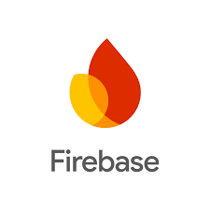
-Users with accounts can save lists of targets, diseases or ligands.
- Unique Identifier (UID) is created per user account with Firebase
- Location: Google cloud
- Access: Social log in (FB, Twitter, GitHub, Google); Owner Permissions: Pharos Staff
- Security: Google Firebase security settings(https://firebase.google.com/support/privacy)
Firebase
Pharos – pharos.nih.gov (public)
Data Storage
API
AWS
(tcrd.ncats.io)
Google Cloud
(ncatsidg)
MySQL Queries
Pharos Public Web Application
TCP connection
Public data
pharos.nih.gov
(NCATS on-prem ncatslnifxpdv06.ncats.nih.gov)
Transferred via https
- Public Data Resources organized in a relational database
- Access: Separate credentials for read and write access)
- Security: AWS security settings (managed by ITRB)
- GraphQL backend
- Includes a Redis Cache layer that is queried first.
- If cache results do not exist, then the AWS gets queried through MySQL queries.
- Access: Pharos staff and ITRB
- Security: google security settings (managed by ITRB)
Angular
Communication through APIs via https
Access: Pharos staff and ITRB
Security: server security settings (managed by ITRB)

