Slide 1
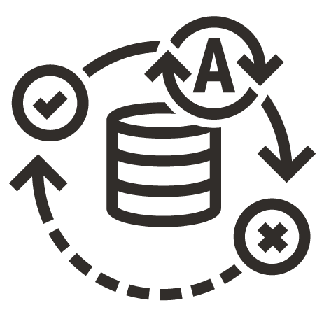
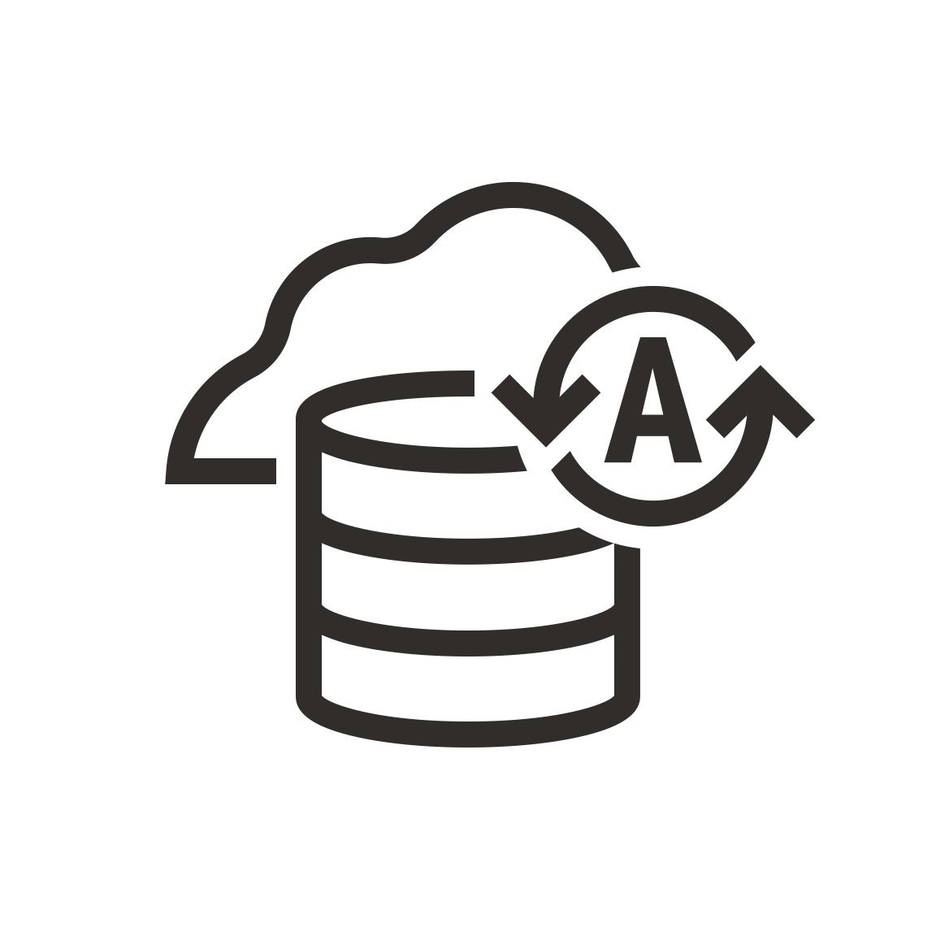

One Autonomous Database – For Both Transactional and Analytic Workloads
Built on the converged Oracle Database and Oracle Exadata
ADB for Transaction Processing
and Mixed Workloads - ATP
Pre-configured for row format, indexes, and data caching to accelerate transaction processing and mixed workloads
ADB for Analytics
and Data Warehousing - ADW
Pre-configured for columnar format, partitioning, and large joins to accelerate analytics, data warehouse, and data lakehouse
Autonomous Database (ADB)

Slide 2


Slide 3
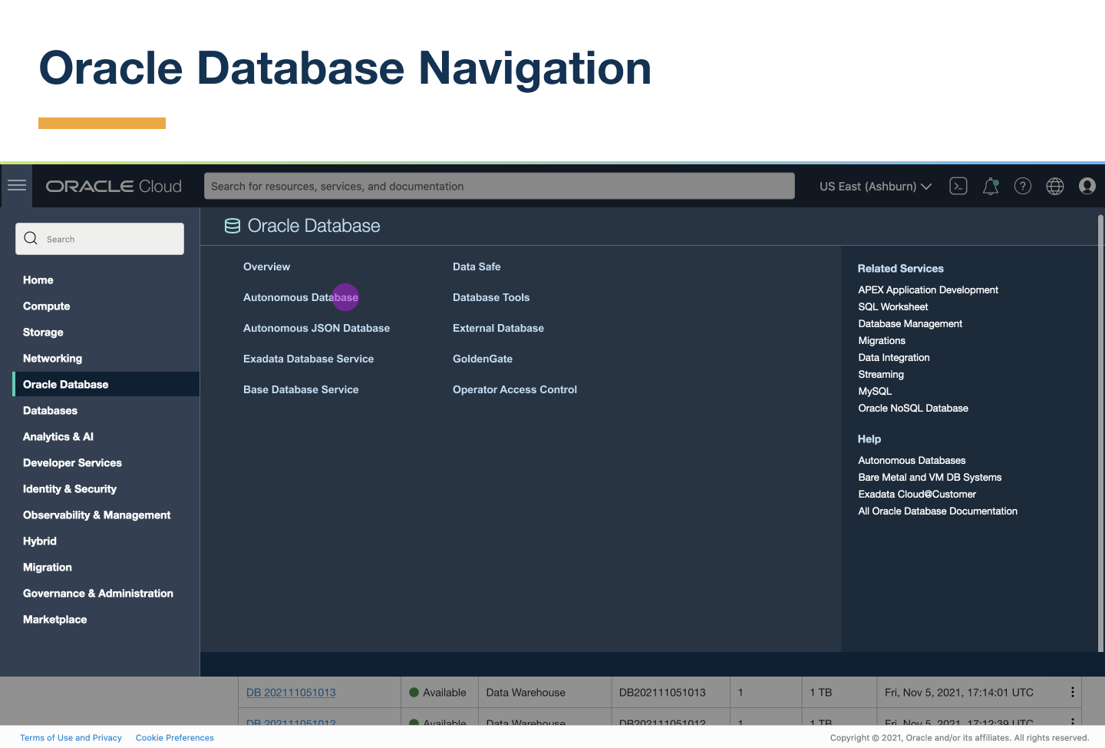

Slide 4
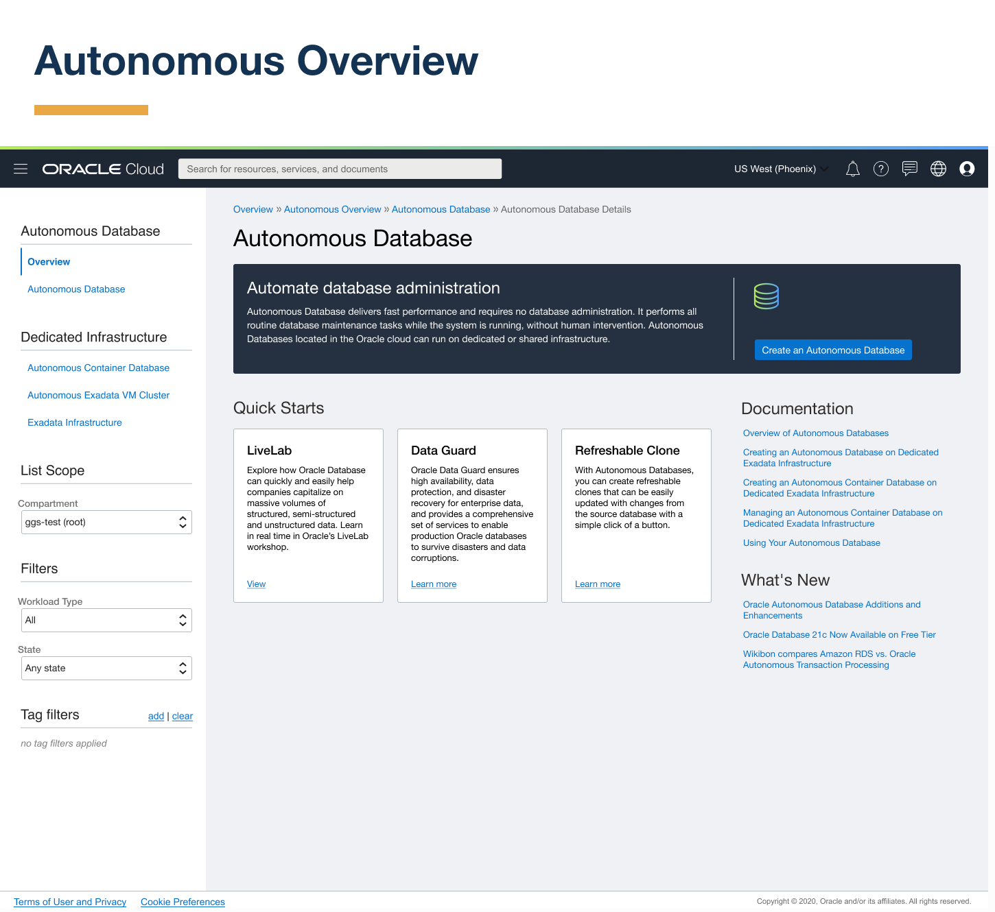

Slide 5
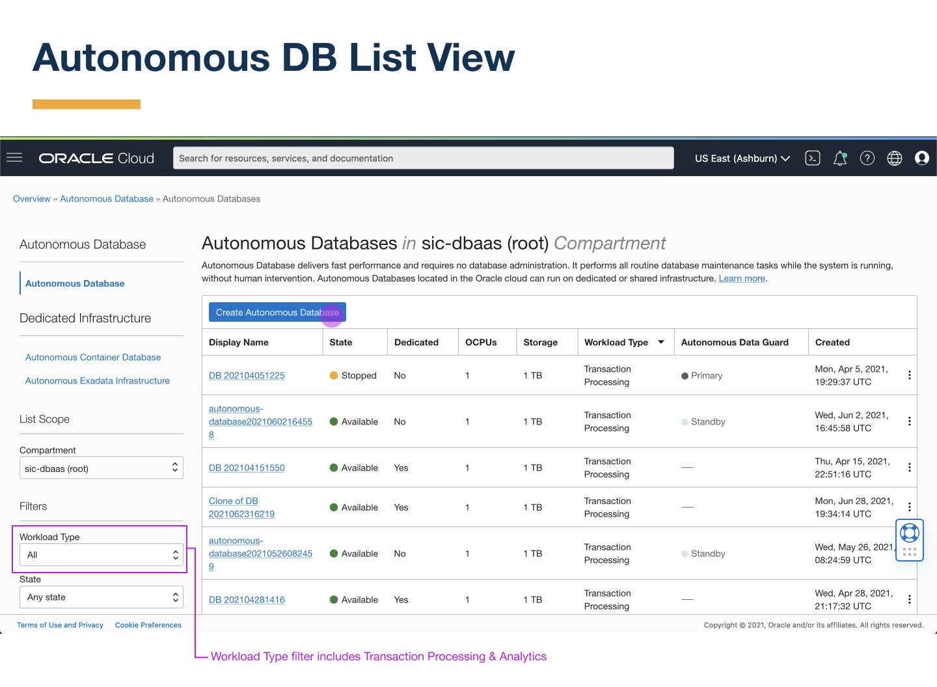

Slide 6
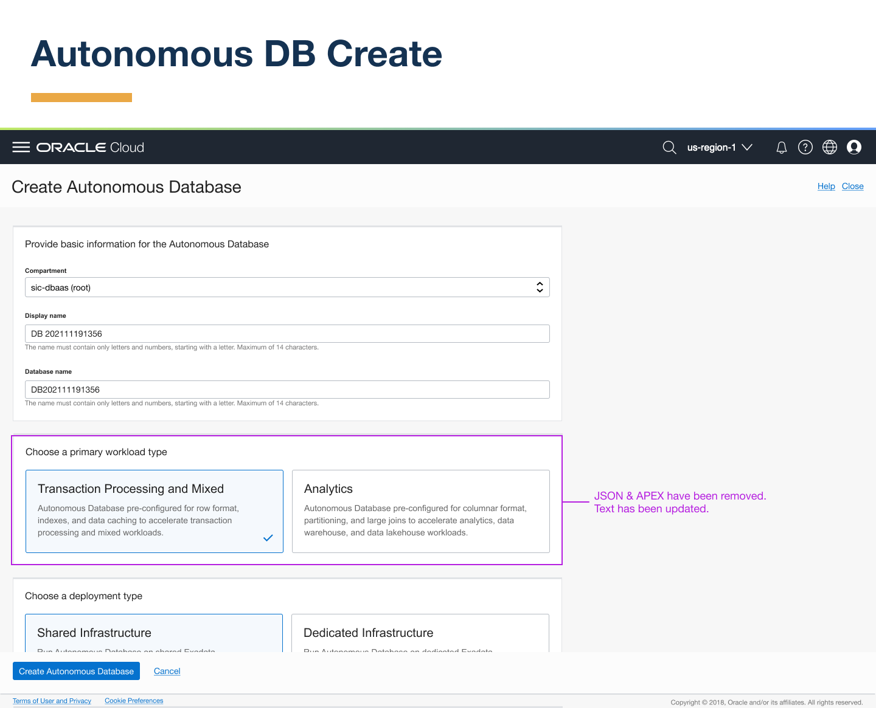

Slide 7
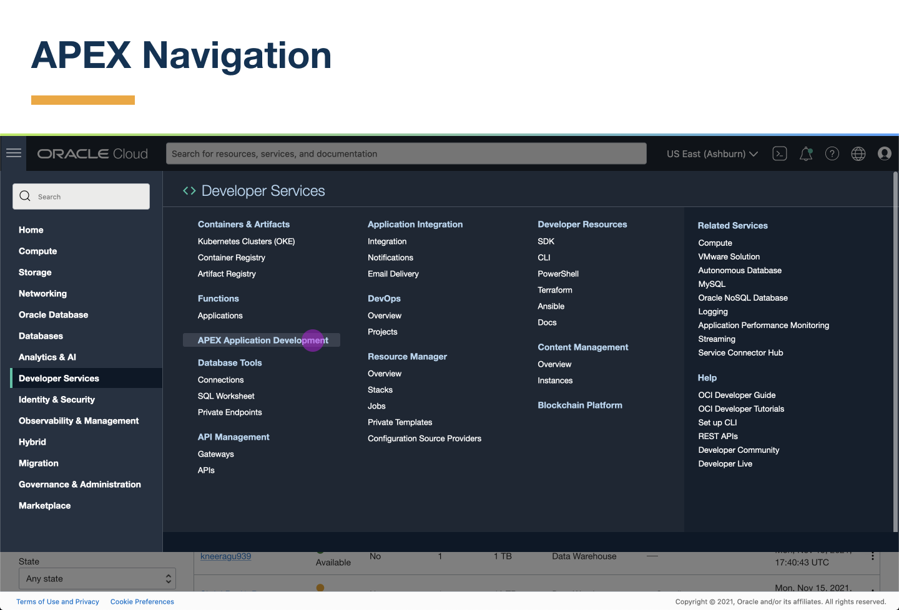

Slide 8
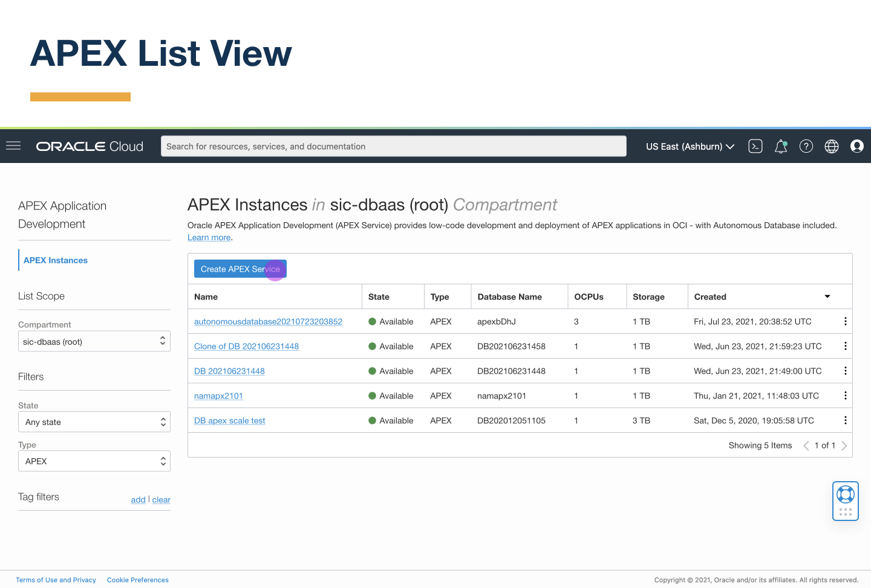

Slide 9
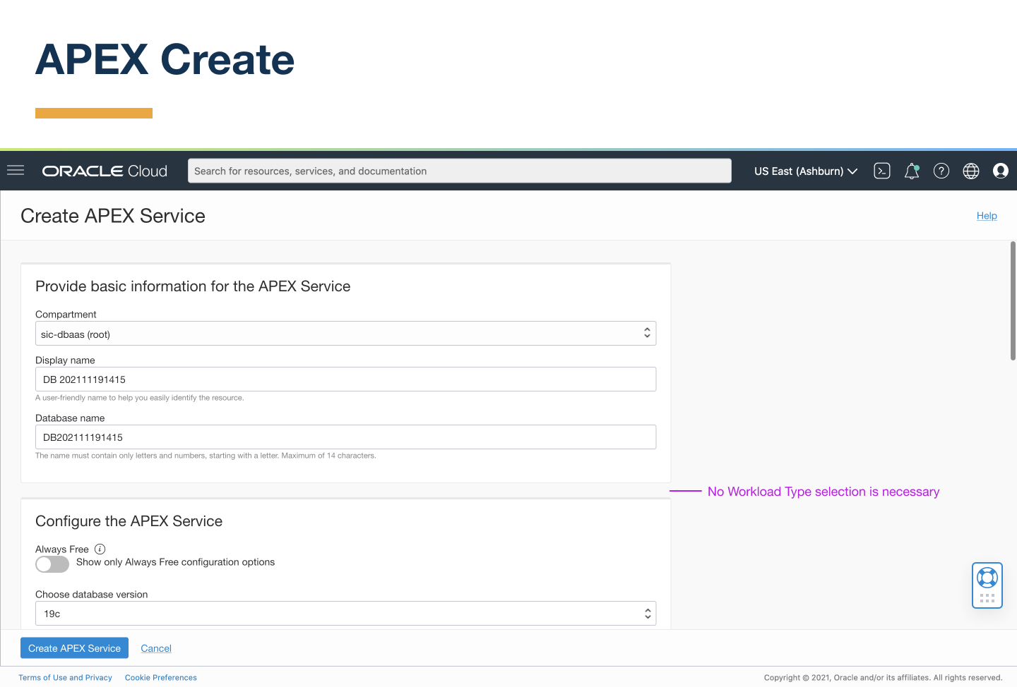

Slide 10


Slide 11
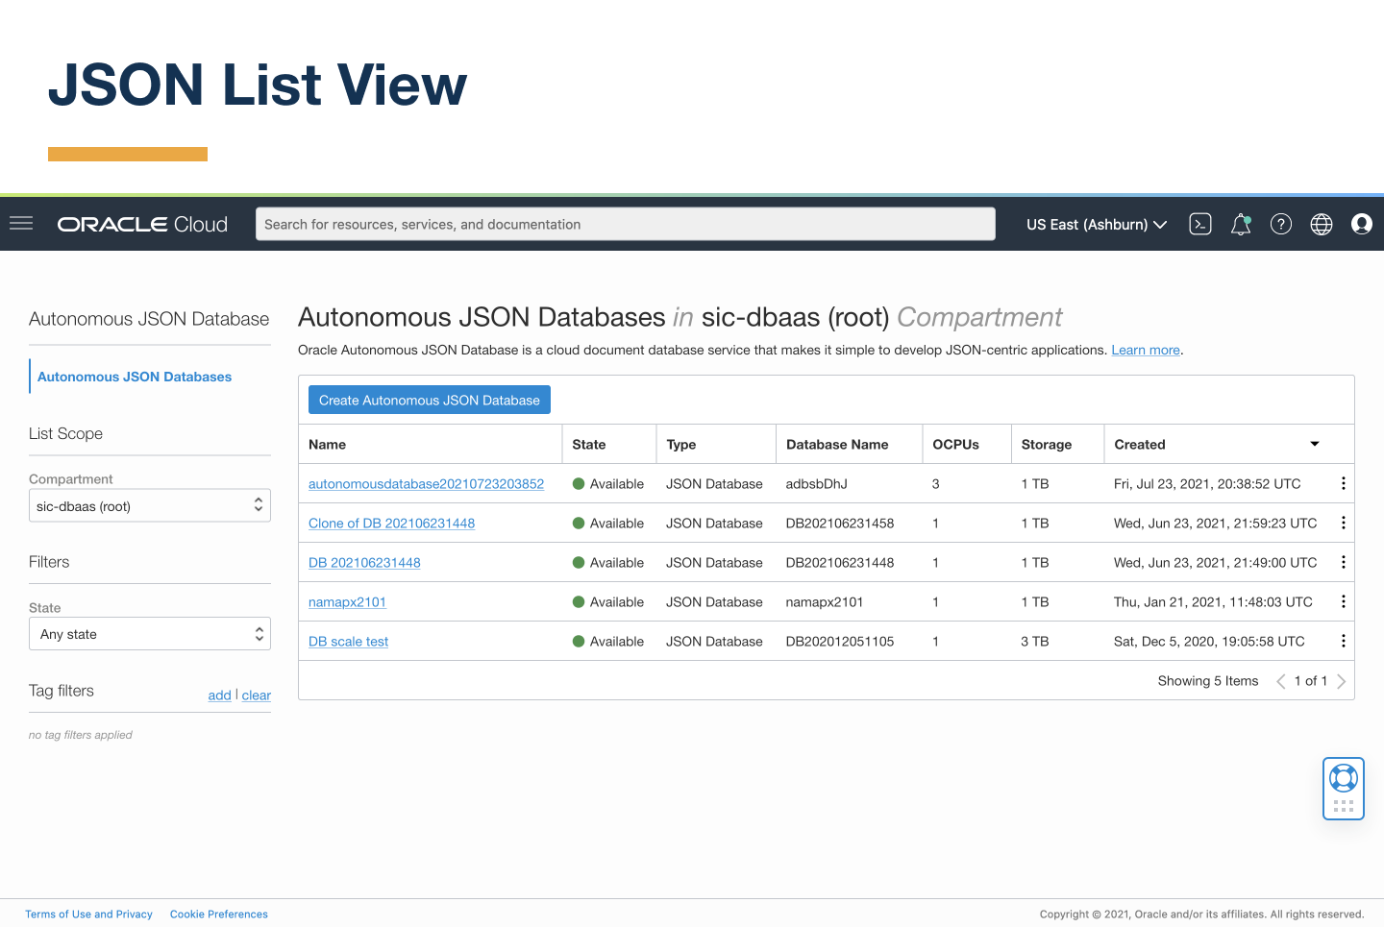

Slide 12
