Slide 1
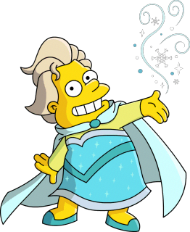
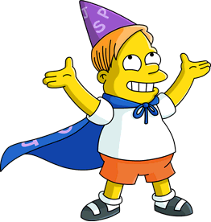
Spell Master

Slide 2
Spell Master
Short Skill Description:
Master your spelling with “Spell Master”. An easy way to practice for your spelling tests. Simply add words to your spelling list then say, start spelling test.
Full Skill Description:
Master your spelling with “Spell Master”. An easy way to practice for your spelling tests. Simply add words to your spelling list then say, start spelling test.
Spell Master recognizes more than 24,000 kid-safe words that one might expect to have learned by the age of 18. It has been designed with the purpose of allowing 6 to 18-year-olds to study independently for their school's spelling tests.
To get started:
You will first want to add words to your spelling list. You can do this by saying "add word". Spell Master will ask you to spell the word you want to add and then prompt you to confirm it captured the correct word.
To practice spelling the words on your list say, start spelling test.
To remove words from your spelling list say, delete word.
To hear the words you have on your spelling list say, list words.
To delete all words from your spelling list say, delete spelling list.
If you get lost, at any time you can say, help.
Report Issues:
Please report issues on the GitHub issue page

Slide 3
Spell Master

Slide 4
Spell Master

Slide 5
Spell Master

Slide 6
Spell Master

