Slide 1


BRAND &
MARKETING
KIT
2026
Specialist tender writing for
UK health and social care
tenderlab.co.uk | info@tenderlab.co.uk | 01707 240393
CONFIDENTIAL

Slide 2
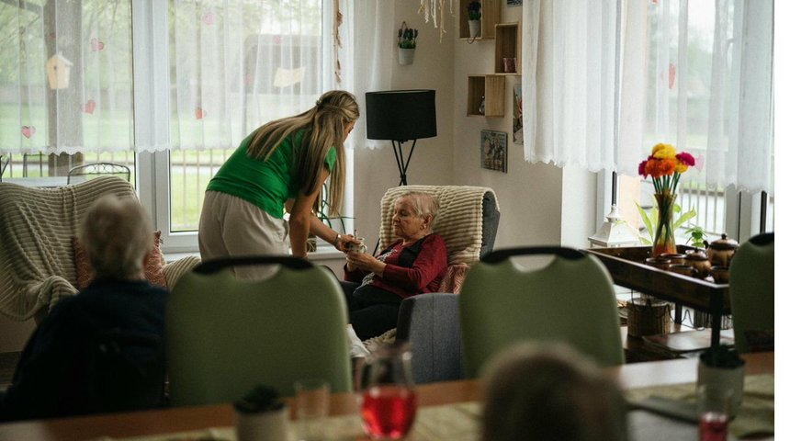

Contents
01
The Market
02
Who We Serve
03
What We Deliver
04
Brand Identity
05
Marketing & Digital
06
Competitive Position
07
Contact
tenderlab.co.uk

Slide 3

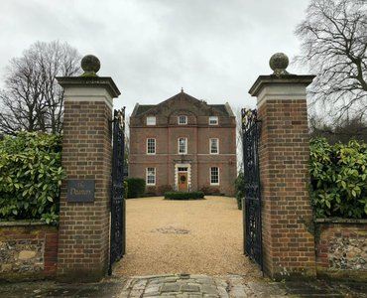

Who We Are
TenderLab is a specialist tender writing and bid consultancy operating exclusively within UK health and social care procurement.
We write, evaluate, and quality-assure tender responses for local authority, NHS, and Integrated Care Board contracts across England. This covers Invitations to Tender, framework applications, Dynamic Purchasing System submissions, and preferred provider list applications.
Hatfield, Hertfordshire | tenderlab.co.uk
01707 240393 | info@tenderlab.co.uk
Health & Social Care | Tender Specialist | England-wide
tenderlab.co.uk

Slide 4





To ensure every care provider with the operational
capability to deliver excellent services has the
written submission to prove it.
Specificity Over Generality
Specification First
Quality Without Exception
Sector Commitment
Named staff, real systems, quantified outcomes. Every claim anchored to operational evidence.
We read the specification the way evaluators read responses. Their language becomes the provider's language.
Every response scored internally before delivery. Nothing leaves below threshold.
One sector. One focus. We do not diversify. We go deeper.
tenderlab.co.uk

Slide 5

01
THE MARKET

Slide 6
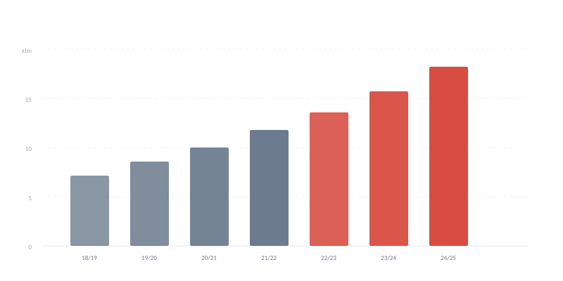
Market at a Glance
£29.4BN
Gross current expenditure on adult social
care by local authorities, England 2024-25
Source: DHSC ASC Finance Report 2024-25
£6.7BN
£4.6BN
10,681
£30BN
Domiciliary care
market 2026
Additional funding
by 2028-29
Domiciliary care
providers
Projected ASC
spend 2025-26
tenderlab.co.uk

Slide 7

Market Pressures
Every pressure below creates procurement activity.
£4BN+
Combined LA budget gaps
2025-26
Councils projecting savings of £1.4bn in ASC alone.
6.7%
National Living Wage
increase 2025
Costs the care sector approximately £1.2bn.
7.39M
NHS pathways awaiting
treatment
Only 59.7% treated within 18-week target.
47%
ASC spending increase
since 2015 (cash terms)
Buys 9% fewer care hours due to inflation.
tenderlab.co.uk

Slide 8



Market Opportunity
Government is consolidating ASC funding through Fair Funding Allocation from 2026-27. This restructuring triggers new commissioning cycles across every local authority in England.
CQC refreshed local authority assessments roll out in 2026-27. Greater transparency means providers need stronger evidence in submissions to demonstrate alignment.
The domiciliary care market alone is worth £6.7bn with 10,681 providers competing. The difference between winning and losing is the quality of the written submission.

Slide 9
02
WHO WE
SERVE

Slide 10







Our Clients
CQC-Regulated Adult Care Providers
Ofsted-Registered Children's Services
Domiciliary care, residential, nursing, supported living, reablement, and specialist services.
Children's residential homes, supported accommodation for young people, fostering agencies.
NHS ICB Framework Applicants
Supported Living & Housing Providers
Continuing healthcare, community services, preferred provider list applications.
Learning disability, mental health, autism, physical disability, semi-independent services.

Slide 11





Client Sectors
Domiciliary Care
Residential & Nursing
Supported Living
Home care, reablement, live-in care, complex care at home.
Care homes, nursing homes, specialist dementia units.
Learning disability, mental health, autism, physical disability.
Children's Services
Specialist Services
Frameworks & DPS
Residential children's homes, supported accommodation 16-25.
Continuing healthcare, neurological, end of life, palliative.
Multi-provider frameworks, DPS, preferred provider lists.
tenderlab.co.uk

Slide 12
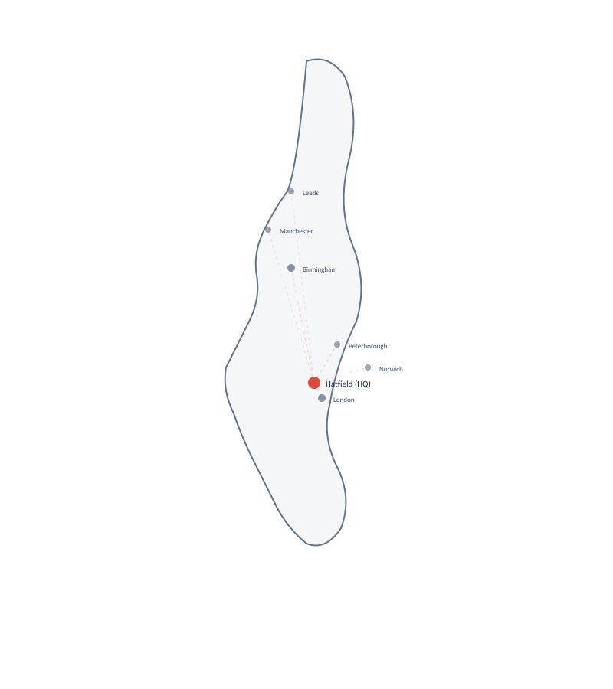
Where We Operate
Based in Hatfield, Hertfordshire. We work across every local authority and Integrated Care Board commissioning structure in England. Our client base spans Birmingham, London, Norfolk, West Sussex, Worcestershire, Buckinghamshire, Peterborough, and beyond.
tenderlab.co.uk

Slide 13
03
WHAT WE
DELIVER

Slide 14





Our Services
Specification Analysis & Briefing
Tender Response Writing
Quality Evaluation & Assurance
Pricing & Financial Modelling
Full ITT analysis. Branded briefing within 24 hours.
20-criterion framework. Iterative rewrite to 4+ threshold.
Independent scoring. Gap analysis. Tracked-change rewrites.
NLW-verified, market-benchmarked.
tenderlab.co.uk

Slide 15
Specification Analysis & Briefing
Every engagement starts here
Full ITT document analysis within 24 hours
Extraction of statutory context, cohort profiles, and KPI frameworks
Eligibility assessment against published criteria
Evaluation weighting and scoring methodology identified
Client briefing report
Bid/no-bid recommendation with rationale
tenderlab.co.uk

Slide 16

Tender Response Writing
The core of what we do
Responses written against criterion evaluation framework
Specification language embedded directly into provider approaches
Named staff, real systems, quantified outcomes throughout
Internal scoring across five weighted domains before delivery
Iterative rewriting until all criteria meet 4/5 threshold
Cross-referenced against commissioning body's published criteria
tenderlab.co.uk

Slide 17

Quality Evaluation & Assurance
Independent assessment of existing submissions
Scoring against five weighted domains with written commentary
Gap analysis identifying missing specification requirements
Tracked-change rewrite recommendations with improvement rationale
Before-and-after score comparison across all criteria
Specification compliance verification against original ITT
Delivered as branded evaluation report with appendices
tenderlab.co.uk

Slide 18
Pricing & Financial Modelling
Every figure verified before submission
National Living Wage compliance verification for all hourly rates
Market rate benchmarking against published local authority data
Cost breakdown reconciliation between Section A and Section B
Python-verified arithmetic across all schedule totals
Sensitivity analysis for rate variations and volume changes
Formatted to match the commissioning body's required template
tenderlab.co.uk

Slide 19

Why Providers Choose Us
01
We only work in health and social care
CQC, Ofsted, ICB, Care Act 2014, MCA 2005, TUPE 2006.
02
We read specifications like evaluators
Exact language, statutory context, and scoring methodology extracted first.
03
Everything is scored before delivery
20 criteria. Five weighted domains. 4/5 minimum threshold.
04
We write with operational specificity
Named staff. Real systems. Quantified outcomes.
05
We verify every number
NLW-checked, market-benchmarked.
06
We deliver within structured timelines
Briefing report within 24 hours. Full response within programme.
tenderlab.co.uk

Slide 20
04
BRAND
IDENTITY

Slide 21
Logo System
ON MIDNIGHT INK
ON SLATE
Construction TENDER in bold sans-serif caps. LAB in rounded rectangular container. Connected by horizontal rule. Transparent background.
Clear Space Minimum clearance = height of letter L from all edges.
Minimum Size 30mm (print) / 120px (screen).
Prohibited No rotation, skew, effects, separation, or unapproved colours. No white box behind logo.
PRIMARY (transparent)
tenderlab.co.uk

Slide 22
Colour Palette
Heritage Red
Slate
Midnight Ink
#D4382C | PMS 7621 C
#3B5068 | PMS 7545 C
#192231 | Custom
Logo, headings, accents
Data, structure, secondary
Dark backgrounds, body text
SUPPORTING
Off-White #FAFAF5
Light Grey #F3F4F6
Mid Grey #6B7280
Crimson #A3192A
Slate Light #5A7A96
RATIOS
55% Neutrals 20% Midnight Ink 15% Slate 10% Heritage Red
tenderlab.co.uk

Slide 23
Typography
PRINT
DIGITAL
Section Header
Inter (Google Fonts)
H1 / 22pt / Bold / Heritage Red
Identical x-height to Calibri. Open apertures.
Fallback: Inter, -apple-system, Segoe UI, sans-serif.
Subsection
H2 / 16pt / Bold / Midnight Ink
Sub-subsection
H3 / 13pt / Bold / Slate
RULES
Body text reads like this.
Line height 1.5x minimum
Body / 11pt / Regular
Max 75 characters per line
Caption and metadata
All-caps for section labels and logo only
Caption / 10pt / Light
Bold sparingly; no italic for emphasis
Paragraph spacing: 6pt after body
tenderlab.co.uk

Slide 24


Tone of Voice
DIRECT
TECHNICAL
EVIDENCE-LED
ECONOMICAL
State what we do, how, and what it produces.
Sector terminology used accurately.
Every claim substantiated with specifics.
Fewest words at required precision.
WE WRITE
WE DO NOT WRITE
"We scored this response 3.2/5."
"The specification requires TUPE compliance."
"This response does not evidence named staff."
"We feel this is a strong response."
"You may want to consider TUPE."
"This could be improved."

Slide 25
Visual Identity
Photography
The Horizontal Rule
Real care sector images. Desaturated to 40% with Heritage Red duotone for brand consistency where needed.
From the logo. 2pt for section dividers, 1pt for heading emphasis. Always Heritage Red.
The Container
Iconography
From the LAB element. For callouts and key statistics. Tightened radius. Max two per page.
24px grid, 1.5px stroke, rounded caps. Heritage Red or Midnight Ink only. Functional, not decorative.
Templates
Prohibited
Briefing (2pp landscape). Evaluation report. Invoice. Proposal. Deck (16:9). All version-controlled.
No animations, gradients, drop shadows, glows. No unapproved fonts. No co-branding. No white box behind logo.
tenderlab.co.uk

Slide 26
05
MARKETING
& DIGITAL

Slide 27



Content Strategy
LinkedIn, Facebook, Blog. Google My Business. Three content categories.
SECTOR ANALYSIS
Commissioning trends. Regulatory changes. Procurement insights. Specification patterns. Funding announcements.
PERFORMANCE DATA
Anonymised win rates. Scoring improvements. Evaluator feedback patterns. Before-and-after scores.
OPERATIONAL COMMENTARY
Common scoring failures. What evaluators look for. Pricing errors. Tender red flags.
EXCLUDED: motivational content, team celebrations, win announcements, industry-leading, best-in-class, passionate, synergy, game-changer

Slide 28
Digital Presence
WEBSITE: tenderlab.co.uk
EMAIL SIGNATURE
Name (Bold 11pt). Role (Light 10pt). Heritage Red rule. Logo at 80px. No taglines.
Credibility platform. Every page answers: what does this organisation know that generalist competitors do not.
Proposition in under 20 words above the fold
LinkedIn, Facebook, Blog. Google My Business
Five primary navigation items maximum
Only social platforms. Brand palette on all assets. Sector analysis, performance data, operational commentary.
Page load under 2 seconds on 4G
No animations, carousels, pop-ups, chat widgets
TEMPLATES
Briefing (2pp landscape). Evaluation report. Invoice. Proposal. Deck (16:9). All version-controlled.
tenderlab.co.uk

Slide 29

Target Keywords & SEO
PRIMARY
tender writing health social care
bid writing social care UK
health care tender consultancy
social care bid writer
tender writing domiciliary care
NHS tender writing services
care tender consultant
LONG-TAIL
supported living tender writing UK
CQC compliant bid writing
domiciliary care framework application
local authority care contract bid
NHS continuing care tender support
children's residential home tender writer
DPS application social care
tender evaluation health social care
SEO METADATA
Title: TenderLab | Specialist Tender Writing for UK Health & Social Care
Meta: Expert tender writing and bid consultancy for UK health and social care providers. We write, evaluate, and quality-assure responses for local authority, NHS, and ICB contracts.
Schema: LocalBusiness + ProfessionalService | serviceType: Tender Writing, Bid Consultancy | areaServed: England
tenderlab.co.uk

Slide 30

Hashtag Strategy
PRIMARY (every post)
#TenderWriting
#BidWriting
#HealthAndSocialCare
#SocialCareProcurement
#TenderLab
SECONDARY (rotate by content category)
Sector
#CQC
#CareAct2014
#NHSProcurement
#LocalAuthority
#IntegratedCare
Performance
#WinRate
#ContractWin
#TenderSuccess
#BidManagement
#ProcurementStrategy
Operational
#TenderTips
#PricingSchedule
#SocialValue
#TUPE
#DomiciliaryCare
Max 5 per post. First 3 primary, 2 rotated secondary. End of post after line break. Track monthly. All posts include #TenderLab.

Slide 31
06
COMPETITIVE
POSITION

Slide 32
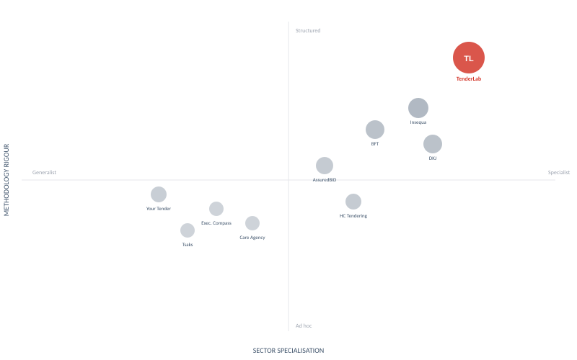
Competitive Landscape
Competitor | Focus | Gap vs TenderLab
BFT Consult | H&SC, est. 2014 | No structured scoring
Executive Compass | Multi-sector | Breadth dilutes depth
Insequa | Social care, 13+ yrs | Closest; higher volume
DKJ Support | Healthcare bids | NHS-weighted; less LA
AssuredBID | H&SC, 5+ yrs | No evaluation framework
Tsaks | Multi-sector | H&SC one vertical
HC Tendering | H&SC bids | Portal product alongside
Your Tender Team | H&SC | No methodology gap
Care Agency Media | H&SC + marketing | Marketing-first
Our Position
Top-right quadrant: highest sector specialisation combined with highest methodology rigour. No identified competitor operates a published, replicable evaluation framework with a defined pass threshold. Insequa is closest in focus but operates at higher volume with less visible quality assurance.
tenderlab.co.uk

Slide 33
Competitive Differentiation
Dimension | Generalist Bid Writer | TenderLab
Sector knowledge | Cross-sector; surface-level | Exclusive H&SC; CQC, Ofsted, ICB fluency
Specification analysis | Reads questions at face value | Extracts statutory context, KPIs, cohort profiles
Response evidence | Generic statements | Named staff, real systems, quantified outcomes
Quality assurance | Proofreading | 20-criterion scoring; iterative rewrite to 4+
Pricing | Figures formatted | NLW-verified, Python-reconciled models
Turnaround | Variable, undefined | Structured; briefing within 24 hours
tenderlab.co.uk

Slide 34


Brand Architecture
Single-brand model. One brand, one sector, one methodology.
TENDERLAB
Specification
Analysis
Response
Writing
Quality
Evaluation
Pricing &
Modelling
Client deliverables carry the client's branding where procurement requires it. Our branding appears on advisory documents only: briefing report, evaluation report, and invoice.
No sub-brands. Services categorised but not separately branded. All assets centrally maintained and version-controlled.

Slide 35




Get in touch
tenderlab.co.uk
info@tenderlab.co.uk
01707 240393
Hatfield, Hertfordshire
CONFIDENTIAL | Brand & Marketing Kit | 2026

