Slide 1
Microservices
SOA 2.0

Slide 2

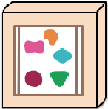

SOA
What About…
An architectural pattern for building applications. Functionality is exposed as a collection of services provided to the user through a common interface. The API
Loosely coupled
Black Boxed
Reusable business logic

Slide 3

Web Services
Even Better…
Network
Implementations of the SOA architectural concepts. Generally falling into 2 non-mutually exclusive categories, SOAP and REST. These applications are distributed over a network either local or the internet. That allow for increased interoperability between applications and platforms

Slide 4
SOAP
Simple Object Access Protocol
Contract Based Web Service Protocol (WSDL)
Transfers XML based messages

Slide 5
WSDL
<definitions>
What is it…
<types> data type definitions........ </types>
<message> definition of the data being communicated.... </message>
<portType>
</portType>
Web Service Description Language. AKA the service contract.
XML Document that describes how to interact with a Web Service
Describes Service APIs, Messages, and Types
Describe Service Access Urls and Binding Styles
Damn, These Malls Put On Big Sales
<operations>
a set of operations….
</operations>
<binding> protocol and data format specification.... </binding>
<service>
service contact information…
</service
</definitions>

Slide 6

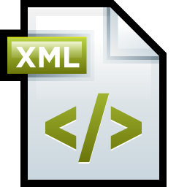
Contract First or Last
Contract First
WSDL is created as a contractual representation of the service
The application environment is automatically created as functional representation of the service.
Contract Last
The application environment is created as the functional representation of the service
WSDL is created automatically as a contractual representation of the service

Slide 7

Message Transfer
<Envelope>
SOAP messages are XML messages sent by clients to servers and from servers back to clients.
Envelope
Header?
Body
Fault?
<Header>
a set of optional headers…
</Header>
<Body>
a message to send….
</Body>
<Fault>
only if an error occurs…
</Fault>
</Envelope>

Slide 8
SOAP Fault
<fault>
</fault>
<faultCode>
Server|Client|VersionMisMatch|MustUnderstand
</faultCode
<faultString>
human readable explanation
</faultString>
Indication of an error. Contains all information needed to construct a platform specific error message
faultCode
faultString
faultActor
detail
<detail>
Application specific details of the fault
</detail>
<faultActor>
the entity that raised the error
</faultActor>

Slide 9
What is a Monolith Application?
Now the breakdown….
A collection of services that are served together as a single process and scaled as a single process. This is commonly known as a Monolith.

Slide 10


What’s Wrong With a Monolith
Think about this…
Large Teams
Difficult to scale
High cost of maintenance
Services become tightly coupled
Can be difficult to understand at a fine grained scope

Slide 11
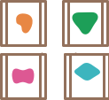
What are microservices
Can we get finer
A variant of SOA. A collection of loosely coupled, fine-grained services. Each service is treated as a separate process and scaled separately from other services.

Slide 12


Microservice components
Architecture
Entry point to system
Handles request routing
Separate applications
That handle business logic
Gateway
Discovery
Services
Messaging Queue

Slide 13
Services register with Discovery at startup
Requests are made to the API Gateway
Gateway confers with Discovery for service info
Requests are routed to the appropriate service
Changes in service states are pushed to the Message Queue
Message Queue broadcast messages

