Slide 1
Medical Costs Prediction Micro-Project #3 https://github.com/KeithSmith89/ANA500.git
Keith D. Smith
February 19, 2023

Slide 2
Problem Statement
Background: A dataset consisting of medical costs paid by insurance and demographic data will be analyzed to determine which features associate with higher medical costs. Various machine learning models will be used to predict medical costs.
Objective(s):
Determine which features associate with higher medical costs
Can a machine learning model be utilized to predict medical costs based on demographic data

Slide 3

Hypothesis
$H_{0}:$ age, sex, bmi, children, smoker, and region have no association with medical costs
$H_{A}:$ age, sex, bmi, children, smoker, and region have an association with medical costs

Slide 4
Program Design
Program Design
Program: Cardiovascular Prediction Using
Machine Learning Models
Task: Develop a python program that takes demographic data as inputs and outputs a prediction as to medical costs billed by health insurance.
Data Science Process Steps:
Data Acquisition
Data Preparation (Feature exploration and engineering)
Predictive Analytics (Train, test, and validate machine learning models. Chose optimal model)
Report Analysis Results
Act or apply results from analysis by connecting results with problem statement

Slide 5
Hierarchy Chart
Hierarchy Chart
[cardio] = age, sex, height, bmi, children, smoker, region,
Main Program (Output: Prediction of Medical Costs Billed by Insurance; Input: Demographic Data

Slide 6
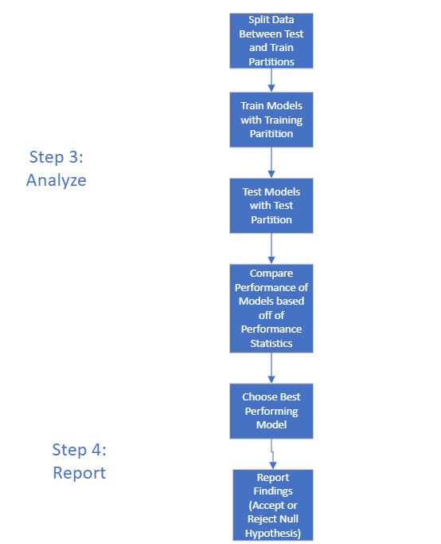
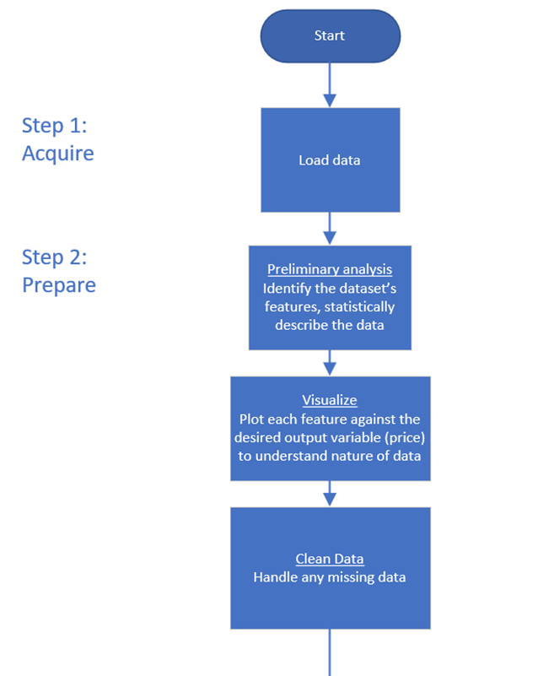
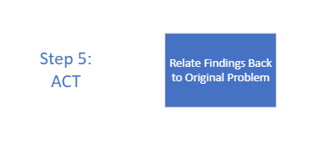
Flow Chart

Slide 7
Pseudocode
Step 1: Acquire Data
Import Libraries
Pandas, Numpy, Seaborn, Matplotlib, Statsmodels, Itertools, sklearn
Read in Data
Data=pandas.read
Step 2: Prepare Data
Data Information
Data head
Data shape
Null Values
Summary Stats
5 number summaries
Count data
Visualization
Boxplots
Countplots

Slide 8
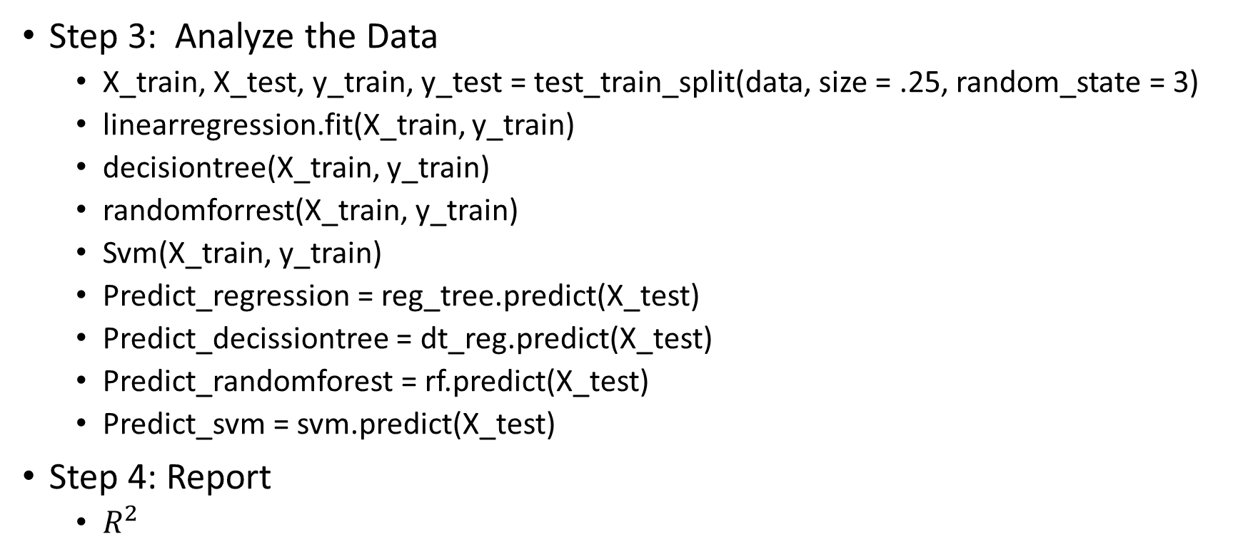
Pseudocode
Step 3: Analyze the Data
X_train, X_test, y_train, y_test = test_train_split(data, size = .25, random_state = 3)
linearregression.fit(X_train, y_train)
decisiontree(X_train, y_train)
randomforrest(X_train, y_train)
Svm(X_train, y_train)
Predict_regression = reg_tree.predict(X_test)
Predict_decissiontree = dt_reg.predict(X_test)
Predict_randomforest = rf.predict(X_test)
Predict_svm = svm.predict(X_test)
Step 4: Report
$R^{2}$

Slide 9
Acquire
Medical data was acquired through Kaggle.com
Data source: https://www.kaggle.com/datasets/mirichoi0218/insurance

Slide 10
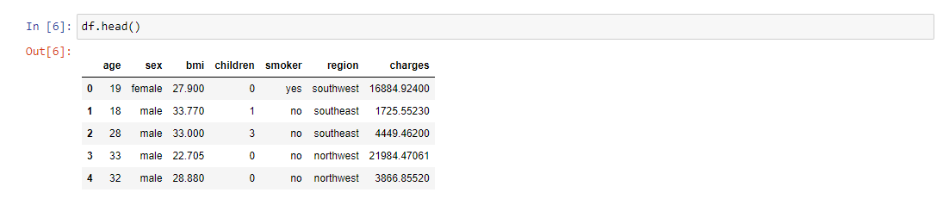
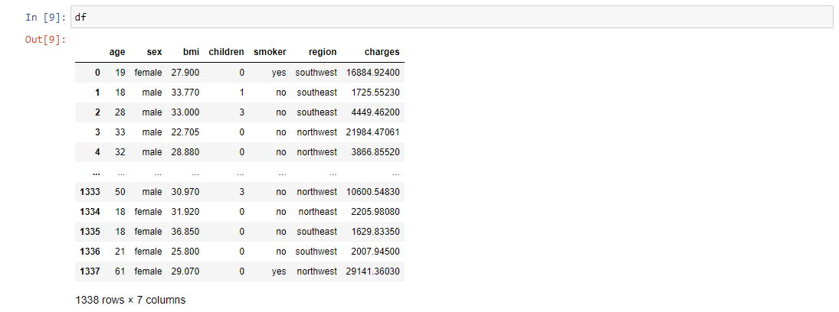
Prepare

Slide 11
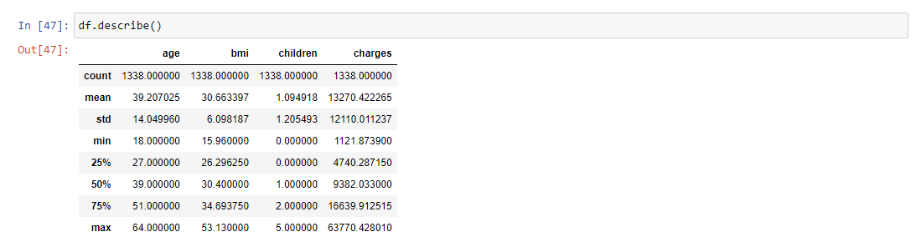
Prepare

Slide 12
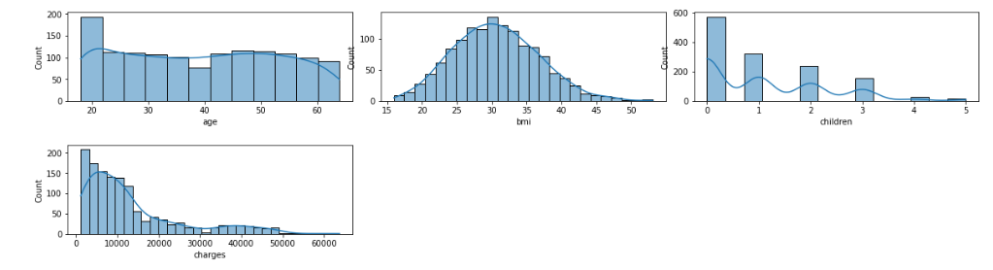
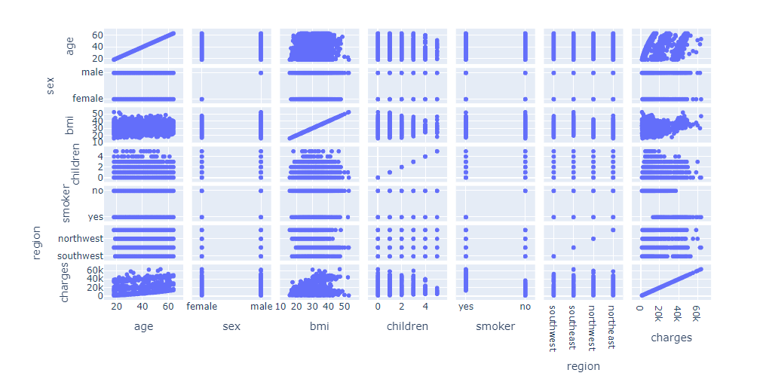
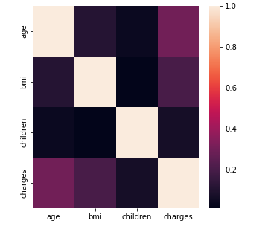
Prepare (Visualization)
The histograms represent the distribution of the numerical predictors. Age is fairly normally distributed with the exception of younger individuals. BMI is normally distributed. Charges appear to have outliers. Children is really a discrete variable as it represents count data. The scatterplot matrix is valuable to compare the continuous data with the target, charges. For example, BMI appears to have a positive non-linear correlation with charges. Finally, the heat map is a visual representation of Pearson’s R which depicts correlation. Age and BMI appear to have the highest correlation among the numerical variables with charges.

Slide 13
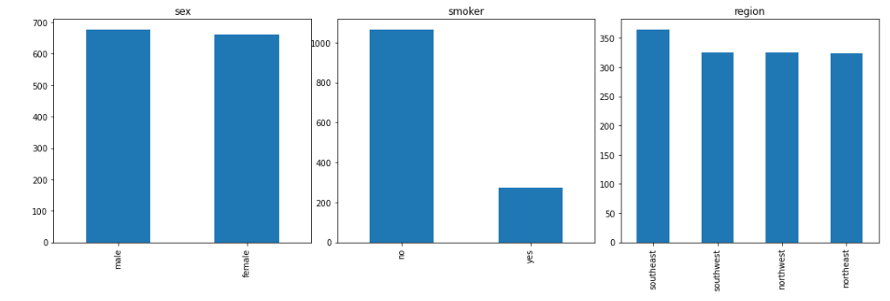
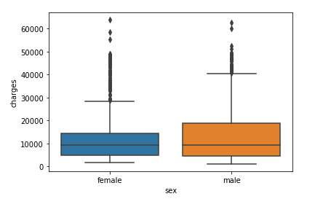
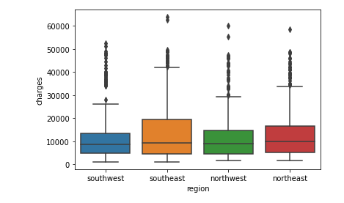
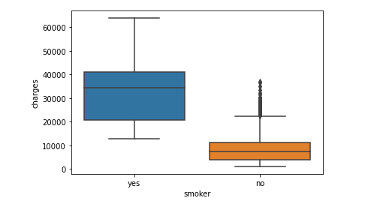
Prepare (Visualization)
The bar graphs represent the distribution of categorical variables. The distribution appears to be similar among sex and region but is imbalanced with respect to smoker. The boxplots depict the group differences among the categorical variables with respect to the target, charges. There appears to be a group difference for charges based on region and smoking status.

Slide 14
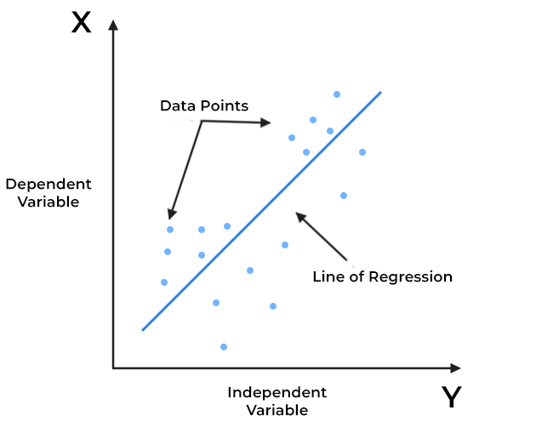

Predictive Analysis (Linear Regression)
Based on Ordinary Least Squares (OLS) which seeks to minimize error terms of a continuous response variable
$y=β_{0}+β_{1}X_{1}$

Slide 15
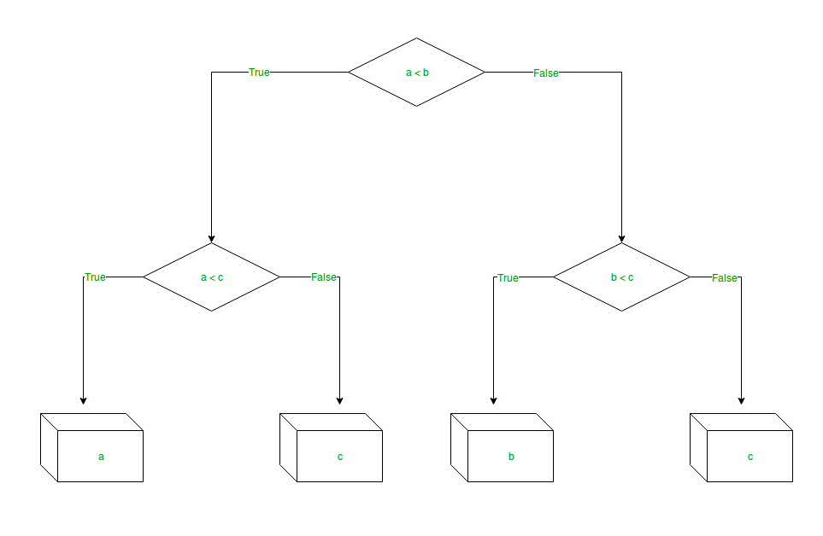
Predictive Analysis (Decision Tree Regression)
Non-parametric learning algorithm
Gain from traditional decision tree is replaced by Standard Deviaion Reduction

Slide 16
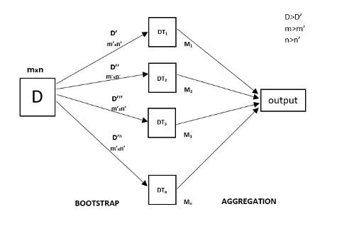
Predictive Analysis (Random Forest Regression)
Non parametric learning algorithm
Ensemble of Regression Trees
Decision Trees Have High Variance
Random Forests combine multiple Regression Trees to reduce variance

Slide 17
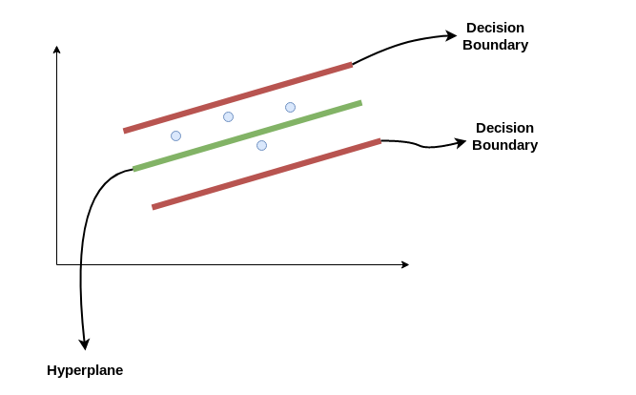
Support Vector Regression
Application of Support Vector Machine to Continuous Outcomes
Establishes boundary lines, based on a hyperplane, that contain predictor variables
Best fit line establishes a hyperplane containing the maximum amount of data

Slide 18
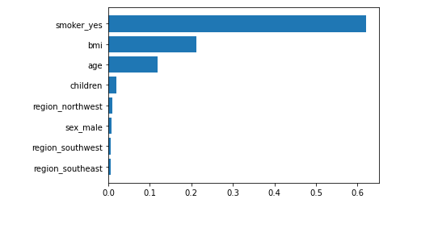
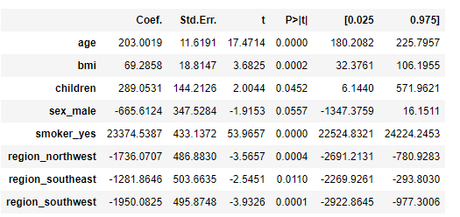
Report of Analysis Results (Feature Importance)
Smoker_yes, bmi, and age are the most important predictors for charges based on decision tree regression
sex_male is not statistically significant and can be removed from the models

Slide 19
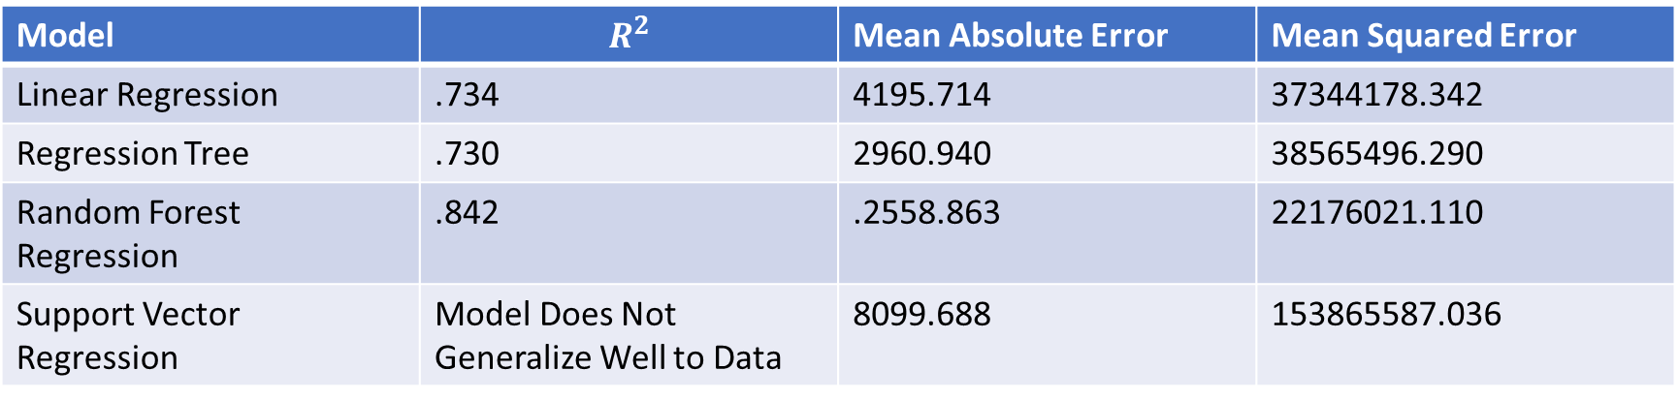
Report of Analysis
Model | $$R^{2}$$ | Mean Absolute Error | Mean Squared Error
Linear Regression | .734 | 4195.714 | 37344178.342
Regression Tree | .730 | 2960.940 | 38565496.290
Random Forest Regression | .842 | .2558.863 | 22176021.110
Support Vector Regression | Model Does Not Generalize Well to Data | 8099.688 | 153865587.036
The null hypothesis can be rejected in favor of the alternate hypothesis
age, sex, bmi, children, smoker, and region have an association with medical costs billed by insurance
Random Forest Regression Outperforms all Other Models

Slide 20
Act: Recommendations
Higher Cost Associated with Following Factors
Smoking Status
If individuals smoke, they will be charged higher premiums
BMI
AGE
Region
A Random Forest Regressor can be trained to predict medical costs billed by insurance on the bases of smoking status, BMI, age, number of children, and region.

Slide 21
References
Decision Tree Regression. (n.d.). https://www.saedsayad.com/decision_tree_reg.htm
GeeksforGeeks. (2023a, January 11). Python Decision Tree Regression using sklearn. https://www.geeksforgeeks.org/python-decision-tree-regression-using-sklearn/
GeeksforGeeks. (2023b, January 11). Random Forest Regression in Python. https://www.geeksforgeeks.org/random-forest-regression-in-python/
James, G., Witten, D., Hastie, T., & Tibshirani, R. (2022). An Introduction to Statistical Learning: with Applications in R (Springer Texts in Statistics) (2nd ed. 2021). Springer.
Kanade, V. (2022, December 14). What Is Linear Regression? Types, Equation, Examples, and Best Practices for 2022. Spiceworks. https://www.spiceworks.com/tech/artificial-intelligence/articles/what-is-linear-regression/
sklearn.preprocessing.StandardScaler. (n.d.). Scikit-learn. https://scikit-learn.org/stable/modules/generated/sklearn.preprocessing.StandardScaler.html

