Slide 1
Apple Stock Value Prediction Micro-Project #4 https://github.com/KeithSmith89/ANA500.git
Keith D. Smith
February 26, 2023

Slide 2
Problem Statement
Background: A dataset consisting of Apple closing stock values will be analyzed to determine whether the previous day’s closing value can be used to predict the following day’s closing value. A Recurrent Neural Network (RNN) will be trained to predict the following day’s closing data and an Augmented Dickey-Fuller Test will be performed to determine the model’s reliability based on the underlying data.
Objective(s):
Train an RNN to predict Apple’s Closing Values
Perform Augmented Dickey-Fuller Test to Determine RNN’s Reliability

Slide 3
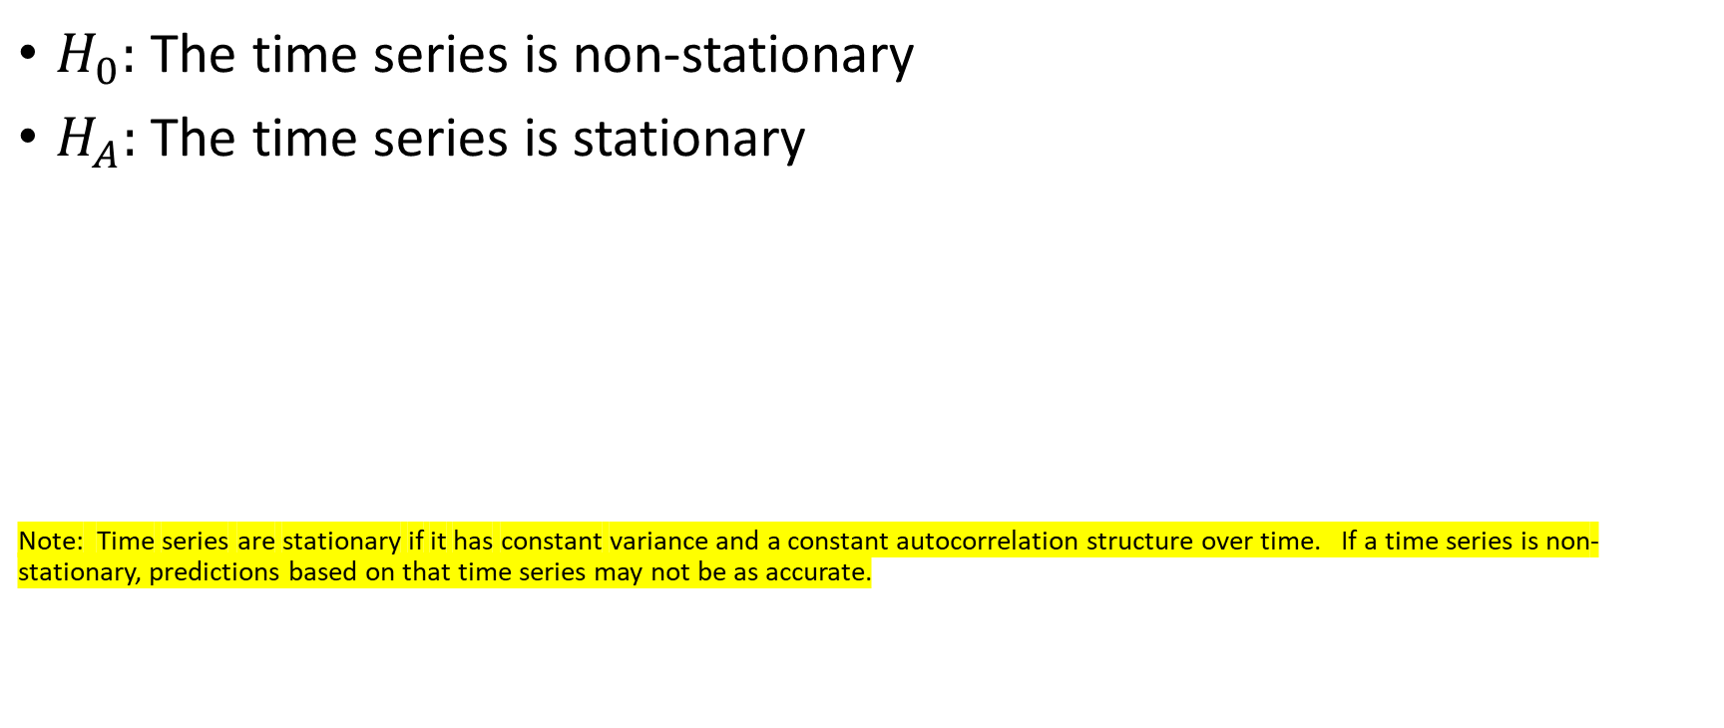
Hypothesis
$H_{0}:$ The time series is non-stationary
$H_{A}:$ The time series is stationary
Note: Time series are stationary if it has constant variance and a constant autocorrelation structure over time. If a time series is non-stationary, predictions based on that time series may not be as accurate.

Slide 4
Program Design
Program Design
Program: Apple Stock Closing Value Prediction
RNN
Task: Develop a python program that takes Apple’s previous day’s closing value as an input and predicts the next day’s closing value as an output.
Data Science Process Steps:
Data Acquisition
Data Preparation (Feature exploration and engineering)
Predictive Analytics (Train, test, and RNN)
Report Analysis Results
Act or apply results from analysis by connecting results with problem statement

Slide 5
Hierarchy Chart
Hierarchy Chart
[Apple Closing Value] = f(Previous Day’s Closing Value)
Main Program (Output: Prediction of Apple Stock Closing Value; Input: Previous Day’s Closing Value

Slide 6
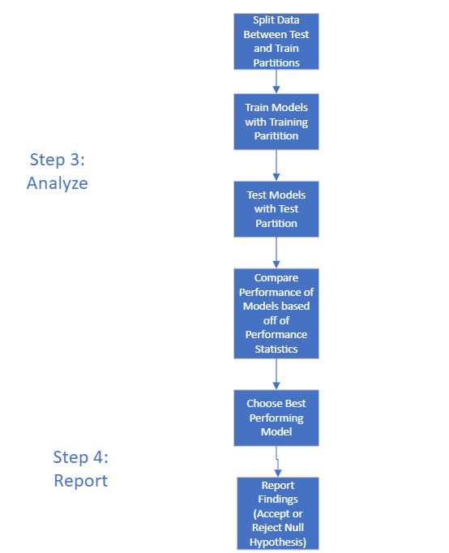
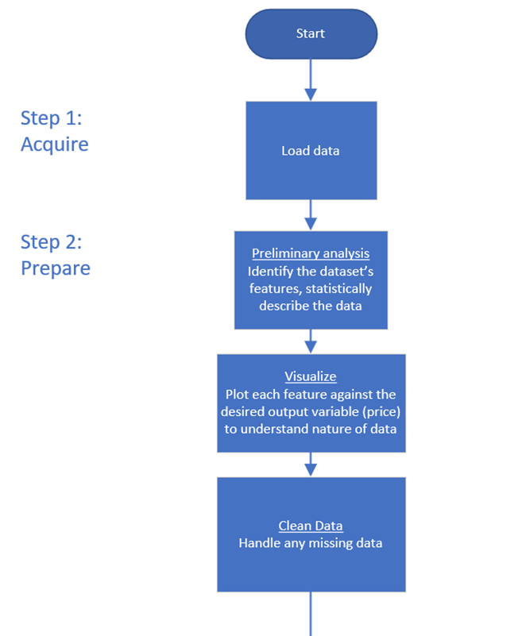
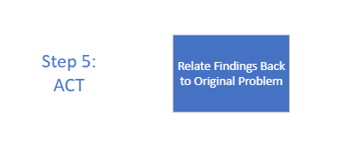
Flow Chart

Slide 7
Pseudocode
Step 1: Acquire Data
Import Libraries
Pandas, Numpy, Seaborn, Matplotlib, yfinance, tensorflow, keras, statsmodels
Read in Data
Data=yahoo_finance
Step 2: Prepare Data
Data Information
Data head
Data shape
Null Values
Summary Stats
5 number summaries
Count data
Visualization
Closing Value Over Time, Rolling Average, Rolling Standard Deviation

Slide 8
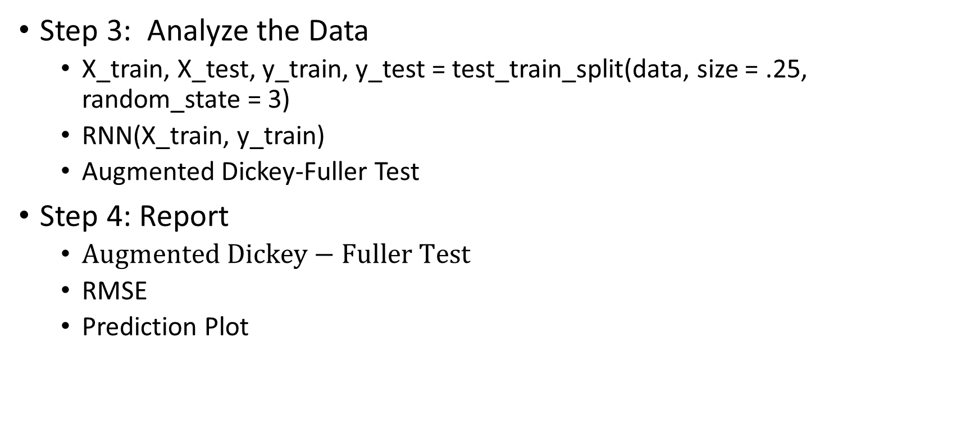
Pseudocode
Step 3: Analyze the Data
X_train, X_test, y_train, y_test = test_train_split(data, size = .25, random_state = 3)
RNN(X_train, y_train)
Augmented Dickey-Fuller Test
Step 4: Report
$Augmented Dickey−Fuller Test$
RMSE
Prediction Plot

Slide 9
Acquire
Apple Stock Values Were Acquired Through Yahoo Finance

Slide 10
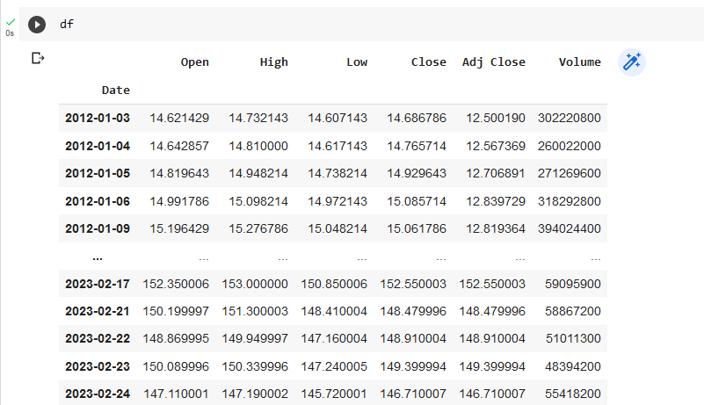
Prepare

Slide 11
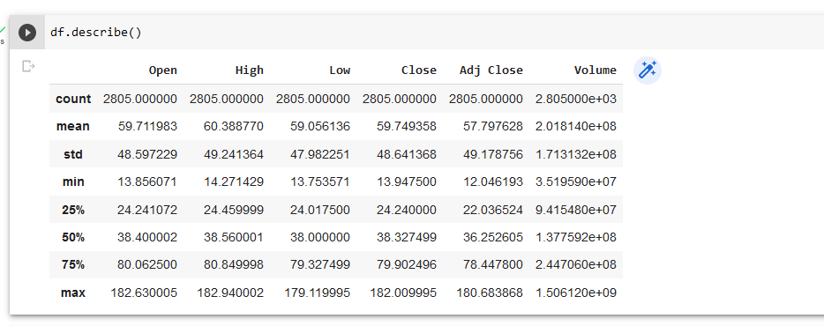
Prepare

Slide 12
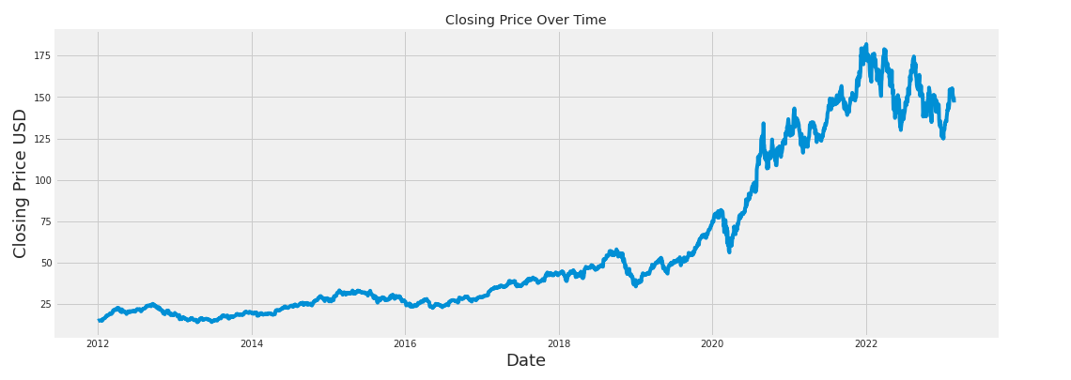
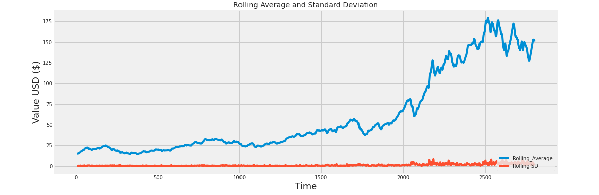
Prepare (Visualization)
The plots demonstrate interesting features of Apple Closing Value. For example, the plot of the Closing Value changes drastically after 2018. It is possible that something different is going on with the data in from 2018-present. This is also reflected in the Rolling Average Plot as both the Rolling Average and Rolling Standard Deviation do not appear constant. Should these features not be constant, predictions may be less accurate.

Slide 13
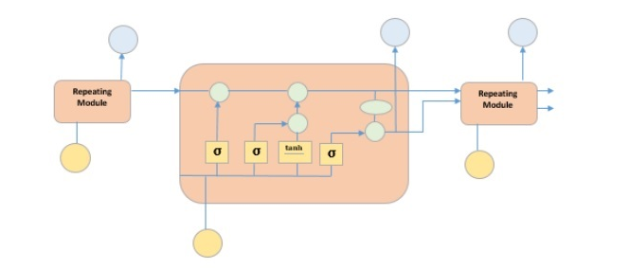
Predictive Analysis (RNN)
Long Short-term Memory Model (Particular Type of RNN)

Slide 14
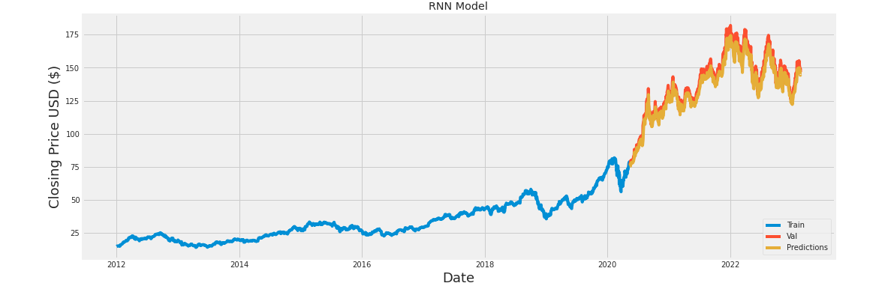
Report of Analysis Results
Augmented Dickey-Fuller Test
Test Statistic | -0.048
P-Value | 0.954
Model RMSE
5.100
Based on the Augmented Dickey-Fuller Test, the time series is not stationary; therefore, the null hypothesis can be rejected

Slide 15
Act: Recommendations
Predictions
Predictions can be made on Apple stock with an average error of approximately $5.00.
Predictive Performance could be increased by subsetting the data from 2018-present which could possibly return a stationary dataset.
Mathematical operations could be performed on the dataset to make the data stationary; however, interpretability could be compromised.

Slide 16
References
Mesidor, F. (2021, December 11). A basic guide to time series analysis - Towards Data Science. Medium. https://towardsdatascience.com/a-basic-guide-into-time-series-analysis-2ad1979c7438
Moody, J. (2021, December 11). What does RMSE really mean? - Towards Data Science. Medium. https://towardsdatascience.com/what-does-rmse-really-mean-806b65f2e48e
Time Series - LSTM Model. (n.d.). https://www.tutorialspoint.com/time_series/time_series_lstm_model.htm
Z. (2021, May 25). Augmented Dickey-Fuller Test in Python (With Example). Statology. https://www.statology.org/dickey-fuller-test-python/

