Slide 1
Heart Disease Prediction Micro-Project #1 https://github.com/KeithSmith89/ANA500.git
Keith D. Smith
February 12, 2023

Slide 2
Problem Statement
Background: A dataset consisting of medical and demographic data will be analyzed to determine which features associate with cardiovascular disease. Various machine learning models will be used to predict the occurrence of cardiovascular disease.
Objective(s):
Determine which features associate with the presence of heart disease
Can a machine learning model be utilized to predict the presence of heart disease

Slide 3
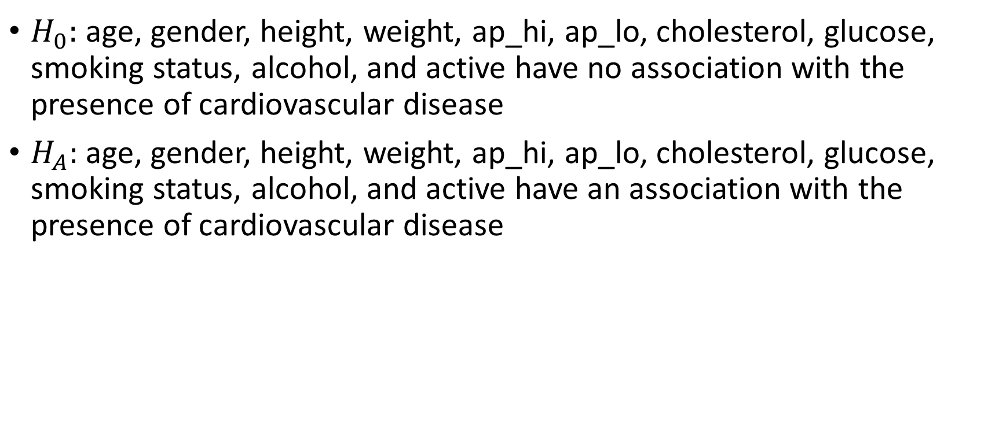
Hypothesis
$H_{0}:$ age, gender, height, weight, ap_hi, ap_lo, cholesterol, glucose, smoking status, alcohol, and active have no association with the presence of cardiovascular disease
$H_{A}:$ age, gender, height, weight, ap_hi, ap_lo, cholesterol, glucose, smoking status, alcohol, and active have an association with the presence of cardiovascular disease

Slide 4
Program Design
Program Design
Program: Cardiovascular Prediction Using
Machine Learning Models
Task: Develop a python program that takes medical and demographic data as input and outputs a prediction as to whether the individual has cardiovascular disease.
Data Science Process Steps:
Data Acquisition
Data Preparation (Feature exploration and engineering)
Predictive Analytics (Train, test, and validate machine learning models. Chose optimal model)
Report Analysis Results
Act or apply results from analysis by connecting results with problem statement

Slide 5
Hierarchy Chart
Hierarchy Chart
[cardio] = age, gender, height, weight, ap_hi, ap_lo, cholesterol, glucose, smoking status, alcohol, active
Main Program (Output: Presence of Cardiovascular Disease; Input: Medical and Demographic Data

Slide 6
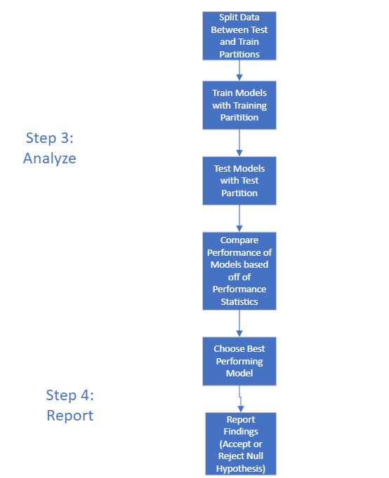
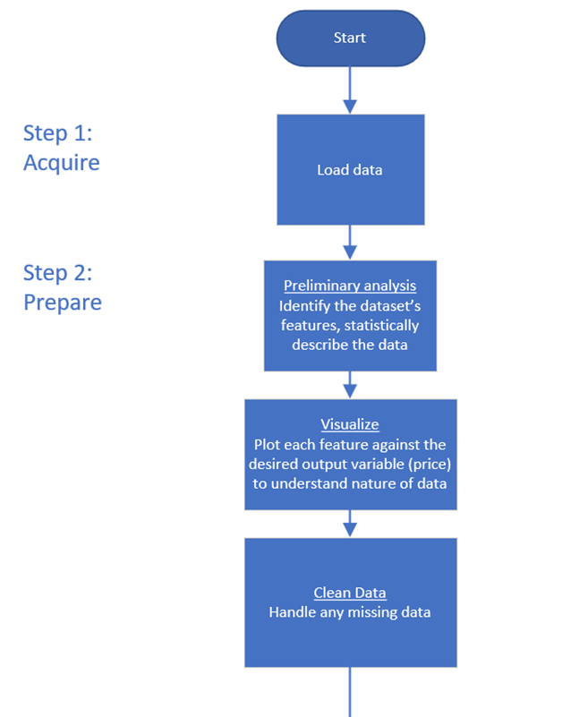
Flow Chart

Slide 7
Pseudocode
Step 1: Acquire Data
Import Libraries
Pandas, Numpy, Seaborn, Matplotlib, Statsmodels, Itertools
Read in Data
Data=pandas.read
Step 2: Prepare Data
Data Information
Data head
Data shape
Null Values
Summary Stats
5 number summaries
Count data
Visualization
Boxplots
Countplots

Slide 8
Pseudocode
Step 3: Analyze the Data
X_train, X_test, y_train, y_test = test_train_split(data, size = .25, random_state = 1)
Dec_Tree.fit(X_train, y_train)
Log_reg(X_train, y_train)
XGBoost(X_train, y_train)
Predict_tree = dec_tree.predict(X_test)
Predict_reg = log_reg.predict(X_test)
Predict_XGBoost = xgboost.predict(X_test)
Step 4: Report
ROC/AUC Curve

Slide 9
Acquire
Medical data was acquired through Kaggle.com
Data source: https://www.kaggle.com/datasets/thedevastator/exploring-risk-factors-for-cardiovascular-diseas

Slide 10
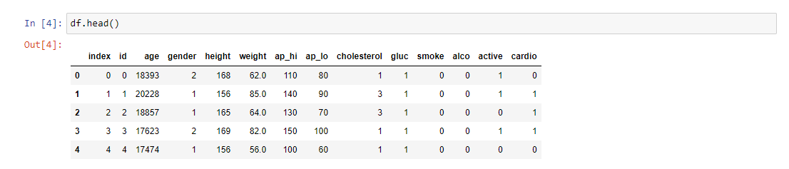
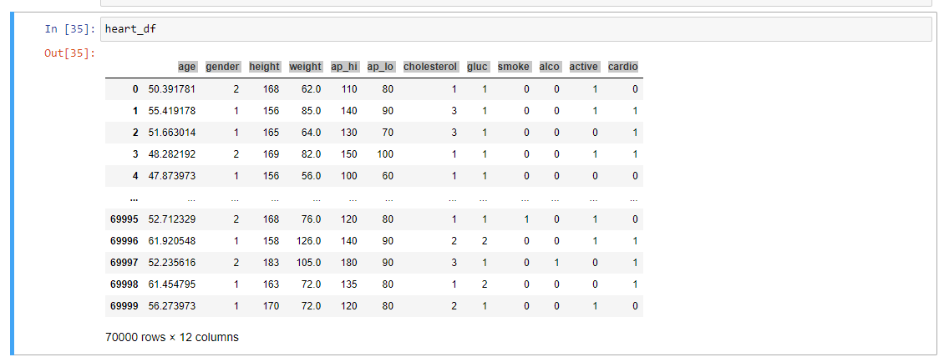
Prepare

Slide 11
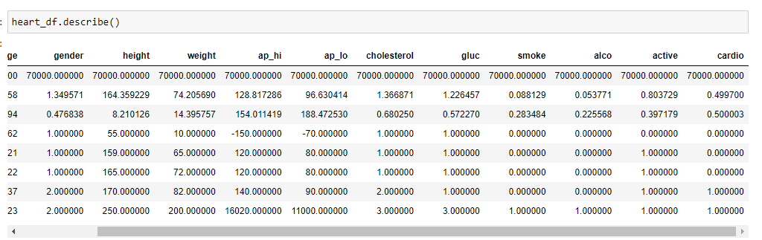
Prepare

Slide 12
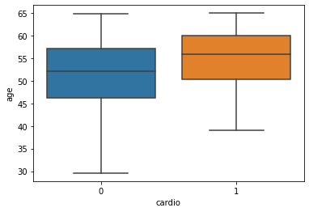
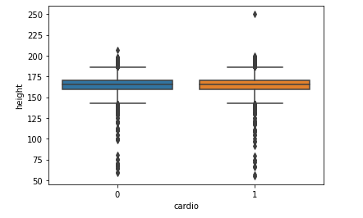
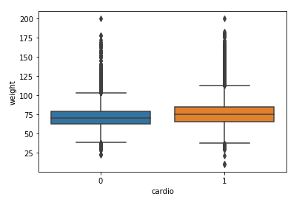
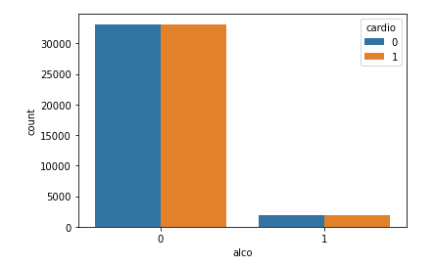
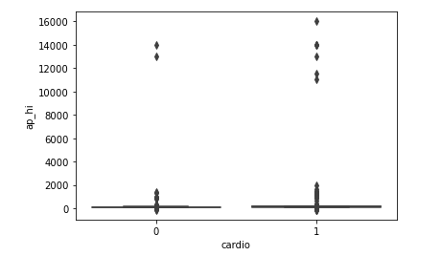
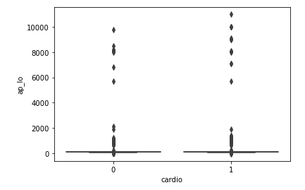
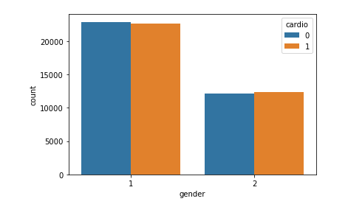
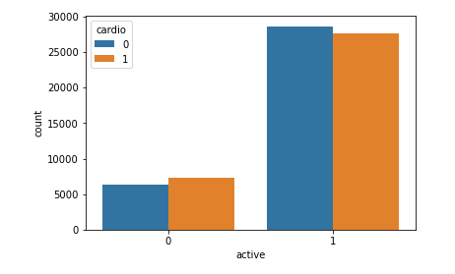
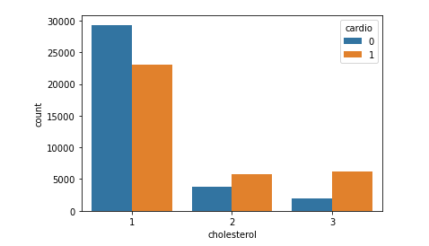
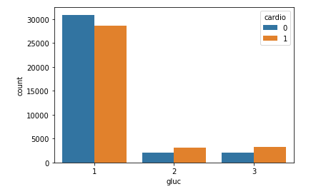
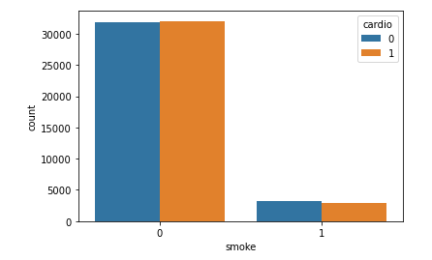
Prepare (Visualization)
Numerical predictors are represented by boxplots and categorical predictors are represented by bar graphs. With respect to the boxplots, association can be inferred by examining the center of each group distribution with respect to the other groups. Large differences imply that there may be an association between that variable and the target. With respect to the bar graphs, differences can be inferred by comparing each group stratified by the target; differences imply possible association. Age, Weight, Active, Cholesterol, and Glucose all appear that they may be associated with heart disease.

Slide 13
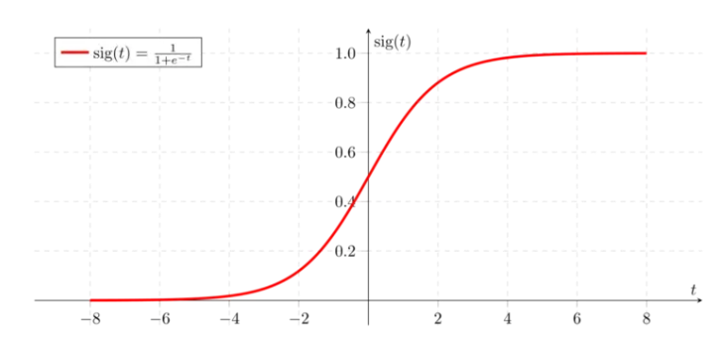

Predictive Analysis (Logistic Regression)
Generalization of linear regression via linear to sigmoid function transformation.
Redline represents in figure below represents decision boudary
$p=\frac{e^{a+bX}}{1+e^{a+bx}}$

Slide 14
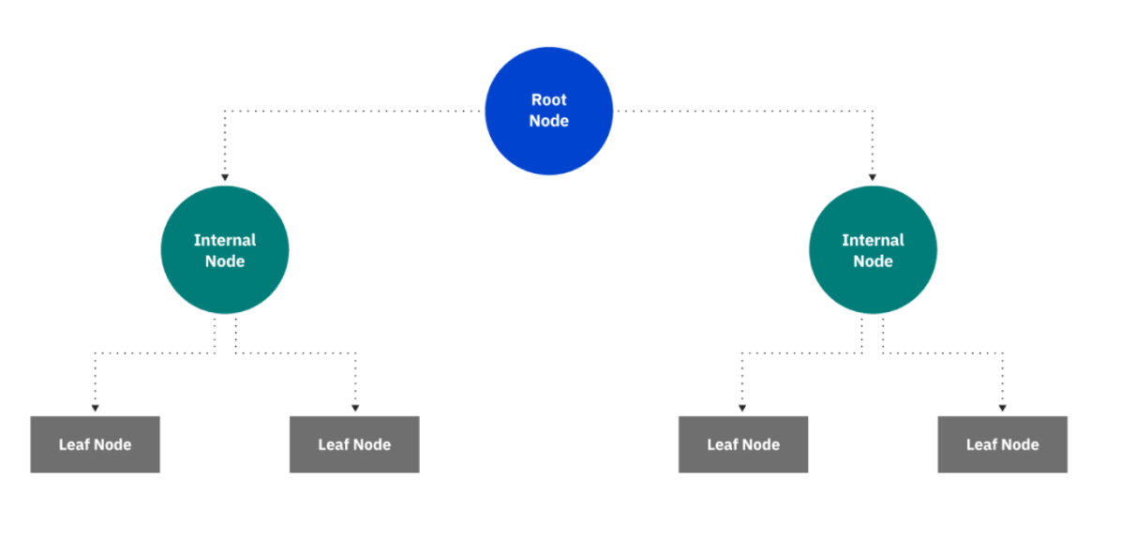
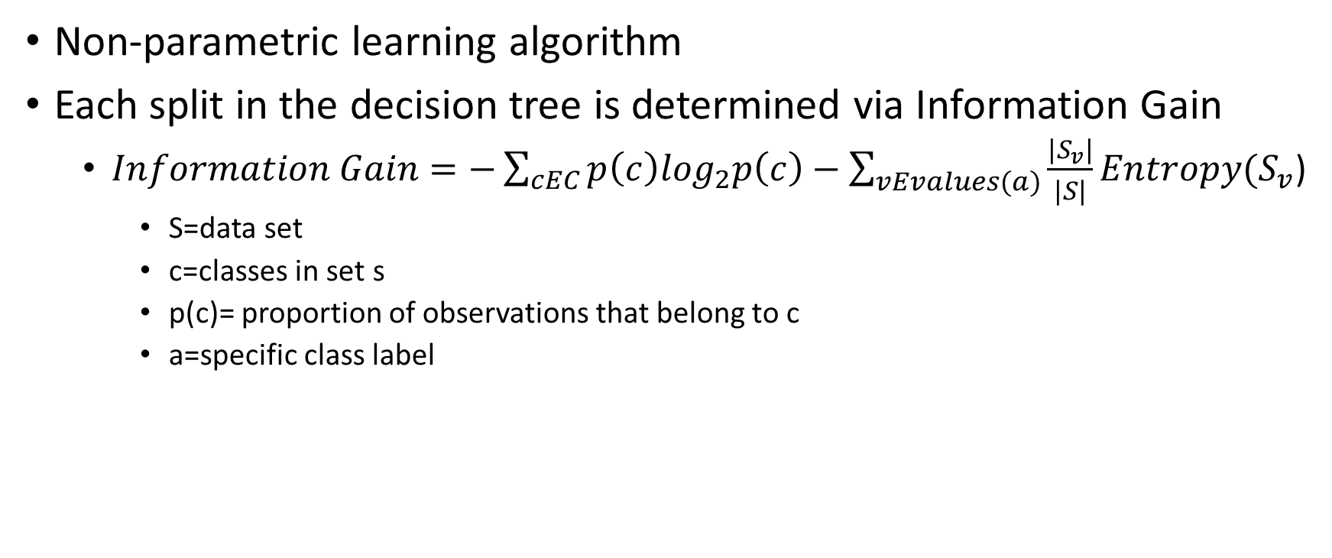
Predictive Analysis (Decision Tree)
Non-parametric learning algorithm
Each split in the decision tree is determined via Information Gain
$Information Gain=−\sum_{cEC}{p\left(c\right)\log_{2}p\left(c\right)−\sum_{vEvalues(a)}{\frac{|S_{v}|}{|S|}Entropy(S_{v}}}$)
S=data set
c=classes in set s
p(c)= proportion of observations that belong to c
a=specific class label

Slide 15
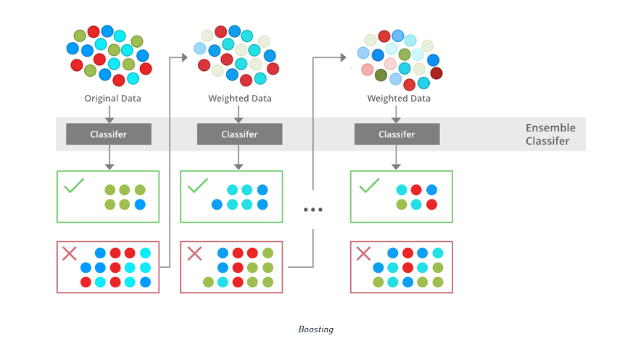
Predictive Analysis (XGBoost)
Non parametric learning algorithm
Combination of a number of “weak” random forests to generate a strong model.
Gradient descent over objective function
Targeted outcomes based on gradient of error

Slide 16
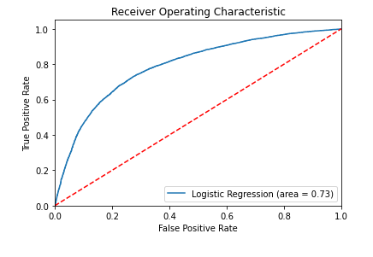
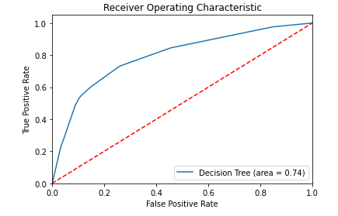
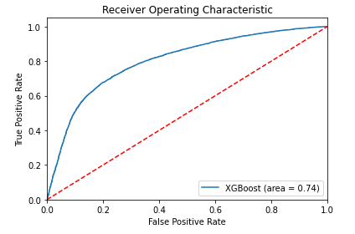
Report of Analysis Results
The null hypothesis can be rejected in favor of the alternate
The predictors do have an association with the presence of heart disease
XGBoost algorithm is the most accurate and least computationally expensive
Model | Accuracy Statistic | Comments
Logistic Regression | 0.73 | Not Computationally Expensive
Decision Tree | 0.74 | Computationally Expensive
XGBoost | 0.74 | Not Computationally Expensive

Slide 17
References
Classification: ROC Curve and AUC | Machine Learning |. (n.d.). Google Developers. https://developers.google.com/machine-learning/crash-course/classification/roc-and-auc
GeeksforGeeks. (2023a, January 10). Decision Tree. https://www.geeksforgeeks.org/decision-tree/
GeeksforGeeks. (2023b, February 6). XGBoost. https://www.geeksforgeeks.org/xgboost/
sklearn.model_selection.GridSearchCV. (n.d.). Scikit-learn. https://scikit-learn.org/stable/modules/generated/sklearn.model_selection.GridSearchCV.html
sklearn.preprocessing.StandardScaler. (n.d.). Scikit-learn. https://scikit-learn.org/stable/modules/generated/sklearn.preprocessing.StandardScaler.html
What is a Decision Tree | IBM. (n.d.). https://www.ibm.com/topics/decision-trees
What is XGBoost? (n.d.). NVIDIA Data Science Glossary. https://www.nvidia.com/en-us/glossary/data-science/xgboost/

