Slide 1
Heart Disease Prediction Micro-Project #1 https://github.com/KeithSmith89/ANA500.git
Keith D. Smith
February 5, 2023

Slide 2
Problem Statement
Background: A dataset consisting of medical and demographic data will be analyzed to determine which features associate with cardiovascular disease. Various machine learning models will be used to predict the occurrence of cardiovascular disease.
Objective(s):
Determine which features associate with the presence of heart disease
Can a machine learning model be utilized to predict the presence of heart disease

Slide 3

Hypothesis
$H_{0}:$ age, gender, height, weight, ap_hi, ap_lo, cholesterol, glucose, smoking status, alcohol, and active have no association with the presence of cardiovascular disease
$H_{A}:$ age, gender, height, weight, ap_hi, ap_lo, cholesterol, glucose, smoking status, alcohol, and active have no association with the presence of cardiovascular disease

Slide 4
Program Design
Program Design
Program: Cardiovascular Prediction Using
Machine Learning Models
Task: Develop a python program that takes medical and demographic data as input and outputs a prediction as to whether the individual has cardiovascular disease.
Data Science Process Steps:
Data Acquisition
Data Preparation (Feature exploration and engineering)
Predictive Analytics (Train, test, and validate machine learning models. Chose optimal model)
Report Analysis Results
Act or apply results from analysis by connecting results with problem statement

Slide 5
Hierarchy Chart
Hierarchy Chart
[cardio] = age, gender, height, weight, ap_hi, ap_lo, cholesterol, glucose, smoking status, alcohol, active
Main Program (Output: Presence of Cardiovascular Disease; Input: Medical and Demographic Data

Slide 6
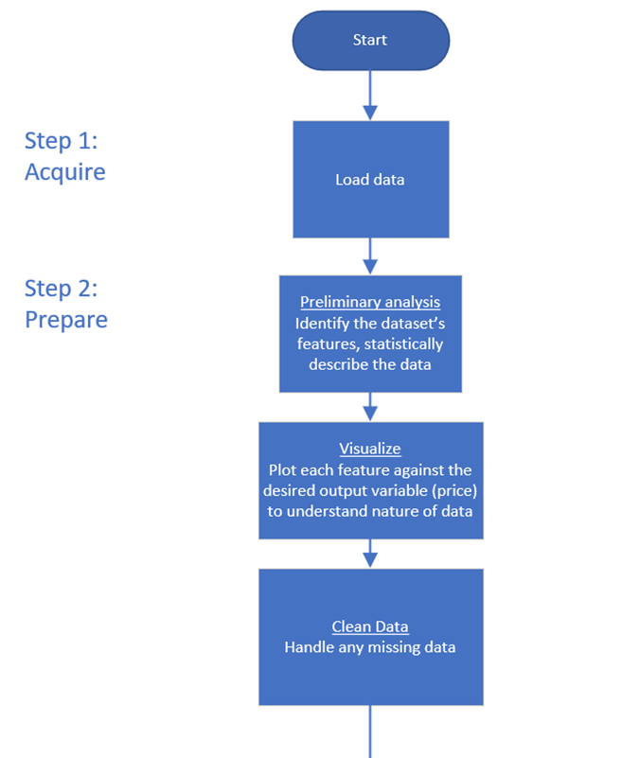
FlowChart

Slide 7
Pseudocode
Step 1: Acquire Data
Import Libraries
Pandas, Numpy, Seaborn, Matplotlib, Statsmodels, Itertools
Read in Data
Data=pandas.read
Step 2: Prepare Data
Data Information
Data head
Data shape
Null Values
Summary Stats
5 number summaries
Count data
Visualization
Boxplots
Countplots

Slide 8
Acquire
Medical data was acquired through Kaggle.com
Data source: https://www.kaggle.com/datasets/thedevastator/exploring-risk-factors-for-cardiovascular-diseas

Slide 9
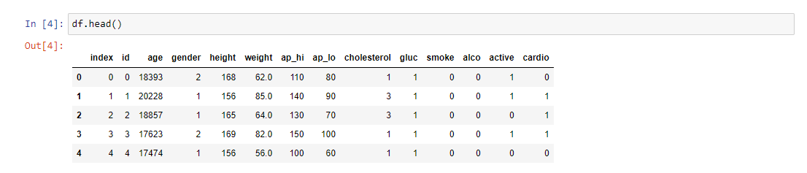
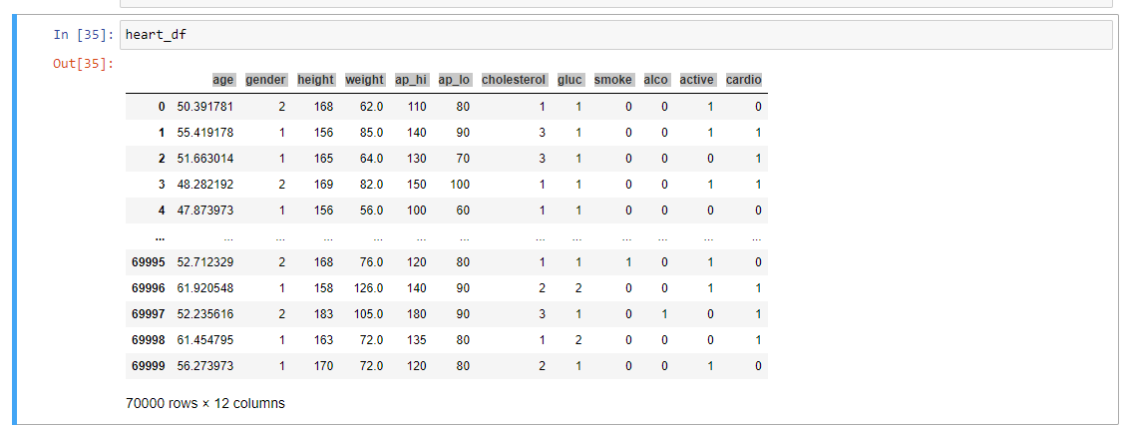
Prepare

Slide 10
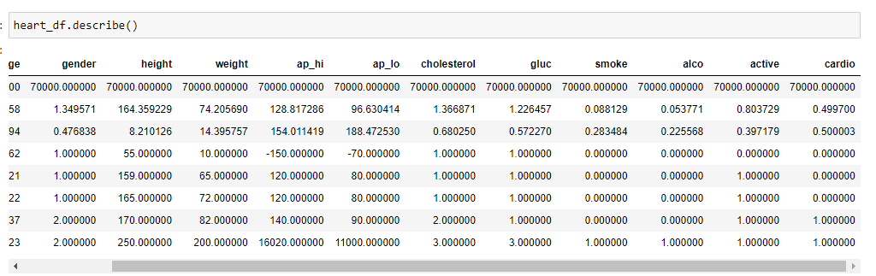
Prepare

Slide 11
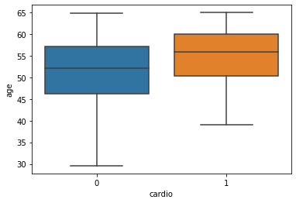
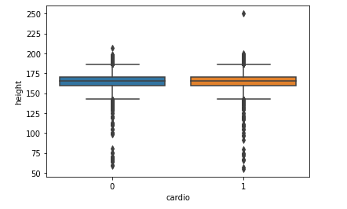
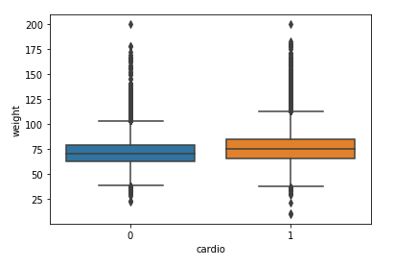
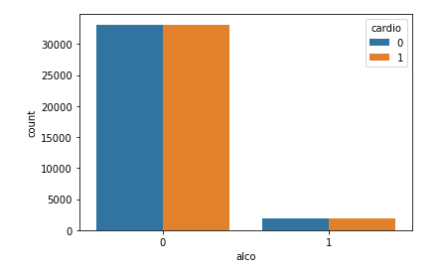
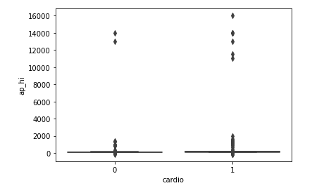
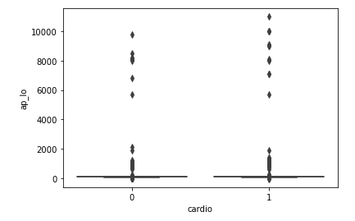
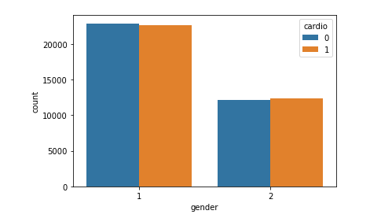
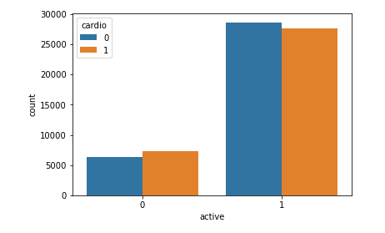
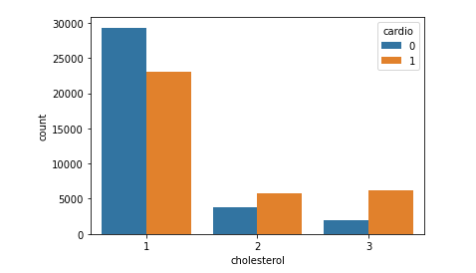
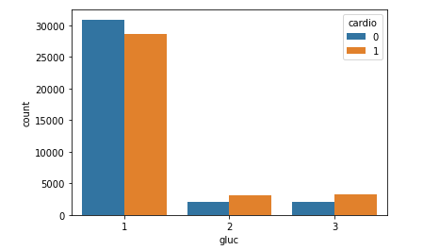
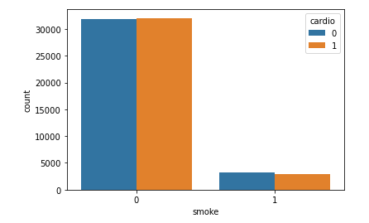
Preparation

