Slide 1
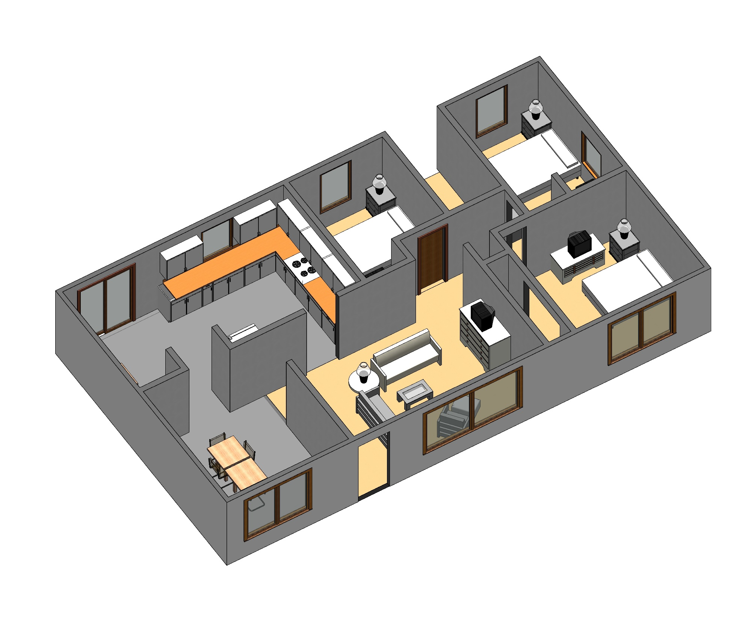
- Adequate Compartmentalization
- No Compartmentalization

Slide 2
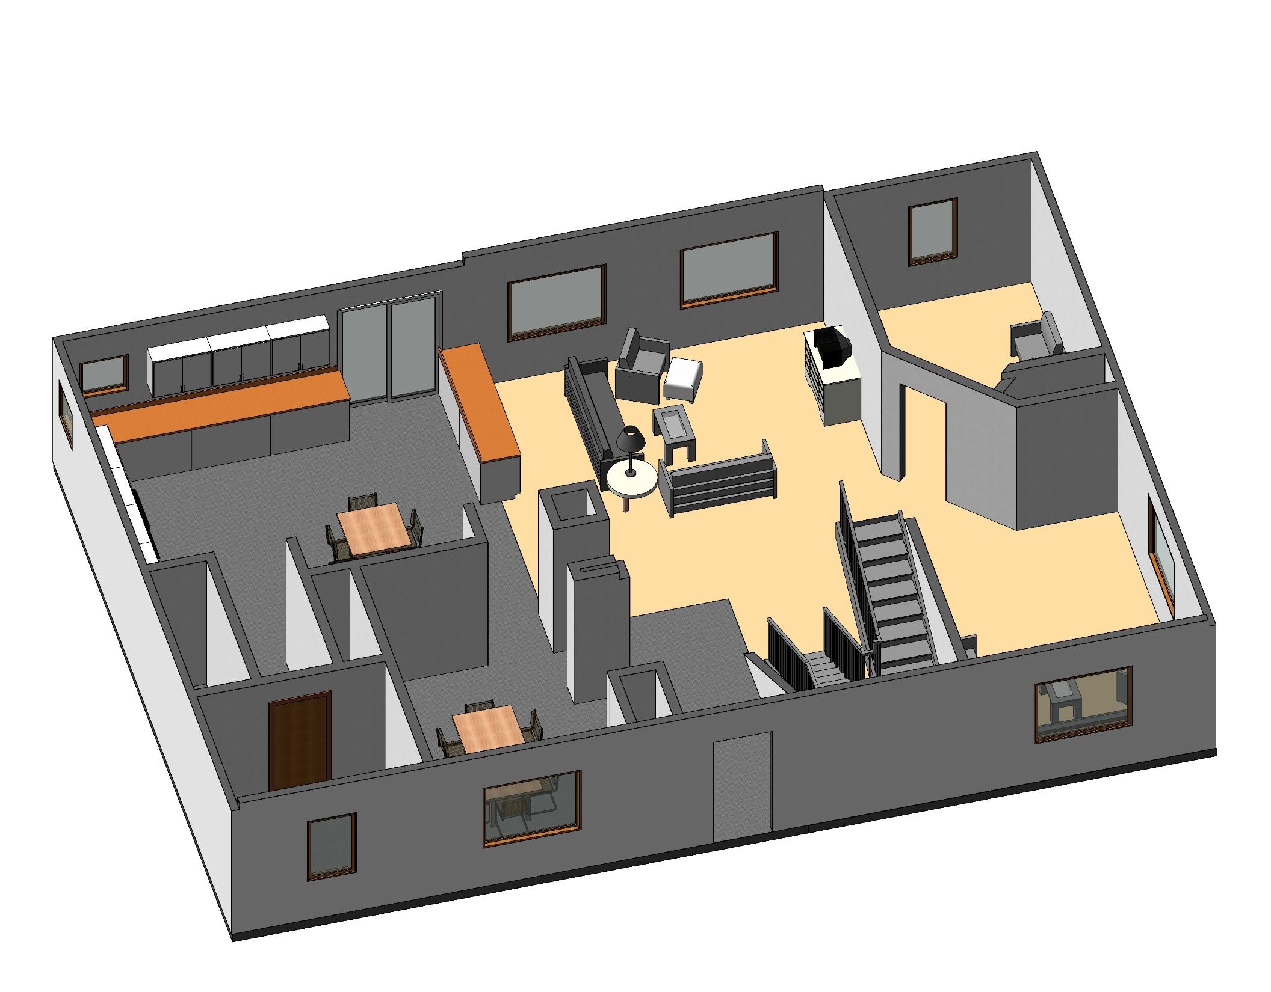

Slide 3
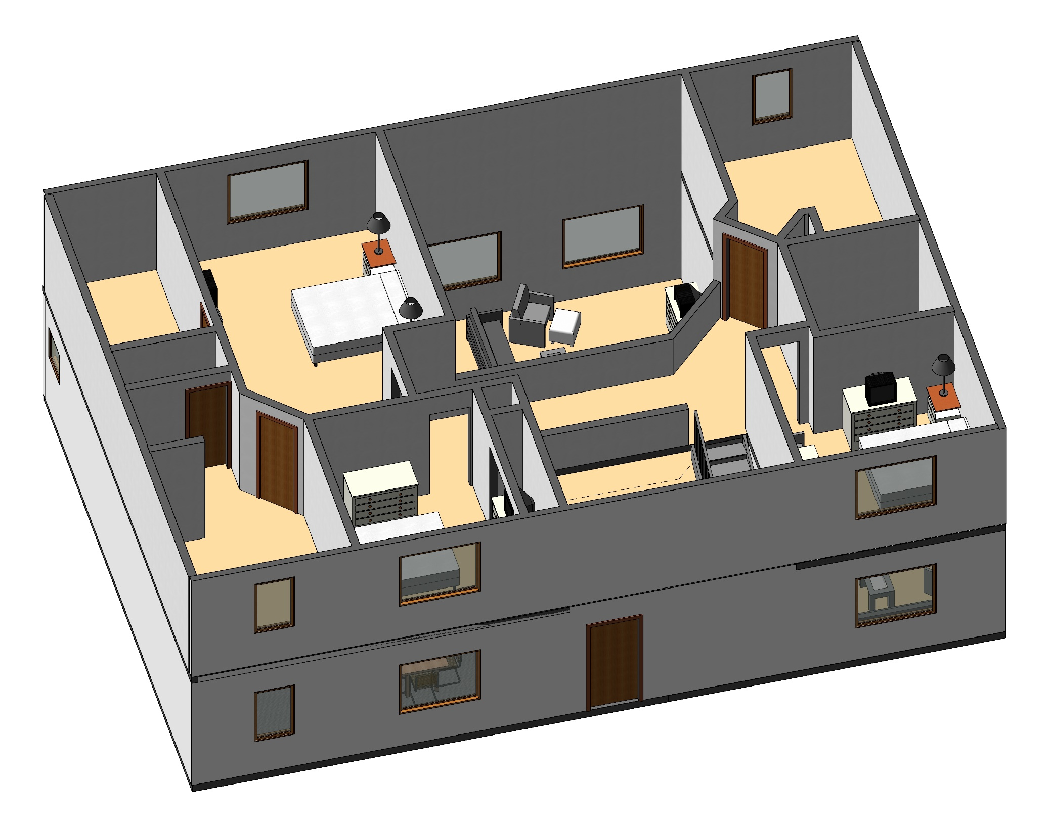

Slide 4
