Slide 1
Progress Report
2023/11/29
B4 Kubo Keito

Slide 2
Background
The development of integrated circuits that can operate in a cryogenic environment of about the temperature of helium is an important issue for the realization of quantum computers.
At low temperatures, Pauli exclusion principle plays an important role.
Goal :
Create a Monte Carlo program for a two-dimensional electron gas that takes degeneracy into account.

Slide 3
Progress
Implemented Thermal equilibrium distribution function
Replaced inelastic scattering with phonon scattering
Considered Fermi degeneracy effect

Slide 4
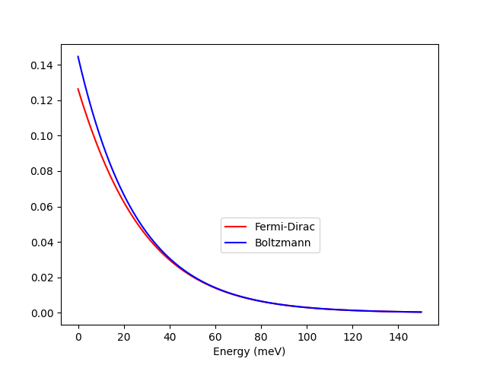
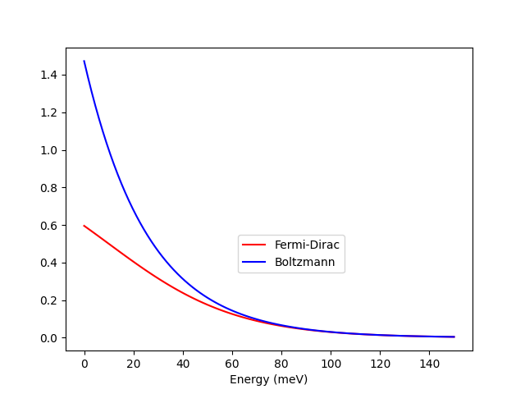


Boltzmann → Fermi-Dirac
At Fermi degeneracy, the Fermi energy is greater than the bottom of the conduction band
No degeneracy : $E_{F}≪0$ meV
degeneracy : $E_{F}>0$ meV

Slide 5
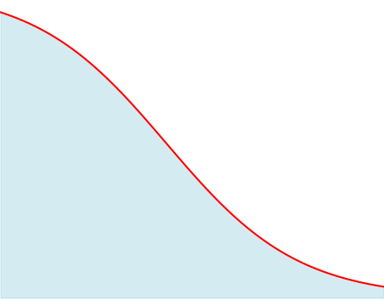

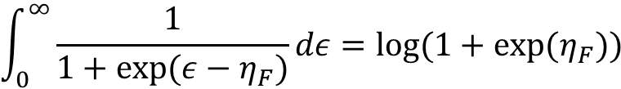



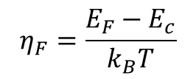



Energy initial state
Electron density is calculated using the Fermi integral :
$$Z_{max}$$
$$ε=\frac{E−E_{c}}{k_{B}T}$$
$$\int_{0}^{∞}{\frac{1}{1+exp⁡(ε−η_{F})}dε=log⁡(1+exp⁡(η_{F}))}$$
$$Z\left(E\right)=D(E)f(E)$$
$$η_{F}=\frac{E_{F}−E_{c}}{k_{B}T}$$
$$Reject$$
Energy is determined using the rejection sampling
$$Adopt$$
$$O$$
$$E_{max}$$

Slide 6
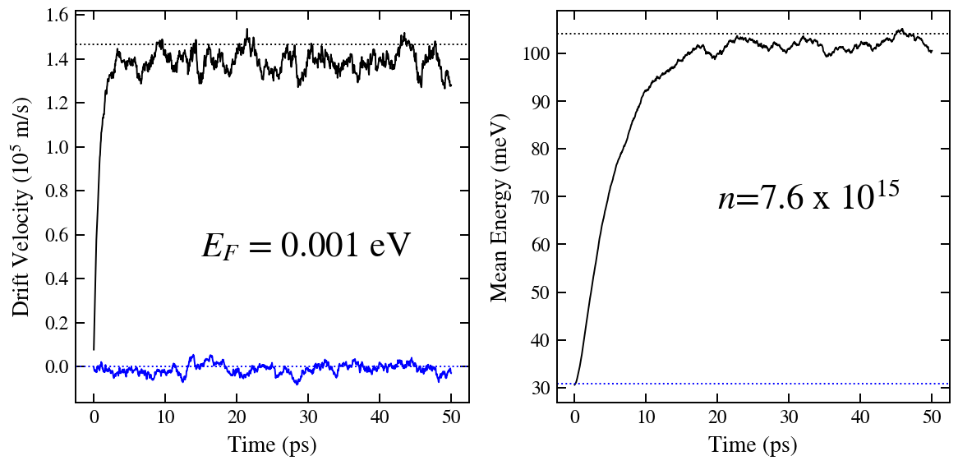
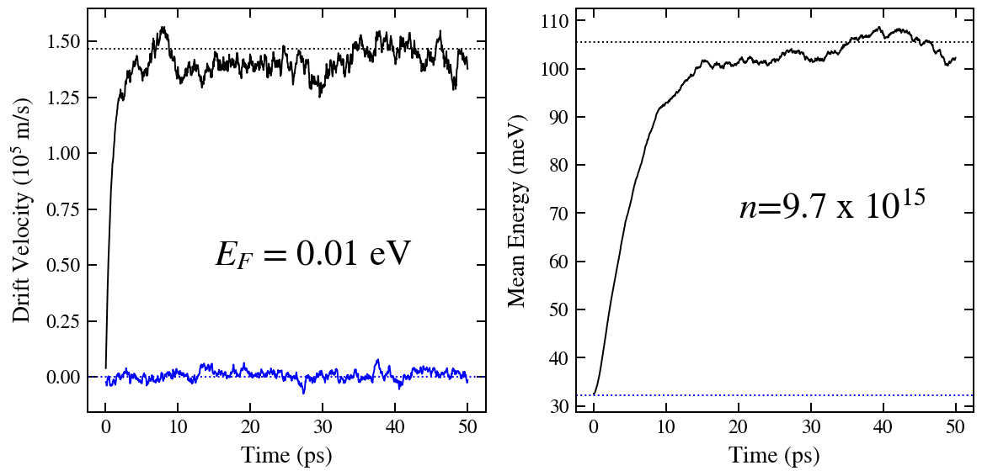
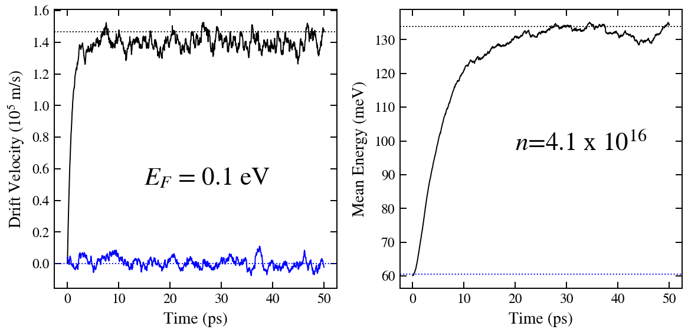
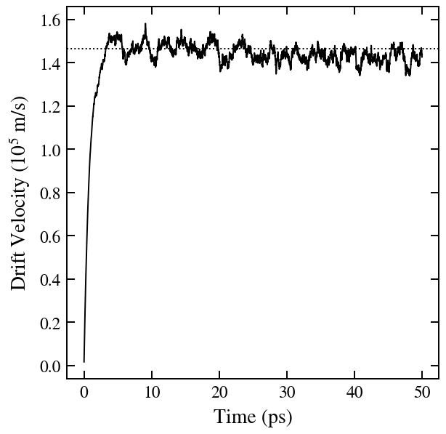
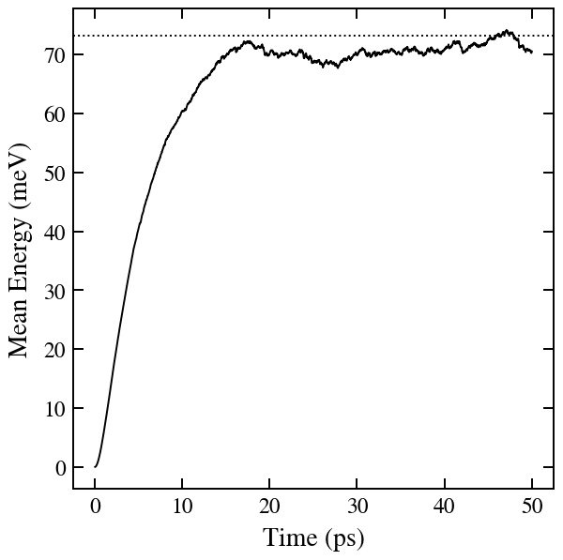
Fermi-Dirac : Simulation
↓EMC with Boltzmann

Slide 7
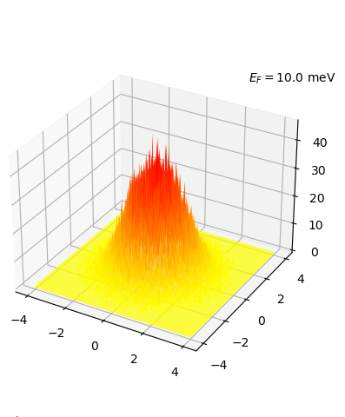
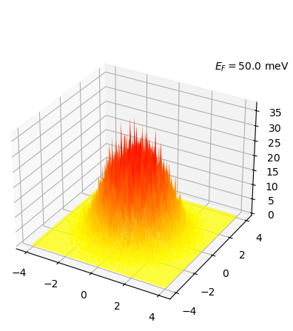

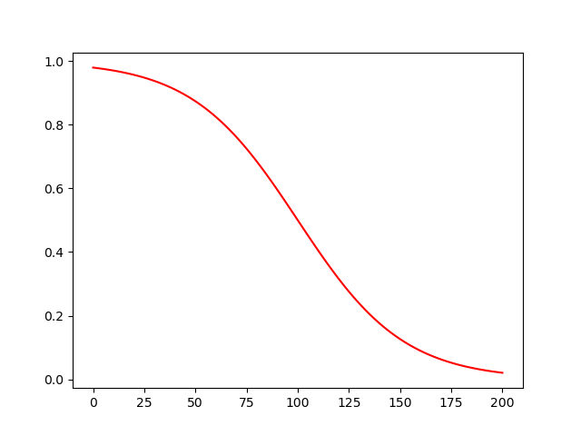
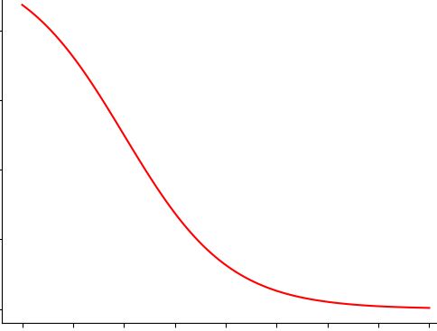
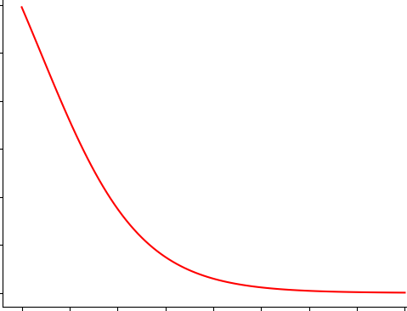


k-space initial distribution
Divide square area with $2×k_{max}$ on a side into grids
$$2k_{max}$$

Slide 8


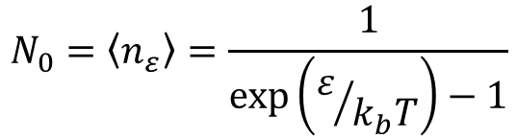

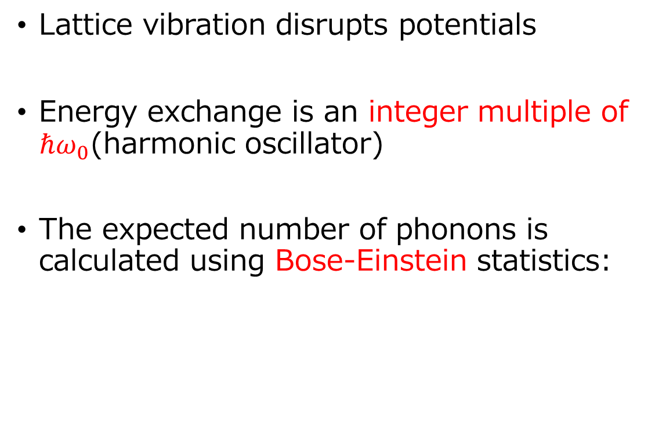





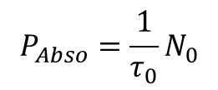
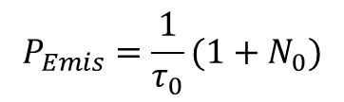
Phonon scattering
[Absorption]
Lattice vibration disrupts potentials
Energy exchange is an integer multiple of $ℏω_{0}$(harmonic oscillator)
The expected number of phonons is calculated using Bose-Einstein statistics:
$$E+ℏω_{0}$$
$$ℏω_{0}$$
$$phonon$$
$$E$$
$$P_{Abso}=\frac{1}{τ_{0}}N_{0}$$
[Emission]
$$E$$
$$N_{0}=\left\langle n_{ε}\right\rangle =\frac{1}{\exp\left(ε/{k_{b}T}\right)−1}$$
$$ℏω_{0}$$
$$phonon$$
$$E−ℏω_{0}$$
$$P_{Emis}=\frac{1}{τ_{0}}{(1+N}_{0})$$

Slide 9
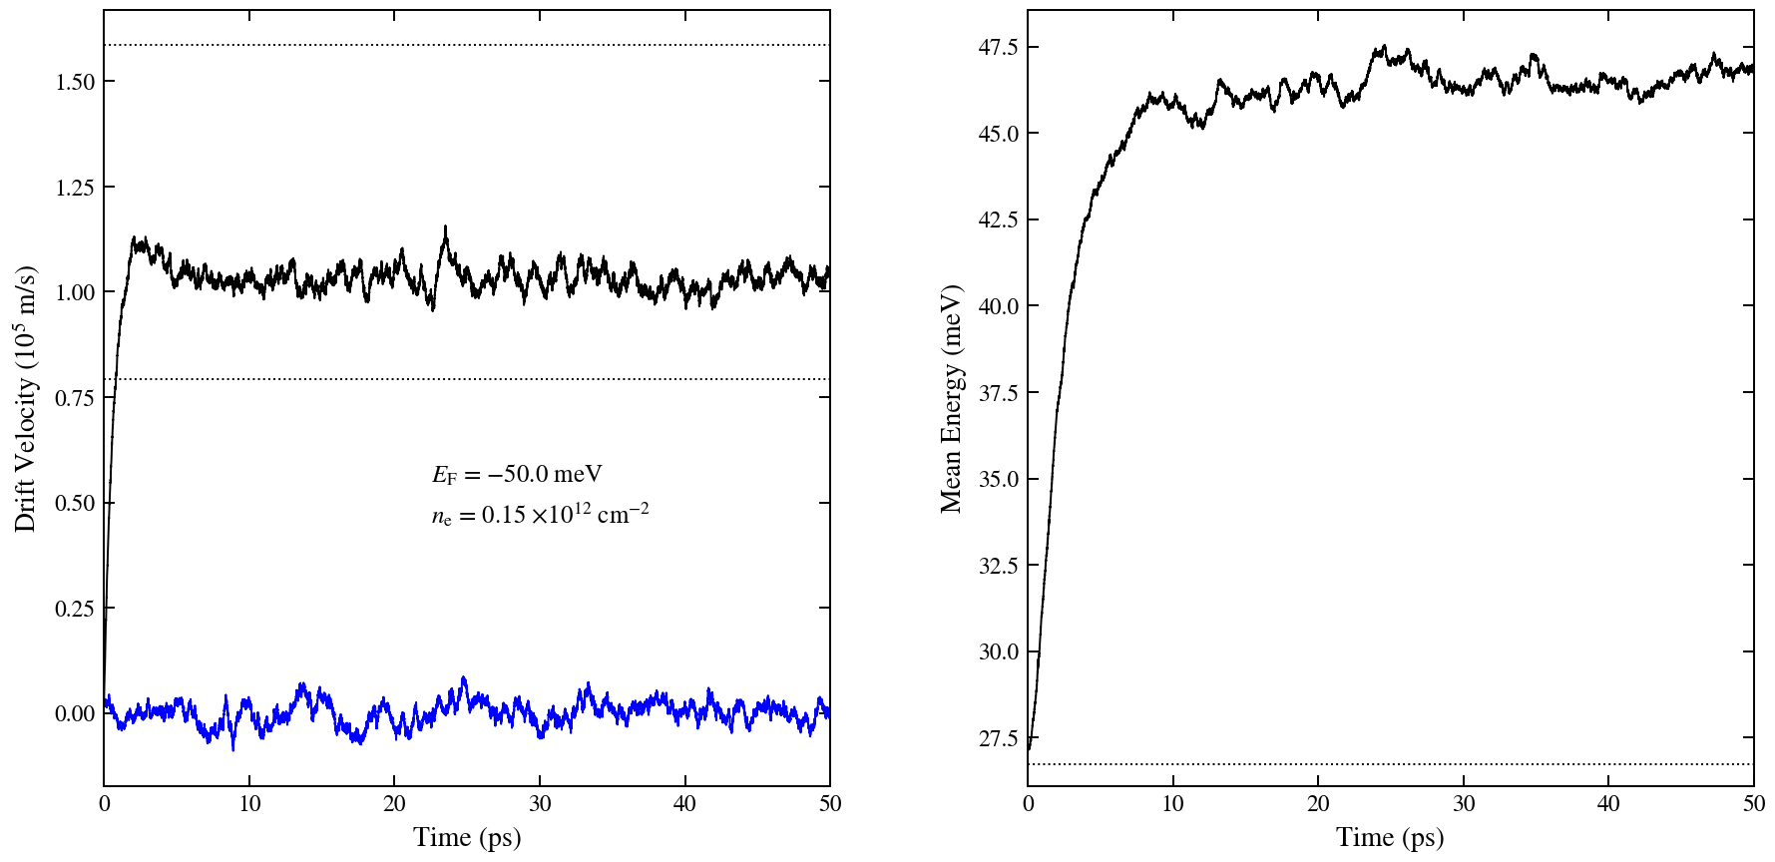
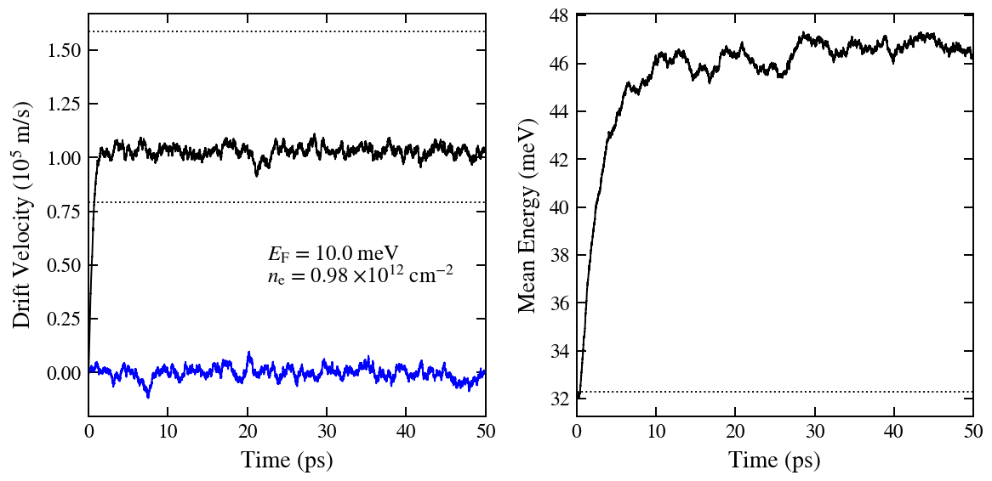
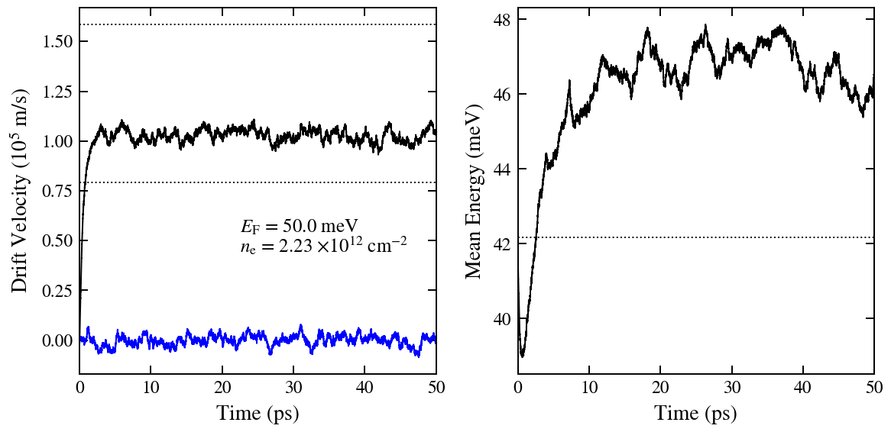
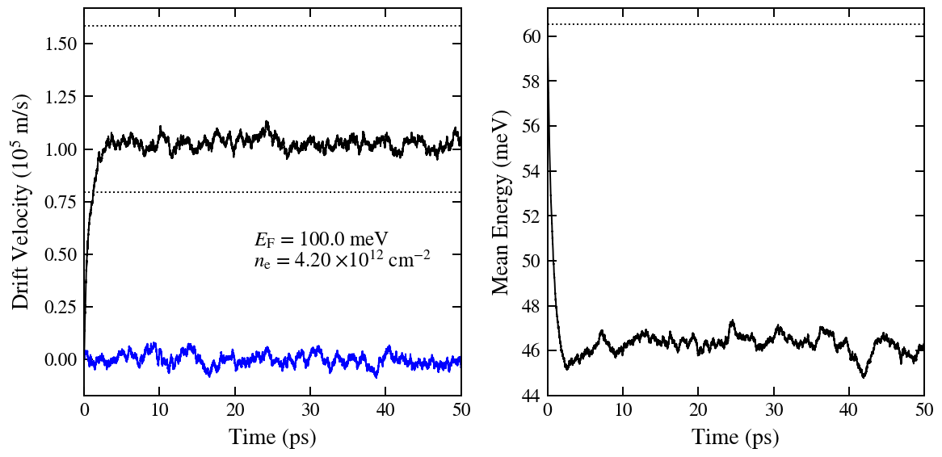
Phonon scattering : Simulation

Slide 10
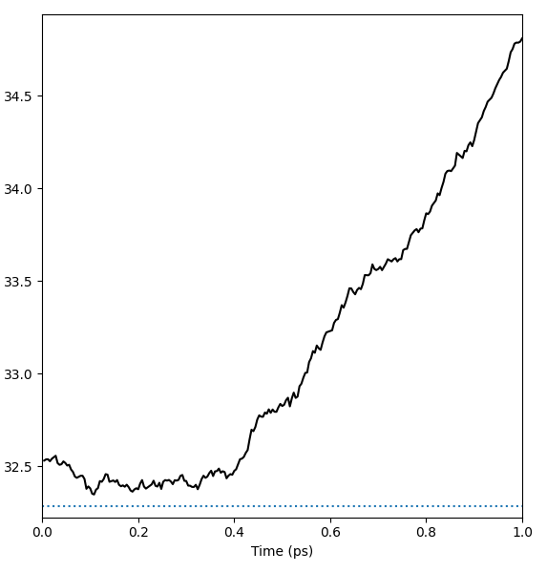
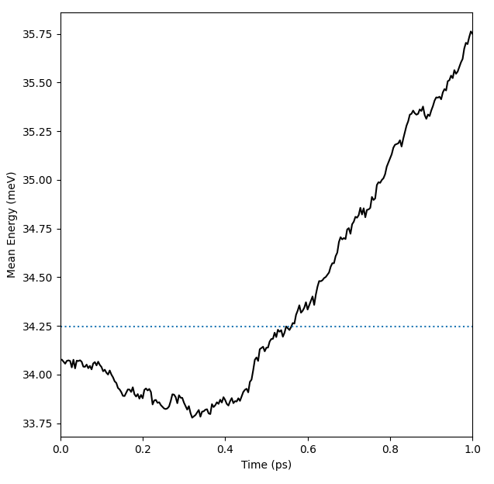
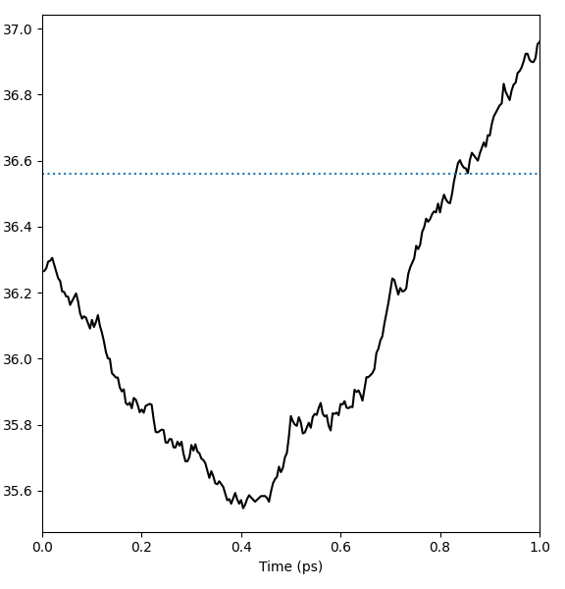
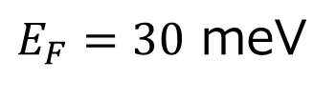
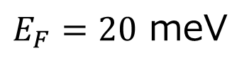
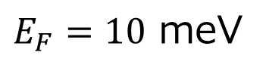
Phonon scattering : Discover
A slight decrease in mean energy is observed for a short period of time after start-up (seems about $0.4$ ps)
$E_{F}=30$ meV
$E_{F}=10$ meV
$E_{F}=20$ meV

Slide 11
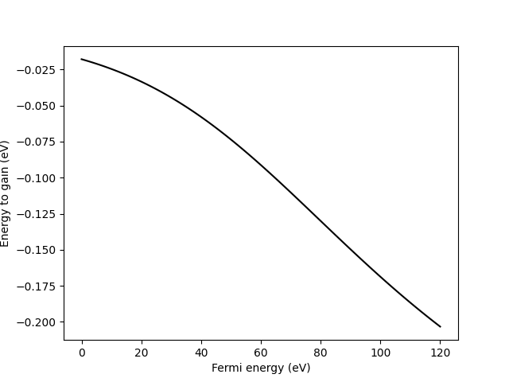
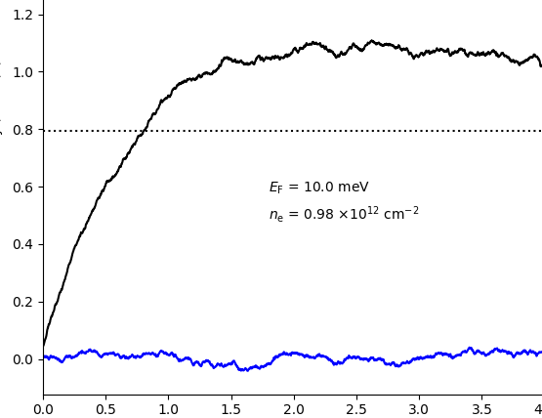
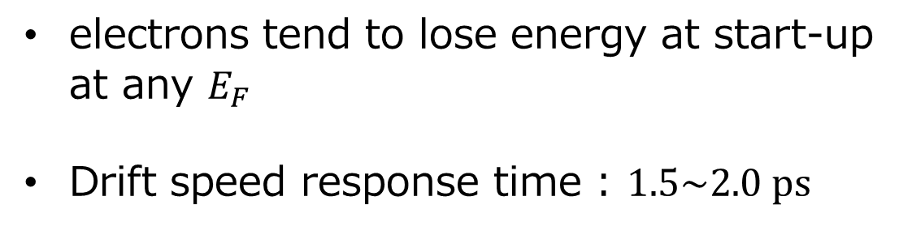
Phonon scattering : Consideration
electrons tend to lose energy at start-up at any $E_{F}$
Drift speed response time : $1.5\sim 2.0 ps$
Expected value of energy gained by one electron in the Fermi-Dirac distribution
$$E_{g}=∆t∙ℏω_{0}\left\{N_{E≥ℏω_{0}}\left(W_{i,abs}−W_{i,emi}\right)+N_{E<ℏω_{0}}W_{i,abs}\right\}$$

Slide 12
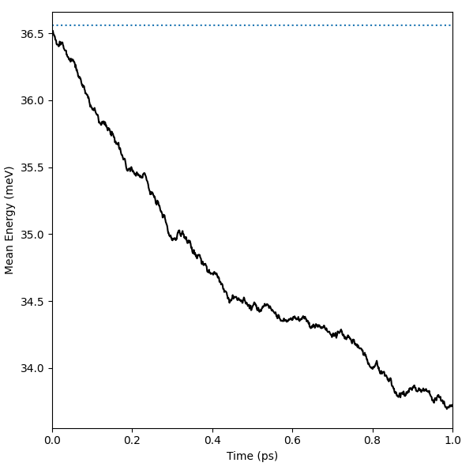
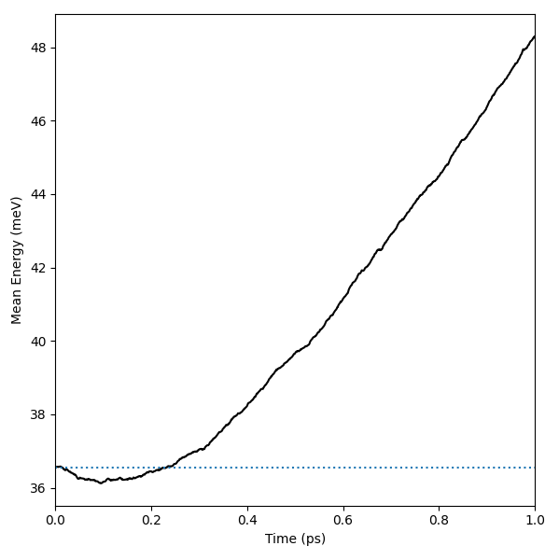
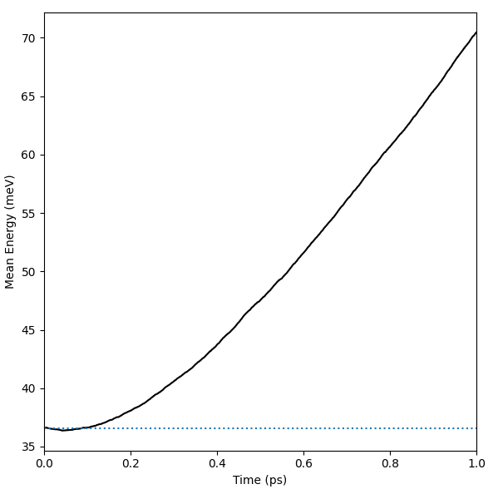
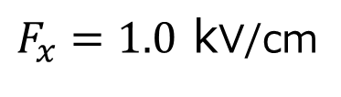
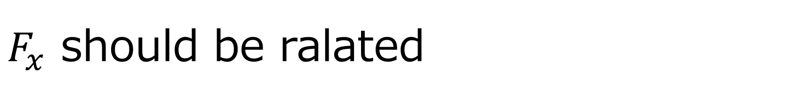
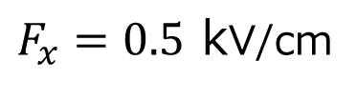
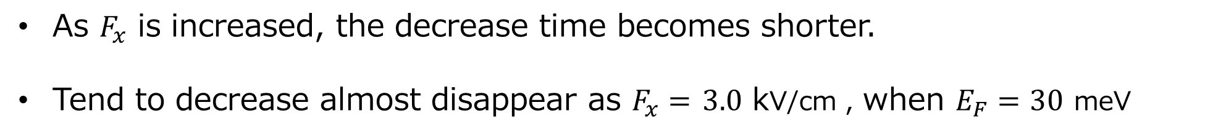
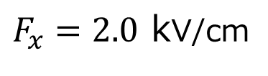
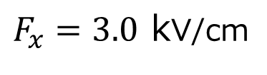
$F_{x}$ should be ralated
As $F_{x}$ is increased, the decrease time becomes shorter.
Tend to decrease almost disappear as $F_{x}=$ $3.0$ kV/cm , when $E_{F}=30$ meV
$F_{x}=0.5$ kV/cm
$F_{x}=1.0$ kV/cm
$F_{x}=2.0$ kV/cm
$F_{x}=3.0$ kV/cm

Slide 13













Preparation for Fermi degeneracy
$$W$$
$$W_{i,emis}$$
$$Self scattering$$
Introducing self-scattering, the total scattering probability is constant.
$$W_{e}+W_{i,abso}$$
$$O$$
$$E$$
$$ℏω_{0}$$
$$Yes$$
Update the distribution function preodically.
Deterimine whether the electon can scatter.
$$k^{′}$$
$$k$$
$$rnd<1−f(k^{′})$$
$$k$$
$$No$$

Slide 14
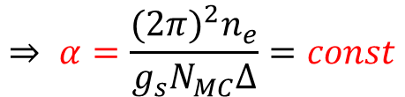

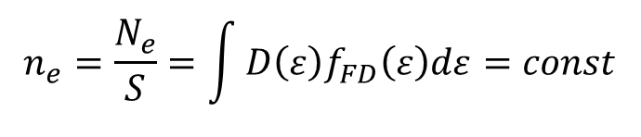
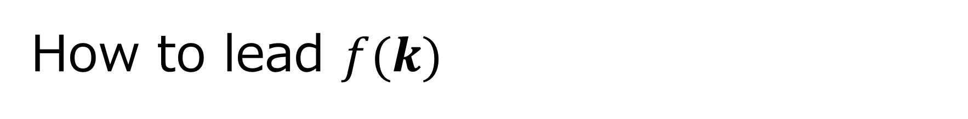

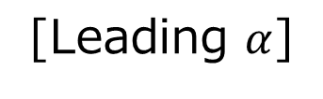


How to lead $f(k)$
Calculate the distribution function from the number of particles in the grid
$$f\left(k\right)= α∙c_{adr(k)}$$
$c:$ Number of electrons
$adr\left(k\right):$Address of the grid to which $k$ belongs
[Leading $α$]
$$N_{e} = g_{s}\sum_{k}{f\left(k\right)} = g_{s}\int{\frac{S∙dk}{{\left(2π\right)}^{2}}f\left(k\right) = }g_{s} \frac{S∙∆}{{\left(2π\right)}^{2}}\sum{f\left(k\right)}= g_{s}\frac{S∙∆}{{\left(2π\right)}^{2}}αN_{MC}$$
$$n_{e}=\frac{N_{e}}{S}=\int{D\left(ε\right)f_{FD}\left(ε\right)dε}=const$$
$$k$$
$$⇒ α=\frac{{(2π)}^{2}n_{e}}{g_{s}N_{MC}Δ}=const$$
$$adr\left(k\right)$$

Slide 15
Near future Plans
Implementation of the described Fermi degeneracy effect.
Preparation of thesis

