Slide 1


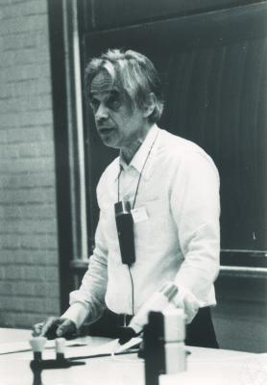
Specker Sequences and their relevance to Proof Mining

Slide 2
What is a Specker sequence
The Standard definition of Specker sequences, found in computable analysis, is a monotone sequences of converging computable numbers whose limit is not computable
The first construction of such a sequence was by Specker in 1949 and was used to demonstrate that the field of computable numbers did not satisfy the least upper bound property

Slide 3
New definition of Specker sequences
Since the property of Specker’s original sequence that was useful to us was the fact that the sequence didn’t have a computable rate of convergence. In the context of Proof Mining we shall call any sequence of converging computable numbers, without a computable rate of convergence, a Specker sequence.
This relaxation of the original definition therefore allows for the existence of sequences of computable numbers converging to computable limits to be Specker and we shall see that this can actually happen!

Slide 4
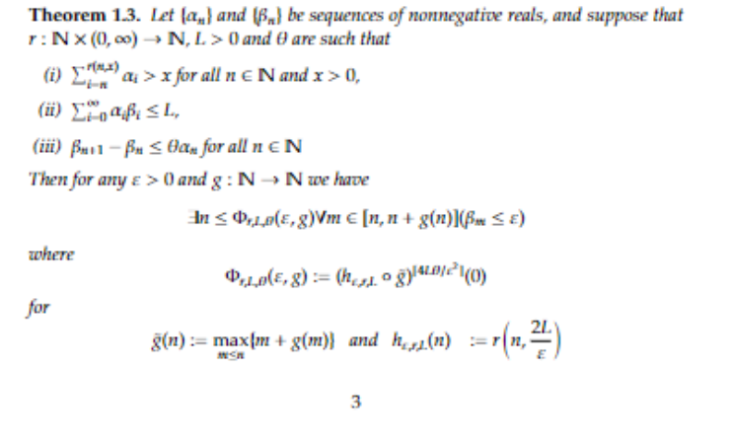
Rate of Metastability

