Slide 1
Return, Risk, and the Security Market Line
Chapter
Thirteen

Slide 2
Chapter Outline
Expected Returns and Variances
Portfolios
Announcements, Surprises, and Expected Returns
Risk: Systematic and Unsystematic
Diversification and Portfolio Risk
Systematic Risk and Beta
The Security Market Line
The SML and the Cost of Capital: A Preview

Slide 3
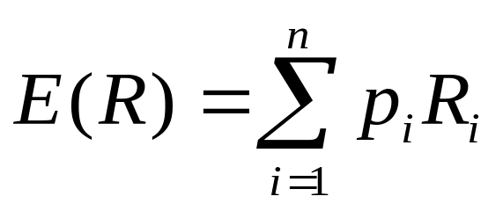
Expected Returns
Expected returns are based on the probabilities of possible outcomes
In this context, “expected” means average if the process is repeated many times
The “expected” return does not even have to be a possible return
Notes:
Use the following example to illustrate the mathematical nature of expected returns:
Consider a game where you toss a fair coin: If it is Heads then student A pays student B $1. If it is Tails then student B pays student A $1. Most students will remember from their statistics that the expected value is $0 (=.5(1) + .5(-1)). That means that if the game is played over and over then each student should expect to break-even. However, if the game is only played once, then one student will win $1 and one will lose $1.

Slide 4
Example: Expected Returns
Suppose you have predicted the following returns for stocks C and T in three possible states of nature. What are the expected returns?
  State Probability C T
  Boom 0.3 0.15 0.25
  Normal 0.5 0.10 0.20
  Recession ??? 0.02 0.01
R_{C} = .3(.15) + .5(.10) + .2(.02) = .099 = 9.99%
R_{T} = .3(.25) + .5(.20) + .2(.01) = .177 = 17.7%
Notes:
What is the probability of a recession? 0.2
If the risk-free rate is 6.15%, what is the risk premium?
Stock C: 9.99 – 6.15 = 3.84%
Stock T: 17.7 – 6.15 = 11.55%

Slide 5
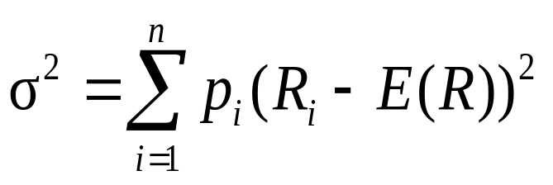
Variance and Standard Deviation
Variance and standard deviation still measure the volatility of returns
Using unequal probabilities for the entire range of possibilities
Weighted average of squared deviations
Notes:
It’s important to point out that these formulas are for populations, unlike the formulas in chapter 10 that were for samples (dividing by n-1 instead of n).
Remind the students that standard deviation is the square root of the variance

Slide 6
Example: Variance and Standard Deviation
Consider the previous example. What are the variance and standard deviation for each stock?
Stock C
  σ² = .3(.15-.099)² + .5(.1-.099)² + .2(.02-.099)² = .002029
  σ = .045
Stock T
  σ² = .3(.25-.177)² + .5(.2-.177)² + .2(.01-.177)² = .007441
  σ = .0863

Slide 7
Another Example
Consider the following information:
  State Probability ABC, Inc.
  Boom .25 .15
  Normal .50 .08
  Slowdown .15 .04
  Recession .10 -.03
What is the expected return?
What is the variance?
What is the standard deviation?
Notes:
E(R) = .25(.15) + .5(.08) + .15(.04) + .1(-.03) = .0805
Variance = .25(.15-.0805)² + .5(.08-.0805)² + .15(.04-.0805)² + .1(-.03-.0805)² = .00267475
Standard Deviation = .051717985

Slide 8
Another Example
Consider the following information:
  State Probability ABC, Inc.
  Boom .25 .15
  Normal . 50 .08
  Slowdown .15 .04
  Recession .10 -.03
What is the expected return?
  E(R) = .25(.15) + .5(.08) + .15(.04) + .1(-.03) = .0805
What is the variance?
  Variance = .25(.15-.0805)² + .5(.08-.0805)² + .15(.04-.0805)² + .1(-.03-.0805)² = .00267475
What is the standard deviation?
  Standard Deviation = .051717985
Notes:
E(R) = .25(.15) + .5(.08) + .15(.04) + .1(-.03) = .0805
Variance = .25(.15-.0805)² + .5(.08-.0805)² + .15(.04-.0805)² + .1(-.03-.0805)² = .00267475
Standard Deviation = .051717985

Slide 9
Portfolios
A portfolio is a collection of assets
An asset’s risk and return is important in how it affects the risk and return of the portfolio
The risk-return trade-off for a portfolio is measured by the portfolio expected return and standard deviation, just as with individual assets

Slide 10
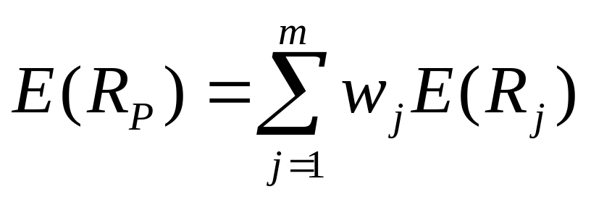
Portfolio Expected Returns
The expected return of a portfolio is the weighted average of the expected returns for each asset in the portfolio
You can also find the expected return by finding the portfolio return in each possible state and computing the expected value as we did with individual securities

Slide 11
Portfolio Variance
Compute the portfolio return for each state:
R_{P} = w₁R₁ + w₂R₂ + … + w_{m}R_{m}
Compute the expected portfolio return using the same formula as for an individual asset
Compute the portfolio variance and standard deviation using the same formulas as for an individual asset
Notes:
The instructor’s manual provides information on how to compute the portfolio variance using the correlation or covariance between assets.

Slide 12
Example: Portfolio Variance
Consider the following information
  Invest 50% of your money in Asset A
  State Probability A B
  Boom .4 30% -5%
  Bust .6 -10% 25%
What is the expected return and standard deviation for each asset?
What is the expected return and standard deviation for the portfolio?
Portfolio
12.5%
7.5%
Notes:
If A and B are your only choices, what percent are you investing in Asset B?
Asset A: E(R_{A}) = .4(30) + .6(-10) = 6%
Variance(A) = .4(30-6)² + .6(-10-6)² = 384
Std. Dev.(A) = 19.6%
Asset B: E(R_{B}) = .4(-5) + .6(25) = 13%
Variance(B) = .4(-5-13)² + .6(25-13)² = 216
Std. Dev.(B) = 14.7%
Portfolio (solutions to portfolio return in each state appear with mouse click after last question)
Portfolio return in boom = .5(30) + .5(-5) = 12.5
Portfolio return in bust = .5(-10) + .5(25) = 7.5
Expected return = .4(12.5) + .6(7.5) = 9.5 or
Expected return = .5(6) + .5(13) = 9.5
Variance of portfolio = .4(12.5-9.5)² + .6(7.5-9.5)² = 6
Standard deviation = 2.45%
Note that the variance is NOT equal to .5(384) + .5(216) = 300 and
Standard deviation is NOT equal to .5(19.6) + .5(14.7) = 17.17%
What would the expected return and standard deviation for the portfolio be if we invested 3/7 of our money in A and 4/7 in B? Portfolio return = 10% and standard deviation = 0

Slide 13
Detailed Solution
Portfolio return in boom = .5(30) + .5(-5) = 12.5
Portfolio return in bust = .5(-10) + .5(25) = 7.5
Expected return = .4(12.5) + .6(7.5) = 9.5 or
Expected return = .5(6) + .5(13) = 9.5
Variance of portfolio = .4(12.5-9.5)² + .6(7.5-9.5)² = 6
Standard deviation = 2.45%
Note that the variance is NOT equal to .5(384) + .5(216) = 300 and
Standard deviation is NOT equal to .5(19.6) + .5(14.7) = 17.17%
What would the expected return and standard deviation for the portfolio be if we invested 3/7 of our money in A and 4/7 in B? Portfolio return = 10% and standard deviation = 0

Slide 14
Another Example
Consider the following information
  State Probability X Z
  Boom .25 15% 10%
  Normal .60 10% 9%
  Recession .15 5% 10%
What is the expected return and standard deviation for a portfolio with an investment of $6000 in asset X and $4000 in asset Y?
Notes:
Portfolio return in Boom: .6(15) + .4(10) = 13%
Portfolio return in Normal: .6(10) + .4(9) = 9.6%
Portfolio return in Recession: .6(5) + .4(10) = 7%
Expected return = .25(13) + .6(9.6) + .15(7) = 10.06%
Variance = .25(13-10.06)² + .6(9.6-10.06)² + .15(7-10.06)² = 3.6924
Standard deviation = 1.92%
Compare to return on X of 10.5% and standard deviation of 3.12%
And return on Z of 9.4% and standard deviation of .48%

Slide 15
Detailed Solution
Portfolio return in Boom: .6(15) + .4(10) = 13%
Portfolio return in Normal: .6(10) + .4(9) = 9.6%
Portfolio return in Recession: .6(5) + .4(10) = 7%
Expected return = .25(13) + .6(9.6) + .15(7) = 10.06%
Variance = .25(13-10.06)² + .6(9.6-10.06)² + .15(7-10.06)² = 3.6924
Standard deviation = 1.92%
Compare to return on X of 10.5% and standard deviation of 3.12%
And return on Z of 9.4% and standard deviation of .48%

Slide 16
Expected versus Unexpected Returns
Realized returns are generally not equal to expected returns
There is the expected component and the unexpected component

Slide 17
Expected Returns
“Discounted” information used by the market to estimate the expected return
Already included in the expected return (and the price).
Note tie-in to efficient markets. Assumption: markets are semistrong efficient.

Slide 18
Unexpected Returns
At any point in time, the unexpected return can be either positive or negative
Over time, the average of the unexpected component is zero

Slide 19
Announcements and News
Announcements and news contain both an expected component and a surprise component
It is the surprise component that affects a stock’s price and therefore its return
This is very obvious when we watch how stock prices move when an unexpected announcement is made or earnings are different than anticipated

Slide 20
Efficient Markets
Efficient markets are a result of investors trading on the unexpected portion of announcements
The easier it is to trade on surprises, the more efficient markets should be
Efficient markets involve random price changes because we cannot predict surprises

Slide 21
Systematic Risk
Risk factors that affect a large number of assets
Also known as non-diversifiable risk or market risk
Includes such things as changes in GDP, inflation, interest rates, etc.

Slide 22
Unsystematic Risk
Risk factors that affect a limited number of assets
Also known as unique risk and asset-specific risk
Includes such things as labor strikes, part shortages, etc.

Slide 23
Returns
Total Return = expected return + unexpected return
Unexpected return = systematic portion + unsystematic portion
Therefore, total return can be expressed as follows:
Total Return = expected return + systematic portion + unsystematic portion

Slide 24
Diversification
Portfolio diversification is the investment in several different asset classes or sectors
Diversification is not just holding a lot of assets
For example, if you own 50 internet stocks, you are not diversified
However, if you own 50 stocks that span 20 different industries, then you are diversified
Notes:
Video Note: “Portfolio Management” looks at the value of diversification using Tower Records

Slide 25
The Principle of Diversification
Diversification can substantially reduce the variability of returns without an equivalent reduction in expected returns
This reduction in risk arises because worse than expected returns from one asset are offset by better than expected returns from another
However, there is a minimum level of risk that cannot be diversified away and that is the systematic portion

Slide 26
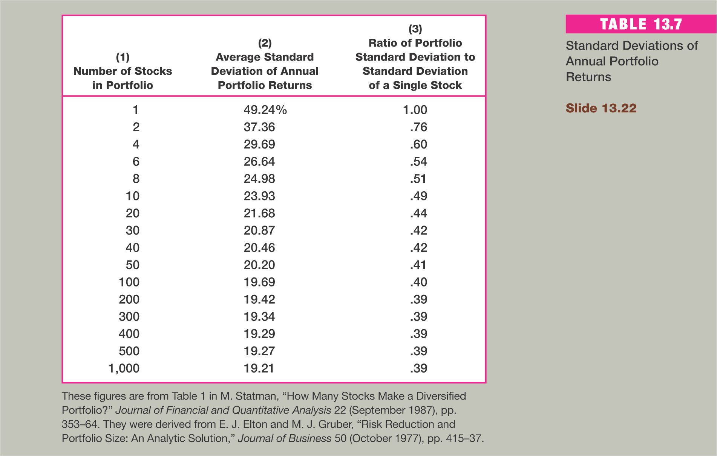

Slide 27
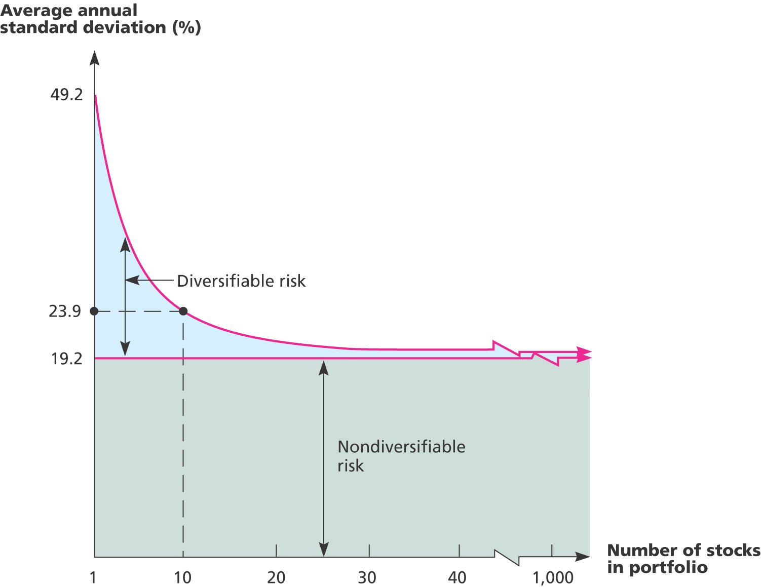
FIGURE 13.1

Slide 28
Diversifiable Risk
The risk that can be eliminated by combining assets into a portfolio
Often considered the same as unsystematic, unique or asset-specific risk
If we hold only one asset, or assets in the same industry, then we are exposing ourselves to risk that we could diversify away

Slide 29
Total Risk
Total risk = systematic risk + unsystematic risk
The standard deviation of returns is a measure of total risk
For well diversified portfolios, unsystematic risk is very small
Consequently, the total risk for a diversified portfolio is essentially equivalent to the systematic risk

Slide 30
Systematic Risk Principle
There is a reward for bearing risk
There is not a reward for bearing risk unnecessarily
The expected return on a risky asset depends only on that asset’s systematic risk since unsystematic risk can be diversified away

Slide 31
Measuring Systematic Risk
How do we measure systematic risk?
We use the beta coefficient to measure systematic risk
What does beta tell us?
  A beta of 1 implies the asset has the same systematic risk as the overall market
  A beta < 1 implies the asset has less systematic risk than the overall market
  A beta > 1 implies the asset has more systematic risk than the overall market

Slide 32
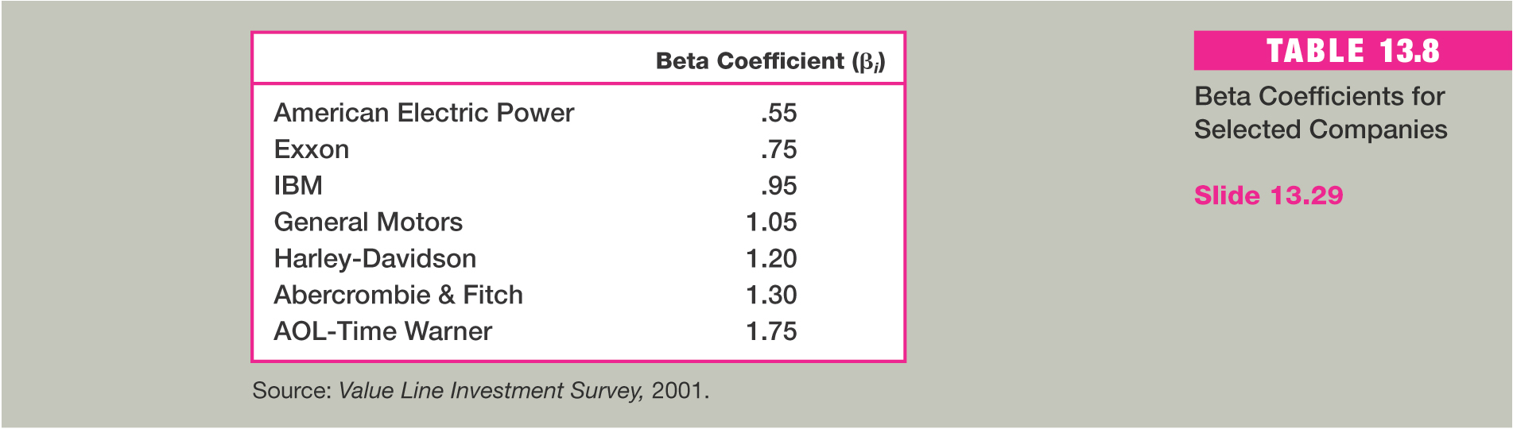

Slide 33
Total versus Systematic Risk
Consider the following information:
  Standard Deviation Beta
  Security C 20% 1.25
  Security K 30% 0.95
Which security has more total risk?
Which security has more systematic risk?
Which security should have the higher expected return?
Notes:
Security K has the higher total risk
Security C has the higher systematic risk
Security C should have the higher expected return

Slide 34
Portfolio Betas
Portfolio variance is not a weighted average of the individual asset betas,
Portfolio betas are a weighted average of the individual asset betas

Slide 35
Example: Portfolio Betas
Consider the following example with the following four securities
  Security Weight Beta
  DCLK .133 3.69
  KO .2 0.64
  INTC .167 1.64
  KEI .4 1.79
What is the portfolio beta?
.133(3.69) + .2(.64) + .167(1.64) + .4(1.79) = 1.61
Notes:
Which security has the highest systematic risk? DCLK
Which security has the lowest systematic risk? KO
Is the systematic risk of the portfolio more or less than the market? more

Slide 36
Beta and the Risk Premium
Remember that the risk premium = expected return – risk-free rate
The higher the beta, the greater the risk premium should be
Can we define the relationship between the risk premium and beta so that we can estimate the expected return?
  YES!

Slide 37
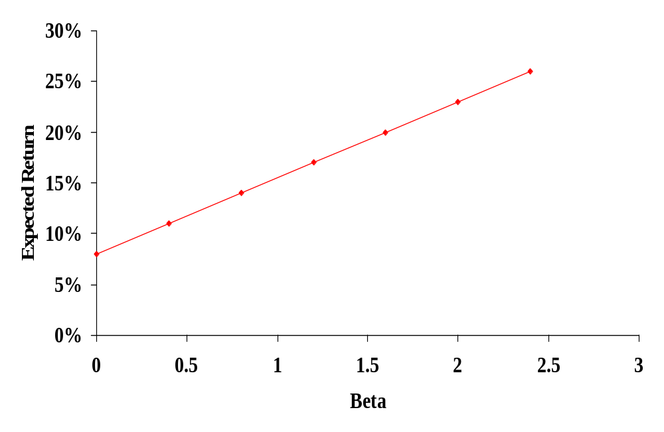
Example: Portfolio Expected Returns and Betas
E(R_{A})
R_{f}
β_{A}
Notes:
Based on the example in the book.
Point out that there is a linear relationship between beta and expected return. Ask if the students remember the form of the equation for a line.
Y = mx + b
E(R) = slope (Beta) + y-intercept
The y-intercept is = the risk-free rate, so all we need is the slope

Slide 38
Reward-to-Risk Ratio: Definition and Example
The reward-to-risk ratio is the slope of the line illustrated in the previous example
  Slope = (E(R_{A}) – R_{f}) / (β_{A} – 0)
  Reward-to-risk ratio for previous example =
  (20 – 8) / (1.6 – 0) = 7.5
What if an asset has a reward-to-risk ratio of 8 (implying that the asset plots above the line)?
What if an asset has a reward-to-risk ratio of 7 (implying that the asset plots below the line)?
Notes:
Ask students if they remember how to compute the slope of a line: rise / run
If the reward-to-risk ratio = 8, then investors will want to buy the asset. This will drive the price up and the return down (remember time value of money and valuation). When will trading stop? When the reward-to-risk ratio reaches 7.5.
If the reward-to-risk ratio = 7, then investors will want to sell the asset. This will drive the price down and the return up. When will trading stop? When the reward-to-risk ratio reaches 7.5.

Slide 39
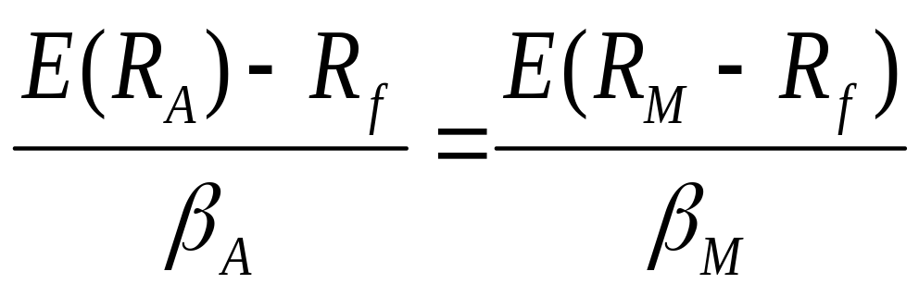
Market Equilibrium
In equilibrium, all assets and portfolios must have the same reward-to-risk ratio and they all must equal the reward-to-risk ratio for the market

Slide 40
Security Market Line
The security market line (SML) is the representation of market equilibrium
The slope of the SML is the reward-to-risk ratio: (E(R_{M}) – R_{f}) / β_{M}
But since the beta for the market is ALWAYS equal to one, the slope can be rewritten
Slope = E(R_{M}) – R_{f} = market risk premium
Notes:
Based on the discussion earlier, we now have all the components of the line:
E(R) = [E(R_{M}) – R_{f}]β + R_{f}

Slide 41
The Capital Asset Pricing Model (CAPM)
The capital asset pricing model defines the relationship between risk and return
E(R_{A}) = R_{f} + β_{A}(E(R_{M}) – R_{f})
If we know an asset’s systematic risk, we can use the CAPM to determine its expected return
This is true whether we are talking about financial assets or physical assets

Slide 42
Factors Affecting Expected Return
Pure time value of money – measured by the risk-free rate
Reward for bearing systematic risk – measured by the market risk premium
Amount of systematic risk – measured by beta

Slide 43
Example - CAPM
Consider the betas for each of the assets given earlier. If the risk-free rate is 4.5% and the market risk premium is 8.5%, what is the expected return for each?
Security | Beta | Expected Return
DCLK | 3.69 | 4.5 + 3.69(8.5) = 35.865%
KO | .64 | 4.5 + .64(8.5) = 9.940%
INTC | 1.64 | 4.5 + 1.64(8.5) = 18.440%
KEI | 1.79 | 4.5 + 1.79(8.5) = 19.715%

Slide 44
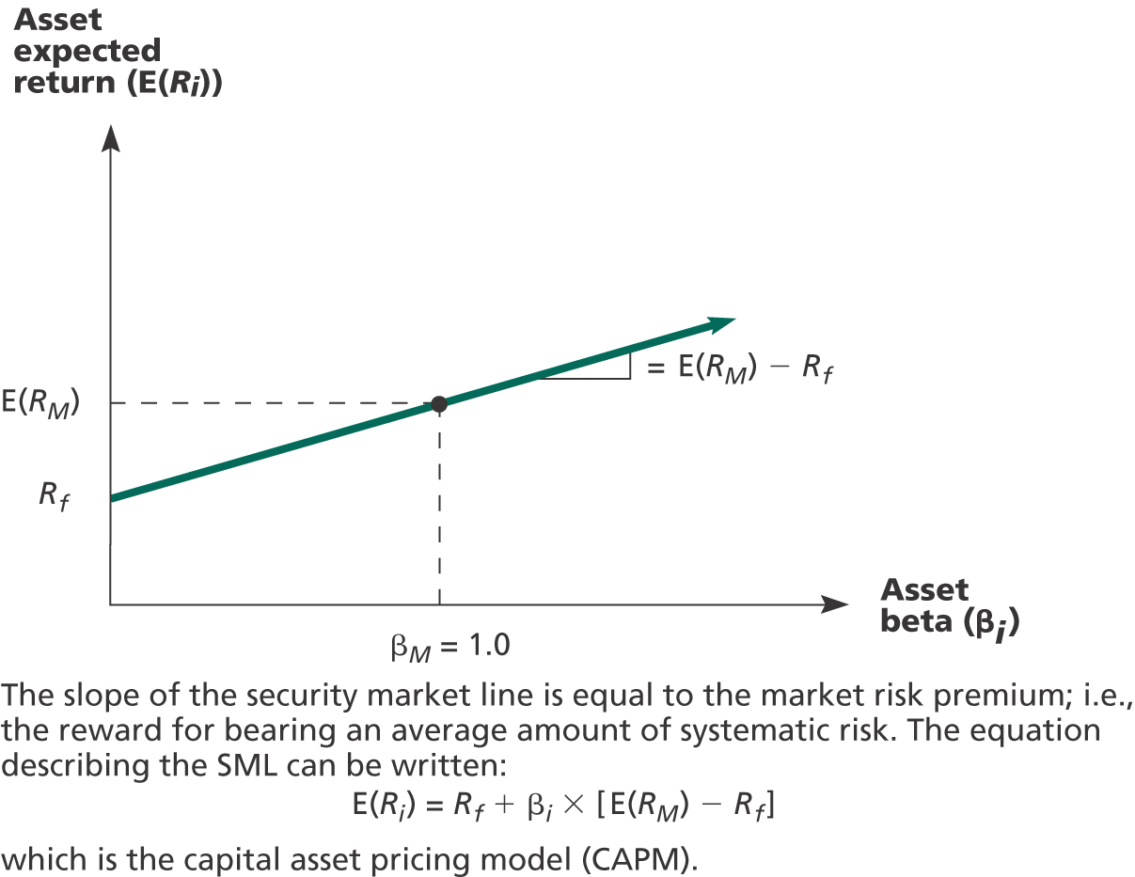

Slide 45
Quick Quiz
How do you compute the expected return and standard deviation for an individual asset? For a portfolio?
What is the difference between systematic and unsystematic risk?
What type of risk is relevant for determining the expected return?
Consider an asset with a beta of 1.2, a risk-free rate of 5% and a market return of 13%.
  What is the reward-to-risk ratio in equilibrium?
  What is the expected return on the asset?
Notes:
Reward-to-risk ratio = 13 – 5 = 8%
Expected return = 5 + 1.2(8) = 14.6%

